Slide 1
Rendering Filters for
Controlling Detail and Creating Effects
Christopher DeCoro
Final Public Oral
Notes:
Thank you for coming to my talk, the topic of which is filters for controlling detail and creating stylistic effects in rendering.

Slide 2
The Filter as Unifying Theme
We present 3 distinct algorithms developed in our work
Each addresses a different aspect of rendering
We propose that these can be viewed coherently as individual examples of rendering filters
Notes:
Disparate examples

Slide 3
What is a filter?
Filter, n. (Oxford English Dictionary)
  Felt (c. 1400) Obsolete
  A piece of felt, woollen cloth, paper, or other substance, through which liquids are passed to free them from matter held in suspension. (1563)
  Photography. A screen to cut out rays which interfere with correct colour-rendering (1902)
  Electronics. A passive circuit that attenuates all signals except those within one or more frequency bands. (1920) [emphasis added]
More background given in the thesis text
Notes:
We should first establish the term “filter”, According to the OED, the word was specifically a alternate form of “felt,” but by the English early modern period assumed its commonly understood meaning of “a substance through which liquids are passed to free them from matter held in suspension”. During the rapid advancements in the technology of photography and later electronics that occurred early in the last century, the word was generalized in meaning; it is believed that the earliest alternative definition was as “a screen to cut out rays which interfere with correct colour rendering”, foreshadowing some of our work, and especially the idea of a filter as a “passive” circuit. We seize on the notion of a passive operator, one which segregates a useful subset from a whole, and gets more utility out of the limited data available to it, [click] rather than an active process that collects additional information.
Additionally, we find useful the optional criterion that a filter has a small constant set of user-configurable parameters data as a whole, rather than per individual items; this is particularly in line with the traditional filters, which allow aspecific set of liquids/light rays/frequency bands to pass.

Slide 4
What is a [digital] filter?
We propose that it is a passive, stateless operator with parameters independent of data size.
Segregates useful matter/information from a whole
As opposed to active process that collects new information; gets more utility out of the limited data
Notes:
We should first establish some terms, especially “filter”, which tends to be bandied about frequently. According to the OED, the word was specifically a alternate form of “felt,” but by the English early modern period assumed its commonly understood meaning of “a substance through which liquids are passed to free them from matter held in suspension”. During the rapid advancements in the technology of photography and later electronics that occurred early in the last century, the word was generalized in meaning; note especially the definition as “a screen to cut out rays which interfere with correct colour rendering”, foreshadowing some of our work, and especially the idea of a filter as a “passive” circuit. We seize on the notion of a passive operator, one which segregates a useful subset from a whole, and gets more utility out of the limited data available to it, [click] rather than an active process that collects additional information.
Additionally, we find useful the optional criterion that a filter has a small constant set of user-configurable parameters data as a whole, rather than per individual items; this is particularly in line with the traditional filters, which allow aspecific set of liquids/light rays/frequency bands to pass.

Slide 5
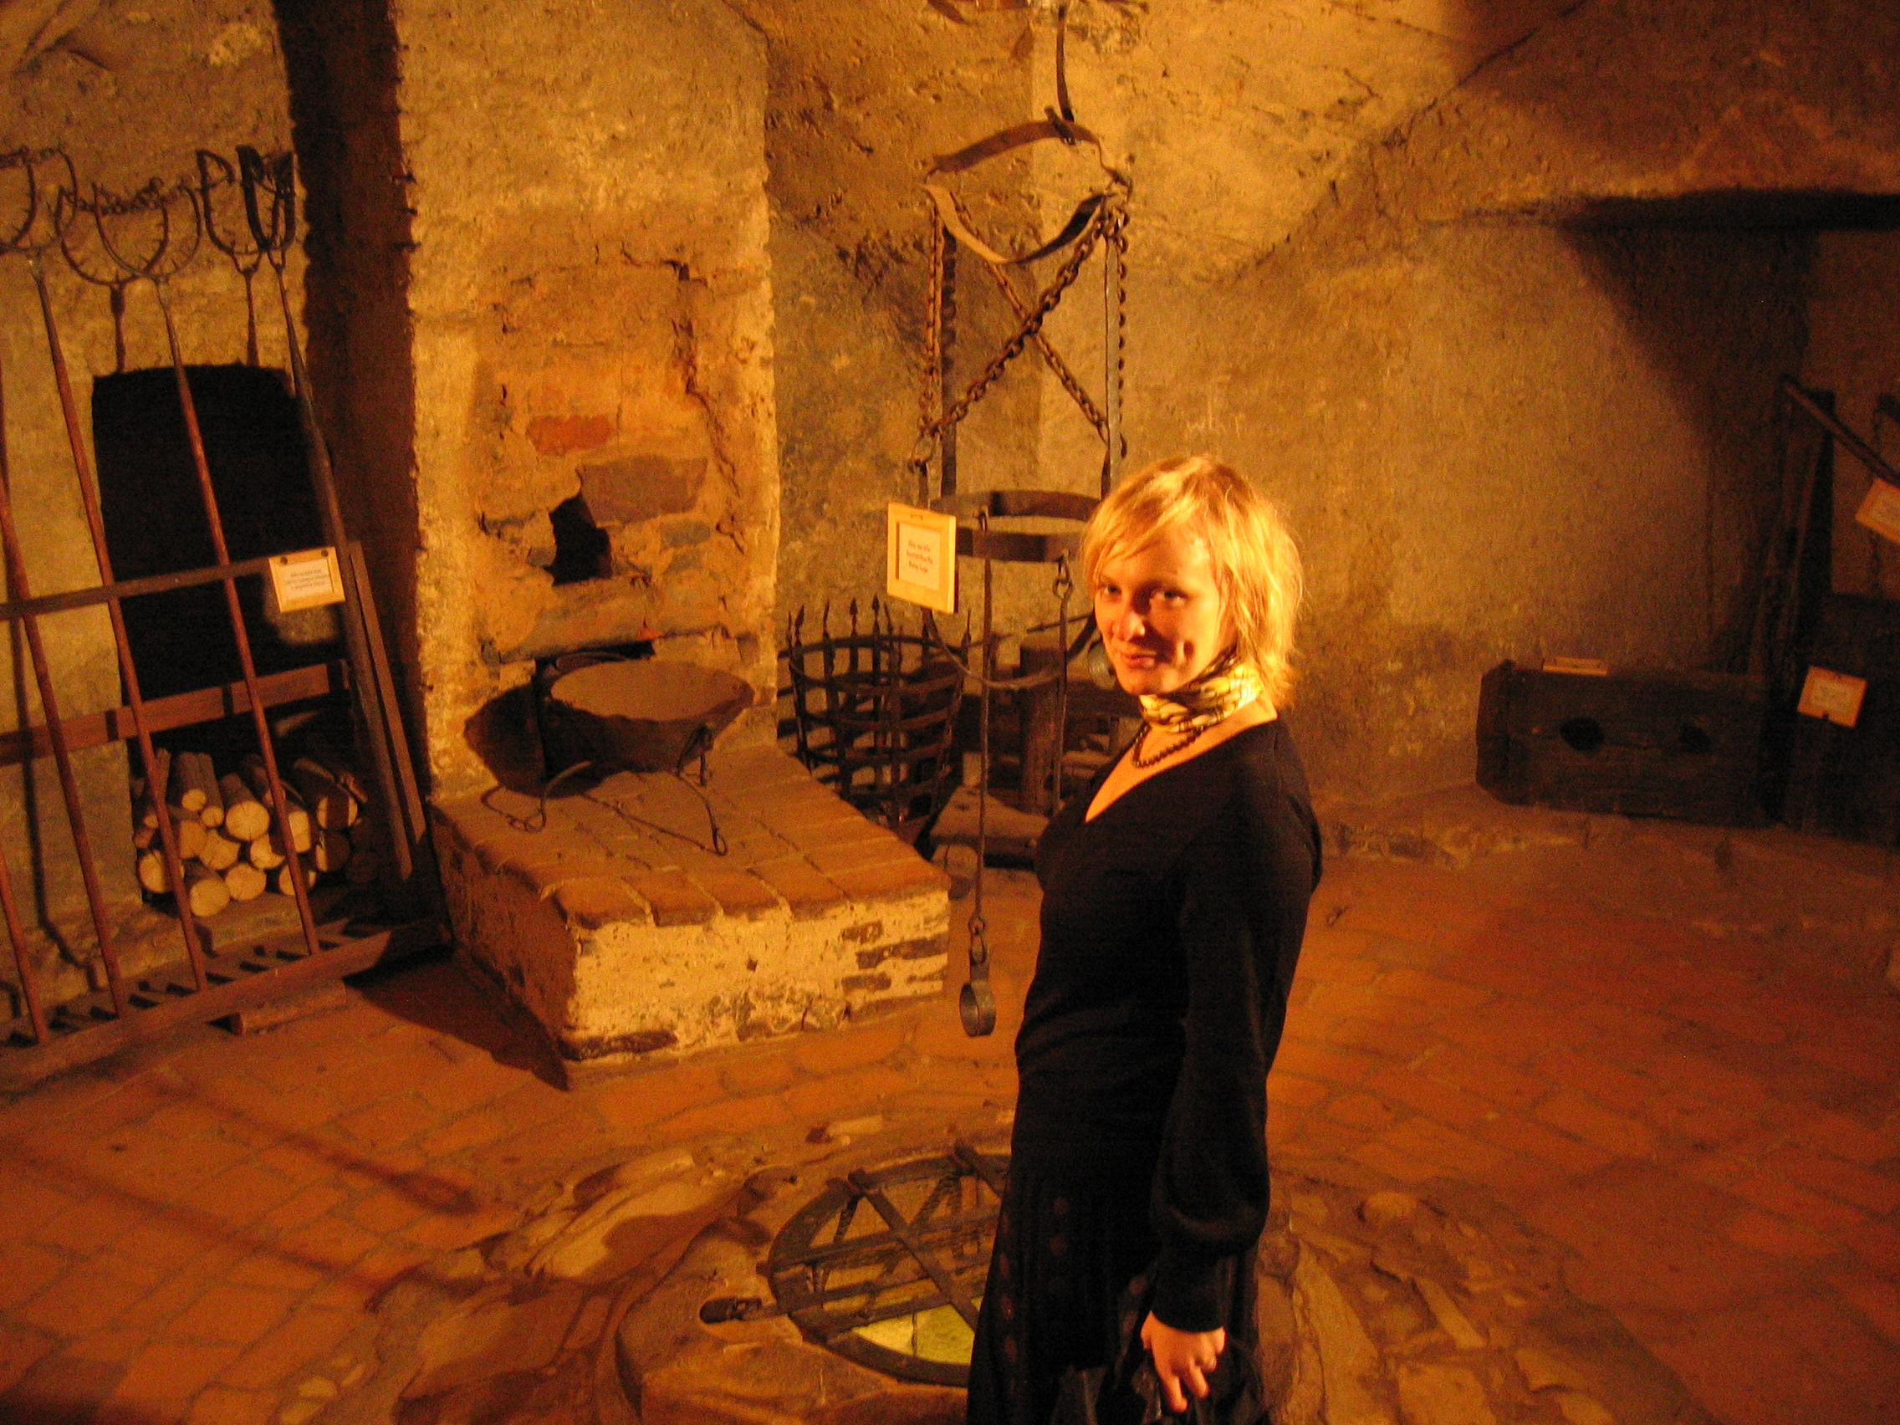
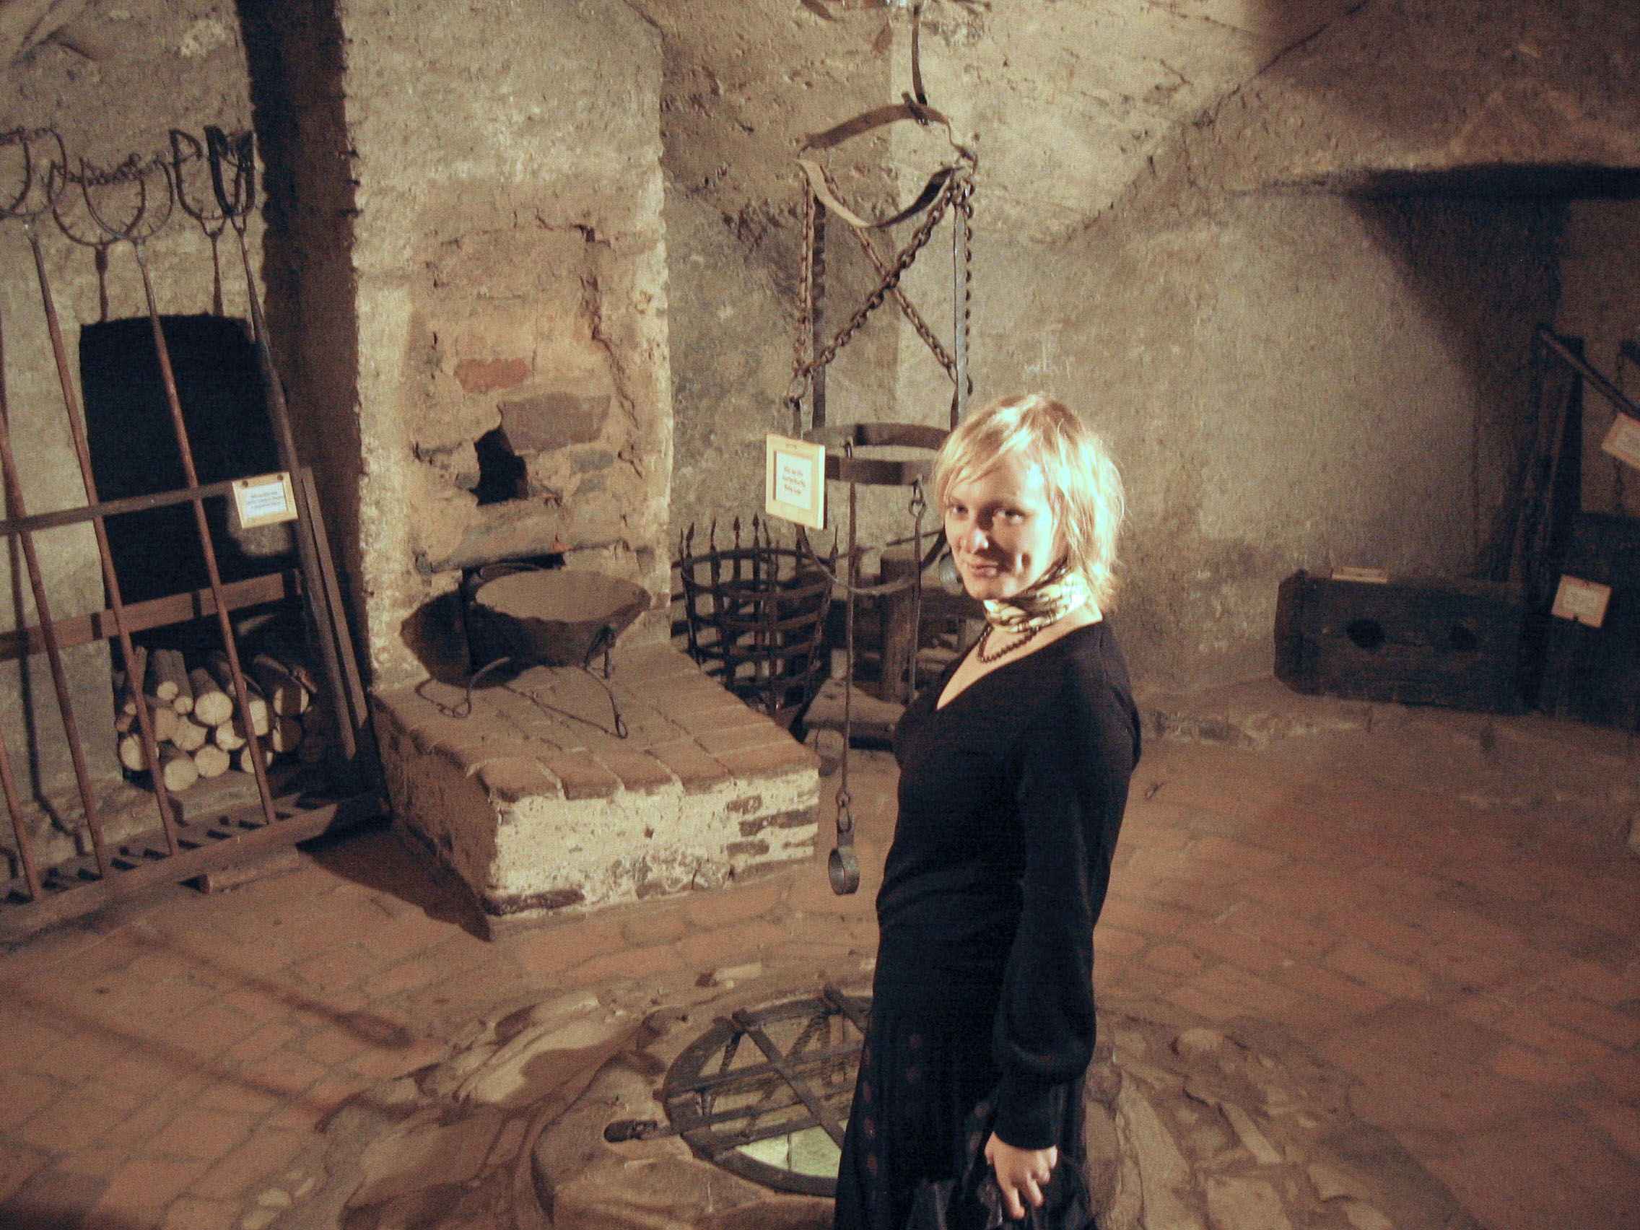
Example: Image Filters
Image filtering extremely common in use
Color shifting/correction, over/underexposure
Original Photograph, Tungsten Lighting
Color-corrected with #80A Wratten filter
Notes:
The concept of the filter is frequently employed in an image processing framework ;[change] common image filtering operations include smoothing, demonstrating a restriction of certain frequency bands, [change] color correction, or, “cutting out those rays which interfere with correct colour-rendering”, and stylistic filters of various sorts, which allow us to manipulate the limited data we have access to, in order to produce results diffucult to measure directly – without giving Tom quite a bit of a headache.
Note, while all are passive operations, all also have a small constant-sized O(1) set of user parameters that apply to the image as a whole.

Slide 6
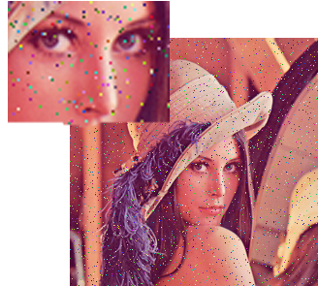

Example: Image Filters
Image filtering extremely common in use
Color shifting/correction, over/underexposure
Noise removal*
Noisy Original Image
After Noise Removal
Notes:
The concept of the filter is frequently employed in an image processing framework ;[change] common image filtering operations include smoothing, demonstrating a restriction of certain frequency bands, [change] color correction, or, “cutting out those rays which interfere with correct colour-rendering”, and stylistic filters of various sorts, which allow us to manipulate the limited data we have access to, in order to produce results diffucult to measure directly – without giving Tom quite a bit of a headache.
Note, while all are passive operations, all also have a small constant-sized O(1) set of user parameters that apply to the image as a whole.

Slide 7


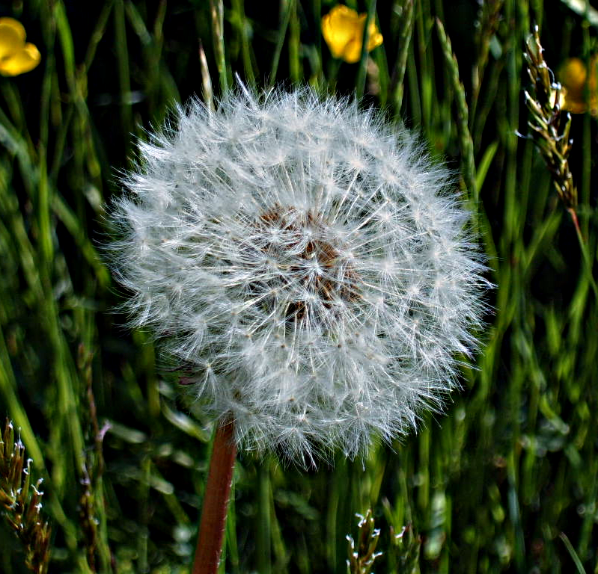
Example: Image Filters
Image filtering extremely common in use
Color shifting/correction, over/underexposure
Noise removal
Stylistic filters* of all kinds
Original Image
Smoothed
Sharpened
Notes:
The concept of the filter is frequently employed in an image processing framework ;[change] common image filtering operations include smoothing, demonstrating a restriction of certain frequency bands, [change] color correction, or, “cutting out those rays which interfere with correct colour-rendering”, and stylistic filters of various sorts, which allow us to manipulate the limited data we have access to, in order to produce results diffucult to measure directly – without giving Tom quite a bit of a headache.
Note, while all are passive operations, all also have a small constant-sized O(1) set of user parameters that apply to the image as a whole.

Slide 8
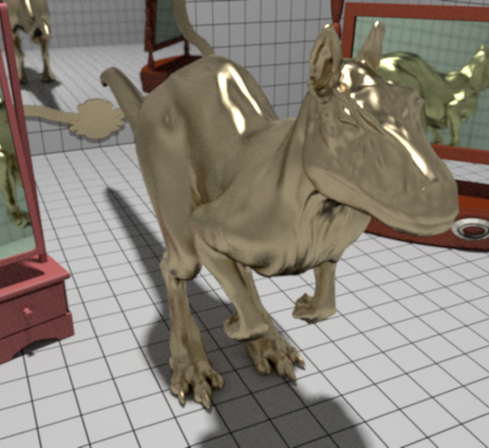
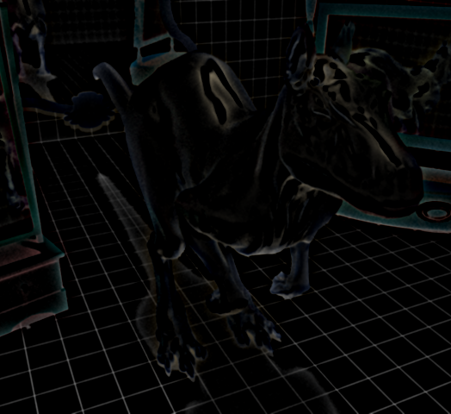
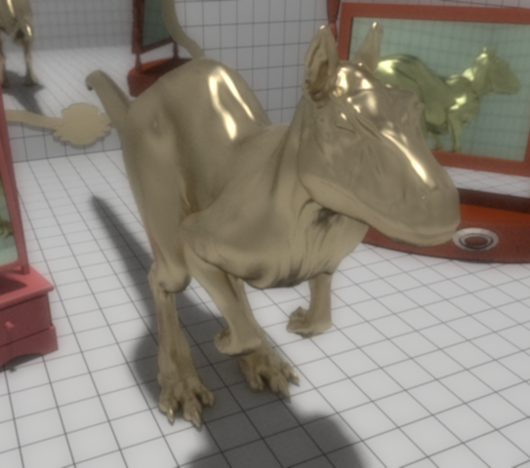
Example: Image Filters
Image filtering extremely common in use
Color shifting/correction, over/underexposure
Noise removal, smoothing and blurring
Stylistic filters* of all kinds
Original Image
Added Bloom
Final Result
Notes:
The concept of the filter is frequently employed in an image processing framework ;[change] common image filtering operations include smoothing, demonstrating a restriction of certain frequency bands, [change] color correction, or, “cutting out those rays which interfere with correct colour-rendering”, and stylistic filters of various sorts, which allow us to manipulate the limited data we have access to, in order to produce results diffucult to measure directly – without giving Tom quite a bit of a headache.
Note, while all are passive operations, all also have a small constant-sized O(1) set of user parameters that apply to the image as a whole.

Slide 9
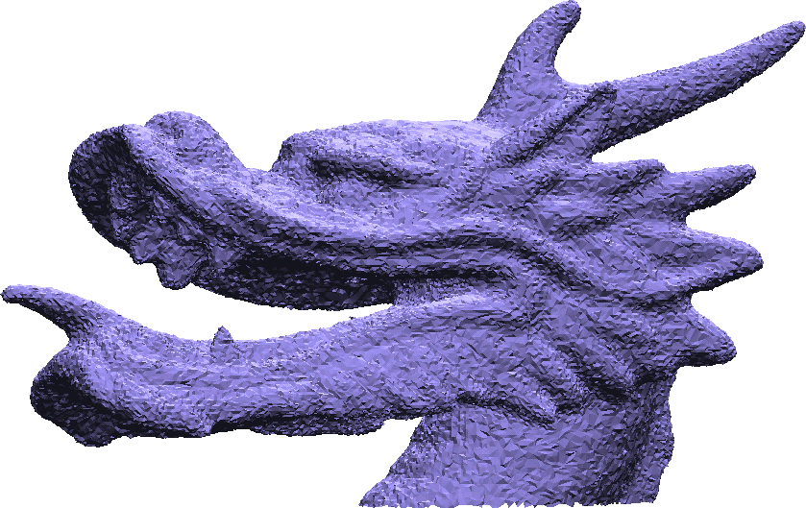
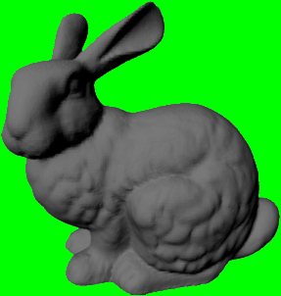
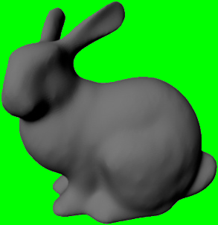
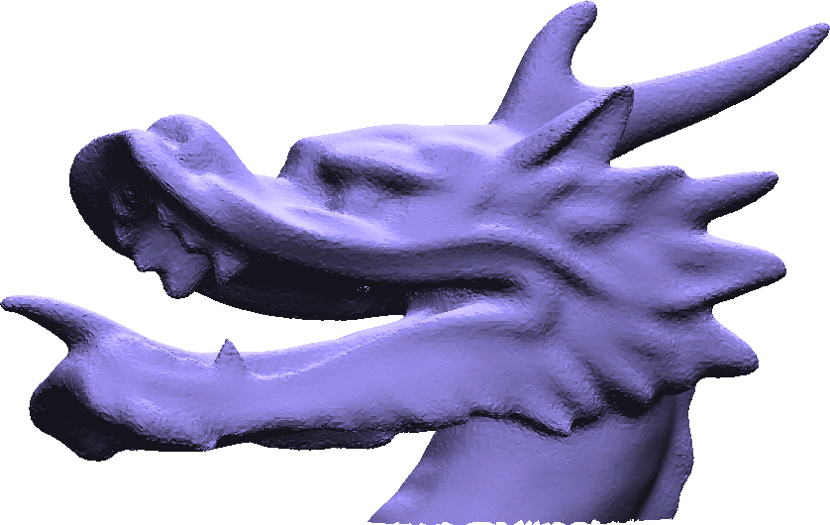
Example: Geometry Filters
Digital geometry processing applies common operations from image processing to meshes
Noise removal, smoothing/blurring
Gaussian Blur
Noise Removal
Dragon Images: Jones et al. “Non-Iterative Feature-Preserving Mesh Smoothing”
Notes:
As our field has developed from 2D images to 3D geometry, many of the same image operations have been applied in the setting of digital geometry processing. These include removal of noise from acquired data, as well as smoothing operators of all kinds.

Slide 10
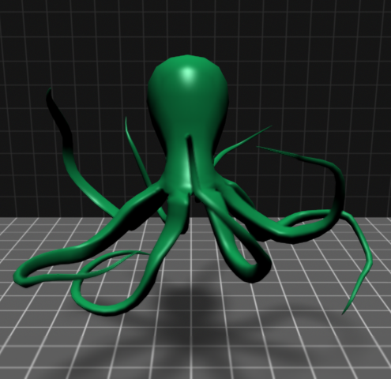
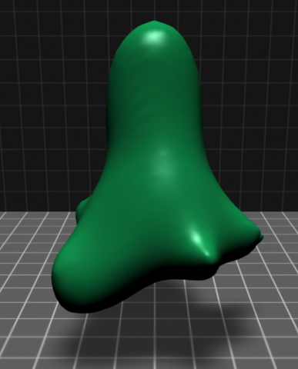
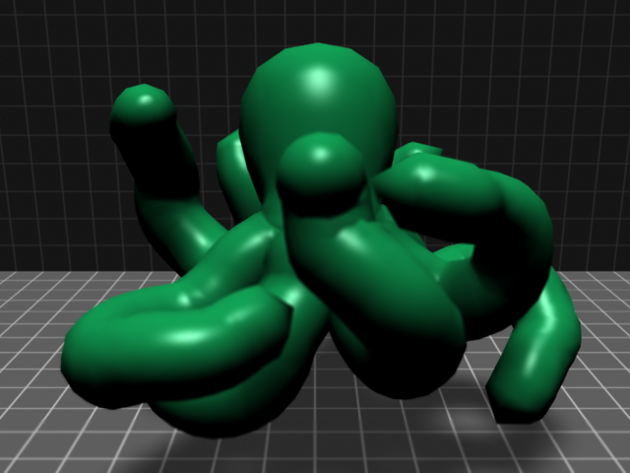
Example: Geometry Filters
Digital geometry processing applies common operations from image processing to meshes
Smoothing
Stylistic Filters
Original Mesh
Smoothed Mesh
Inflated Mesh
Notes:
Stylistic operators have seen their share of applications to geometry, such as this inflation operator.

Slide 11
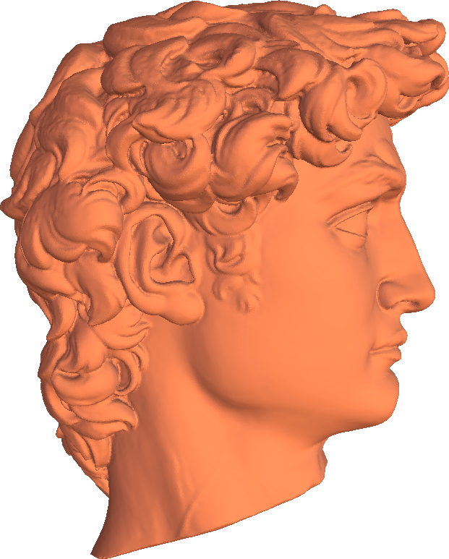

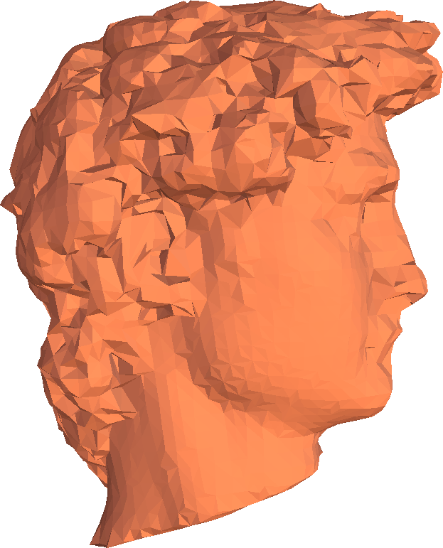
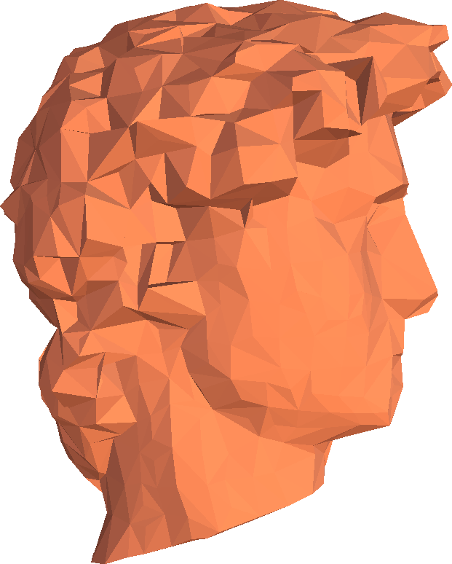
Example: Geometry Filters
Digital geometry processing applies common operations from image processing to meshes
Smoothing
Stylistic Filters
Simplification / Progressive Level-of-detail*
2M Faces
30K Faces
5K Faces
1K Faces
Notes:
And finally compression, or simplification filters, (applied to both images and geometry) removes certain bands of frequency to produce an approximation of the input more efficient to operate on and store. Here we show a filter-like approach providing a continuous level-of-detail of this high-resolution model, from very fine to very coarse. In the course of this talk we will see similar concepts applied in the rendering setting.

Slide 12
A Unique Challenge: Rendering
Geometry as input, Image as output
Poses unique problems that share many features of both, with some challenges present in neither
We present a series of rendering filters developed in the course of our research
Different from what can be achieved on either the image output or input to rendering
Notes:
Importantly, however, while we’ve seen filters applied to both images and geometry, and it follows that rendering would share features of both, it also poses challenges present in neither. [click] In this dissertation, I will present a series of rendering filters that have been developed in the course of my research, producing results distinct from what can be acheived by operating on either or both the image output, or geometric input independently of the other.

Slide 13
The Light Transport Equation (1)
Describes the transport of light in the scene
  Infinite-dimensional (recursive) integral equation
  Describes radiance, the quantity measured by cameras
  Too complex for quadrature, computed using Monte Carlo
The foundation of rendering algorithms
(often also referred to as the rendering equation)
Outgoing Radiance
Emission
Reflectance (BRDF)
Incoming Irradiance
Integral over all incident directions
Notes:
Rendering models the transport of light throughout a scene; The LTE is an infinite-dimensional integral equation, in which the radiance outgoing from a point x in space, in some direction omega, is recursively defined as the emission from the point in that direction, plus the sum of incoming irradiance from all directions reflected towards that same direction omega. Note the function f is known as the Bidirectional Reflectance Distribution function, for which we use the abreviate as BRDF in this presentation. The LTE is the foundation of rendering algorithms, and is often referred to simply as the rendering equation

Slide 14
The Light Transport Equation (2)
Can be written in multiple (equivalent) forms
  Hemispherical integral, Surface integral, etc
  Certain forms may be more useful for certain algorithms
Rendering frameworks are characterized by their method of evaluating the LTE
Outgoing Radiance
Emission
Reflectance (BRDF)
Incoming Irradiance
Visibility
Integral over area of all surfaces
Notes:
It can be written in varying but still equivalent forms, such as this, which replaces the integral over the hemisphere of all incoming directions, with an integral over all surfaces in the scene. We instead sum the transferred irradiance between all pairs of points, reflected into the outgoing direction, with the important additional criteria that the points are visible to one another.
Rendering frameworks therefore are charecterized by their method of evaluating the LTE.

Slide 15
Render Frameworks: Rasterization
Object space; For each geometric primitive:
  Project vertices to screen
  Interpolate vertices to determine pixels
  Interpolate values to compute color
  Update screen pixel
Main feature: Highly localized
  Each triangle, vertex, pixel computed independently
  Minimal global information, no complex data
  Highly coherent, amenable to hardware implementation
Notes:
One of the two main frameworks is that of rasterization. This is an object-space technique, in that the main loop proceeds per each geometric primitive (“object”), . Vertices are projected to screen coordinates, which are interpolated to find the image pixels corresponding to the object. Then, material properties specified per vertex are also interpolated across the face to compute an updated color per pixel.
Rasterization is a highly localized and coherent technique readily amenable to parallel hardware implementation, achieving significant speed and making it the method of choice for real-time applications such as games. Each triangle, vertex, and pixel can be operated on almost entirely independently.

Slide 16
Render Frameworks: Ray Tracing
Image space: For each image pixel:
  Trace rays from eye, through pixel, into scene
    Determine intersection with scene
    Trace rays until reaching a light
  Average contribution of all rays through pixel
Main feature: Able to consider global information
  Directly supports complex lighting, shadowing
  Arbitrary paths from eye to light
Opposite strengths to those of rasterization
Notes:
Ray tracing, the second major approach proceeds from the opposite direction by looping over each pixel, and determining geometry that correponds to that pixel by tracing a ray into the scene, and computing intersection. The rays trace recursively, bouncing around the scene until reaching a light; at which point the algorithm can then backtrack to determine the contribution of that reflected light to the pixel.
Ray tracing is in a sense diametrically opposed to rasterization, is that it draws its strength from being able to consider and take full advantage of the global information in the scene; ray tracing can consider arbitrary paths of light and complex light reflection and transport to make highly realistic scenes. Of course, it does so at a speed cost of several orders of magnitude relative to rasterization.

Slide 17
Comparison of Frameworks
Rasterization
  Evaluates blocks of pixels as a unit
  Computes same terms across all units
  Very fast by exploiting coherency
Ray Tracing
  Evaluates individual terms of the (infinite) rendering equation
  Selects terms arbitrarily or randomly, allows complex lighting
Rendering Terms
Pixels
Rendering Terms
Pixels
Notes:
The 2 main frameworks are… We’ve developed a graphical notion for the rendering equation to express many of the concepts that we discuss. The x-axis on this grid represents pixels in the resulting image, Y-axis represents the individual terms computed per pixel (lighting, reflectance, visibilty, etc) and combined for the final color
Rasterization evaluates blocks of pixels as a unit, computing the same terms at each unit (such as the same lighting direction for all triangles) –allowing the system to be very efficient by exploiting coherency. To evaluate additional rendering terms, the rasterizor renders additional large blocks, referred to as “passes” over the pixels as a whole.
The ray tracing framework operates (effectivly) on a pixel at a time, evaluating arbitrary rendering terms at each pixel. Terms, such as lighting directions, may be evaluated on an as-needed basis, and may be tuned to the specific properties of the rendering terms computed so far. Note that since the rendering equation has infinite terms (indicated by no upper bound on the grid) the ray tracer has to find a specific path through the evaluation space, which is frequently done at random. We will talk about this in detail later.

Slide 18
Rendering Filter: A Definition
Operates on samples of the rendering equation
  Terms associated with a pixel coordinate, plus additional info
  Can include incident lighting bounces, BRDF, visibility, etc.
  Can be considered an augmented image-space
Rather than collapse individual rendering terms into a pixel color, maintain and use information
Produces an alternate rendering result
Notes:
We propose then, finally, that a rendering filter is one that operates on a set of samples of the rendering equation, we can consider each sample as a vector that includes both image space coord, as well as a partially evaluated set of corresponding rendering terms, such as emitted light, reflectance, world-position, etc. In general, we view our filters as operating on an augmented image-space representation; one in which we maintain all of the terms that contributed to the computation of a pixel color.

Slide 19
Our Contributed Rendering Filters
Stylized Shadow Filter
  Provides user-control over stylization of appearance, especially shadowing
Subtractive Shadow Filter
  Provides continuous shadow level-of-detail with rasterization
  Allows low-frequency content computed with less samples
Path-Density Outlier Filter
  Allows reduction of the most perceptually significant sources of error with ray tracing
Notes:
Our contributed rendering filters are in three classes; the filters of the subtractive shadowing method allow for complex yet flexible illumination in the rasterization context, the stylized illumination filter provides user control over the stylistics effects of shadowing and illumination, and finally the path-density filter allows a reduction of the most perceptually significant sources of error observed in ray tracing, thereby increasing effective speed.

Slide 20
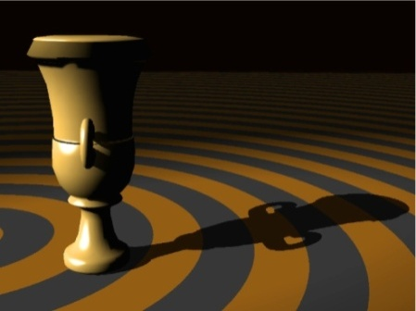
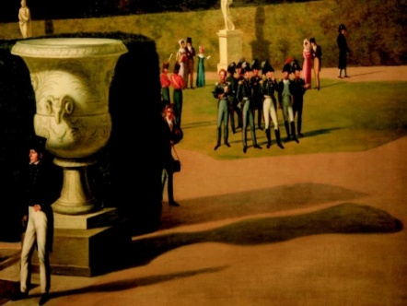
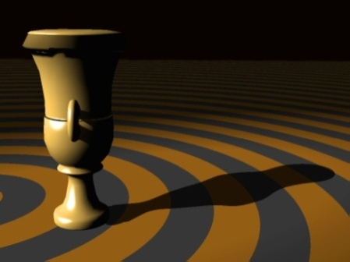
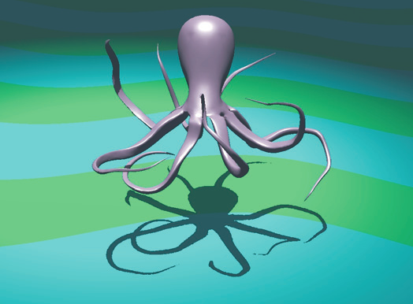
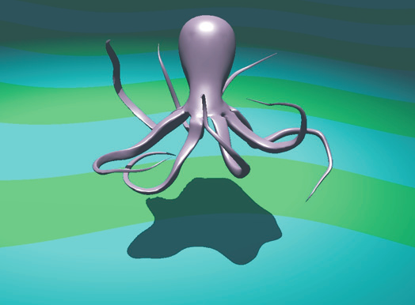
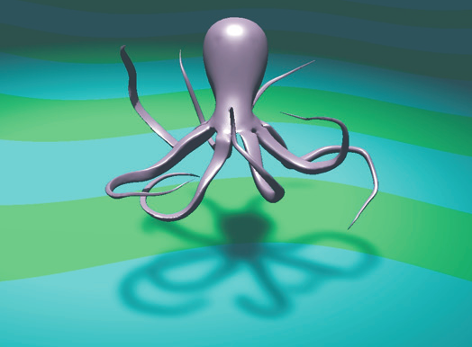
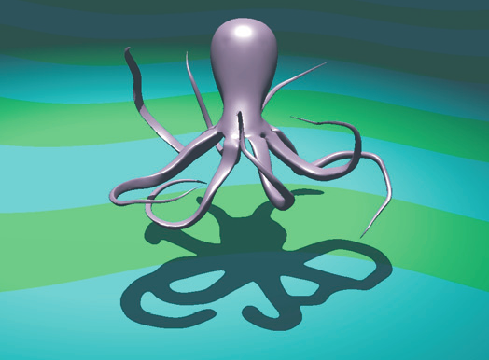

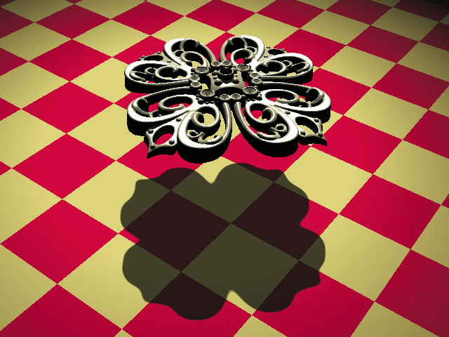

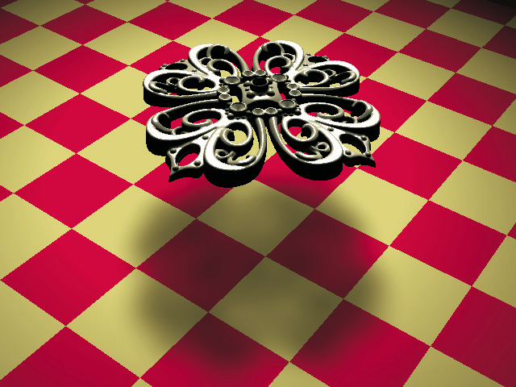
Part I: Stylized Shadows
Notes:
Our second contribution is the stlyzed illumination, or stylized shadowing filter, which corresponds to the stylistic filters seen earlier.

Slide 21
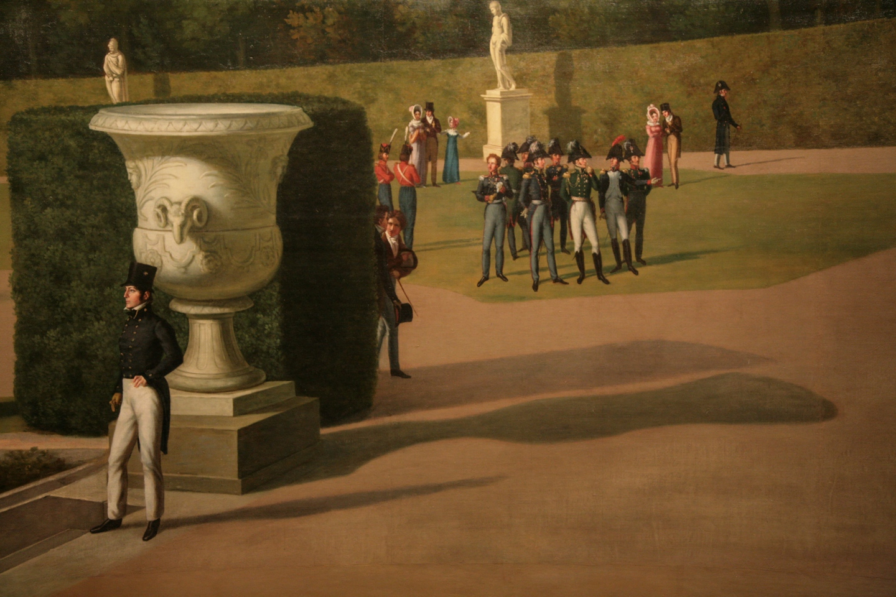
Recreating an Artistic Example
Consider this portion of John Vanderlyn’s panorama of the
Palace and Garden of Versailles
  Note the abstracted shadow cast from the planter
  The object is the focus – the shadow exists to provide cues
Our goal is to provide the same stylization to rendered shadows
Notes:
Consider portion of John Vanderlyn’s room-sized panorama of the Palace and Garden of Versailles, at the Met in New York. Focusing specifically on the planter, note that its shadow is “abstracted” – or intentionally rendered inaccuratly by the artist for compositional purposes. While the ram’s head is clearly indicated in shilhouette to the light, no corresponding feature is present in the shadow.

Slide 22
Recreating an Artistic Example
The planter appears to float without a shadow
  The shadow provides an essential cue to anchor it to the ground
Notes:
We hypothesize that the object is the intended focus, and the shadow, while providing essential cues such as the positioning of the planter on the ground –consider the rendering without shadow --, the inclination and position of the ground and sun is of secondary importance

Slide 23
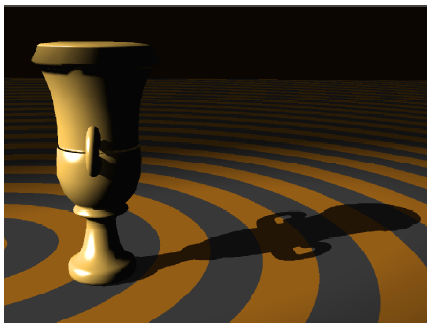
Recreating an Artistic Example
The planter appears to float without a shadow
However, an accurate shadow provides extraneous detail
  The planter has a handle in silhouette, yet the shadow does not
  Perhaps the artist decided this detail was distracting

Slide 24
Recreating an Artistic Example
The planter appears floating without a shadow
However, an accurate shadow provides extraneous detail
We allow a stylized shadow, providing for greater artistic control
Notes:
.By removing superfluous detail from the shadow, condensing it to its basic function, the artist avoids distracting away the viewer’s attention. Our goal is to provide the same effects to rendered shadows.

Slide 25
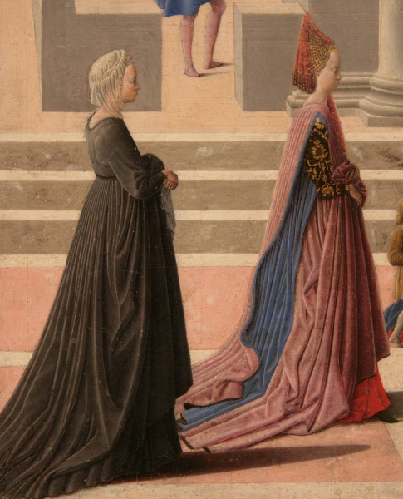
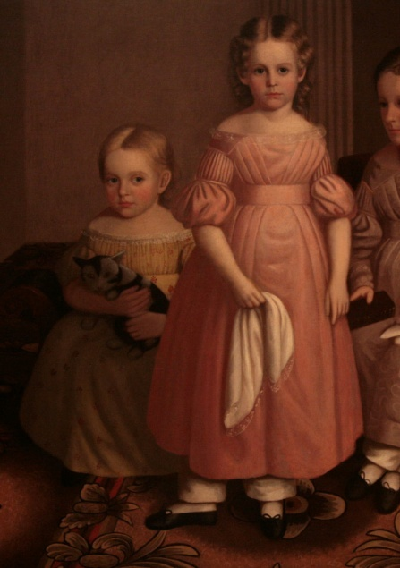

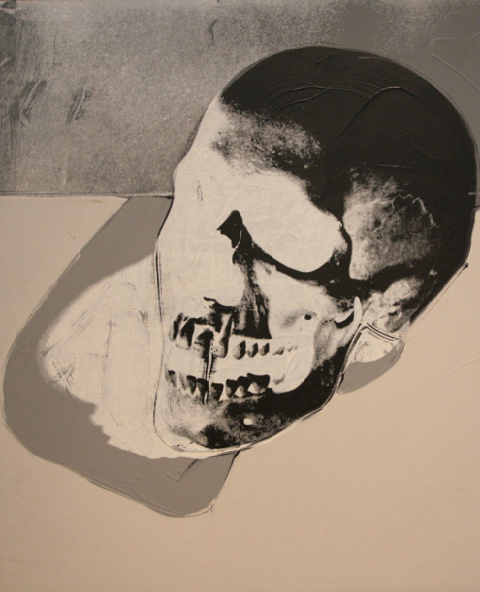
Examples of Stylized Shadows
Artwork from Metropolitan Museum of Art in New York
The two left examples use simplified shadows to provide cues
The right examples use discrete penumbrae for effect
Fra Carnavale
Birth of the Virgin, 1467
Oliver Eddy
The Alling Children, 1839
William Nicholson
19th Century
Andy Warhol
Skull, 1976
Notes:
We can see other examples of stylistic shadows in tradiational art; the left two examples use clearly abstract shadows to preserve ground cues – note especially the inaccurate shadow in the Eddy painting – while the right two modern examples extend use of abstract shadowing in the opposite direction, drawing attention with discrete penumbra.

Slide 26

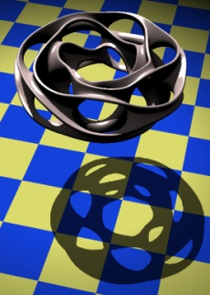

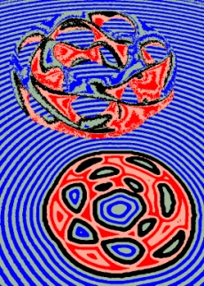
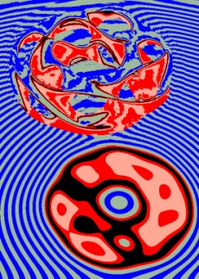
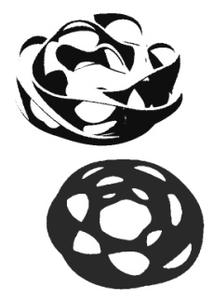
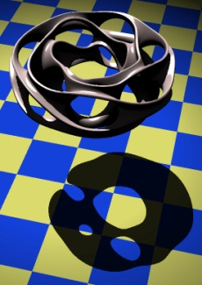
Our Contributions
Identification of a set of useful stylization controls
  Inflation
  Softness
  Brightness
  Abstraction
A rendering filter framework for stylized shadows
  Establishing stylization parameters that are controlled at a high level
  Interactive visualization
Original
Inflation
Brightness
Softness
Abstraction
Accurate
Stylized
Notes:
Our contribution here is the identification of a set of useful stylization controls, as well as a rendering filter framework for evaluation.

Slide 27
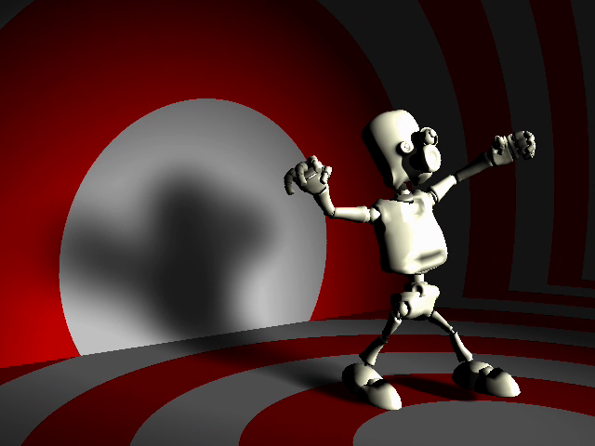
Notes:
To show an example of our filter at work, captured in real-time. As we will see, the various stylistics controls have both a image-space and geometry-space analog

Slide 28
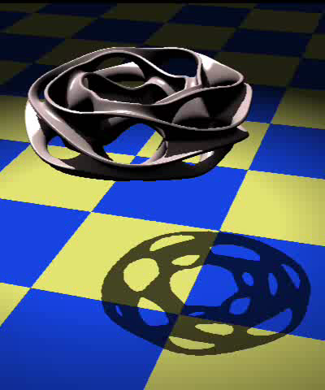
Stylization Parameters
Inflation (and deflation) i
  Size of the shadow relative to original
  Corresponds to inflating original mesh
Notes:
We have four basic parameters, each of which has some correlation to a geometric effect. Shadow inflation corresponds to inflating the original mesh.

Slide 29

Stylization Parameters
Inflation (and deflation) i
  Size of the shadow relative to original
  Corresponds to inflating original mesh
Softness, s
  Width of transition from lit to occluded
  Corresponds to increasing light area

Slide 30

Stylization Parameters
Inflation (and deflation) i
  Size of the shadow relative to original
  Corresponds to inflating original mesh
Softness, s
  Width of transition from lit to occluded
  Corresponds to increasing light area
Brightness, b
  Maximum amount of occlusion
  Corresponds to increasing ambient light

Slide 31

Stylization Parameters
Inflation (and deflation) i
  Size of the shadow relative to original
  Corresponds to inflating original mesh
Softness, s
  Width of transition from lit to occluded
  Corresponds to increasing light area
Brightness, b
  Maximum amount of occlusion
  Corresponds to increasing ambient light
Abstraction, α
  Smoothness of the shadow contour
  Corresponds to smoothing the mesh
Notes:
And finally we identify abstraction as the smoothness of the shadow contour.

Slide 32
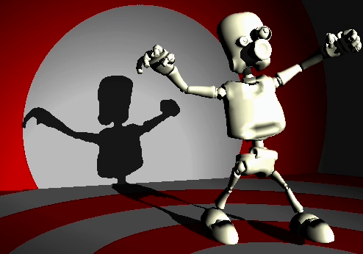
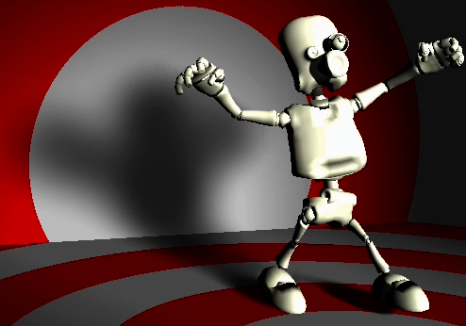
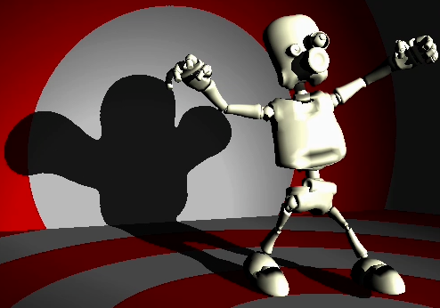
Stylized Rendering Filter
We apply a stylistic filter in rendering space
  Start with accurate shadow visibility and light color
  Consider additional rendering terms, such as position and normal
  Compute stylized shadow from all terms
Faster, more flexible than object- or image-space alone
a
Stylized Shadow #2
Transfer Terms
Stylized Shadow
Surface Normals
World Position
Light Color
Shadow Visibility
Alternate Stylized Shadow
Accurate Shadow
Pixels
Stylized Shadow
Notes:
To apply our stylistic filter, we start with the accurate shadow and light color; [click] and then consider additional rendering terms, such as position and normal. Finally, we compute stylized shadows from all rendering terms. [click]
This approach is faster and more flexible than object-space alone; in this representaion, we can easily change filter parameters to achieve alternate effects.

Slide 33


Algorithm Description
Start with hard shadow visibility
Accurate Shadow
1. Visibility

Slide 34

Algorithm Description
Start with hard shadow visibility
Compute distance transform of visibility
Accurate Shadow
1. Visibility
2. Dist. Transform

Slide 35
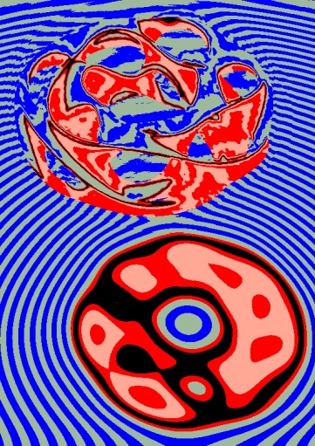
Algorithm Description
Start with hard shadow visibility
Compute distance transform of visibility
Apply Gaussian blur
Accurate Shadow
1. Visibility
2. Dist. Transform
3. Blur

Slide 36

Algorithm Description
Start with hard shadow visibility
Compute distance transform of visibility
Apply Gaussian blur
Apply transfer function
Accurate Shadow
1. Visibility
2. Dist. Transform
3. Blur
4. Threshold

Slide 37

Algorithm Description
Start with hard shadow visibility
Compute distance transform of visibility
Apply Gaussian blur
Apply transfer function
Light using modified visibility buffer
Accurate Shadow
1. Visibility
2. Dist. Transform
3. Blur
4. Threshold
5. Light

Slide 38
Inflation and Deflation
Implemented by taking isocontours of distance transform, D(V)
  Inflation for D(V) > 0, deflation for D(V) < 0, original at D(V)=0
Apply a threshold transfer function f( ) to D(V)
  Allows interactive changes without recomputation
Analogous to inflating the original object
Visibility, V(x)
Dist. Transform, D(V(x))
Notes:
The inflation operator is implemented by taking isocontours of a distance transform D of the visibilty function V, it which each point is assigned a distance value to the shadow contour. Applying a thresholding function, inflates or deflates the shadow, in a manner analagous to inflating the original object, without recomputation.

Slide 39
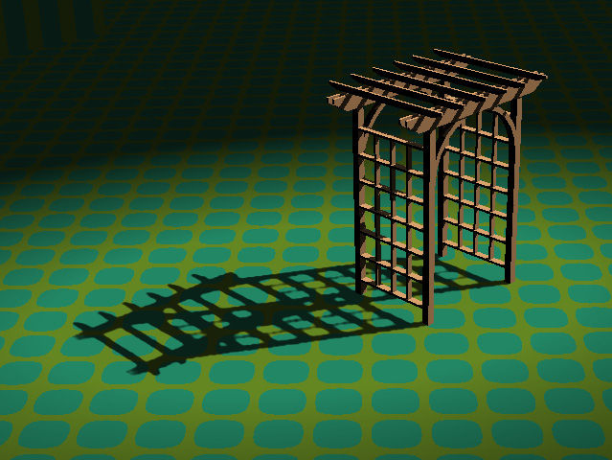
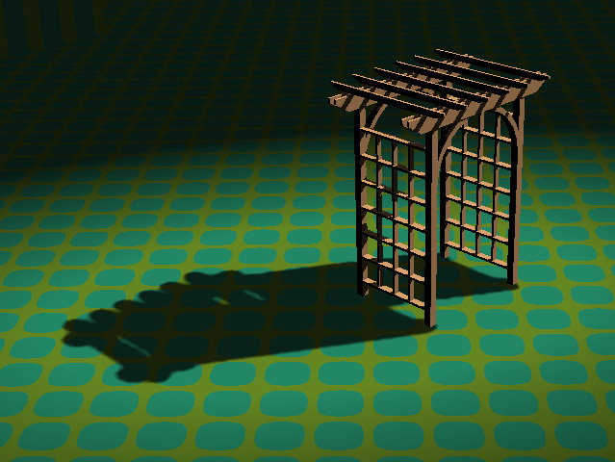
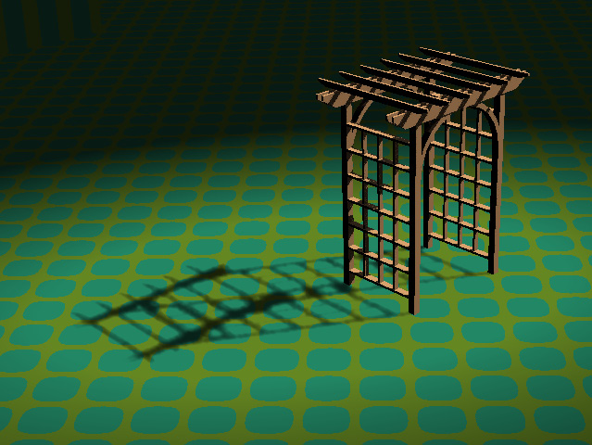
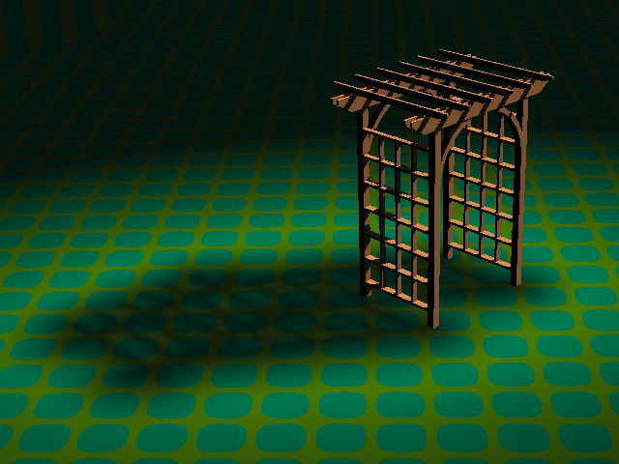
Inflation Examples
Accurate Shadow
Inflation, i=20
Deflation, i=-10, s=5
Inflation & Softness, i=20, s=50

Slide 40


World-space & Averaged Distance
Screen space distance does not account for foreshortening
Screen-space Euclidean Dist.
Notes:
A naïve approach uses the screen space Euclidean distance from the shadow contour. However, screen space doesn’t count for foreshortening.

Slide 41


World-space & Averaged Distance
Screen space distance does not account for foreshortening
We compute world-space distance using stored world positions
Screen-space Euclidean Dist.
World-space Euclidean Dist.
Notes:
Instead, we can compute a world-space distance using stored world positions.

Slide 42
World-space & Averaged Distance
Euclidean distance has sharp changes in isocontour curvature
Screen-space Euclidean Dist.
World-space Euclidean Dist.
Notes:
A further problem is that the Euclidean distance has sharp changes in isocontour curvature, seen here.

Slide 43

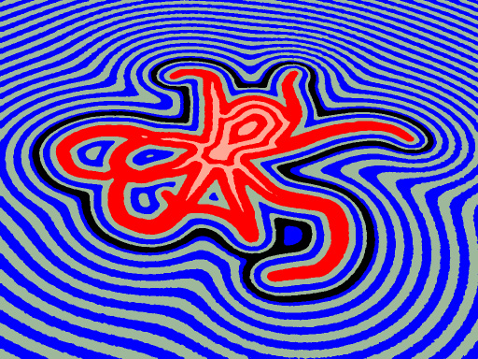
World-space & Averaged Distance
Euclidean distance has sharp changes in isocontour curvature
World-space Euclidean Dist.
World-space Averaged Dist.
Notes:
We prefer using an averaged-distance metric, shown here, removing the sharp artifacts.

Slide 44
World-space & Averaged Distance
Euclidean distance has sharp changes in isocontour curvature
Averaged Distance has smooth contours
World-space Euclidean Dist.
World-space Averaged Dist.
Screen-space Euclidean Dist.

Slide 45
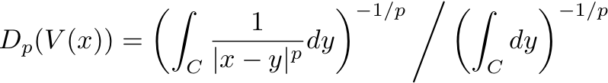
L_{p}-averaged Distance Metric
Use metric of average distance to the contour
  As opposed to minimum distance to contour (Euclidean)
  Originally used for mesh inflation [Peng et al. 2004]
Parameter p allows tradeoff of smoothness/accuracy
  p=8: empirically a reasonable compromise
  p=2: heat diffusion equation
  p=infinity: Euclidean
Evaluated with Monte Carlo integration
Notes:
The Lp-averaged metric that we use is the average distance from a point x to the entire shadow contour, with a parameter p that trades between smoothness and accuracy. We found that p=8 is a reasonable compromise; p=2 correponds to heat diffusion, and the metric tends to the Eucliden as p goes to infinitly.
Evaluated with Monte Carlo

Slide 46
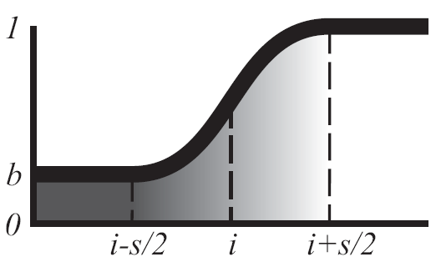
Softness & Brightness
Instead of a hard threshold, we use a smoothstep with width s
Scale range from [0,1] to [b,1]
  No upper bound, w/out loss of generality
  Allows combination of multiple functions
Smoothness of D(V) allows smooth penumbrae
Width can be changed without additional explicit blurring
Notes:
To implement smoothness, we replace the hard threshold function with a smoothstep of width s. Brightness is implemented by biasing and scaling the function. Iimportantly, the smoothness of D(V) from the Lp-averaged distance allows for smooth penumbra without explicit blurring; similar approach with the Euclidean distance will display the sharp artifacts seen earlier.

Slide 47
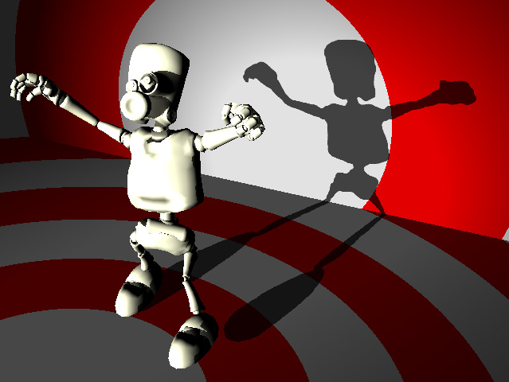


Softness & Brightness Examples
Accurate Shadow
Moderate Softness, s=20
Discrete Umbra and Penumbra

Slide 48
Abstraction
Defined as a limit on the curvature detail of shadows (isocontours)
By blurring distance transform, it can be shown that curvature detail decreases away from medial axis
Analogous to smoothing the original object
Distance Transform, D(V)
Blurred, G ⊗ D(V)
Notes:
Finally, abstraction is a limit on the curvature detail of the shadow isocontours; by blurring the distance transform, the frequency of curvature detail decreases.

Slide 49



Abstraction Examples
Accurate Shadow
Softness & Abstraction, α=20 i=20
Moderate Abstraction, α=10 i=10
High Abstraction, α=70 i=10

Slide 50



Variable Stylization Parameters
Parameters can be a function of other properties
  Such as time, surface geometry, or distance to shadow casters
Quadratic functions of distance to shadow-caster
  Hardening of shadows (left)
  Selective detail preservation (right, note tip of trident)
α = 10 s = 20d²
Accurate Shadow
α = 13+4d-8d², i = -2d²,
s = 12-4d²
Notes:
Importantly, parameters can be described as functions of other scene properties, such as screen-space position or distance to shadow casters, allow for effects like shadow hardening or detail preservation.

Slide 51



Monte-Carlo Filtering
Both distance transform and blur evaluate integral over screen
  We reduce computation by random Monte Carlo sampling
Allows a time-quality tradeoff when moving light or camera
Not necessary to compute when only changing stylization
  Abstraction only changes blur, which is very fast
24 Samples
30 FPS
50 Samples
18 FPS
120 Samples
8 FPS

Slide 52




More Examples
Accurate Shadow
α = 13+4d−8d², i = −2d²,
s = 12−4d²
α = 5, i = −4, s = 10
α = 20+10d, i = 5+10d,
s = 50
Accurate Shadow
α = 20, i = 4, s = 1
α = 7, i = −4, s = 5
α = 20, i = 10, s = 25

Slide 53


Challenges
Image-space rasterization cannot consider shadows that are not visible to the eye
We also assume a point light source
View from Camera #1
View from Camera #2

Slide 54
Stylized Illumination Summary
Our parameters allow for a range of stylization effects corresponding to traditional artistry
Our method provides a flexible and efficient framework for interactive stylization of shadows
Rendering filter approach allows for greater flexibility than image- or object-space alone

Slide 55




Part II: Subtractive Shadow Filter

Slide 56
Subtractive Shadows Motivation
Rendering natural scenes/materials in real-time
  Illumination from continuous environment map
  Materials from very diffuse to perfectly specular
Rasterization poorly suited for continuous lighting
  Fixed evaluation of rendering terms limits flexibility
  Shadowing for more than a few lights is slow
  Complex materials and soft shadows require many lights
Preserve relevant detail, remove irrelevant.
Notes:
To motivate this problem, As we said, RT allows rendering of complex lighting and reflectance; while rasterization is poorly suited, as its fixed evaluation of rendering terms limits its flexibility. Of particular concern is the limitation to a single lighting direction per “pass,” as the direction must be specified globally per scene to preserve locality and data independence. Complex lighting and shadowing require evaluating the LTE in arbitrary directions, which will require the rendering of the scene over and over again, bringing even the speed of rasterization to a halt. Our solution, as you will see, is to cut corners – but to cut the right ones.

Slide 57
Sampling Theorem
Fundamental result from signal theory introduced by Claude Shannon:
  If f(t) contains no frequencies greater than B Hz, is it completely determined by series of points B/2 sec apart
Implication is that low-frequency (smooth) signals need fewer samples than highly-detailed ones
We can use this to our advantage by reducing rendering samples (i.e. computation)
Notes:
We take guidance from a fundamental result in signal theory, the sampling theorem:

Slide 58
Decomposition of Render Terms
Consider the one-bounce direct illumination
  Reflectance term f₀
  Lighting term L_{e}
  Visibility Term V₀
High-frequencies, unsuitable for reduced sampling

Slide 59
Decomposition of Render Terms
We use an alternate (equivalent) decomposition
Local Lighting can be prefiltered (very fast)
Subtractive Shadow low frequency, can be computed with reduced samples
Local Lighting
Subtractive Shadow

Slide 60


Continuous Lighting & Sampling
Environment maps indicate light from all directions –
but rasterization requires fixed set of rendering terms
View each pixel as an individual light;
Approximate by sampling the most important lights
Complete Environment, 65536 Lights
Sampled Environment, 1000 Lights
Notes:
Now before we continue, consider this “environment map” which is a sampling of incident lighting of a scene from all directions (in this case, taken from pixtures of a eucalyptus grove). Each pixel can be seen as an individual small-area light, further we can approximate this environment by sampling an important subset of the lights.

Slide 61
Standard: Additive Shadows
Use samples for direct computation of final lighting term L₀
For each light in the approximation:
  Determine which screen pixels are visible to the light
  Add the contribution of that light to the appropriate pixels
a | b
Light 4
Shadow 4
Light 3
Rendering Terms
Shadow 3
Light 2
Shadow 2
Light 1
Shadow 1
Pixels
Notes:
Now the standard approach for rendering a scene illuminated by this environment, is termed by us as “additive,” and given a sampled approximation of the lighting, proceeds as follows: For each light, determine which screen pixels are visible to that light (recall our visibility term from the rendering equation, shown specifically as rendering terms here); then add the contribution of that light to all and only illuminated pixels. You see an example of there here, with a dragon figurine illuminated in the lighting envirnoment of St. Peters Basillica. Note as the number of lights increases, the illumination is gradually filled in

Slide 62


Slide 63



Challenge: Complex Reflectance
Specularity appears spotty with environment sampling
Should sample BRDF; not amenable to rasterization
Requires evaluating different terms at each pixel
Additive, Diffuse
Additive, Glossy
Additive, Shiny
Notes:
This problem is compounded with certain types of materials, such as those that are very shiny. In particular, using too few environment-sampled lights causes a spotty appearance for shinier objects; ideally, we would consider the BRDF in sampling, to sample the lighting in the reflected direction, however, this variable evaluation of rendering terms per-pixel is not well-suited to rasterization, as we discussed. Additionally, with few samples, soft shadows are made blocky, another noticable artifact.

Slide 64



Prefiltered Illumination
It is possible to pre-multiply integral term in LTE
  Assume that lighting is fixed
  Tabulate function parameterized by surface normal and ω_{o}
  Lookup in constant time at runtime
Precomputation supports arbitrarily sharp BRDFs
Precomputed, Diffuse
Precomputed, Glossy
Precomputed, Shiny
Notes:
Instead of computing the lighting additivly, it is possible to premultiply and tabulate the integral term of the LTE by assuming that the lighting is fixed; the exitant reflectance can than be looked up in constant time during rendering. This precomputation allows for arbitrarily sharp BRDFs.

Slide 65
Comparisons
Additive, Diffuse
Additive, Glossy
Additive, Shiny
Precomputed, Diffuse
Precomputed, Glossy
Precomputed, Shiny
Notes:
While for diffuse, or matte, objects the additive and precomputed lighting looks similar, as shininess increases, the precomputed version perserves the illumination in significantly higher fidelity.

Slide 66




Algorithm Overview
Sample Environment
Render Low-Res Shadow Buffer
Filter Shadow Buffer
Subtractive Shadow Filter
Cache Radiance
Render Color Buffer
Subtract Shadows from Color
Notes:
Our algorithm, therefore, starts with a sampling of the environment, and computes a precomputed representation of illumination, that in turn is used to quickly compute the local illumination. Independently, the sampling, or potentially a smaller sampling, is used to compute a shadow buffer of extraneous light, which itself may be of significantly lower resolution than the color buffer. The shadow buffer is filtered to match the resolution of the color buffer, in such a way as to respect the high-frequency boundaries present along edges, which is then finally subtracted from the color buffer to produce the final, shadowed, result.

Slide 67
Alternative: Subtractive Shadows
Compute local illumination for all pixels
  Lookup illumination in pre-computed cache
Approximate lighting with discrete samples
For each light in the approximation:
  Determine which screen pixels are not visible to the light
  Subtract the contribution of that light from the appropriate pixels
a | b
Light 4
Shadow 4
Light 3
Rendering Terms
Shadow 3
Light 2
Shadow 2
Light 1
Shadow 1
Pixels
Notes:
Our alternative approach we term “subtractive”, in which we start first with computing the local illumination of the scene at all pixels. Then, given the light sampling from before, for each light, determine which screen pixels are NOT visible to that light, and subtract the extraneous light assigned to that pixel.

Slide 68

Notes:
Now you see a similar scene as before, but with the subtractive approach; note in particular the differences in the illumination on the dragon itself.

Slide 69


Subtractive vs. Additive
Additive
Local Illumination f₀L_{e}
  Usually most important, and high freq.
  Additive model requires use of all lights
  Always full detail in subtractive model
Indirect Shadowing f₀L_{e}(1-V₀)
  Important but secondary, and low freq.
  Can be rendered in lower detail
  Fewer lights leads to hard shadows, often hard shadows still near-correct
Subtractive
Notes:
We can identify two primary areas of difference; clearly evident in the figures, which are shown at fixed numbers of lights. First, the local illumination of we intuit to be of primary visual importance, is preserved in full detail in the subtractive model, while the additive model requires the use of all lights. The indirect effect of shadowing, while important, is secondary. Rendering fewer lights in the subtractive model leads only to harder shadows, which are often near-correct, while fewer additive lights results in significant errors in the noticable direct illumination.

Slide 70
Fast Illumination with Shadows
Precomputed Fast Illumination assumes fixed lighting, excludes occlusion and shadowing
Our method takes advantage of Fast Illumination, while maintaining an approximation of shadowing
Our contribution: showing that this leads to a flexible control over shadow level-of-detail.
Accuracy of shadows can be gracefully degraded for significant improvements in rendering time
Notes:
The assumption of fixed lighting is a double-edged sword, however: it enables fast illumination, but specifically excludes shadowing. Our method will take advantage of fast illumination while maintainging an approximation of shadowing; the contribution of our work is to show that this leads to a flexible control over shadow level-of-detail, in which accuracy of shadows can be gracefully degraded (certain corners can be cut in the shadowing) in exchange for significant improvements in rendering time; in addition, cutting these corners in fact often improves the final result.

Slide 71
Shadow Optimizations
Reduced illumination detail (# of lights)
  Important shadows preserved w/ few lights; direct always full detail
Reduced pixel sampling detail per frame
Artifacts compensated for through filtering
Subtractive (2 shadowed lights)
Additive (2 lights, same cost)
a | b
Light 4
a | b
Light 3
Rendering Terms
Light 2
Shadow 2
Light 1
Shadow 1
Pixels
Pixels
Notes:
As hinted, two corners can be cut here: fewer lights, and fewer pixel samples per frame. First, we have observed that the most important shadows are preserved with few lights. Since the direct is always in full detail, rendering only, say, 2 lights as here takes the same amount of time additive or subtractive, but the subtractive method has the advantge of including significantly more information from the precomputed representation.

Slide 72




Results: Varying Illumination Detail
1000 Light Reference
Additive, 100L, 20fps, .093rms
Subtractive, 100L, 18fps, .039rms
Subtractive, 20L, 56fps, .043rms
Notes:
This is clearly noticable in the comparison with this shiny object at fixed lights; while the frame rate is approximatly the same, the comparison to a reference scene (measure root-mean squared error over all pixels) [click] reflects very poorly on the additive rendering. When we decrease the number of shadowing lights significantly, the 20L subtractive rendering degrades only slightly in shadow quality from the 100L subtractive (to say nothing of preserves signifcantly better quality than the additive) while now at significantly higher framerate.

Slide 73




Results: Varying Illumination Detail
1000 Light Reference
Additive, 40L, 28fps, .069rms
Subtractive, 40L, 23fps, .026rms
Subtractive, 15L, 40fps, .043rms
Notes:
We see a similar pattern here again, in which the additive model shows significantly higher error (both quantitativly, and qualitatively, considering the faceted shadows) than a subtractive model at much faster speeds. Note in the figure that the soft shadows are better preserved in the subtractive figures. This leads us into our next optimization:

Slide 74
Reduced Pixel Sampling Detail
Fewer pixel samples per frame
  Shadows can be computed low-res; direct cannot
  Shadows can be meaningfully blurred
Separation allows for greater efficiency than previously possible
Direct Illumination
(High Frequency)
a | b
Light 4
Shadow 4
Light 3
Rendering Terms
Shadow 3
Light 2
Shadow 2
Light 1
Shadow 1
Pixels
Indirect Shadows
(Low Frequency)
Notes:
In that by seperating the computation of direct and indirect illumination, we achieve greater efficiency than previously possible. Before, we observed that the indirect illumination tends to contain locally lower frequency content, from the sampling theorem we can compute this at a lower resolution than the high-frequency direct illumination. This directly implies that shadows can be meaningfully blurred, while direct illumination cannot. . Rendering at low-res leads to a very signifcant decrease in rendering overhead, and blurring allows for signifcantly more plausible shadows.

Slide 75




Results: Pixel Sampling Detail
1000 Light Reference
Additive, 30L, 19fps
1/16 Subtractive, 30L, 30fps
1/1024 Subtractive, 30L, 30 fps
Notes:
To show an example, consider another pair of subtractive and additive renderings; by computing lowresolution shadows, we both improve frame rate, as well as increase shadow plausibility. This plausibility remains (though physically inaccurate) at drasitcally reduced resolution.

Slide 76




Quality / Performance Tradeoff
Subtractive, 25L, 15 fps (1/4 sampling)
Equal-Quality Additive, 70L, 4 fps
Equal-Speed Additive, 15L, 15fps
Reference, 1000L, 0.2 fps
Notes:
To quantify the quality performance tradeoff of these various factors, we selected a fixed point in parameter space, 25L with ¼ sampling, shown here compared to its reference. We adjusted the number of lights in an additive framework to achieve equal speed, matched at 15 lights, but which causes significant direct and indirect illumination artifacts. Equal quality was reached at 70 lights, but now with a quarter of the speed.

Slide 77


Quality / Performance Tradeoff
Evaluated on two metrics:
  Error relative to reference
  Frames per second
Subtractive better on both
  Dataset from previous slide
  # of Lights is x-axis
In summary:
  Subtractive approach is a flexible method to improve performance
Notes:
We evaluated on these two metrics, error and fps across an entire range of lights for the previous scene, and plotted the results. From the analysis, we can see that for a given number of lights, the subtractive (green) always has lower error than the additive (top graph) and always has higher frame rate (bottom graph). In summary, the subtractive approach, by using an augmented image-space, rendering filter approach, allows for flexible control over rendering performance.

Slide 78




Part III: Path-space Outlier Rejection

Slide 79
Monte-Carlo Ray Tracing
Real-world lighting has infinite lighting paths
  Light can be bounced off one object to another
Monte Carlo Methods are used to solve
  No good deterministic solution, instead take a random solution
  Randomly trace paths (rays), compute average
  Tradeoff between efficiency and noise caused by variance
Reducing the effects of this variance is one of the primary goals of research
Notes:
Given that real-world lighting has an infinite number of paths, we have no good deterministic way to solve the rendering equation. Instead, we will take a probabalistic approach, and rather randomly trace paths throuch the scene, computing their average. The issue we face now is the tradeoff between the time to cast additional rays, and the noise caused by variance of too few rays. Reducing this variance is a primary goal of research, and we will show an example of that in a minute.

Slide 80

Image Reconstruction Equation
Reconstruction of radiance falling on a sensor
  Sensor assumed to be 2d region (image plane), eg. film/retina
Regular samples of I(x) computed and stored
  Redisplayed on output device (monitor, print, etc.)
Each pixel location influenced by nearby samples
  Continuous function from discrete samples by convolution
Pixel Value
(x is 2D)
Sensor Response
Incoming Radiance
Integral over image plane
Notes:
First, lets describe how the LTE is used in the ray-tracing context. In general, we are trying to compute a regular, discrete sampling of radiance falling on a sensor, assumed to be a finite 2d region, termed the image plane and denoted with I(x). These values I(x) that are the pixels, or picture elements. While each pixel has a specific central location x, the value I(x) is an average over a neighborhood in the image plane all incident lighting, weighted by some sensor response function.
Stated alternatively, image reconstruction is a process of a discrete resampling of a continuous signal, by means of convolution.

Slide 81

Monte Carlo Approximation
Pixel Estimate
Sensor Response
Sampled Radiance
Normalization Term
Integral can be written as sum of random samples
  Points x'_{j} are drawn uniformly randomly across image plane
  Integral estimated as weighted sum
Pixel estimate I_{n}(x) is a random variable
  Expected value is I(x), the true value of the pixel
  Variance decreases with increasing n
With large n, we have increasingly greater confidence in I_{n}(x) as an estimate of true value I(x)
Notes:
Because both the reconstruction equation and the underlying rendering equation involve complex integrals, we solve them together with a single Monte Carlo approximation, where we draw random samples across the image plane, time, and rendering terms in the LTE. We term I_n(x) as the n-sample-estimator of I(x), the true image; it is a random variable, one whose expected value is I(x), but with a finite variance. This means that were we to repeatedly compute SEPARATE n-sample estimator, their values would cluster around I(x), distributed by some variance.
For n-sample-estimators with large n, the variance is decreased, such that we would have greater confidence in the value of In(x) as an approximation of the true value.

Slide 82


Noise Resulting From Variance
Reference image (> 1024 samples/pixel)
  Complex lighting effects (soft shadows, color bleeding, etc)
Low-sample Approximation (2 samples/pixel)
  Significant variance, noise masks smooth regions
  Areas with high variation (i.e. ceiling) near-random
Reference Image
2 samples/pixel
Notes:
On the left we show an image with complex lighting paths. Note the soft shadows from the area lighting, and subtle effects, such as the color bleeding from the colored walls onto the white ceiling. While hard to see on this projector, left has 10% more blue, right 10% more red. In general, two adjacent pixels should have similar values, however, given a 2-sample estimator, the variance of the estimator is so high that while those pixels may have the correct expectation, the variation from that expectation is significant enough to appear as noise.

Slide 83



Noise Resulting From Variance
2 samples/pixel
16 samples/pixel
64 samples/pixel
256 samples/pixel
Notes:
As we increase the number of samples, the estimators have smaller variance, such that two adjacent pixels have greater confidence of being within a tight window of their expected value.

Slide 84

Importance Sampling of Lights
Uniform Random Sampling
  Most directions have no light
  Few samples contribute energy
  High variance (shown previously)
Importance Sampling
  Test illumination only in light dir.
  Choose a point on the light, determine visibility
  Lower variance
16 samples/pixel (Uniform)
16 samples/pixel (Toward Lights)
Notes:
While variance provably decreases with additional samples, we can also take samples in a more intelligent way. Most directions on the hemishpere contribute no lighting; we can optimize by favoring directions towards the known lights, resulting in significantly better performance for the same number of samples.

Slide 85


Variance From Specularity
Light sampling ignores reflections
  Works well for diffuse (matte) objects with uniform reflections
  Less useful for shiny objects
Specularity adds variance
  Reflectance has sharp “peaks”
  Unexpected large contribution of light in certain regions
Reference Image
16 samples/pixel (Toward Lights)
Notes:
This importance sampling of the lights works best for diffuse objects, in which the reflection of light is omindirectional. For shiny objects with a higly directed reflection, this is less useful, as the variation is primarily in the BRDF

Slide 86

Importance Sampling BRDF
Sample BRDF distribution
  In shiny objects, near-reflected directions carry most energy
  Less useful for diffuse objects, which have uniform reflection
However, naively combining samples increases noise
  Improves specular surfaces, corrupts diffuse surfaces
  Var[a+b] = (Var[a] + Var[b]) / 2
16 samples/pixel (Toward Lights)
16 samples/pixel (Light & BRDF)
Notes:
Therefore, we can also importance sample the BRDF, but naively combing this with light-samples, while improving the specular surfaces, corrupts the diffuse surfaces, due to the additive nature of variance.

Slide 87



Multiple Importance Sampling
A good sampling strategy for part of the scene may be poor for other parts
  Diffuse: light sampling; shiny: BRDF sampling
Instead of choosing one or the other, sample both
  Combine in such a way as to reduce variance [Veach 1997]
BRDF Sampling Only
Light Sampling Only
Light and BRDF Sampling
Eric Veach, Robust Monte Carlo Methods for Light Transport Simulation, Ph.D Thesis, Stanford, 1997
Notes:
In general, a good sampling strategy for one part of the scene may be poor for others, here we see a scene with alternating diffuse and specular tiles. The solution is indeed to sample both, but to combine them in a weighted fashion so as to reduce variance, a techniuqe known as multiple importance sampling.

Slide 88


Noise from Gross Outliers
Despite MIS, we cannot account for all variation
  Shiny reflections, light occlusion cannot be determined in advance
Leads to “gross outliers” corrupting final image
  Not incorrect, but not consistent with expected distribution
  Converge in the limit; but we want to use finite samples
Notes:
We cannot account for all variation, despite MIS, which requires knowledge of the probability distributions taken into account. This is due especially to specular reflections which cause arbitrary areas to act as directed light sources, as well as occlusion. This lead to the artifacts that we refer to as gross outliers, which, although not “wrong,” are highly inconsistent with our expected distribution. While these images would converge in the limit, we would like to use finite samples.
Scenes sampled at total 10m.

Slide 89


Rejecting Gross Outliers
We propose to identify and reject these outliers
  Reject (or down-weight) samples statistically
Significant quality improvement for finite sampling
  Not necessarily correct, but consistent and plausible
  Consistent in the limit: more samples produce more accuracy
  Reasonable at all samples
Notes:
We propose then, a method to statistically identify and reject (or down-weight) these samples. While the result is not necessarily correct, it is consistent and plausible given the data, even at low numbers of samples.

Slide 90


Understanding Outliers
Importance sampling clusters samples near energy peaks
Some samples will be taken away from peaks, scaled up
We do not have a priori knowledge of the indirect lighting energy
If those points were high-energy, the value is made extremely large
We would like to detect and compensate for these outliers
BRDF
Direct Light
Indirect Light
Rendering Terms
Pixels

Slide 91


The Median Estimator
Compute median of data, instead of mean
  Location estimator with highest breakdown point (50% gross outliers)
  Significantly reduces visible noise
While robust, median is inefficient
  Efficiency is variance relative to the mean, for normal distribution
  Other artifacts increased, especially hard shadows and other edges
Notes:
There is a large field of work known as “robust statistics,” studing the computation of statistical parameters in the presence of noise. The sample mean used in Monte Carlo is known as a “location estimator”, albeit one that is very sensitive to noise, while the median is the location estimator with the highest “breakdown point,” withstanding arbitrary corruption of up to 50% of its samples, and the noise in the result is clearly reduced.
While robust, the median is also very inefficient, defined as the variance relative to the mean estimator for a well-behaved distribution. In particular, not that other artifacts have been significantly increased, especially the hardening of shadows and illumination.

Slide 92


L-Estimators; Trimmed Means
Median is a case of an L-estimator of location
  Linear Combination of Order Statistics
  Can generalize by considering other order statistics
Trimmed means generalize the median
  Remove highest and lowest order statistics, average rest
  E.g. “trim” 1st and 4th quartile, taking mean of IQR (25% TM)
10% Trimmed Mean
1% Trimmed Mean
Notes:
The mean is a specific case of an L-estimator of location, or Linear Combination of Order Statistics (the kth-order statistics of a dataset is the kth largest sample). We can generalize this by considering other order statistics, such as the trimmed mean, where the highest and lowest percentage of order statistics are discarded, and the rest averages.
Here we show the reconstruction using a 10% and 1% trimmed mean.

Slide 93





Comparisons
Our Method, .041 rms
Median, .093 rms
10% Trimmed Mean, .072 rms
1% Trimmed Mean, .051 rms
Notes:
Showing a comparison, note that the Median and 10% Trimmed mean figures show a significant decrease in the total light level, especially along the roof, and at the highlights on the shapes, due to trimming too much useful information. The 1% trimmed mean looks better, but starts to reintroduce significant noise.
Interestingly, the noisy original has .0519 rms, which is better than all of the trimmed means except 1%. Of course, this shows that rms is not the best metric for analyzing noise removal, but additionally show that the 10% and 50% TM have a significant loss in efficiency, their higher breakdown point notwithstanding.
By contrast, our method performs the best of all the others on focusing specifically on noise.

Slide 94

Comparisons
Reference
Reference
Reference
Reference

Slide 95


Render-space vs. Image-space
Must perform rejection before reconstruction
  Outliers will dominate reconstruction, corruputng good data
Image-space useful only in limited cases
  Noise withstands extreme blurring, in part due to large magnitude
Image-space Median Filter, 3 pixel radius
Image-space Bilateral Filter, 10 σ_{domain}, 0.1 σ_{range}
Notes:
Note that it is essential to perform noise reduction in rendering-filter space, rather than apply iamge space filtering, otherwise the outliers will dominate the reconstruction and corrupt good data. While image space filtering can be useful in some cases, the noise seen here withstands even extreme blurring due to its large magnitude.

Slide 96
Issues with Location Estimates
Inconsistent variance across image (heteroskedastic)
  Threshold to remove noise in one region may remove data elsewhere
  Single choice of parameter not useful, seen previously
Multiple modes per pixel
  Caused by multiple lights, reflectance lobes, indirect, etc.
  Location estimates assume single mode; multiple estimators required
  Each may be heteroskedastic relative to each other
Our method addresses both issues

Slide 97



Example of Multi-modal Data
Trimmed mean rejects blue as outliers to yellow
Removes useful data in the process
Want integral, not location – reject away from modes
Unfiltered
5% Trimmed Mean
Our Method
Notes:
In general, a good sampling strategy for one part of the scene may be poor for others, here we see a scene with alternating diffuse and specular tiles. The solution is indeed to sample both, but to combine them in a weighted fashion so as to reduce variance, a techniuqe known as multiple importance sampling.

Slide 98

Visualizing Outliers
Slice of image with outliers
  x-position of sample vs. intensity
  Individial RGB samples shown
Intensity spikes are isolated
  Distinguised by lack of redundancy
Specular peak consistent
  Confirmed by multiple similar samples
  Value significantly higher than outliers
Red line indicates slice
Plot of Individual Samples
Notes:
To have a better intuition of what our method is doing, consider an slice of an image with outliers. Points in RGB space are plotted as x vs. intensity. Note that the noise intensity spikes are distinguised by their lack of redundancy with the remainder of the data, as opposed to their values themselves. The specular peak displays a significantly large value, but the data is self-consistent, and confirmed with additional similar samples.

Slide 99
k-Nearest-Neighbor Density Estimation
Estimate density ρ(x,L(x)) given samples
  One method: % of total points within fixed distance
  Alternate: Volume of region containing nearest k points
  Equivalent to finding k-th nearest neighbor
kNN supports heteroskedastic data
  Neighborhood adjusts automatically to more/less data
  Requires choice of k, acts as smoothing parameter
  Also requires distance metric in joint space
Notes:
We would like to estimate then the joint density of samples positions and there values, to use this as an outlier rejection technique. One method would be to estimate as the total % of points within a fixed distance; alternativly, we can compute this as the volume of the regions containing the nearest k points, this converges to the former as the # of points increases.
Importantly, kNN supports heteroskedastic data, in that the size of the neighborhood adjusts automatically to more or less data. This does require two decisions, a choice of k, which acts as a smoothing parameters, and a distance metrics on the joint space.

Slide 100

Example of Image Density
Density estimate indicates regions with outliers
Note that specular peak is well-preserved
We can down-weight or reject points by density
Red line indicates slice
Plot of Individual Samples
Visualization of Sample Density
Notes:
Now given the density estimate, we can easily distinguish outliers from valuable data, note in particular that the specular peak is well preserved.

Slide 101
Example
Notes:
As said, we need to chose a distance metric to distinguish points. We find that RGB color space is not highly useful; the dimensions are highly correlated, and individual dimensions display non-linear perceptual response. Instead, the CIE Lab space is intended as more perceptually uniformm, such that Euclidean distaqnce is a more meaningful measure of color similarity. As shown, this leads to a significant improvement in filtering.

Slide 102
Example
Notes:
As said, we need to chose a distance metric to distinguish points. We find that RGB color space is not highly useful; the dimensions are highly correlated, and individual dimensions display non-linear perceptual response. Instead, the CIE Lab space is intended as more perceptually uniformm, such that Euclidean distaqnce is a more meaningful measure of color similarity. As shown, this leads to a significant improvement in filtering.

Slide 103


Visualization of Density
Color-mapped from blue (low) → red (high)
Areas with high error (i.e. roof) are low density
Notes:
As said, we need to chose a distance metric to distinguish points. We find that RGB color space is not highly useful; the dimensions are highly correlated, and individual dimensions display non-linear perceptual response. Instead, the CIE Lab space is intended as more perceptually uniformm, such that Euclidean distaqnce is a more meaningful measure of color similarity. As shown, this leads to a significant improvement in filtering.

Slide 104
Our Method: Path-space Density Filtering
Store individual rays, before image reconstruction
  Typical approach is to composite color and discard rays
  Instead, track rendering terms as high-dimensional vector
Perform density estimation on entire path space
  Approximate kNN search makes this time-practical
  Incremental distance computation espcially useful
Reweight samples based on density
  Simple to implement
Notes:
Therefore, our overall approach, is to first store invidual rays and rendering terms, without reconstruction. Then perform density estimation on the entire path space, and finally update using the updated reconstruction equation.

Slide 105


Color-space Distance Metric
RGB Color Space not useful for color distance
  Dimensions highly correlated, non-linear perceptual response
CIELAB better distinguishes colors
  Euclidean distance a (more) meaningful measure of similarity
Significant improvement in filtering
Filtering using RGB Color Distance
Filtering using CIELAB Color Distance
Notes:
As said, we need to chose a distance metric to distinguish points. We find that RGB color space is not highly useful; the dimensions are highly correlated, and individual dimensions display non-linear perceptual response. Instead, the CIE Lab space is intended as more perceptually uniformm, such that Euclidean distaqnce is a more meaningful measure of color similarity. As shown, this leads to a significant improvement in filtering.

Slide 106
Combining Metric Components
Screen width set to width of reconstruction kernel
Color width set to a value of ΔE, CIELAB distance
In practice, outliers are distinct enough that any reasonable value for color width gives similar results (ΔE = 10 used)
Choice of neighborhood size most significant
Notes:
One remaining challenges is to combine the components of the metric; we need to assign relative weights to each term – currently, we do this manually, and it seems relativly robust to a range of choices, with the general rule of a wide image kernel and narrow color kernel.

Slide 107

Choosing Neighborhood Size
The choice of k acts as a confidence parameter
  Large k preserves only values with significant confidence
Not proportional to number of samples
  Does not require a priori estimation of corruption
  Reasonable values (i.e. k=50) robust over many scenes
Outlier Rejection with k=10

Slide 108

Choosing Neighborhood Size
The choice of k acts as a confidence parameter
  Large k preserves only values with significant confidence
Not proportional to number of samples
  Does not require a priori estimation of corruption
  Reasonable values (i.e. k=50) robust over many scenes
Outlier Rejection with k=50

Slide 109

Choosing Neighborhood Size
The choice of k acts as a confidence parameter
  Large k preserves only values with significant confidence
Not proportional to number of samples
  Does not require a priori estimation of corruption
  Reasonable values (i.e. k=50) robust over many scenes
Outlier Rejection with k=200

Slide 110


Approximate Nearest Neighbors
Naïve kNN is O(n²), kD-trees improve to O(n log^{d}n)
  Divides the space of the samples, allowing for log-time queries
  Suffers from increasing dimensionality
An approximation scheme allows flexible speedup
  Rather than accurate kNN, find kNN within some error bound
  Bound can be incorporated into our analysis
  Empirically leads to 2x – 10x speedup w/ minor loss
Accurate kNN, 318 sec
1-Approx. kNN, 108 sec, .068 rms
Notes:
The basic knn algorithm is O(n2), we can improve this significantly by the use of spatial partitioning with a kd-tree, which divides the space of the samples, allowing for logarithmic-time queries. However, even this suffers from the curse of dimensionality with increasing samples. An approximation scheme allows for flexible speedup. Rather than accurate kNN, use a kdtree to find the k-nearest neighbor within some error bound, which itself can be incorporated into our analysis. Empiricially, we have found that this leads to a 2x-10x speedup with minor loss.

Slide 111
Outlier Rejection Summary
Adaptive detection of statistical outliers through density estimation
Allows for plausible renderings at lower sampling rates
Fast and robust algorithm that is easily incorporated into existing systems

Slide 112
Summary of Contributions
A real-time framework for stylistic editing of illumination and shadowing
Flexible control over shadow level-of-detail via subtractive shadowing
Robust outlier detection and removal to significantly reduce Monte Carlo noise

Slide 113
Acknowledgements
Partially supported by the Sloan Foundation, and NSF Grants CCF-0347427 and IIS-0511965
Supported in 2007-2008 by an
ATI/AMD Technologies Research Fellowship
Thanks especially to everyone at Princeton GFX that gave feedback during the development of this work
…and thank you all for coming!

Slide 114


Implicit Independent Variables
Independent variables are chosen non-randomly (quasirandomly)
  Uniformly fill space w/ less variance
  Appear random enough to avoid aliasing
  Allow O(1) computation at arbitrary index
Independent variables fully implicit
  Never stored, recomputed when necessary
  Can lead to significant savings for deep paths
1024 Random Samples
1024 Quasirandom Samples
Notes:
The independent variables in the rendering equation – image position, bounce directions, etc. are never stored explicitly. Instead, we choose them according to a deterministic, quasi-random sequence. Not only does this have the advantage of better regularity than actual randomness, but we can compute the value of an arbitrary indexed sample in constant time, and recompute them when necessary in our reconstruction.

Slide 115
Cached Illumination
For some cases, tabulating entire BRDF is too costly
  Especially when BRDF is a general 4D function
  Some configurations of normal and ω_{o} may not be needed all at once
Solution: Compute radiance as needed and cache
  Eye direction can be fixed per frame, reducing 2 dimensions
  Radiance per normal can be computed once per frame, with greater sampling given to facing directions in eye-space [Miller & Hoffman 84]
G. Miller and C. Hoffman, “Illumination and Reflection Maps” SIGGRAPH Course Notes 1984
Notes:
Note that this technique generalizes, while it may be too costly to precompute and store an entire 4D BRDF before runtime, one general solution is to precompute and cache illumination per frame, when we can make the additional assumption of fixed viewpoint in that frame.
Cite is: Gene S. Miller and C. Robert Hoﬀman. “Illumination and Reﬂection Maps: Simulated Ob jects in Simulated and Real Environments.” In Course Notes for Advanced Computer Graphics Animation, SIGGRAPH, New York: ACM Press, 1984.

Slide 116
Encoding Dependent Variables
32-bits unnecessary for most dependent variables
Colors can be quantized significantly in CIELAB
  Luminance most significant, represented in 16-bit log scale
  Chrominance can be downsampled to 8 bits each
Normals, directions not visualized directly
  Serve only to compute distance in high-dimensional space
  Fixed 8-bit vector quantization
Error is insignificant - Used in examples shown; no error detected relative to reference
Notes:
Also, the dependent variables, since they are highly redundant, do not need to be specified in full 32-bit precision. Instead, we can quantize color significantly in Lab space, from 96-bits to 32-bits, and store normals as a fixed 8- or 16-bit vector quantization. The error is unnoticable; the examples we’ve seen actually were pre-quantized before reconstruction.

Slide 117
Future Work
More efficient (or low variance) dist. transform
Investigation of additional stylistic parameters and variation functions
Continuous (non-binary) visibility buffers
Effective stylization for multiple lights and objects
Control over shadow topology

Slide 118





Choosing Neighborhood Size
The choice of k acts as a confidence parameter
  Large k preserves only values with significant confidence
Not proportional to number of samples
  Does not require a priori estimation of corruption
  Reasonable values (i.e. k=50) robust over many scenes
Another area when additional analysis needed
Original with Outliers
Filtering using k=100
Filtering using k=5
Filtering using k=25
Filtering using k=10

