Slide 1
Fast High-Quality Line Visibility
Forrester Cole and Adam Finkelstein
Princeton University

Slide 2
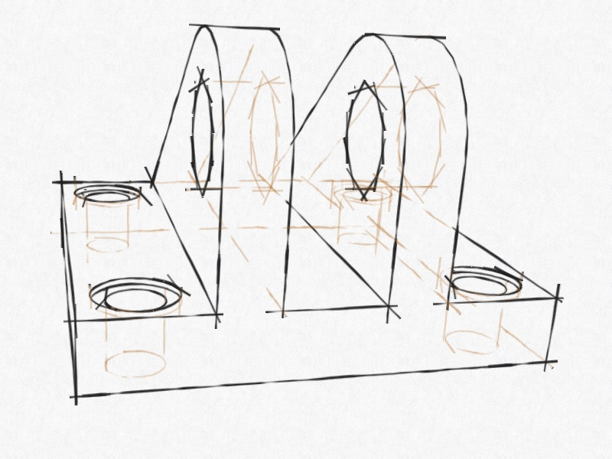
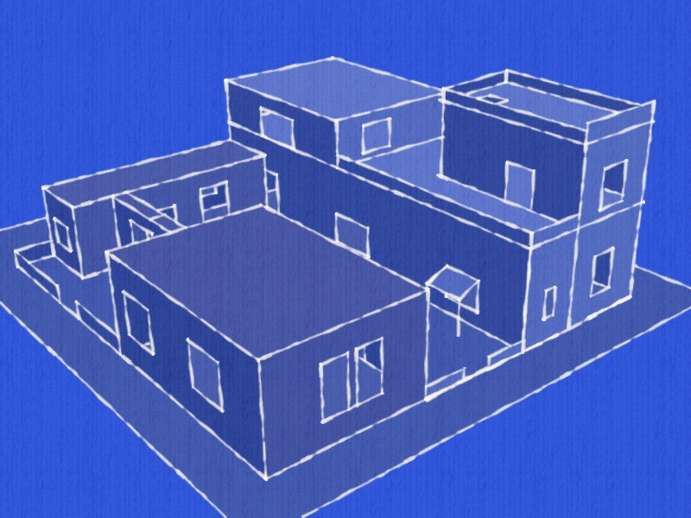
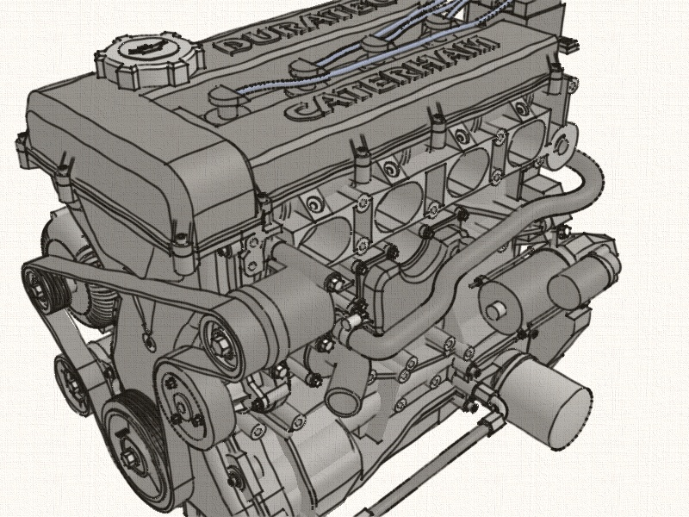
Lines in 3D Scenes
Aid comprehension
Evoke hand-drawn style
Allow elision of detail

Slide 3
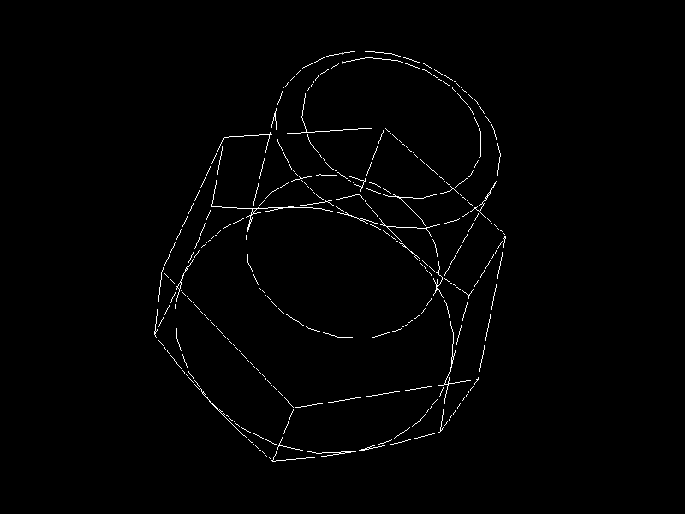
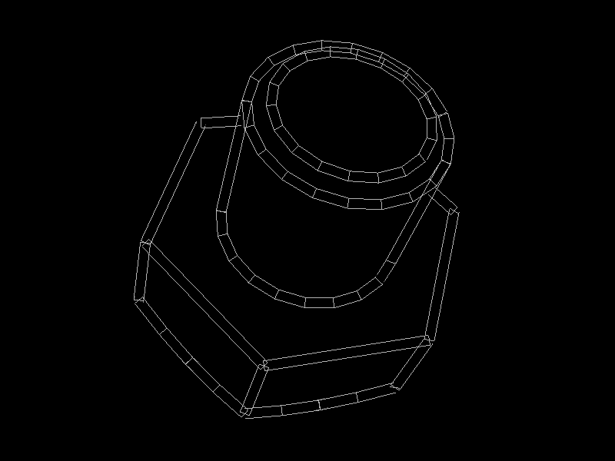
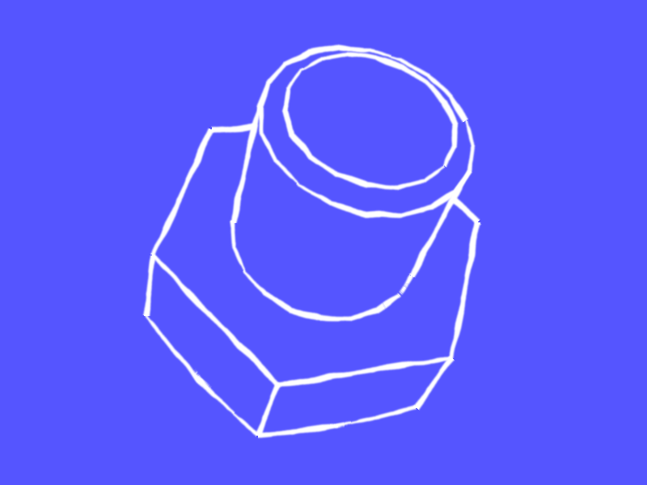
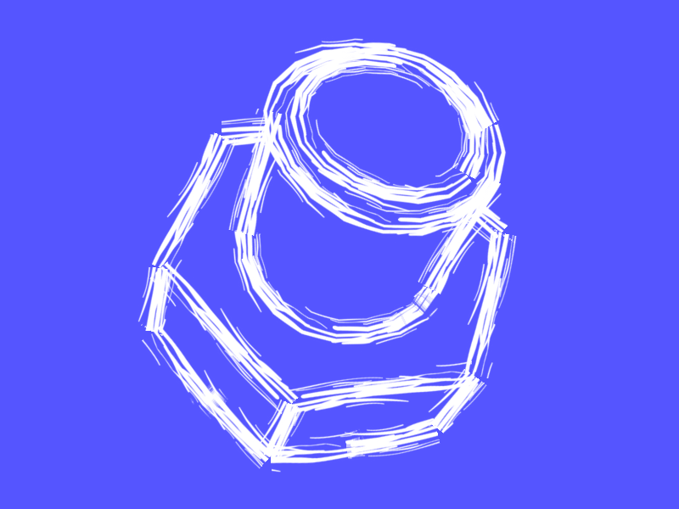
Drawing with Strokes

Slide 4
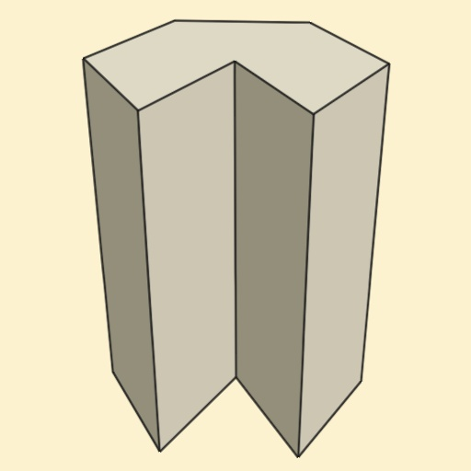
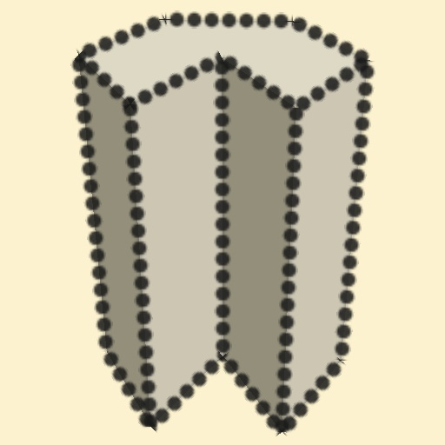
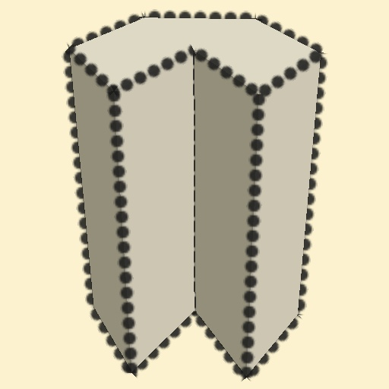
Visibility of Strokes
Simple Lines
Correct visibility
Per-fragment visibility

Slide 5
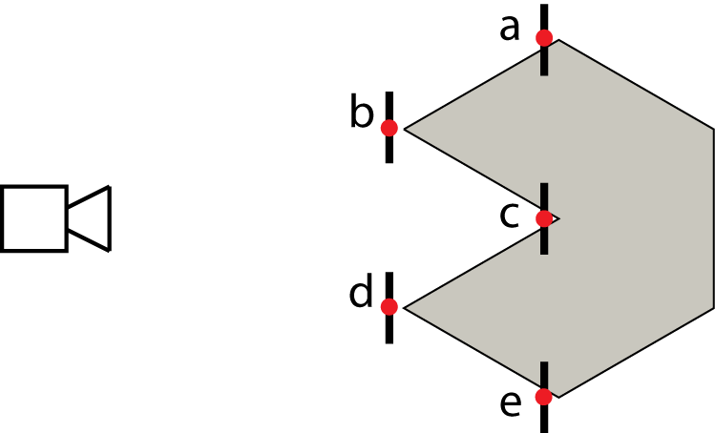
Per-Fragment Visibility
b
d
a
c
e
Top View

Slide 6
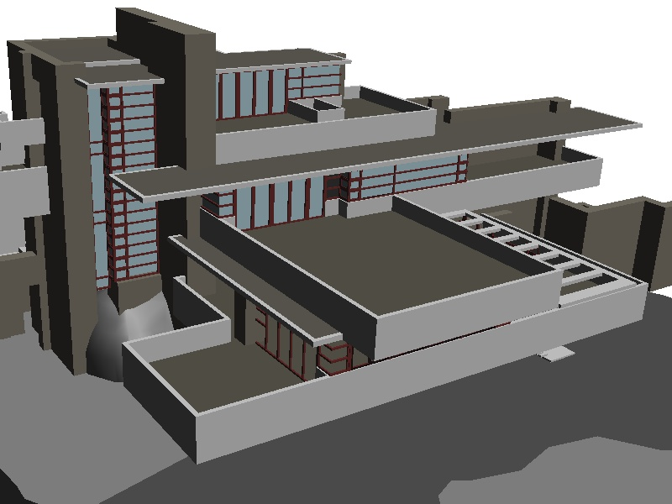
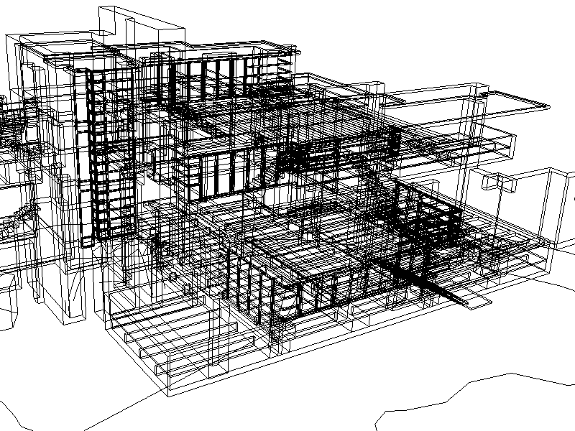
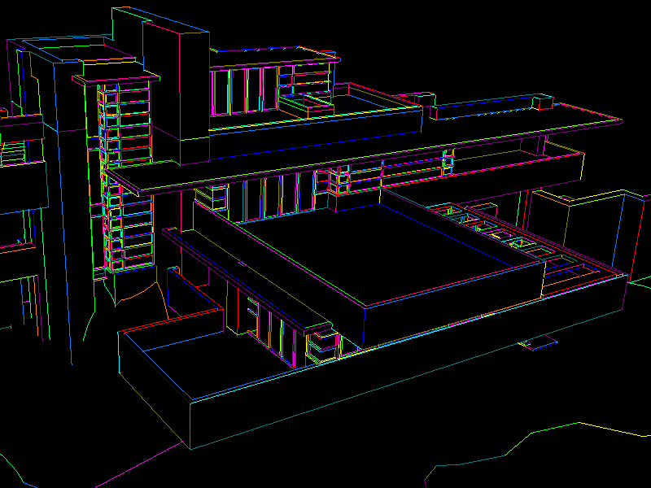
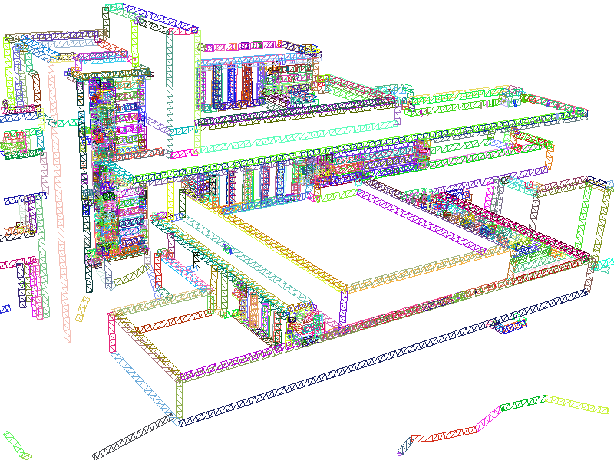
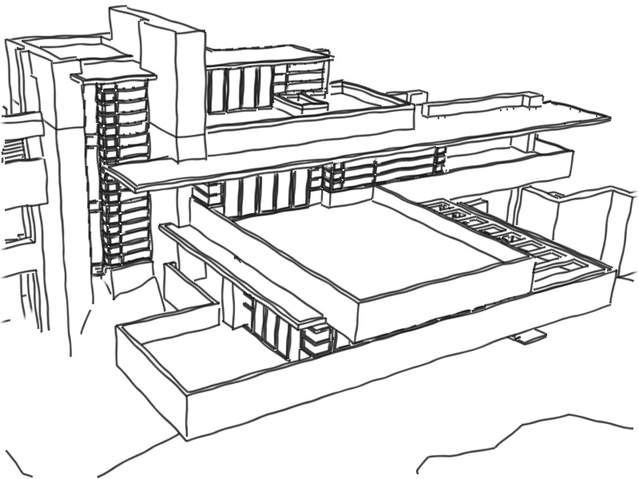
Item Buffer for Line Visibility [Northrup 2000]
Extract lines
Draw Item Buffer
Create strokes
Render

Slide 7
SketchUp Demo
Google SketchUp has stylized stroke rendering
Uses item buffer for visibility
Notes:
(also much slower)

Slide 8
Item Buffer Problems
Slow
Lines may overlap, causing serious artifacts
Multi-layer buffer ameliorates artifacts [Cole08] ….but even slower!
Notes:
(also much slower)

Slide 9
New Approaches
Algorithm 1: Spine Test Shader
Simple, easy to implement
Algorithm 2: Segment Atlas
Allows more stylization options
Notes:
(also much slower)

Slide 10
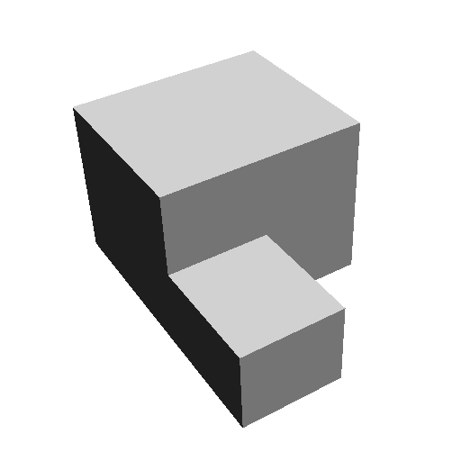
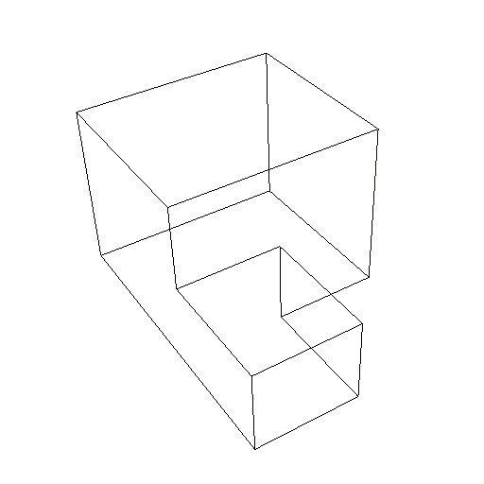
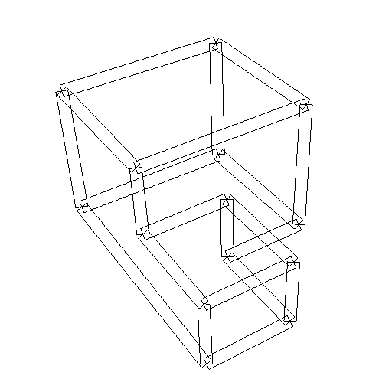
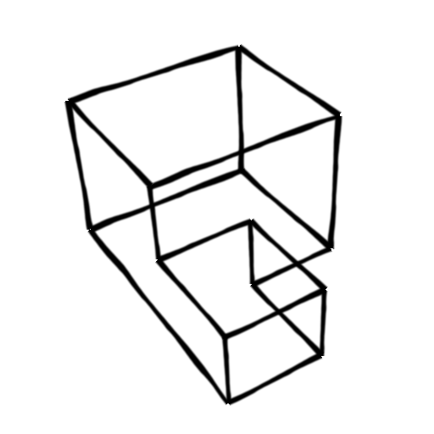
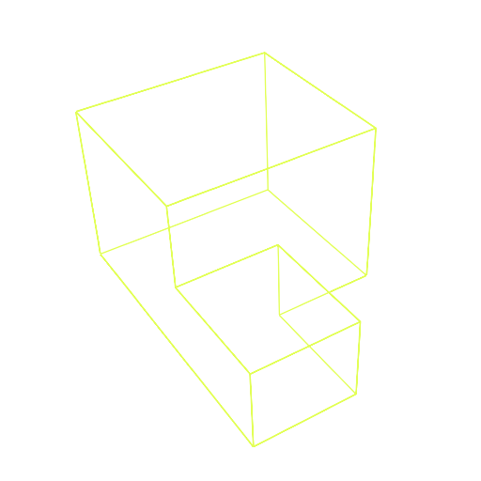
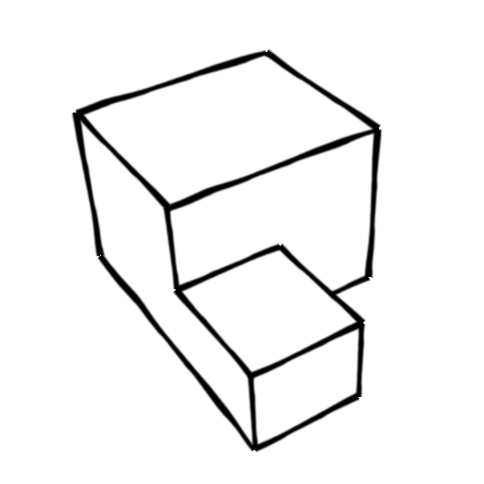
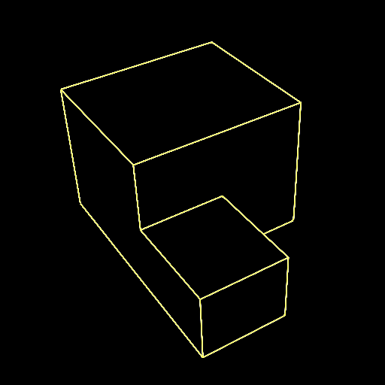
Algorithm 1: Spine Test
Extract Lines
Create Strokes (geom. shader)
Texture Strokes
Check Visibility at Spine

Slide 11
Spine Test Comparison
Item Buffer

Slide 12
Spine Test Comparison
Spine Test Shader

Slide 13
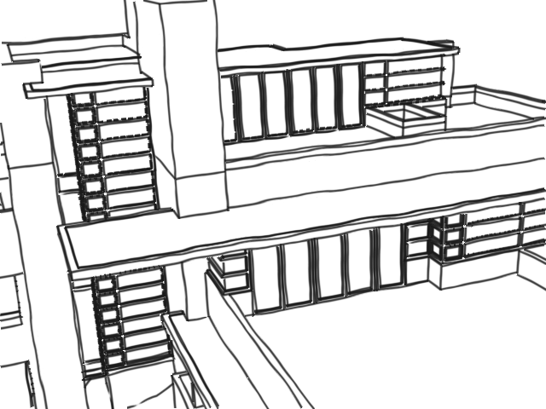
Visibility Errors
Notes:
Single depth test leads to aliasing
Artifacts much more objectionable now that entire line slice depends on one test

Slide 14
Partial Visibility [Cole 2008]
Aliasing inevitable with binary visibility test
Use partial visibility:
Give spine some width
Compute occlusion of spine (alpha)

Slide 15
Visibility Error Example
Notes:
Single depth test leads to aliasing
Artifacts much more objectionable now that entire line slice depends on one test

Slide 16
Partial Visibility Example
(far)
(near)
Depth Buffer (frame i )
Final Result
Depth Buffer (frame i +1)
Notes:
Remove blue Replace black line with thin red -> pink in occluded areas.

Slide 17
Depth Supersampling
Partial visibility can’t fix depth buffer undersampling
Draw depth buffer at 2x, 3x, 4x target resolution

Slide 18
Depth Supersampling
(far)
(near)
Depth Buffer (2x resolution)
Depth Buffer
Final Result
Notes:
Label: 2x resolution

Slide 19
Supersampling Results
1 depth probe, 1x depth buffer

Slide 20
Supersampling Results
16 depth probes, 3x depth buffer

Slide 21
Finished?
Yes, in some cases

Slide 22
Weaknesses of Alg. 1
Each line segment is independent
Can’t parameterize multi-segment paths
Each fragment is independent
Expensive to compute visibility of neighbors

Slide 23
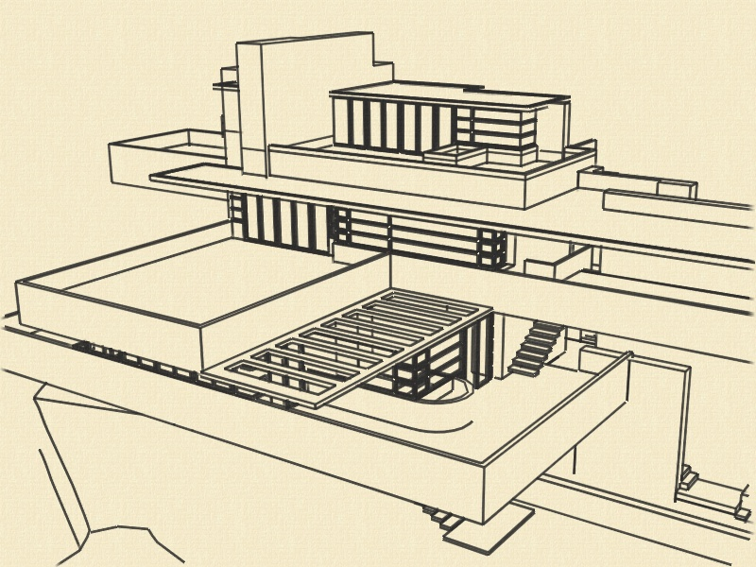
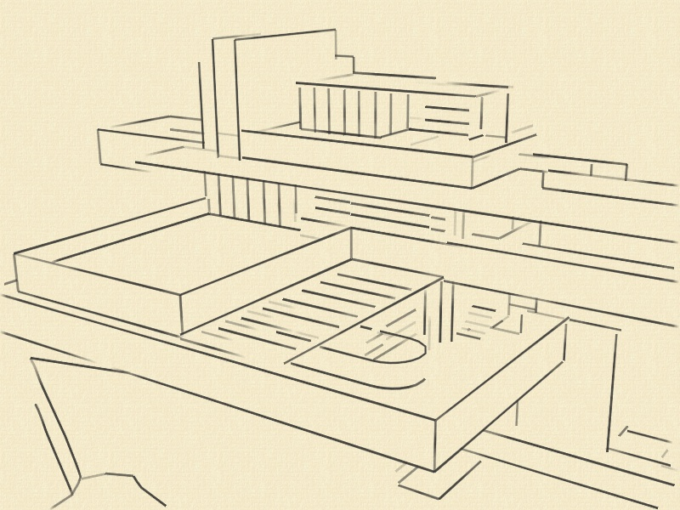
Algorithm 2: Segment Atlas
Table of visibility values for all strokes
Allows parameterization of multi-segment paths
Can store any per-sample values (e.g., line density)
Standard Rendering
Lines Elided

Slide 24
Algorithm 2: Segment Atlas
Table stores samples at fixed (1-2px) spacing
Created in three steps:
Project and clip segments, determine # samples
Sum sample counts to determine atlas offset
Draw proxy segments into atlas

Slide 25
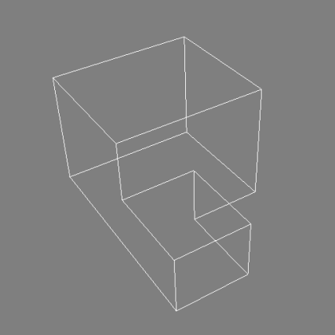
Step 1: Project and Clip
World space segments
Fragment Program
Example shape
22 segments
Clip space
Notes:
Say: as a bonus, we can also process silhouette edges at this point. The fragment program can check for the silhouette condition and discard non-silhouette segments.

Slide 26
Step 2: Sum Sample Counts
Exclusive Scan
[Sengupta 2007]
Example shape
22 segments
Notes:
Fix lengths -> integers
Remove last bit of text?

Slide 27
Step 3: Draw Atlas
GL_POINTS +
Geometry Program
Example shape
22 segments

Slide 28
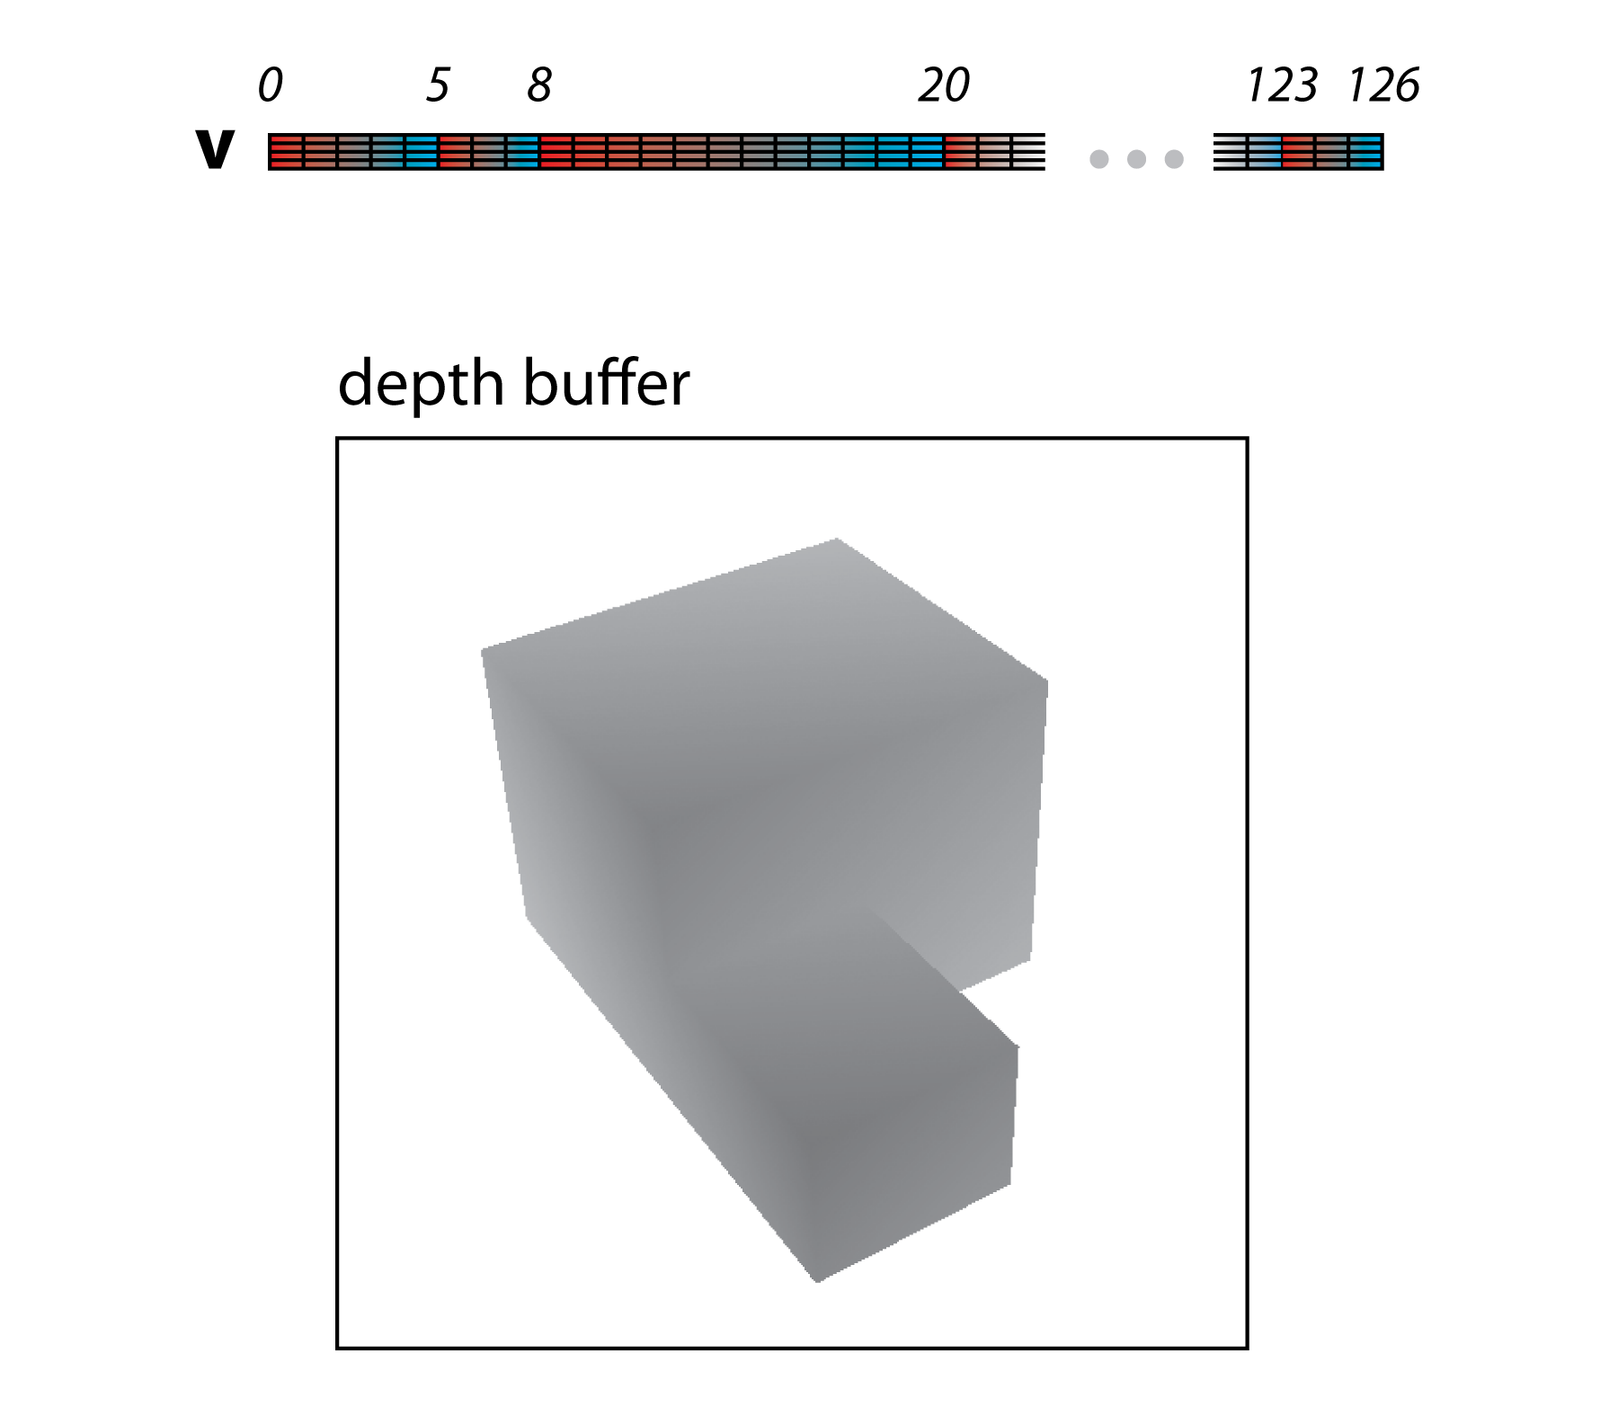
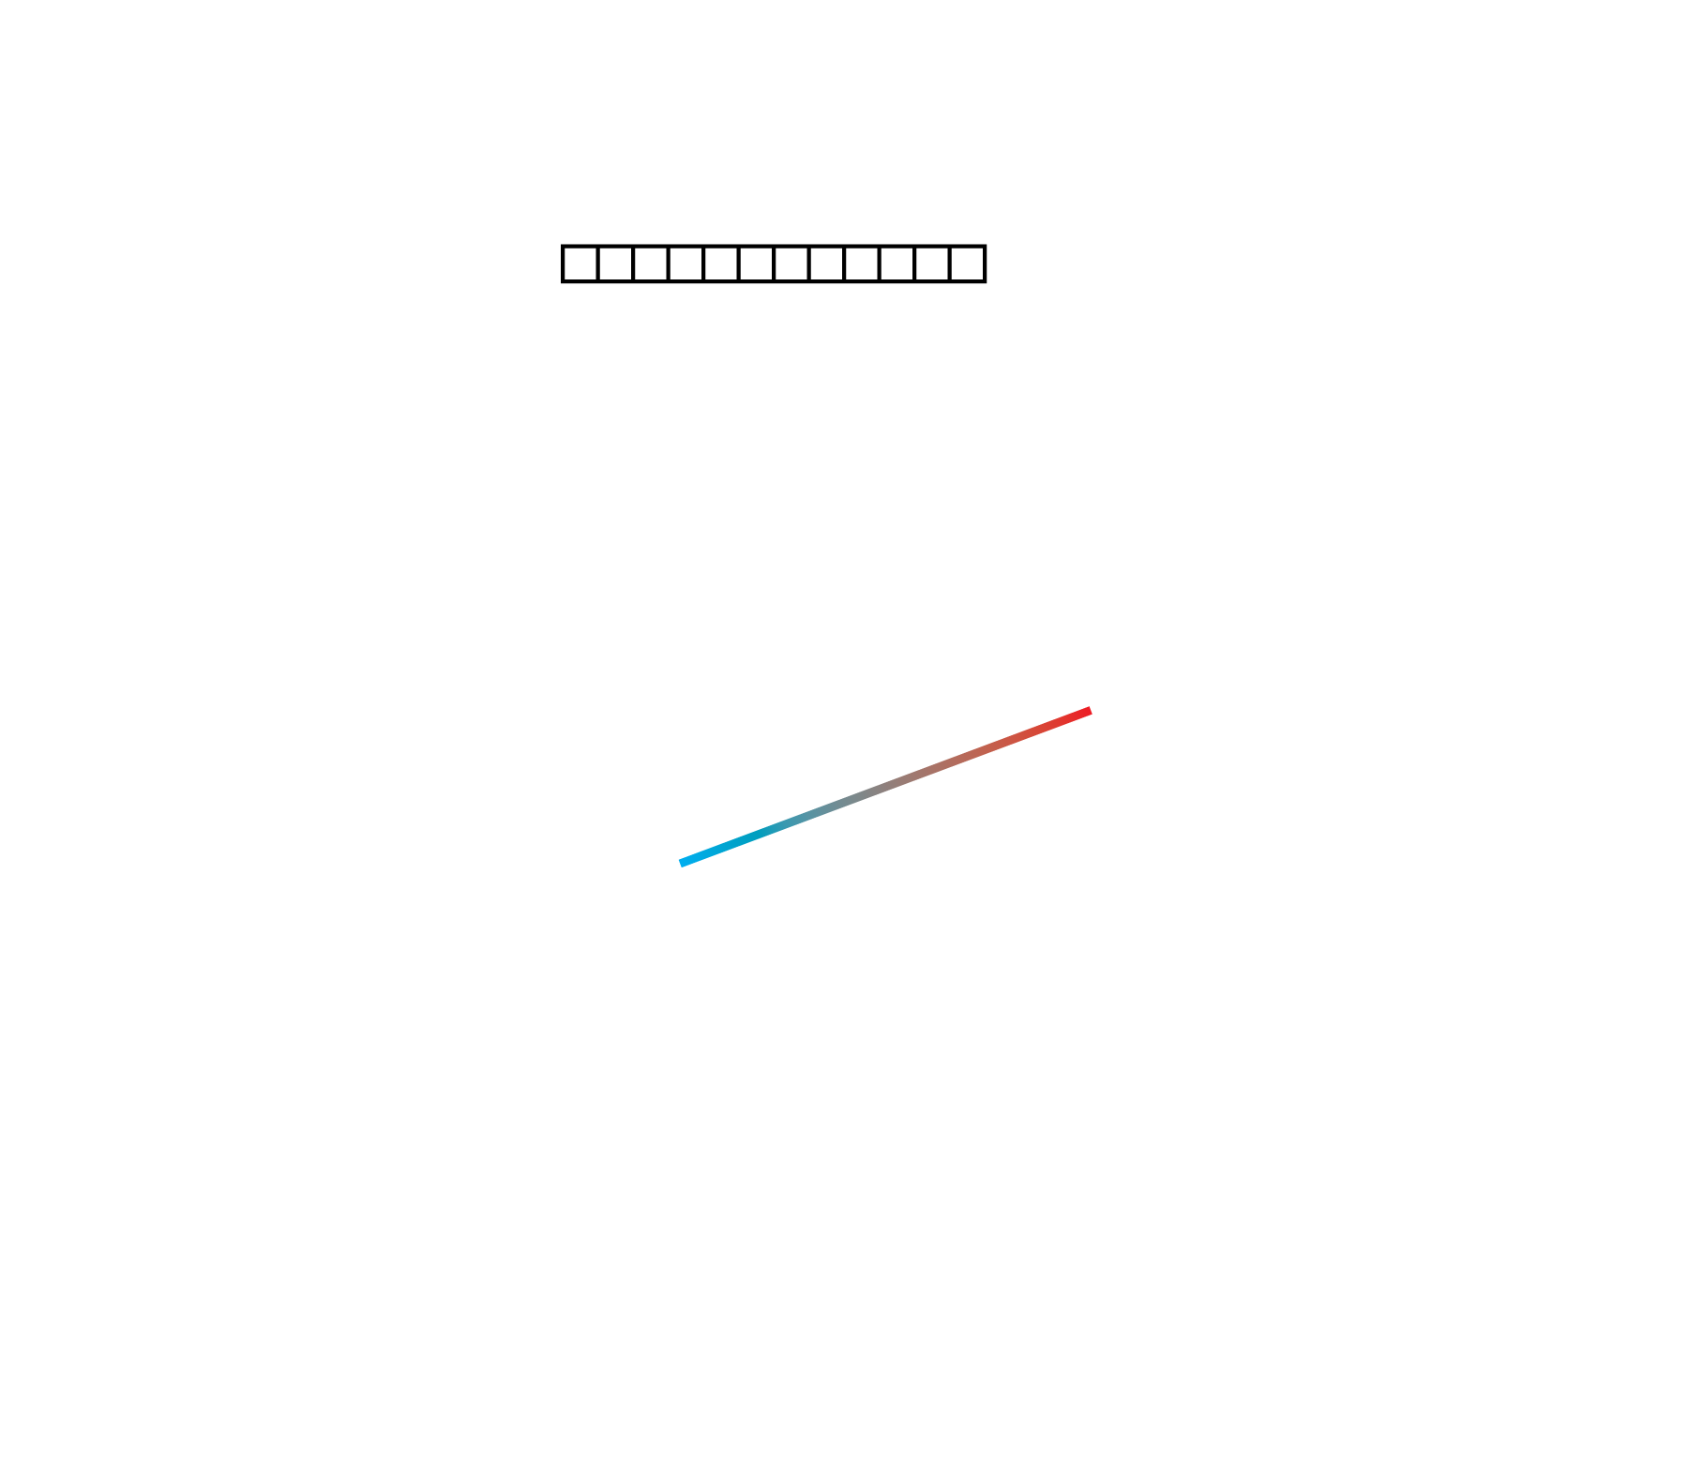
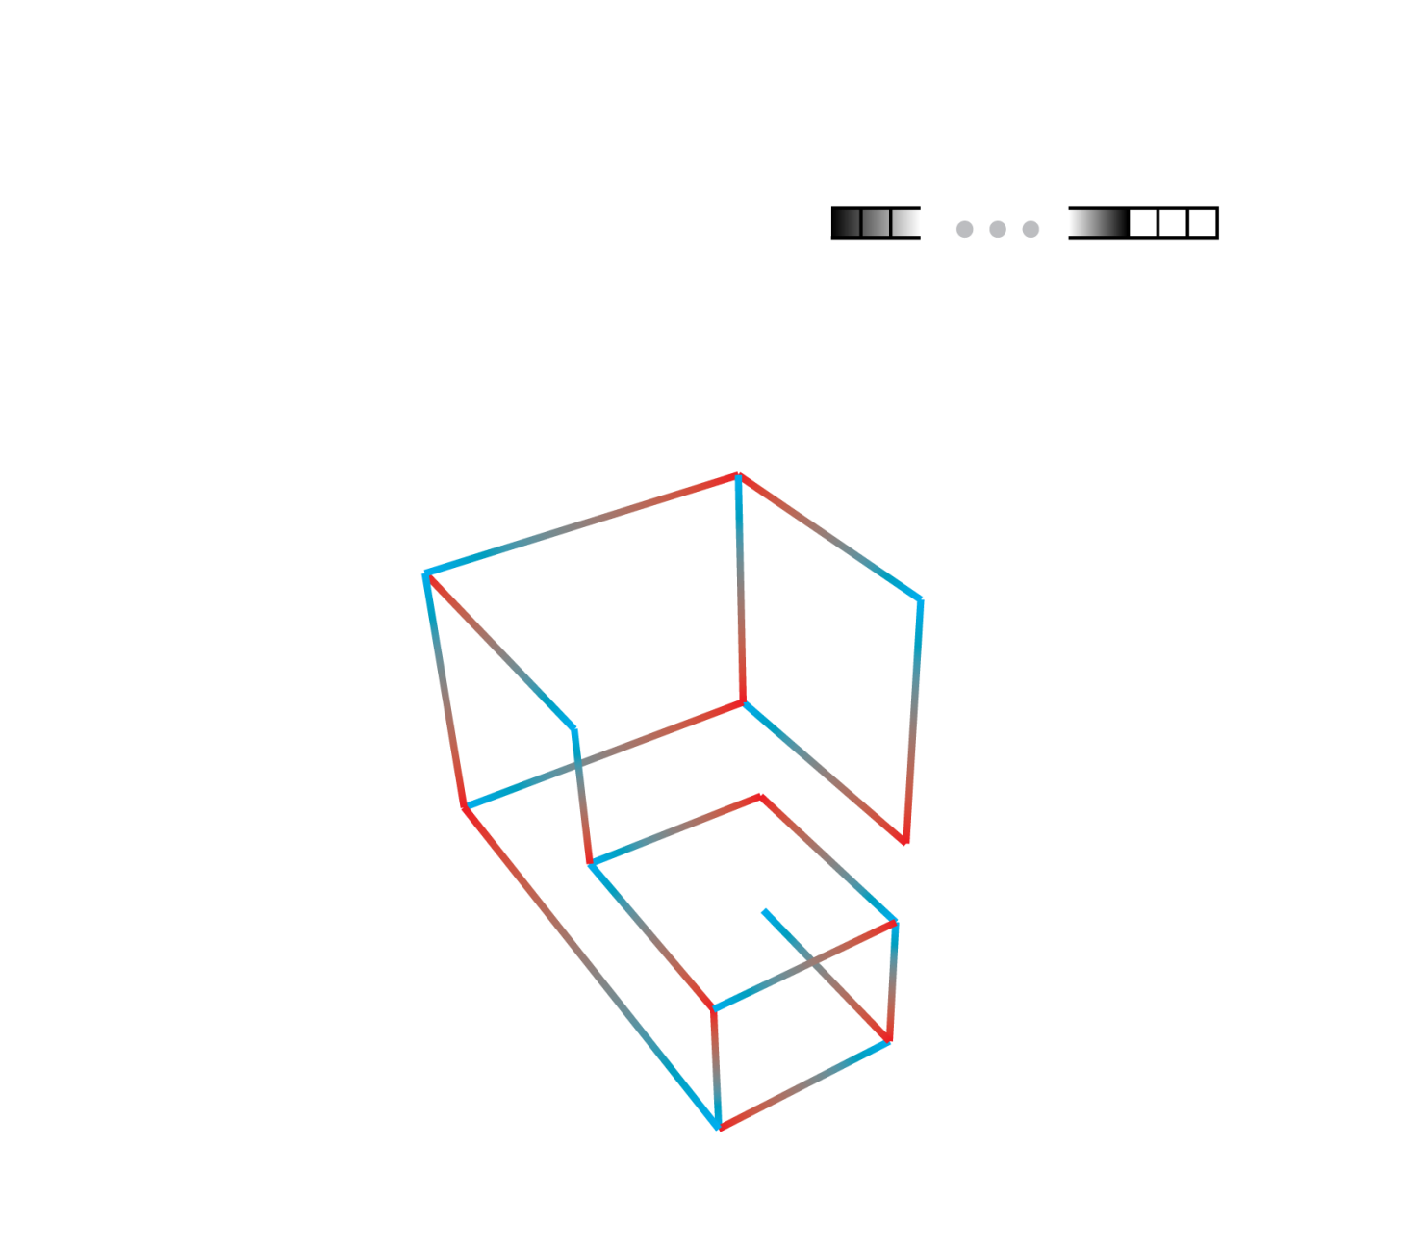
Visibility Computation

Slide 29
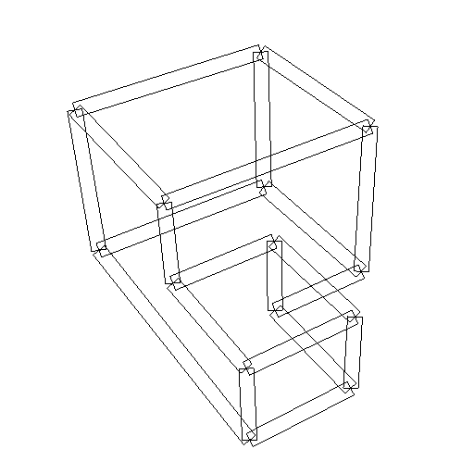
Stroke Rendering

Slide 30
Demo

Slide 31
Performance (fps)
 | clevis | house | ship | ship + sil.
# triangles | 1k | 15k | 300k | -
# segments | 1.5k | 14k | 300k | 500k
OpenGL | 1000+ | 300+ | 42 | -
Spine Test lo | 900+ | 146 | 26 | 19
hi | 300+ | 75 | 24 | 19
Seg. Atlas lo | 400+ | 119 | 33 | 23
hi | 200+ | 76 | 25 | 22
Item Buf. lo | 87 | 24 | 9.6 | -
hi | 20 | 3.4 | 0.5 | -
IB lo: single item buffer [Northrup 2000]
IB hi: 9x supersampling, 3 layers [Cole 2008]
[ST,SA]lo: 1x supersampling, 1x depth buffer
[ST,SA]hi: 9x supersampling, 2x depth buffer
Notes:
For small models, both the spine test and segment atlas algorithms are several factors slower than simple gl lines, but are still quite fast. For large models the difference is smaller, and the differences between the quality levels is also smaller. As mentioned before, we can extract and draw silhouettes on the gpu, and this costs about proportionally to the increase in the number of segments. Both algorithms are faster than the item buffer algorithm by up to a factor of 50.

Slide 32
Conclusion
Algorithm 1: Spine Test Shader:
Fast, simple, good quality
Algorithm 2: Segment Atlas:
Stylization of stroke paths
Extra effects such line elision
Minor performance gain for models with many lines

Slide 33
For More
Try it yourself: email me at fcole@cs.princeton.edu
I3D paper describes algorithm 2
For algorithm 1, see TVCG paper (to appear)

Slide 34
Thank You
Questions?

Slide 35
Tips
Parameterize strokes from the middle, not the end

Slide 36
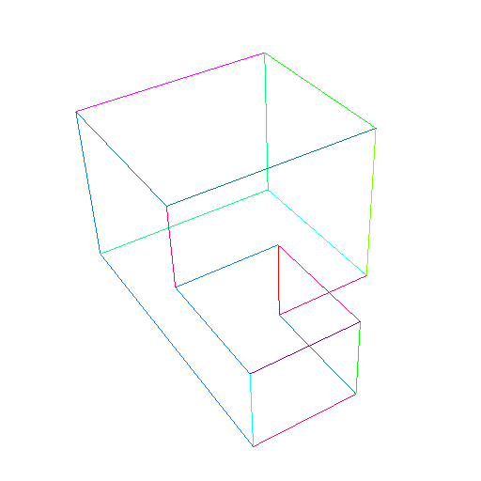
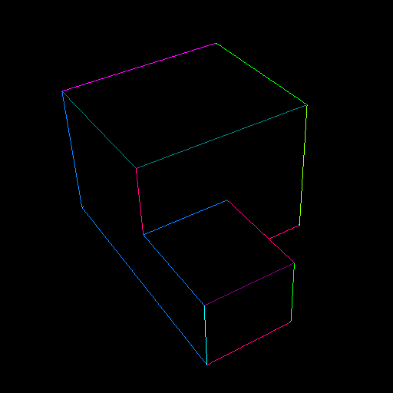
Item Buffer for Line Visibility [Northrup 2000]
Item buffer (rendered on GPU)

Slide 37
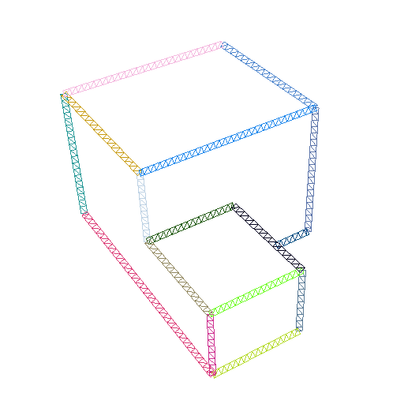
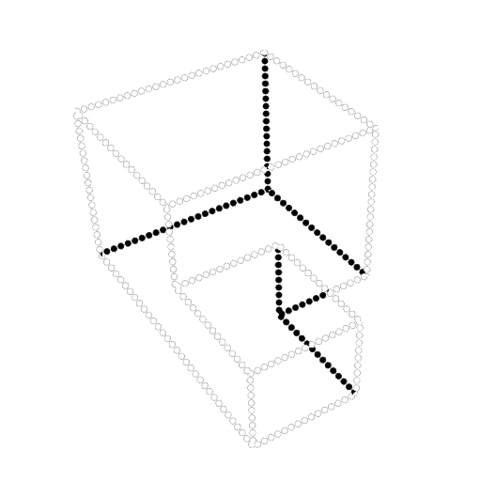
Item Buffer Cont’d
Item buffer (read back to CPU)
Projected and clipped lines (on CPU)
Final result (rendered on GPU)
Visibility sampling
Stroke geometry

Slide 38
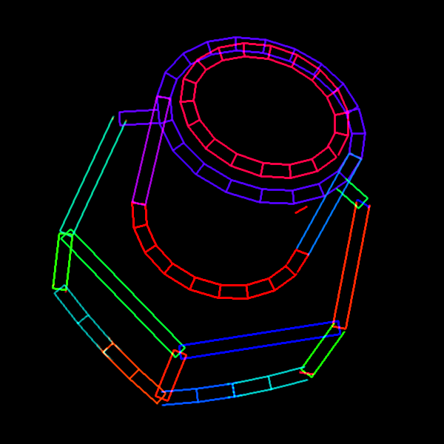
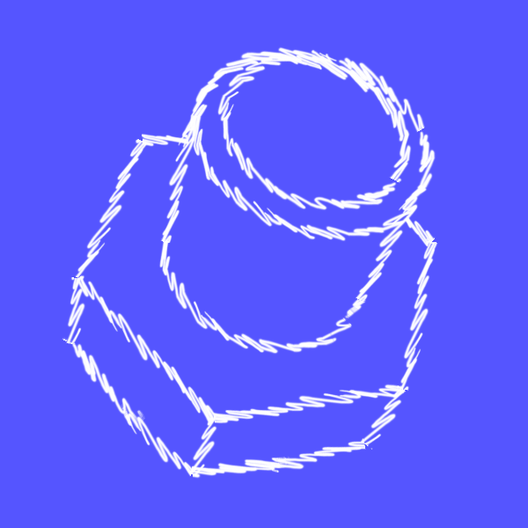
Alg. 1 Weakness: Stroke Paths
Stroke visualization
Final result
Need distance along path for texturing
Notes:
Some strokes are made up of multiple segments
Want texture to run smoothly along path
Need arc length along path

Slide 39
GPU Clipping w/ Silhouettes
M potential segments (p_{i}, q_{i})
World space
Project, Clip,
Silhouette Test
Fragment Program
Clip space

