Slide 1
How Well Do Line Drawings
Depict Shape?
Forrester Cole
Kevin Sanik
Doug DeCarlo
Adam Finkelstein
Thomas Funkhouser
Szymon Rusinkiewicz
Manish Singh
Princeton
Rutgers

Slide 2
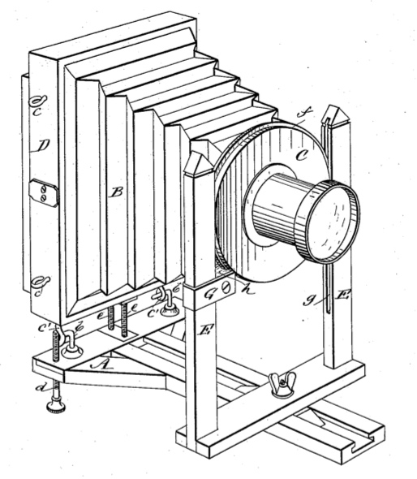
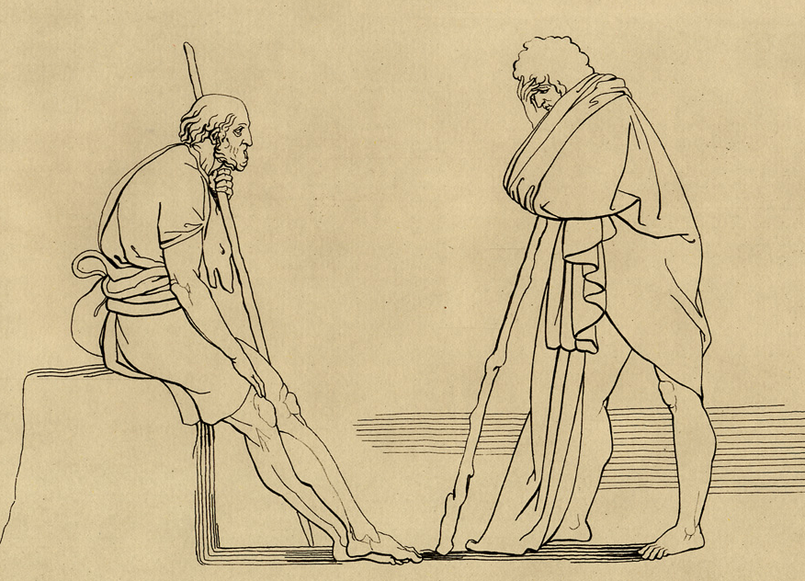
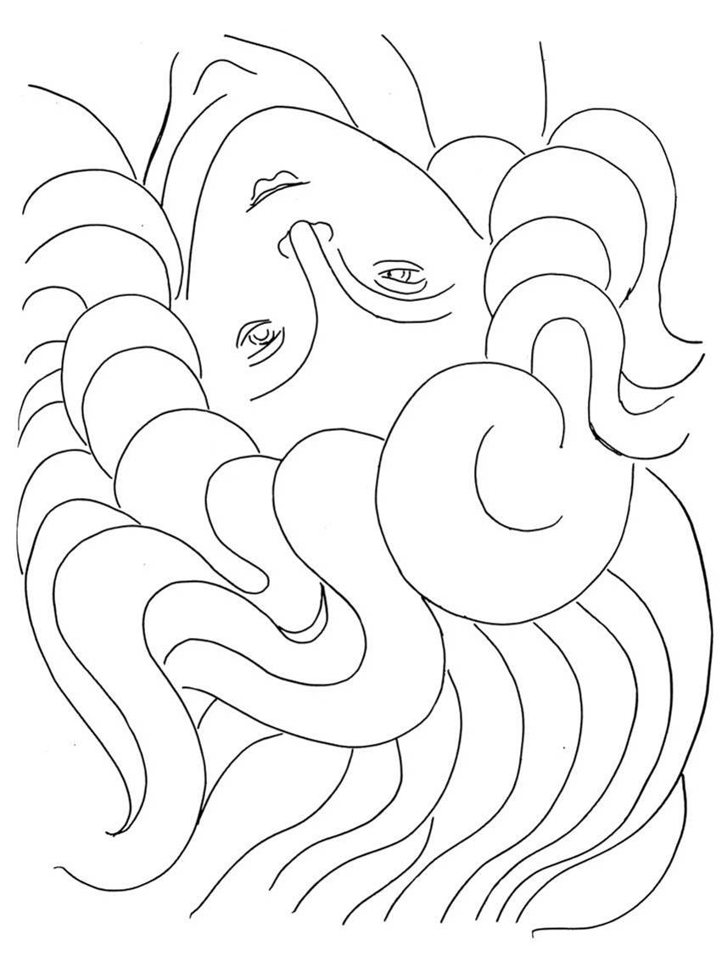
Line drawings
[US Patent 378,973]
[Flaxman 1805]
[Matisse 1932]
Notes:
Line drawings made by artists vary a great deal.
They span the range from technical drawings,
[click] to the plainly depicted forms in illustrations by Flaxman,
[click] to more abstract forms by Matisse.
When viewing these line drawings,
one gets a compelling sense of seeing geometry.
These lines convey shape.
How can we quantify this?
This is the subject of this talk.
.
.
.
…

Slide 3
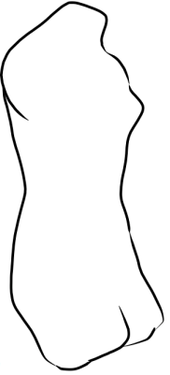
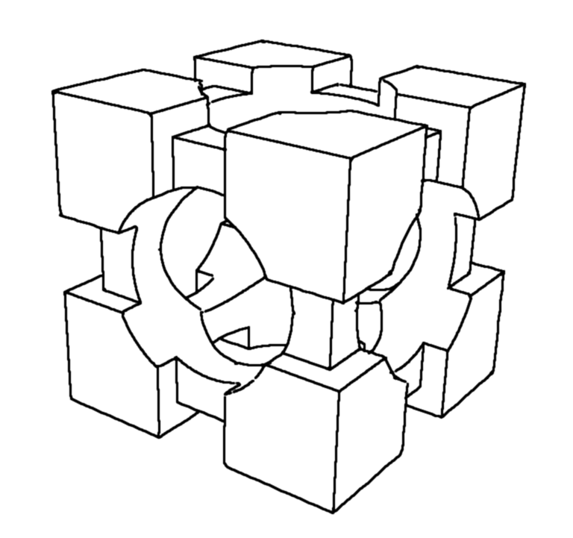
Line drawings
Occluding Contours
Sharp creases
Notes:
This is of interest to computer graphics because
we now have many definitions, or computational models,
that describe different lines to draw.
Let me summarize them.
Occluding contours - which are discontinuities in depth,
and sharp creases - which are discontinuities in normals
are likely ingredients in line drawings.
Beyond this, the evidence isn’t clear, and there are a number of possibilities.

Slide 4
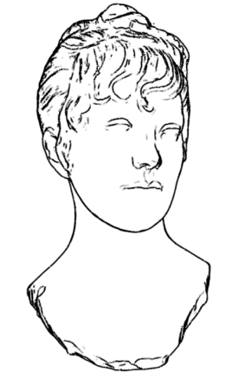
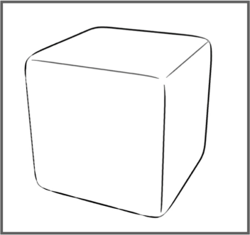
Line drawings
Occluding Contours
Sharp creases
Ridges and Valleys
Suggestive Contours
[DeCarlo et al 2003]
Apparent Ridges
[Judd et al 2007]
Notes:
Ridges and valleys are surface features,
typically defined as local extrema of principal curvatures.
Suggestive contours are view-dependent inflections on the surface
that become occluding contours in nearby viewpoints.
Apparent ridges are a view-dependent adaptation of ridges and valleys
that includes ridge-like features, inflections, and occluding contours.
There are some more recent results, but these are what we’ll be considering.
So how can we assess these models?

Slide 5
Assessing Line Drawings
Goals
  Artistry, abstraction, etc.
  Leads to accurate perception of shape
Notes:
Before talking about assessment, we should be clear about
what we expect from line drawings.
Certainly, line drawings can be beautiful,
and can represent scenes in abstract ways that photographs can’t.
But in this talk, an effective line drawing
is one that leads to an accurate perception of the depicted shape.
This is appropriate for comparing strategies for making line drawings.

Slide 6
Assessing Line Drawings
Goals
  Artistry, abstraction, etc.
  Leads to accurate perception of shape
Methodology
  Qualitative (examples, comparison to artists)
  Quantitative comparison to artists’ drawings
  Direct measurement of perceived shape
Notes:
An assessment can proceed in a number of ways.
We can for instance, subjectively compare output
using various line theories, or to drawings made by artists.
When we know what the artist was drawing,
such comparisons can become much more specific.
And finally, we can ask the viewer what shape they see,
and compare this to the original shape.
This is in fact the approach we take.
Before getting to that, I’ll go through these methodologies in more detail.

Slide 7
Comparing models
Suggestive Contours
Ridges and Valleys
Apparent Ridges
Notes:
Let’s start with comparing outputs from different line drawing models.
In some cases, it’s easy to explain why one model fails.
In this case, for instance, suggestive contours fail to depict
the edges of this rounded cube
simply because there are no inflections on the shape.
But the edges of the rounded cube are depicted just fine
using either ridges or apparent ridges.

Slide 8
Comparing models
Suggestive Contours
Ridges and Valleys
Apparent Ridges
Notes:
In other cases, one model might subjectively produce a better rendering,
but its hard to give a clear reason why.
The dimples on this golf ball seem to be depicted successfully
using suggestive contours.
Ridges and valleys inappropriately appear as surface markings.
And apparent ridges are a mix of the two.

Slide 9
Comparing models
Suggestive Contours
Ridges and Valleys
Apparent Ridges
Notes:
On other geometries,
different models of lines generate noticeably different drawings,
[click] as you can see here.
But the drawings are reasonable.
This is all pretty subjective.
How else can we assess these models?

Slide 10
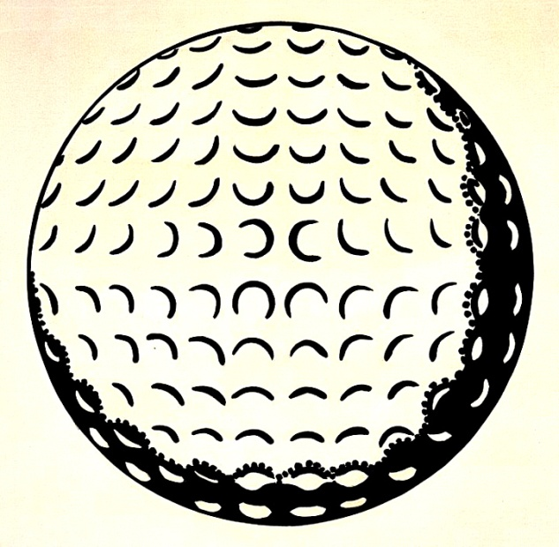
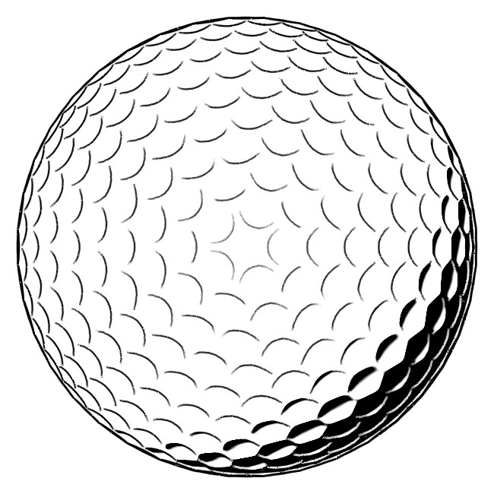
Comparing models to artists
“Golf Ball” [Lichtenstein 1962]
Suggestive contours and suggestive highlights [DeCarlo and Rusinkiewicz 2007]
© Estate of Roy Lichtenstein
Notes:
Well, we can compare line drawings made by artists
to those made using computational models.
Take for instance this painting of a golf ball.
There are, of course, clear differences in the placement of the dimples.
But the dimples are depicted in the same way.
[click] Suggestive contours curve downward here,
just like the lines in the painting,
[click] and the suggestive highlights curve upward here.
[pause]

Slide 11
Comparing models to artists
Argument for ridge-like features [Judd et al. 2007]
[Matisse 1932]
[Brancusi 1910]
Notes:
Here’s another example.
This particular line drawing by Matisse
was used by Judd et al to argue
for the presence of ridge-like features in line drawings.
Notice in particular the lines along the nose.
However, one could also argue
[click] that these lines have a ridge-like appearance
because they correspond to creases in an abstracted form of a face,
such as that clearly seen in sculptures by Brancusi.
This analysis is interesting,
but is still subjective since we can’t be sure what the artist was drawing.

Slide 12
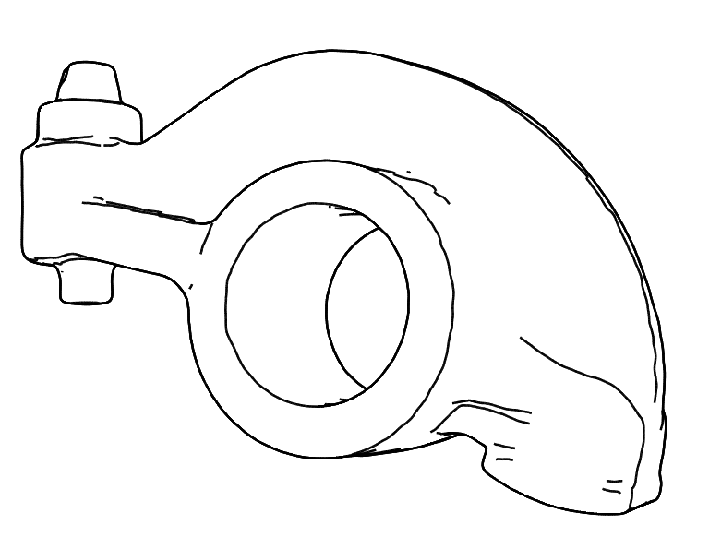
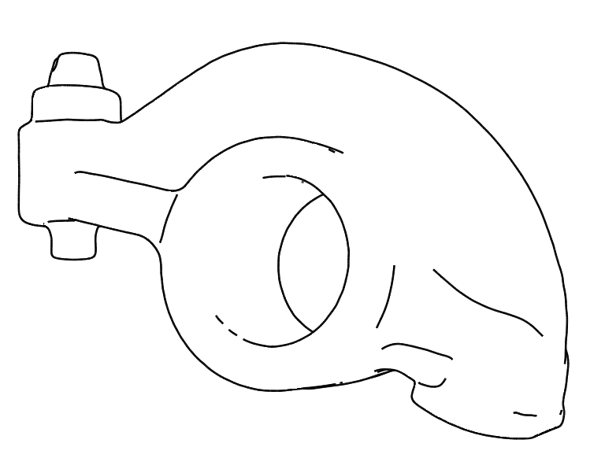
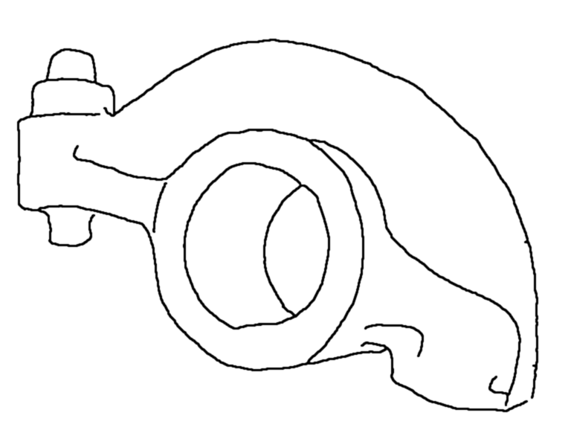
Comparing models to artists
Comparisons to drawings made under controlled conditions [Cole et al. 2008]
…
apparent ridges
suggestive contours
artist drawing
Notes:
One way of knowing what shape an artist is drawing
is to have them make the drawings under controlled conditions.
This is the approach by Cole et al last year:
a set of computer line drawings were compared to a set made by artists,
where the artists were provided with a set of pictures of the object.

Slide 13
Comparing models to artists
Comparisons to drawings made under controlled conditions [Cole et al. 2008]
…
apparent ridges
suggestive contours
artist drawing
d_{line}( , )
rendering
artist drawing
Notes:
The analysis compared drawings by using a metric that measures
how well the lines overlap.
One conclusion of this work is that most lines drawn by artists
are explained by one or more of the existing line drawing models.
However, artist drawings aren’t ground truth.
It’s the perception of the shape that determines effectiveness, and
we’re interested in differences between the depicted scenes.
So how can we measure that difference?

Slide 14
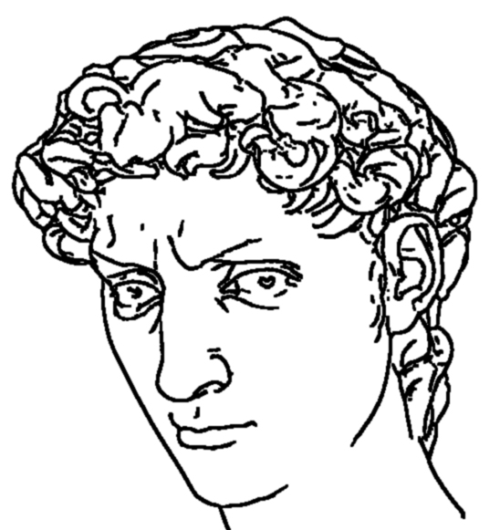
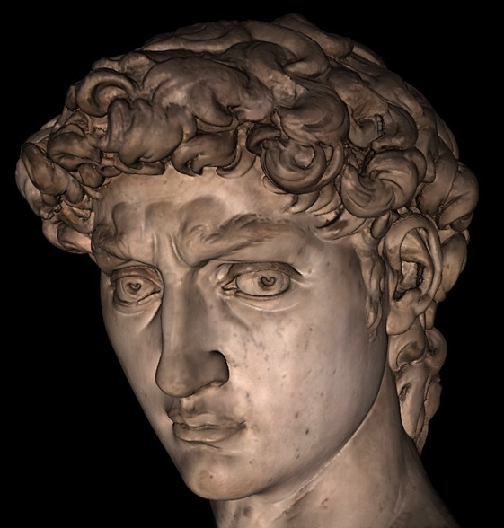
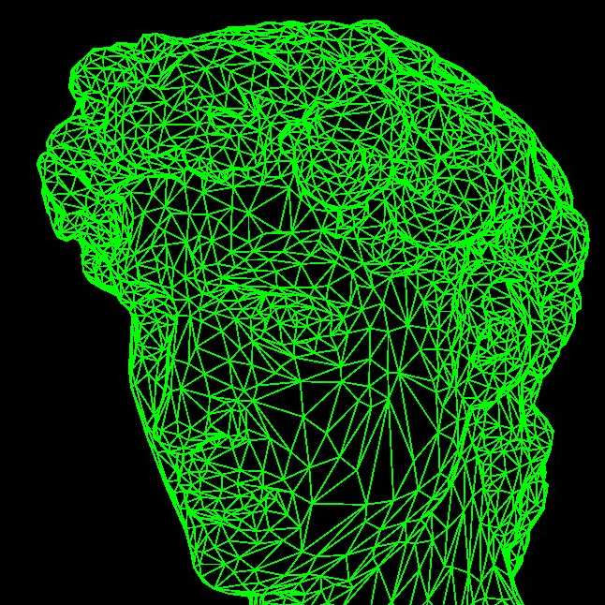
Comparing shapes
3D
rendering
d_{3D}( , )
perceived shape
original shape
Notes:
Perhaps the most direct way
[click] is to show the drawings to a group of people,
and ask them what shape they see.
[click] Then we can simply compare the perceived 3D shape
with the original 3D model.
This is our approach.
Asking people what shape they see may seem like an obstacle,
but there are established ways of doing this.

Slide 15
Measuring perceived shape
Local measurements of shape geometry
Gauge figure adjustment
[Koenderink et al. 1992]
Notes:
Methods in psychophysics ask viewers
a large number of very simple questions about a surface.
Koenderink and colleagues described a set of techniques
for obtaining local information about what shape a viewer perceives.
We use their method of gauge figure adjustment,
[click] where the viewer adjusts a small figure that resembles a thumbtack,
until it appears to be sitting on the surface.

Slide 16
Measuring perceived shape
Local measurements of shape geometry
Gauge figure adjustment
[Koenderink et al. 1992]
Studied shaded surfaces
and one artist line drawing
[Koenderink et al. 1996]
Notes:
This was used to study the perception of shaded images,
and it was determined that people see the surface correctly,
up to the ambiguity that one would expect.
They also studied a single artist line drawing, and found similar results.

Slide 17
Questions
Do artist and CG drawings effectively convey shape?
  how accurate are they?
  how do they compare to a shaded rendering?
Do different viewers perceive the same shape?
When are particular line types most effective?
Notes:
What questions can we answer using this technique?
[click]
We can assess the accuracy of
artist and computer generated line drawings,
and compare these to shaded renderings.
[click]
We can determine if different viewers perceive the same shape,
[click]
and when particular line types are most effective.
Forrester will now describe the study that we’ve run to answer these questions.

Slide 18
Study Methodology
Measure percepts
  Both artist and CG drawings
  Range of models
  Many participants
Compare against ground truth
  3D shape and shaded image
  Accuracy and precision
Notes:
I’ll now describe the study we conducted using the gauge methodology that Doug just mentioned. We first measure viewers’ perceptions of both artists’ drawings and drawings made with computer graphics algorithms, and do this for a range of models and many participants.
We then compare these results against ground truth in terms of accuracy and precision, and against both the original 3D shape and viewers’ perceptions of a shaded image.

Slide 19
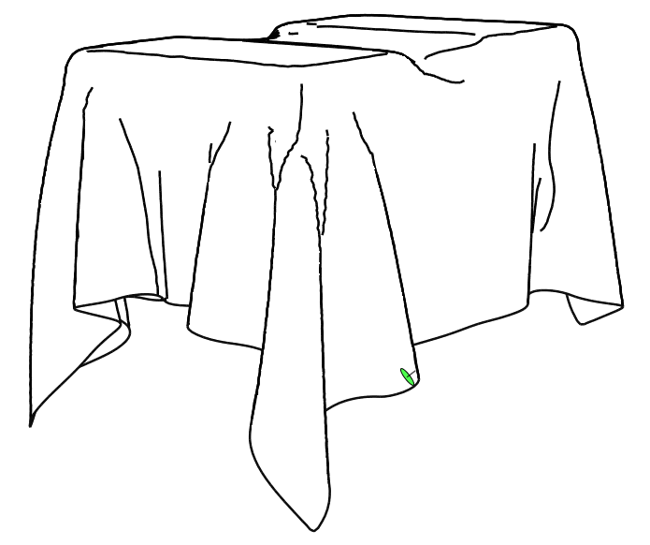
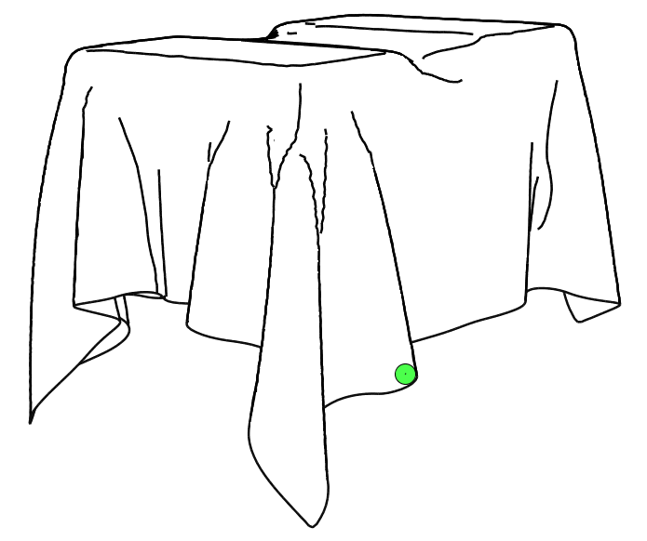
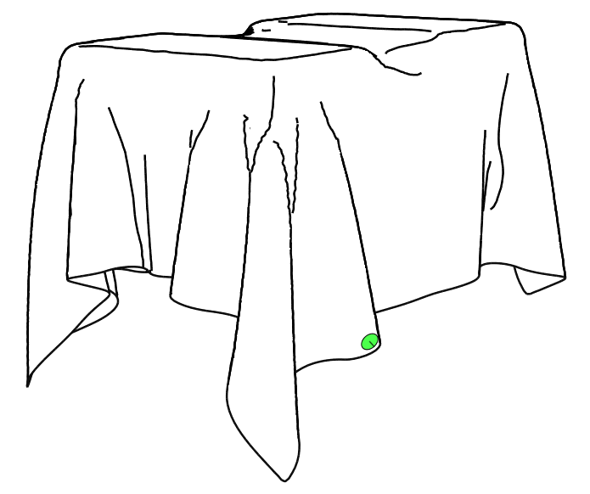


Orienting a Gauge
Notes:
When a participant takes the study, they see a prompt image, usually a line drawing, and one green gauge (or pin) at a time. Each pin is placed at a random location, with a random initial orientation. The participants then used the mouse to rotate the pin until it appeared to lie flat on the surface.

Slide 20
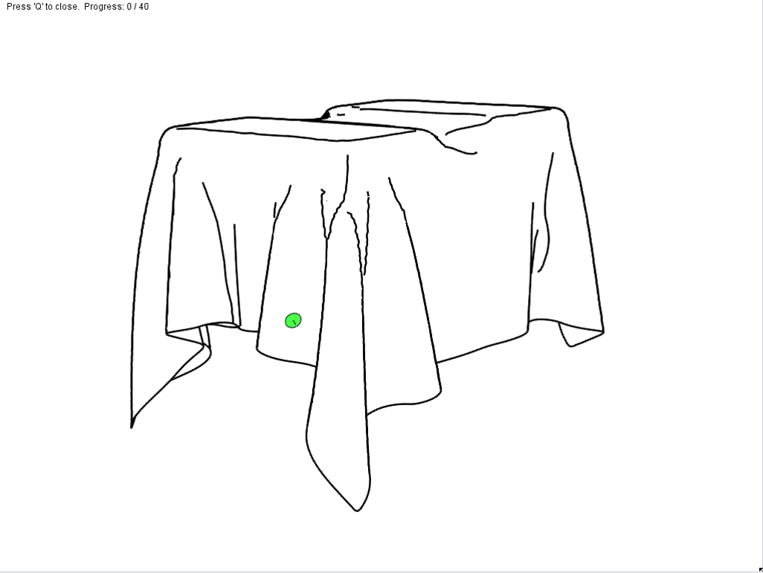
Example Session
Notes:
Here is a video of setting a few gauges. The participant uses the mouse to orient each gauge… once the pin is rotated correctly, the user hits the space bar and is presented with another randomly placed pin, and the process repeats.
(start near the end) As this video is intended to show, this process is simple but tedious and time consuming. This is a big problem for us, because we want to examine a lot of different drawings.

Slide 21
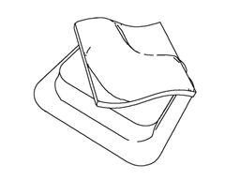
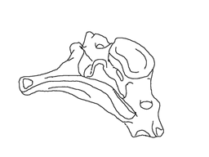

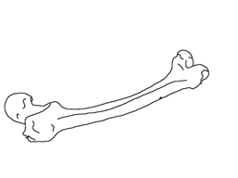
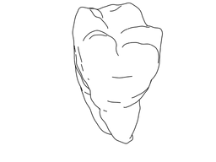
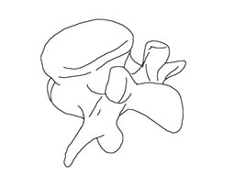
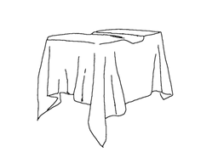
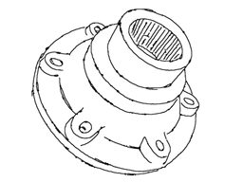
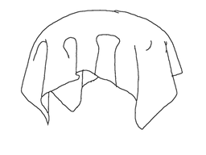
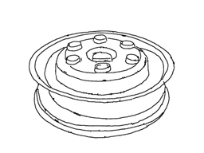

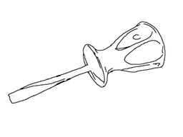
Study Setup
All 12 models from [Cole et al. 2008]
Notes:
To start, we included all 12 models from our 2008 study of artist’s drawings. These models provide a range of familiar and unfamiliar shapes, but more importantly, we have drawings of these shapes made by human artists, so we can compare them with computer drawing algorithms.

Slide 22


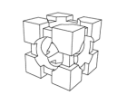



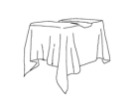




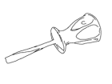
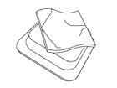
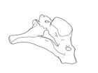
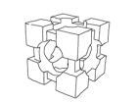
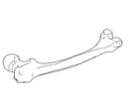
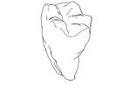
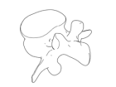
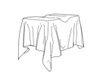
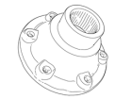
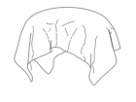
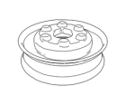
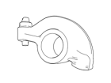
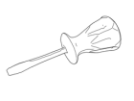
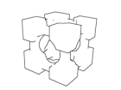
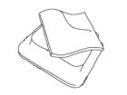
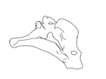
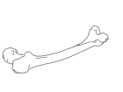
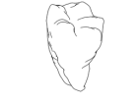
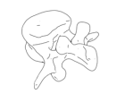








































Study Setup
6 styles
x 12 models
- 2 duplicates
= 70 prompts
Artist’s
R. and V.
Sug. C.
App. R.
Contours
Shaded
Notes:
We chose 6 rendering styles for the study: an artist’s drawing, computer generated drawings with geometric ridges and valleys, suggestive contours, apparent ridges, and only occluding contours, and a shaded image generated using global illumination.
In total we have 6 styles times 12 models, two of which are duplicates, leaving 70 total prompts.
We tried to be as kind as possible to each style: we chose the subjectively best artist’s drawing for each model, and we tweaked smoothing and thresholding parameters for each CG algorithm until we made what we thought was the best possible drawing using that definition.

Slide 23
Study Setup
6 styles
x 12 models
- 2 duplicates
= 70 prompts
Artist’s
R. and V.
Sug. C.
App. R.
Contours
Shaded
Notes:
The contours only and the shaded images were included to bracket the other drawings: we expect that all the other drawings will be more accurately interpreted than the contours only drawing, but not so accurately as the shaded images.

Slide 24

Study Setup
70
prompts
x 90
gauges / prompt
x 8
opinions / gauge
x 2
settings / opinion
≈ 100,000
settings
Notes:
For each of the 70 prompts we need a number of gauge positions.
90 gauges (click) is a number that we found during pilot testing to give a good balance of coverage (click) and workload
To draw any significant conclusions we need a number of different people’s opinions at each gauge, lets say (click) 8.
And to evaluate how precise the individuals were, we need at least 2 (click) settings for each opinion.
That gives us approximately 100,000 gauge settings.

Slide 25

Study Setup
70
prompts
x 90
gauges / prompt
x 8
opinions / gauge
x 2
settings / opinion
≈ 100,000
settings
x 4
seconds / setting
111
hours
Notes:
Lets estimate that setting a gauge takes about 4 seconds (click).
That means an entire set of data would take around 111 man-hours. In previous studies of this type, the authors often gathered all the data themselves. But orienting gauges becomes mind-numbing after even 15 minutes.

Slide 26
So Much Data…
Amazon Mechanical Turk to the rescue!
Turker sets 60 gauges, gets paid $0.20
Efficient even after throwing away garbage
  “Garbage” is inconsistent data
  About 80% of data is consistent
Notes:
So, to collect our data we used the amazon mechanical turk, which is an online service that allows requesters to farm out simple tasks to many people.
For example, a turker sets 60 gauges, and gets paid $0.20. This is efficient even when we throw away garbage data. Since each turker sets each gauge they see twice, we can throw out their data if too many pairs of settings are inconsistent. About 80% of the data we gathered passes our consistency test.

Slide 27
Data Collection
275,000 gauge settings
4 models x 180 gauges + 8 models x 90 gauges
Each gauge 9 to 29 opinions, average 15
560 different people
Assignments
Completed
# Participants
Notes:
The mechanical turk worked so well for us that we were able to collect around 275,000 settings instead of 100,000. This allowed us to double the number of gauges on 4 of our models, and
Gather additional opinions: between 9 and 29 per gauge.
560 unique workers performed our task, though as the histogram shows, the most active 20% (around 100 people) accounted for around 75% of our data.
Lets look at some results.

Slide 28


Global Accuracy
Error from ground (accuracy)
Notes:
This is a histogram of the angular errors from ground truth (what we call accuracy) broken down by style.
On the y axis is frequency, and on the x axis is angle of error. So the more accurately a style is interpreted, the more its curve will be weighted to the left.
This means shaded images were the most accurately interpreted, and contours only were least accurately interpreted, which is no surprise. What is a bit surprising is that all the other drawings are in the same ballpark, even though there are subtle differences.

Slide 29

Global Accuracy
Error from ground (accuracy)
Distribution of errors for shaded
Notes:
To give a feeling for what this distribution looks like, here is a scatter plot of 1000 values of the shaded image distribution (blue). If a gauge hit the ground truth right on the nose, its dot would be in the middle of the graph. The radius is the magnitude of the error, and the compass direction is the direction in which the error was made. If the participants were just clicking randomly, the dots would be spread across the disk. But in this case, around 75% of the points are within the 30 degree ring (about 14% of the area).
This suggests that…

Slide 30
Finding:
On average, turkers did a good job
Notes:
On average, the turkers did a good job of orienting the gauges, though there are definitely outliers and noise in the data. But accuracy is not the whole story…

Slide 31
Aggregating Per-Gauge Data
What is the most representative direction?
  “Mean” is most obvious choice
  “Median” more robust to outliers
mean
median
Notes:
It is also instructive to look at the data on a per-gauge basis, but to do that, we need a way to aggregate the data for each gauge. The most obvious way is the mean, or the normalized sum of the vectors. But since we have some noisy outliers at each gauge, we chose the median, i.e., the vector with the smallest average angle to all other vectors.

Slide 32

Global Accuracy and Precision
Error from Ground (Accuracy)
Error from Median (Precision)
Notes:
Here is the histogram of accuracy values again. If we compute the error against the median at each gauge, instead of ground truth, we get a precision value which we can plot in the same way. The first thing to notice is that errors from the median are much smaller, on average, than the errors from ground truth (that is, the curves are more tightly packed to the left). But the most remarkable thing about the precision values is that they are almost indistinguishable across styles, even between the drawings and the shaded prompts.

Slide 33
Results:
Precision greater than accuracy
Accuracy varies with style, precision does not
Notes:
There are two major results that fall out of the global histogram plots. First, precision is significantly greater than accuracy. Second, accuracy varies with style, while precision does not vary to a significant degree.
These results lead to an observation:

Slide 34
Finding:
Peoples’ interpretations of shape are similar, even when those interpretations do not match ground truth.
Notes:
That peoples’ interpretations of shape are similar, even when those interpretations do not match ground truth.
And if you believe that, then a question naturally comes to mind…

Slide 35
Question:
Where are the errors?
Notes:
Where are the errors, and can we describe what causes them?

Slide 36

Accuracy by Model
Avg. Error
(degrees)
Notes:
We can begin to get a handle on this by breaking down the results by model. This chart shows the average error for the shaded image and the most accurate drawing, per model. Shorter bars indicate lower error, or more accurate interpretation of shape.
People tend to interpret some drawings of some models, such as the cubehole (click) and rockerarm (click) considerably more accurately than models like the cervical (click) and vertebra (click).

Slide 37




Accuracy by Model
Avg. Error
(degrees)
Notes:
Another thing to notice is that for some models, such as the flange (click) and twoboxcloth (click), the difference between the accuracy of the best drawing and the shaded image is quite small.
We can build some hypotheses about these results by looking at the orientation of the gauges themselves.

Slide 38




Gauge Visualization: Screwdriver
Artist’s Drawing
Contours Only
180 gauges
0
Error (deg.)
90
Notes:
First a disclaimer: what follows is work in progress, and what I’m going to show you are basically anecdotal results without a lot of general conclusions. But there are some pretty compelling examples, and I hope that they convince you that these results can be a source for insight, if not yet full answers.
Here are two drawings of the screwdriver: an artist’s drawing, and a drawing with only occluding contours.
Now I’ll add a visualization of the 180 gauges placed on the screwdriver (this is one of the models for which we have double the usual number of gauges).
Explain:
You are seeing gauges oriented according to the median direction, and colored (click) by error of the median direction from ground truth. In this case you can see that the errors in the contours only drawing are clustered around the big ridge in the middle and the concavities towards the back of the screwdriver.

Slide 39


Local Errors: Screwdriver
Artist’s Drawing
Contours Only
15 gauges, 5 pixel spacing
0
Error (deg.)
90
Notes:
Explain:
To investigate these error hotspots, we placed a few tightly spaced lines of gauges, which we call gauge strings, across areas of interest. Here the errors for the gauge string are considerably less for the artist’s drawing, which features some extra lines.

Slide 40

Curvature: Screwdriver
Contours Only
Artist’s Drawing
Zero Curvature
Ground Truth
Artist’s Drawing
Contours Only
Notes:
We can also differentiate the normals along the gauge string to find curvature values. This is a plot of curvature along the string, where left to right on the plot (click) corresponds to the indicated direction on the string.
Here we see that the artist’s drawing (click) effectively captures the curvature of the ground truth, including the big inflection point (zero of curvature, click) in the middle, while the curvature for the contours only (click) is roughly constant and positive, which is what you would expect if people saw a roughly cylindrical object.

Slide 41




Gauge Visualization: Flange
Ridges and Valleys
Suggestive Contours
180 gauges
0
Error (deg.)
90
Notes:
Ok, that one was a warm-up.
Here are two drawings of the flange: ridges and valleys (left), and suggestive contours (right). If I add the gauge visualization (click) it is obvious that the ridges and valleys drawing is doing a better job. However, the area of error around the neck of the shape (click) in the suggestive contours drawing is particularly interesting because error there is close to 90 degrees, which is unusually high for the median direction.

Slide 42




Local Errors: Flange
Ridges and Valleys
Suggestive Contours
15 gauges, 5 pixel spacing
0
Error (deg.)
90
Notes:
We placed a string in that area to see what was going on. From the gauge string visualization it looks like the ridge and valley drawing does a good job, but other than high error, it’s hard to see what is going on with the suggestive contours drawing. If we look at the curvature plot,

Slide 43

Curvature: Flange
Ridges and Valleys
R. and V.
Ground Truth
Sug. Contours
Suggestive Contours
Notes:
Here again the direction of the plot is as indicated by the arrows.
The string in the ridge and valley drawing includes a minimum of curvature (click) that aligns fairly closely with the true geometric valley on the shape (click).
However, there is a strong minimum of curvature for the suggestive contour string as well (click), but in the wrong location. This minimum is, however, near a suggestive contour (click), which appears at a zero of the ground truth curvature.
This suggests that in this case, the participants interpreted the valley and suggestive contour lines as depicting the same geometric feature (i.e., a geometric valley), but since the suggestive contour does not lie on a true valley, the error for suggestive contours drawing was high.

Slide 44





Gauge Visualization: Rockerarm
Ridges and Valleys
Apparent Ridges
90 gauges
0
Error (deg.)
90
Notes:
We have also observed some non-local effects of lines. For example, the ridge and valley and apparent ridge drawings of the rockerarm are interpreted roughly similarly (click), with the exception of the area right near the cylindrical component (click). This area of error is in the neighborhood, but not exact underneath, the only major difference between these two drawings: this little line (click).

Slide 45


Non-Local Effects: Rockerarm
Apparent Ridges
Better than RV
Worse than RV
-90
Error Difference (deg)
90
Notes:
Here is the apparent ridges drawing with that line highlighted green. Here are the gauges again (click). Now we’ve colored the gauges by the difference in error between the apparent ridge drawing and the ridges and valleys drawing. A blue color means the apparent ridges drawing has lower error. It is obvious that the only significant differences in error are associated with the presence of that line, but the line improves the interpretation of the shape away from where it is drawn.
Effects like these are a good place for future work, because while we can observe them on a case-by-case basis, we currently have little understanding of exactly how they happen.

Slide 46
Conclusions
Different people interpret drawings similarly
Some drawings almost match shaded images
Line drawings vary in effectiveness
  Errors can be traced to specific lines
Notes:
We have several final conclusions.
Different people interpret drawings similarly, even when that interpretation is not accurate with respect to ground truth. People also interpret drawings roughly as similarly as they interpret a shaded image.
We have also found that people interpret some drawings almost as *accurately* as a shaded image of the same model, and sometimes more accurately than a shaded image of a different model.
Finally, some types of line drawings create a more accurate perception of shape than others, depending on the model being depicted.
Though we cannot yet describe the interpretation errors generally, we can trace many of the errors to specific lines or the absence of specific lines. This gives us hope that a future study could provide general rules about interpretation of lines.

Slide 47
Future Work
More analysis of collected data
  Towards interpretation model for lines
Further investigation of study methodology
Data available at:
http://lineshape.cs.princeton.edu
Notes:
In future work, we believe the data we gathered will support a lot more analysis, towards an eventual goal of finding an interpretation model for line drawings. We’d love to have help, so if you are interested, you can download the entire dataset at this address.
Finally, in this study we were able to gather useful data from a large number of relatively poorly controlled people, all doing the study at home on their own computer rather than in a lab, and we made conclusions from robust statistics rather than tightly controlled settings. We would like to investigate what other kinds of tasks this methodology may be suitable for.

Slide 48
Thank You
Thanks to Andrew Van Sant and John Wilder
Support by NSF grants CCF-0347427, CCF-0541185, CCF- 0702672, CCF-0702580, IIS-0511965, and IIS-0612231, and Google
Models from Aim@Shape, VAKHUN, and Cyberware
Data available at:
http://lineshape.cs.princeton.edu
Notes:
Thank you, and again, all the data is available online.

Slide 49


Global Accuracy and Precision
Before bas-relief fitting
Error from Ground (Accuracy)
Error from Median (Precision)
Notes:
We can do the same thing koenderink did, and allow a scale in depth before comparing results. If we do that…

Slide 50
Global Accuracy and Precision
After bas-relief fitting
Error from Ground (Accuracy)
Error from Median (Precision)
Notes:
We find that the overall accuracy and precision both improve, as would be expected, but that the precision is now almost indistinguishable across styles. What this means is that the participants interpreted the drawings almost exactly as similarly (on average) as they interpreted the shaded prompts.

Slide 51


Bas-Relief Ambiguity
Ambiguity in perception of shaded shapes [Koenderink 2001]
=
?
Notes:
The bas-relief ambiguity is an ambiguity in the perception of shaded shapes…
Koenderink showed that if you factor out this ambiguity by allowing a scale in depth, then peoples’ interpretations of shading images match quite closely.

Slide 52
Line Drawing Ambiguity
Line drawings are even less constrained
=
?

Slide 53


Gauge Visualization: Flange, #2
Ridges and Valleys
Artist’s Drawing
180 gauges
0
Error (deg.)
90

Slide 54


Extra Line: Flange
Artist’s Drawing
Better than RV
Worse than RV
-90
Error Difference (deg)
90

Slide 55


Non-Local Effects: Flange
Apparent Ridges
Better than RV
Worse than RV
-90
Error Difference (deg)
90

