Slide 1
Composition-Aware Scene Optimization for Product Images
Tianqiang Liu¹ Jim McCann^{2,3} Wilmot Li² Thomas Funkhouser¹
¹Princeton University ²Adobe Research ³Disney Research

Slide 2

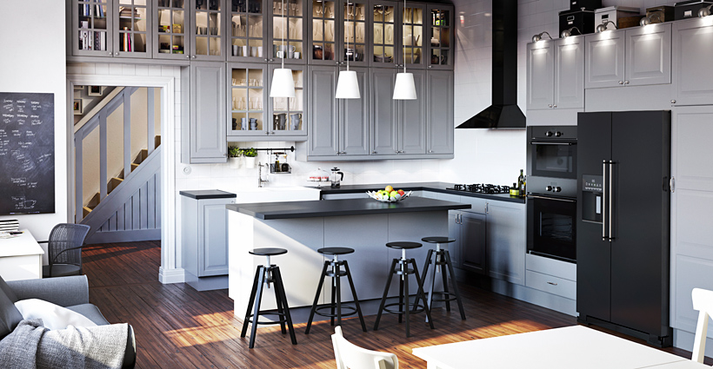
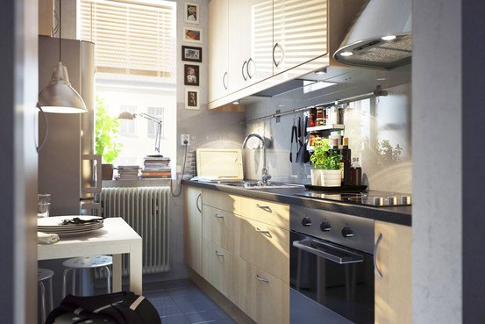
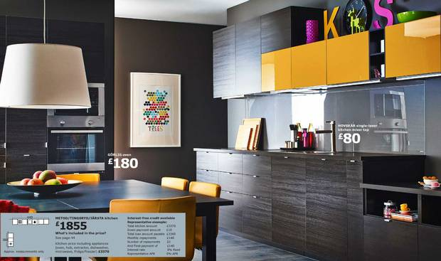
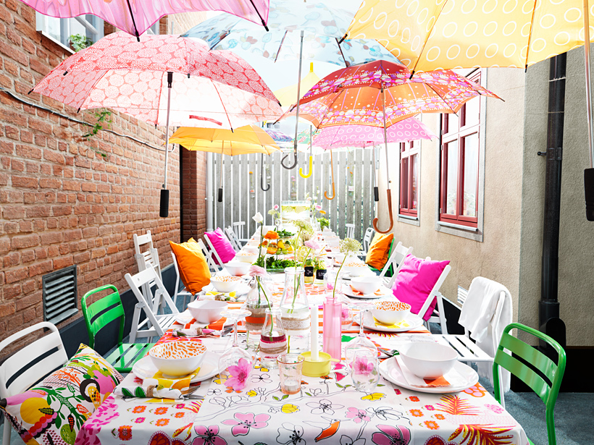

Motivation
Notes:
In this talk, I will talk about our work on creating 2D catalog images by optimizing 3D virtual scenes.
First, I show you 6 catalog images from IKEA catalog. These images are from catalogs of different years, and they are describing different rooms. However, one thing that these images have in common is that they are all rendered from 3D virtual scenes. Since 2010, IKEA started to create and render 3D virtual scenes to produce catalog images, instead of photographing physical objects and scenes.

Slide 3
Motivation
35% of scenes in IKEA catalogue are CGI.
Notes:
In 2014, 35% of the scenes in IKEA catalog are created from virtual scenes, and we expect more catalog images will be created in this way in the future.

Slide 4
Advantages
Much less expensive
Much easier for customization
Notes:
Compared to photographing physical scenes and objects, rendering 3D virtual scenes has many advantages.

Slide 5
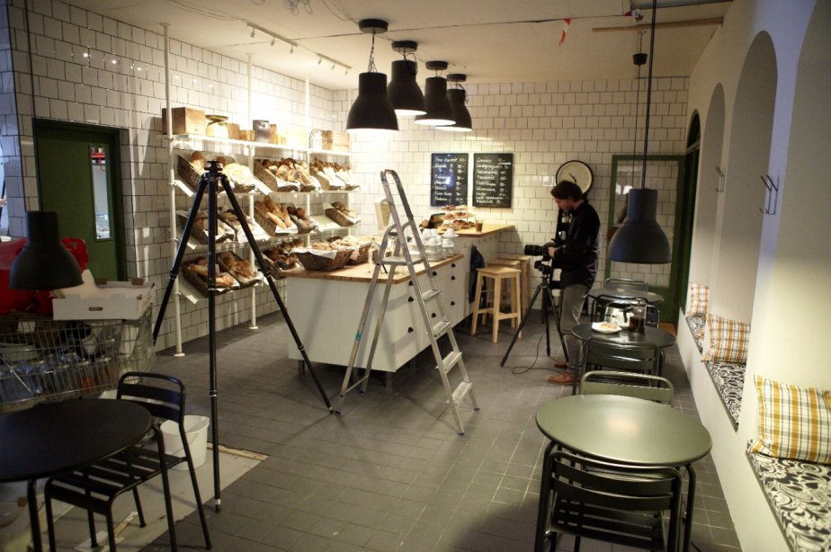
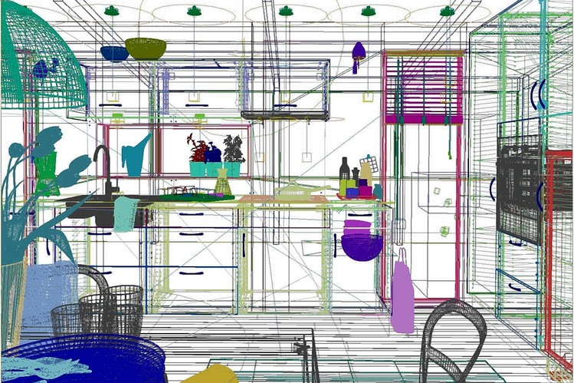

Advantages
Much less expensive
Much easier for customization
Notes:
First, rendering virtual 3D scenes is much less expensive than photographing real scenes, as it does not require building physical sets in large photo studios..

Slide 6
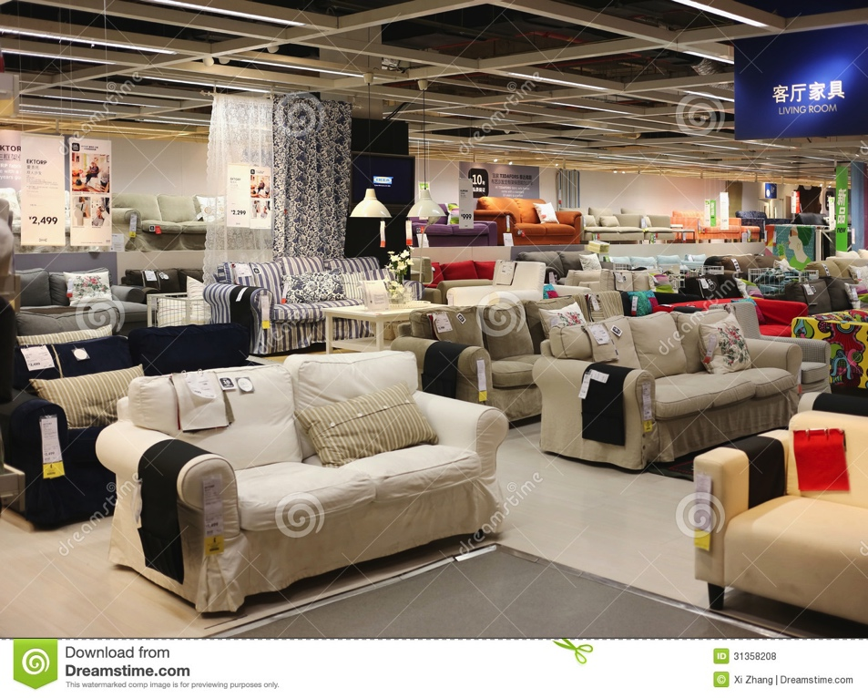
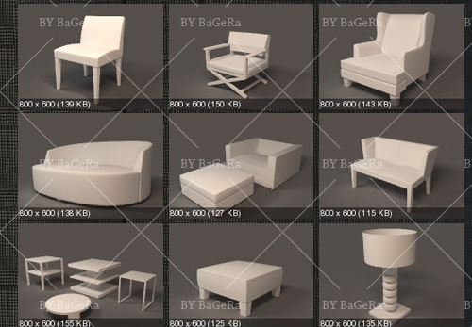
Advantages
Much less expensive
Much easier for customization
Notes:
Or storing physical objects in large warehouses.

Slide 7

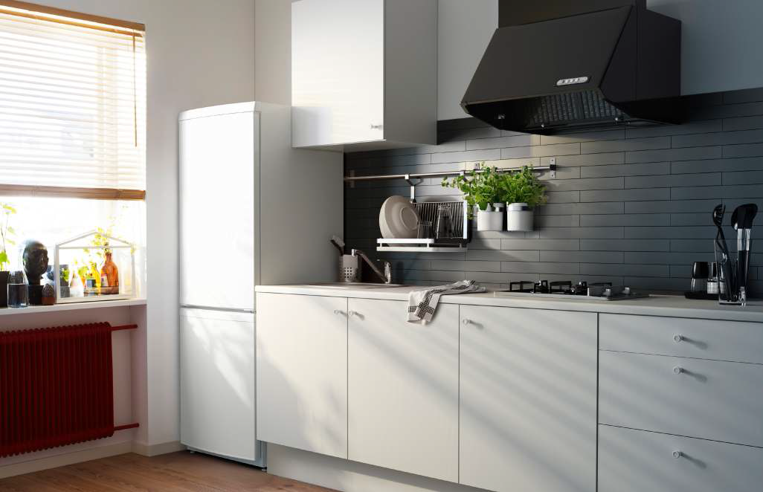

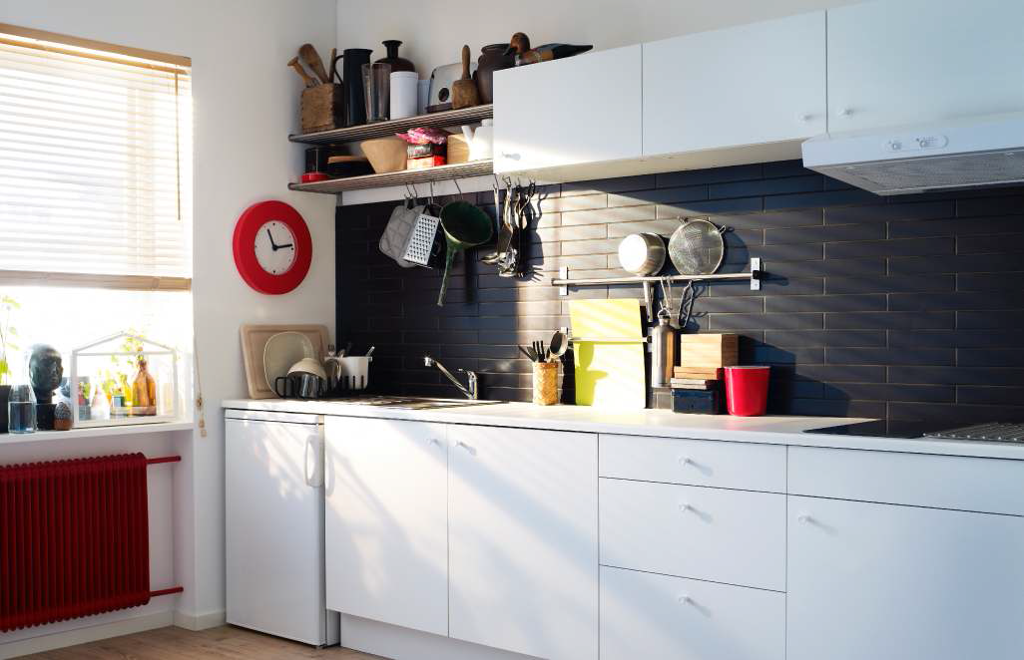
Advantages
Much less expensive
Much easier for customization
Notes:
Second, digital assets make it easier to customize catalog images in a variety of ways. In 2014, IKEA made 62 variants for its catalogue for 43 countries, and the artists usually customize scene layouts to match cultural preferences.
(click)
For example, in this kitchen, the cabinet in the Japanese version is replaced by shelves in the British version, while the range hood is replaced by cabinets. Performing object replacement in a virtual scene is much easier than doing it in a physical scene.

Slide 8
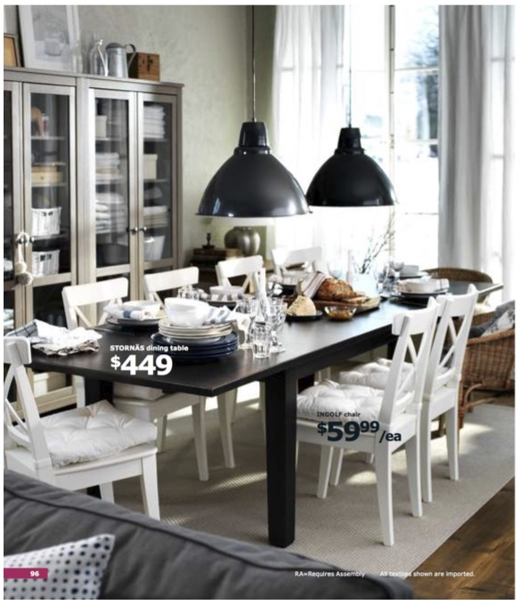
Artist’s goal
Notes:
In this task, the artist’s goal is to create an appealing product image like this.

Slide 9
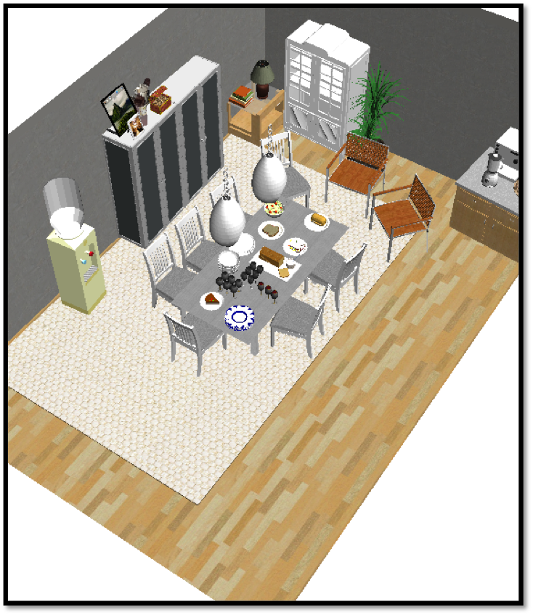
Artist’s goal
Input: a rough scene, objects to highlight, and an initial camera view
Rough layout
Notes:
The artist first creates an approximate scene layout with the appropriate objects in roughly the desired configuration. In this example, the artist creates an approximate layout for a dining room, including dining chairs, dining table, ceiling lamps, and arrange them in a plausible manner.

Slide 10
Artist’s goal
Input: a rough scene, objects to highlight, and an initial camera view
Highlight this chair and this table
Notes:
The artist also specifies two highlighted items, which are the dining table and the dining chair pointed by the red arrows.

Slide 11
Artist’s goal
Input: a rough scene, objects to highlight, and an initial camera view
Camera view
Notes:
The artist may also specify an initial camera view.

Slide 12
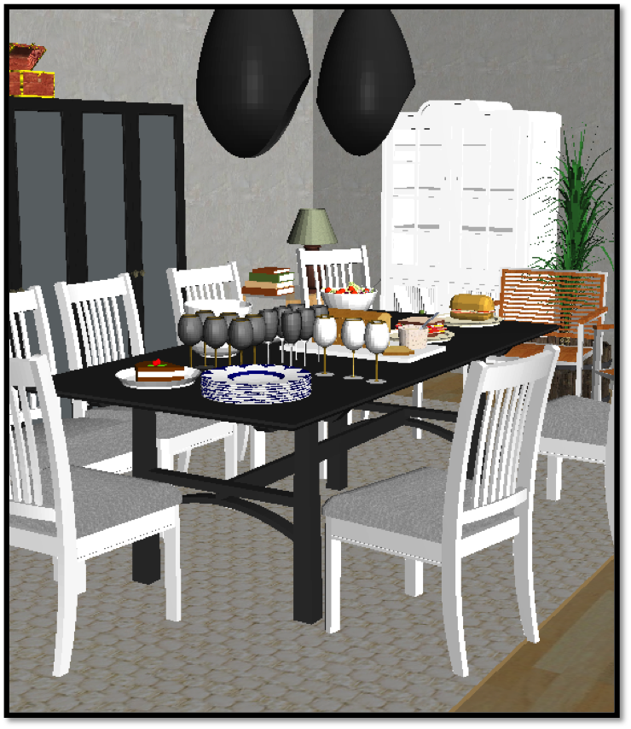
Artist’s goal
Output: a scene with optimized object placement, materials and camera view that produce an appealing 2D composition.
Notes:
Then, based on the input, the artist’s goal is to compose an image of the scene that highlights the prescribed objects of interest by carefully refining the positions, orientations and materials of objects as well as the camera viewpoint.

Slide 13
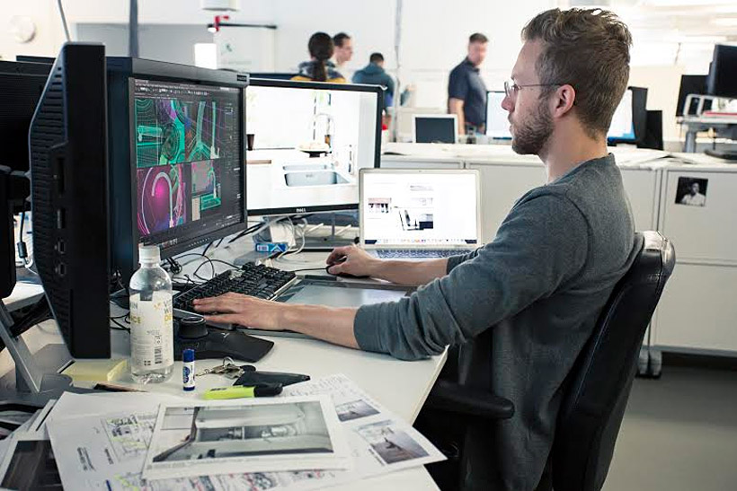
Challenges
Huge search space to explore
Many principles/constraints to balance
Requiring repeating work for customization
Notes:
So far, this refinement step is performed purely manually, which is challenging and tedious due to the following reasons,

Slide 14
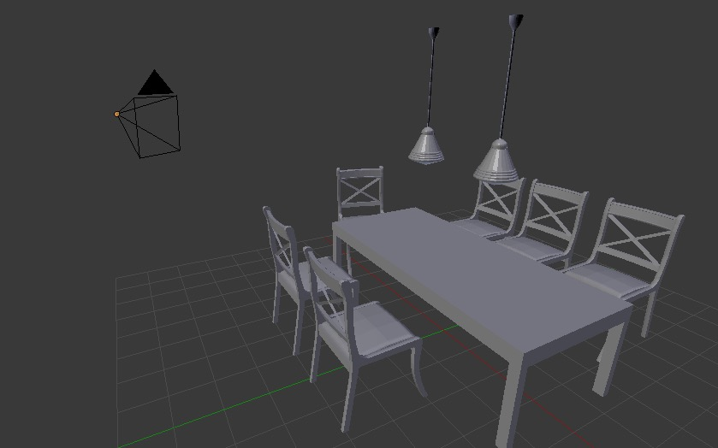
Challenges
Huge search space to explore
Many principles/constraints to balance
Requiring repeating work for customization
4*N + 6 parameters
3 DOF per object
1 material per object
6 DOF for camera
Notes:
First, the search space is large. If there are N objects in the scene and we assume each object stays upon its supporting surface, each object has 3 degree of freedom, which means two for translation and one for rotation, and the camera has 6 degree of freedom, then there are 4*N+6 parameters in total, which is too many for an artist to optimize efficiently.

Slide 15
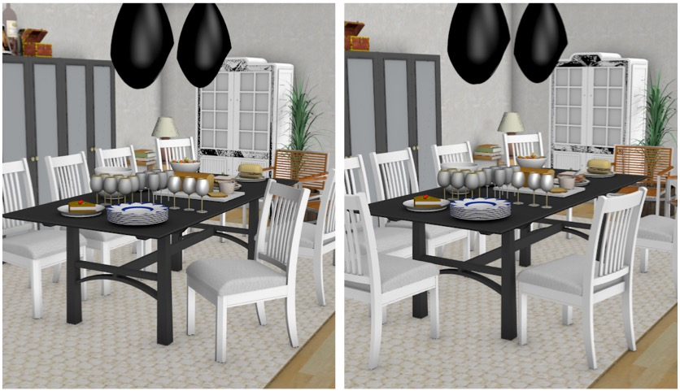
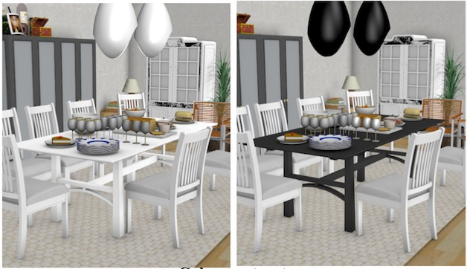
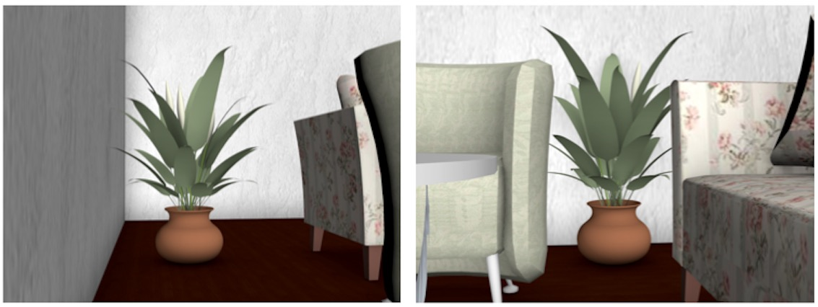
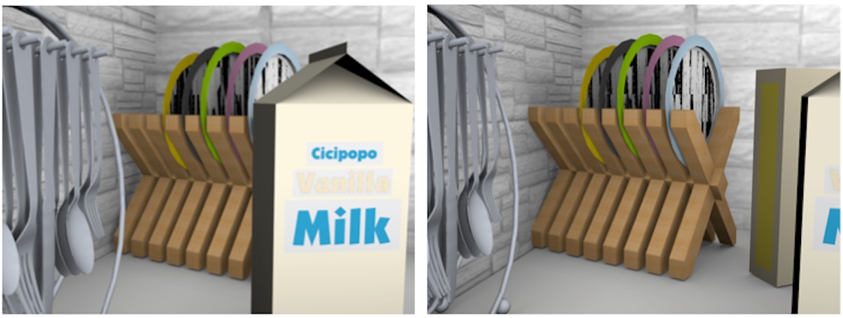
Challenges
Huge search space to explore
Many principles/constraints to balance
Requiring repeating work for customization
…
Notes:
Second, to generate aesthetically appealing compositions, the artist usually has to balance many principles and constraints
(click)
For instance, visual balance needs to be maintained,
(click)
highlighted objects must not be severely occluded
(click)
the arrangement of objects has to be plausible in 3D and
(click)
color contrast must also be considered.

Slide 16

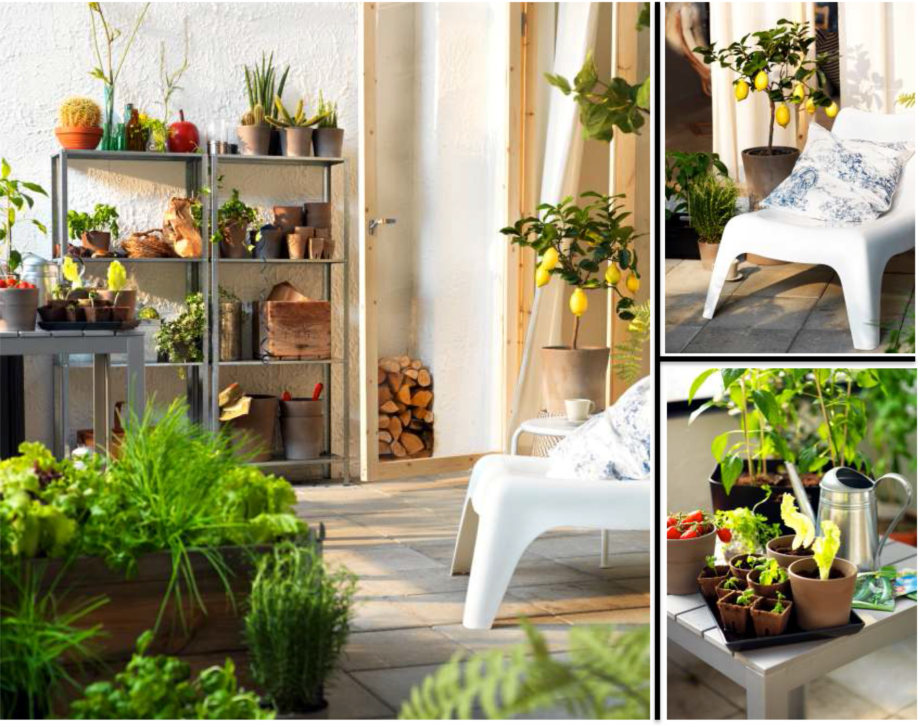

Challenges
Huge search space to explore
Many principles/constraints to balance
Requiring repeating work for customization
Notes:
1. Third, although the artist is working on 3D virtual scenes now, it is still tedious to perform customization.
2. For example,
(Click)
the artist sometimes customizes the scene layout for different countries to match cultural preferences.
(Click)
The artist may also produces multiple compositions from a single 3D scene to highlight different objects each time.
(Click)
He may also want to produce compositions in different aspect ratios for different displays.
As a result, artists often spend multiple days refining the initial rough scene layouts to produce all necessary compositions.

Slide 17
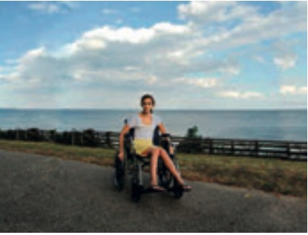
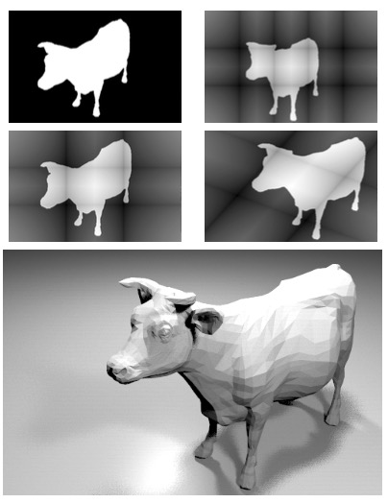
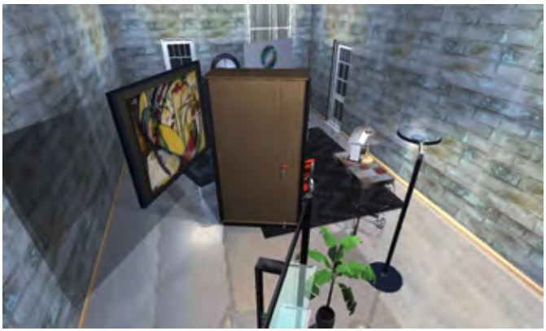
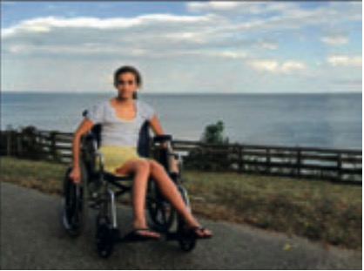
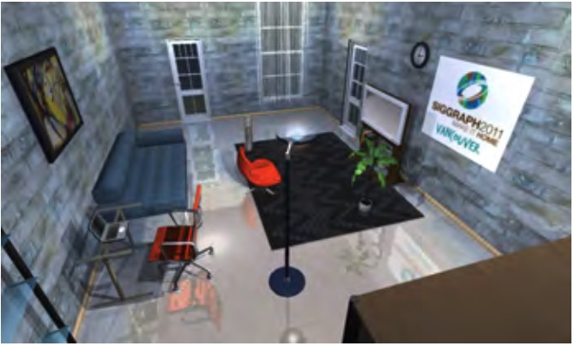
Previous Work
Image optimization
[Liu et al. 2010]
Camera optimization
[Gooch et al. 2001]
Scene optimization
[Yu et al. 2011]
Notes:
Previously, researchers proposed methods to optimize the quality of composition automatically by cropping images or optimizing camera viewpoint. However, this is not sufficient if the image includes many items, which is common for 3D virtual scenes.
(click to show)
Methods have also been proposed to automatically arrange objects in 3D. However, they do not aim to produce an appealing 2D composition.

Slide 18
Key Idea
: position of object i on its supporting surface
Notes:
Our idea is to optimize
Object positions

Slide 19
Key Idea
: position of object i on its supporting surface
: orientation of object i
Notes:
Object orientations

Slide 20
Key Idea
: position of object i on its supporting surface
: orientation of object i
: material of object i
Notes:
Object materials

Slide 21
Key Idea
: position of object i on its supporting surface
: orientation of object i
: material of object i
: camera parameters
Notes:
And camera parameters

Slide 22
Key Idea
: position of object i on its supporting surface
: orientation of object i
: material of object i
: camera parameters
: terms for composition rules
Notes:
in order to minimize an objective function that accounts for image composition, aesthetic principles and object focus, while maintaining 3D spatial constraints and 2D image space layout constraints.

Slide 23
Key Idea
: position of object i on its supporting surface
: orientation of object i
: material of object i
Never been considered before
: camera parameters
: terms for composition rules
Notes:
Note that no previous work has considered to optimize the positions, orientations, and materials of objects in order to improve 2D composition, and we are the first. Later, I will show you these newly added degrees of freedom are critical to produce good compositions.

Slide 24
Overview
Composition rules and constraints
Optimization
Applications
Notes:
First, I will go through the composition rules and constraints that we consider in our work. I will just give a brief explanation of why each is important. Mathematical details of how each one is encoded can be found in our paper.

Slide 25
Terms for composition rules and constraints
Object placement within 2D frame
Object saliency within the 2D frame
Image composition
Camera placement
Object constraints within the 3D scene
Regularization
Notes:
We interviewed professionals responsible for creating scenes for popular product catalogs, and worked with them to identify a set of principles important for product image compositions. The professionals identified 13 different factors, and we group them to form 6 terms in our energy function.

Slide 26
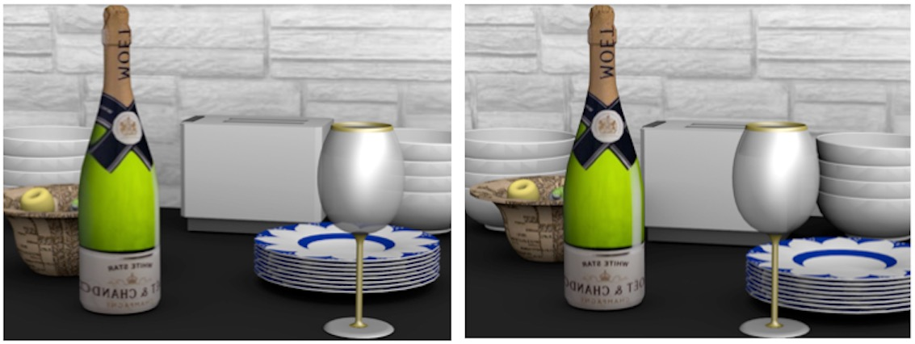
Term 1: Object placement within 2D frame
Rule of thirds
Centeredness
Clearance
Notes:
How objects are positioned in the 2D composition is important for image quality.
In general, focus objects should align with vertical or horizontal lines that divide the viewport into thirds.

Slide 27
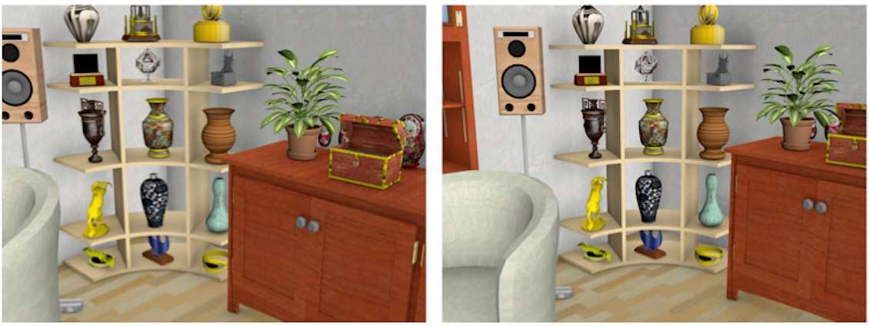
Term 1: Object placement within 2D frame
Rule of thirds
Centeredness
Clearance
Notes:
For some product images, particularly, the ones with zoomed views of single objects, focus objects should appear near the center of the image.

Slide 28
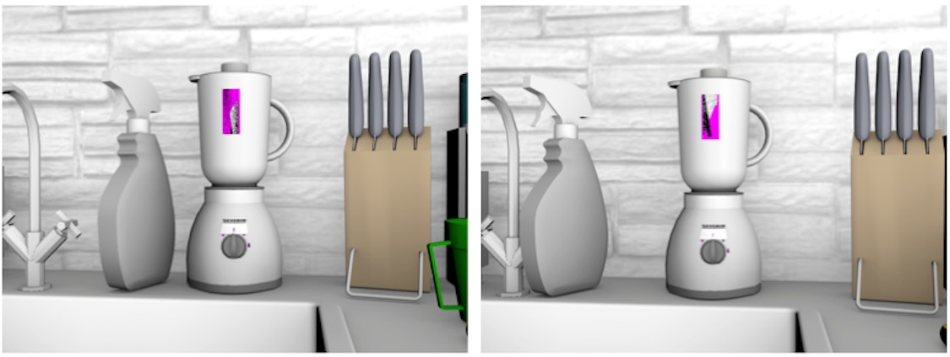
Term 1: Object placement within 2D frame
Rule of thirds
Centeredness
Clearance
Notes:
Since other objects should not compete with the focus objects in the composition, we introduce a term to penalize objects that are close to focus objects.

Slide 29
Term 2: Object saliency within the 2D frame
Visibility
Object size
Notes:
The visibility and the size of objects in the image space also contribute to their perceived importance. Specifically, an object is perceived as less important if it is partially occluded by another objects or partially clipped by the frame. Therefore, focus objects should be more visible than others.

Slide 30
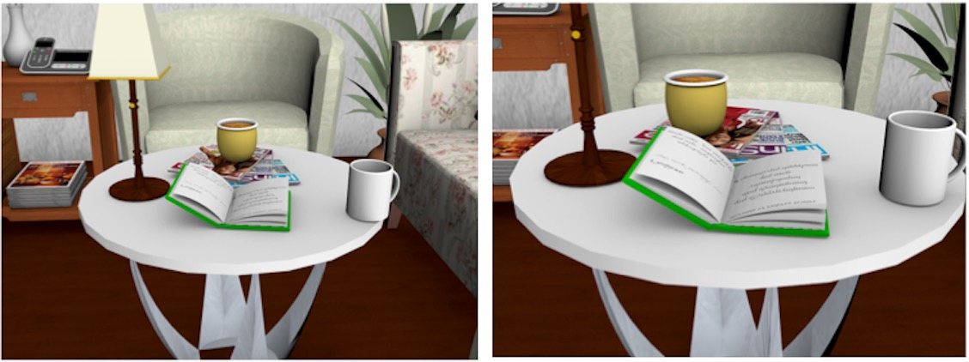
Term 2: Object saliency within the 2D frame
Visibility
Object size
Notes:
Similarly, because larger objects are perceived as more important, focus objects should take up more image space than others.

Slide 31
Term 3: Image composition
Visual balance
Color contrast
Notes:
We also include two well-established composition guidelines for creating aesthetically pleasing images. First is visual balance, which means people in general prefer the center of mass of the image to be close to the center of the image frame.

Slide 32
Term 3: Image composition
Visual balance
Color contrast
Notes:
Second is color contrast. Greater color contrast at object contours can help people understand boundaries between shapes in a scene.

Slide 33
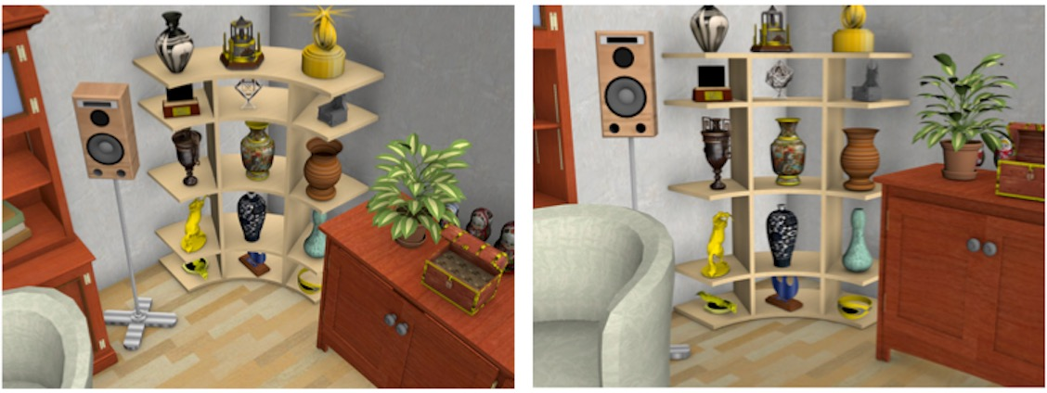
Term 4: Camera placement
Canonical views
Typical views
Notes:
We also impose constraints on camera placement in order to generate images that depict scenes from viewpoints that are natural for people. We consider two typical scenarios. If there is only one highlighted object, artists favor canonical views of the object class.

Slide 34
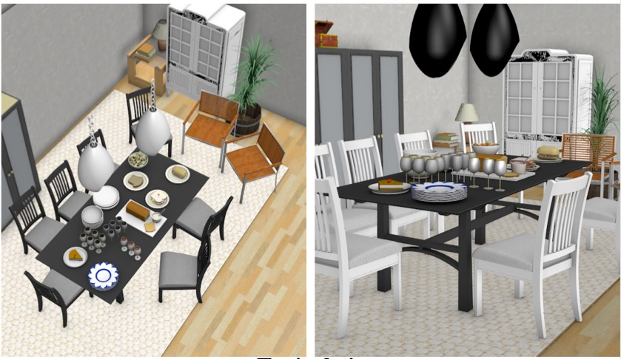
Term 4: Camera placement
Canonical views
Typical views
Notes:
If the image depicts a large scene with multiple focus objects, artists often use camera viewpoints that match how a human would typically see the scene.

Slide 35
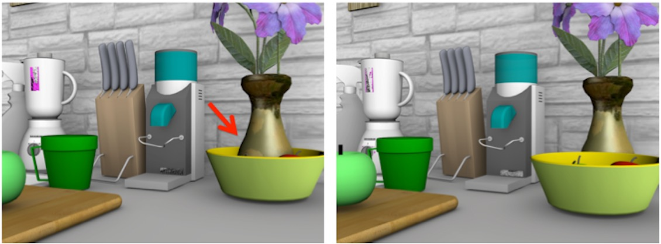
Term 5: Object constraints within the 3D scene
Collision relationships
Support relationships
Semantic constraints
Notes:
Object relations in 3D are also critical to ensure the scene plausibility. Avoiding collision and respecting support relationships are important for physical plausibility.

Slide 36
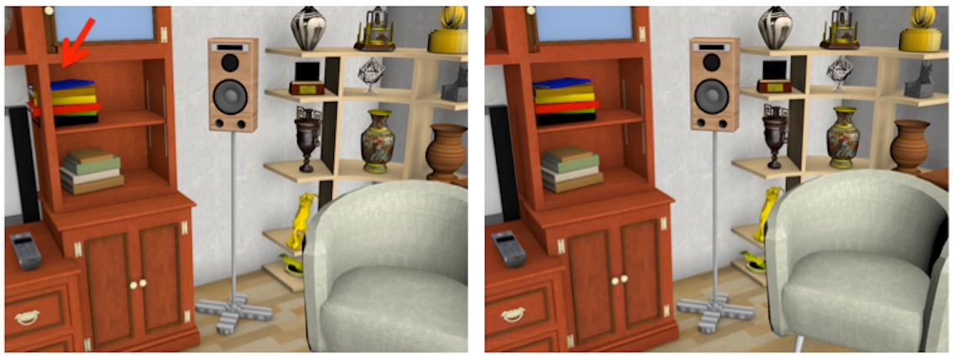
Term 5: Object constraints within the 3D scene
Collision relationships
Support relationships
Semantic constraints
Notes:
In this slide, note how the plausibility of the composition is harmed if we don’t consider support relationship between the cabinet and the books in the energy term.

Slide 37
Term 5: Object constraints within the 3D scene
Collision relationships
Support relationships
Semantic constraints
Notes:
Other semantic spatial constraints should be also satisfied during the optimization. For example, note how the plausibility of the spatial relation between the dining chair in the front and the dining table is important for the quality of the composition.

Slide 38
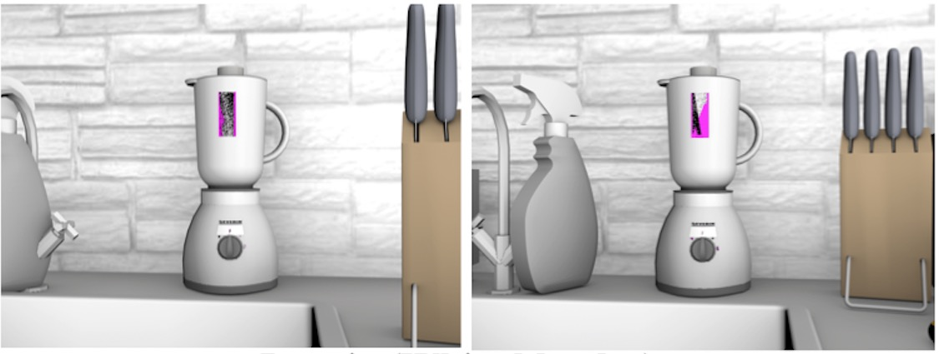
Term 6: Regularization
Notes:
We finally apply a regularization term that encourages small changes to the scene with respect to the initial configuration provided by the artist.

Slide 39
Overview
Composition rules and constraints
Optimization
Applications
Notes:
Now, let me describe how we optimize the energy function.

Slide 40
Energy function
Continuous variables
Discrete variables
Notes:
In our optimization problem, we have continuous variables, including camera parameters, object positions and orientations.
(click)
We also have discrete variables, which are the selected material of each object.

Slide 41
Optimization
Continuous optimization – camera view and object placement
Discrete optimization – materials
Notes:
We therefore alternate between a continuous optimization and a discrete optimization
The continuous optimization accounts for optimizing camera view and object placement, while the discrete optimization accounts for materials.
In the continuous optimization, we use stochastic gradient descent and line search.
The discrete optimization only affects color contrast term, and we iteratively optimize for each object.

Slide 42
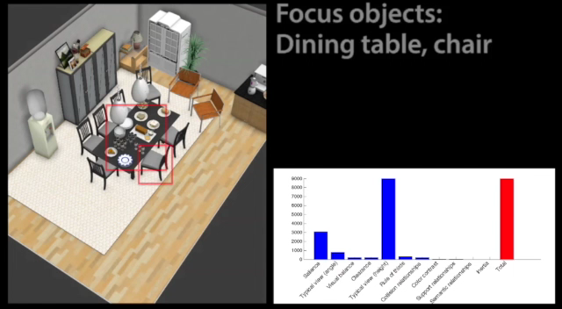
Example 1
Notes:
I use an example to show your how the optimization works. As input, the artist specifies the desired aspect ratio, a rough scene layout, the focus objects and an initial camera view. I use blue bars on the right to show the value of each term in the energy function, and the red bar for the total energy at each frame. In the optimization, the object positions, orientations, camera viewpoints, and materials are updated in order to minimize the energy of the scene.

Slide 43
Overview
Composition rules and constraints
Optimization
Applications

Slide 44
Applications
Refining rough compositions
Retargeting for different aspect ratios
Retargeting for different cultural preferences
Text-incorporated composition
Generating detail images from an overview
Notes:
Now, I will talk about 5 applications that are enabled by our scene optimization technique.

Slide 45
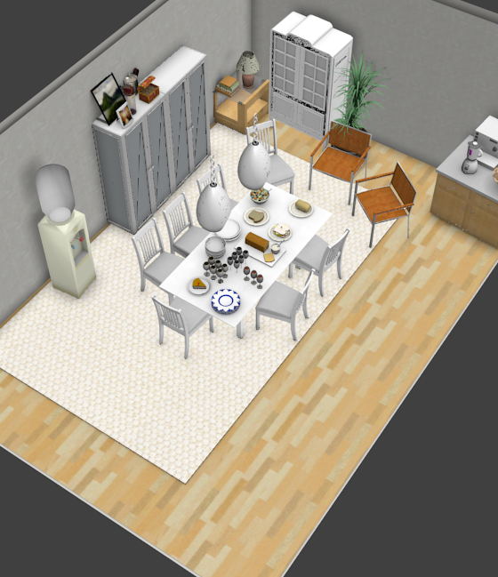
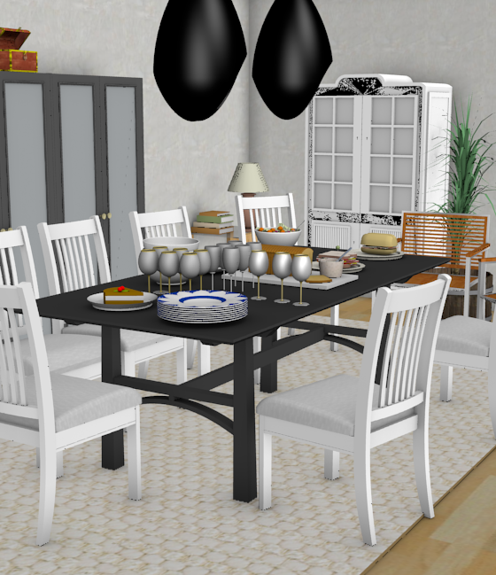
Application 1: Refining rough compositions
Rough composition
Optimized composition
Notes:
The primary application of our system is to facilitate the refinement stage of catalog image creation. Given a rough scene configuration and a set of highlighted objects, we achieve a nice 2D composition by automatically adjusting viewpoint, object placement and materials.

Slide 46
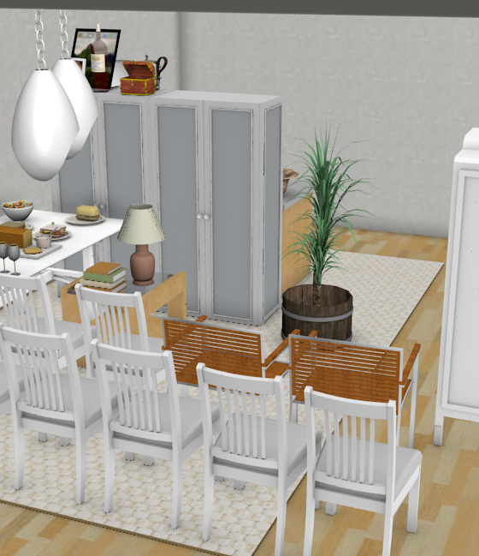
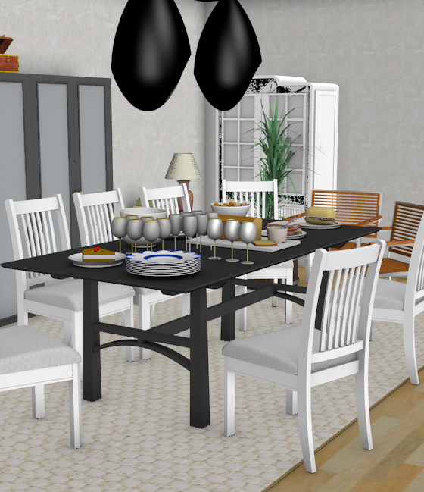
Application 1: Refining rough compositions
User study
Notes:
To evaluate whether our system can assist this application, we ran an informal experiment.
We asked a user to go through the full process of creating and refining a scene for a product image using an interactive modeling tool.
We instructed the user to create a 3D scene motivated by an image highlighting a dining table and chair in the IKEA catalog.

Slide 47
Application 1: Refining rough compositions
User study
Reference
Notes:
which she could refer to as she modeled.

Slide 48
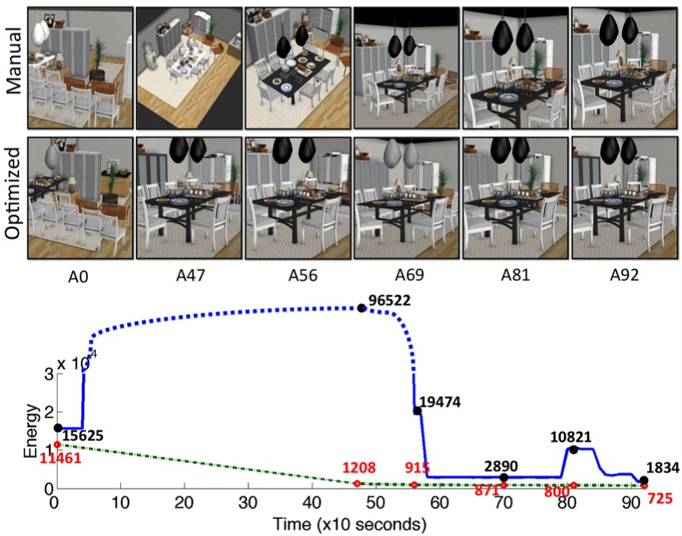
Application 1: Refining rough compositions
Notes:
During the interactive session, we logged ‘snapshot’ scene files to represent the user’s progress. We show several examples in the top row.
After the session was finished, we used the snapshot scenes to do two things. (1) to analyze whether our energy function explains changes made interactively by the user. (2) to study at which point in the modeling process our optimization could have been used to assist the user by refining the scene automatically.

Slide 49
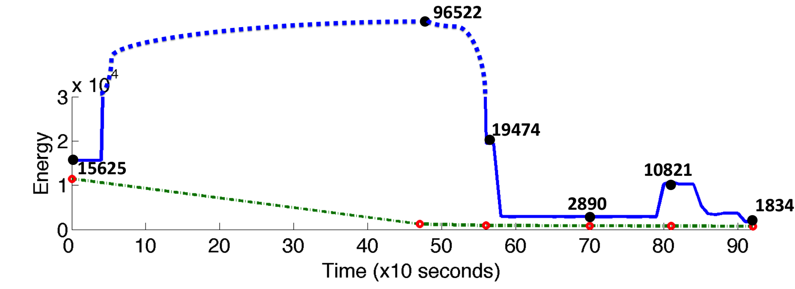
Application 1: Refining rough compositions
Notes:
We use the blue curve to represent the value of our energy function for each snapshot of the user’s interactive session.

Slide 50
Application 1: Refining rough compositions
Notes:
To study how our optimization could have helped, we run our optimization on each of the snapshot scenes shown in the top row. The optimized scenes are in the second row, and we plot the energy function values of the optimized scene in red dots.
The curves clearly reveal two phases.

Slide 51
Application 1: Refining rough compositions
Large-scale layout
Refinement
Notes:
A period of ‘large-scale layout’ when the scene energy goes up and down, on the left
(click)
Followed by a period of ‘fine-scale refinements’, where the energy decreases almost steadily.
First, it indicates that the energy function correctly captures images quality differences of improvements made by the user.

Slide 52
Application 1: Refining rough compositions
(Could have been off-loaded to the computer)
Large-scale layout
Refinement
Notes:
Second, note how the optimized scenes after A47 are qualitatively similar to the final scene created by the user,
(click)
which suggests that the time the user spent on scene refinement could have been off-loaded to the computer.

Slide 53
Application 2: Retargeting for different aspect ratios
?
Notes:
Our system can also automatically retarget catalog images to aspect ratios that are appropriate for different display formats.

Slide 54
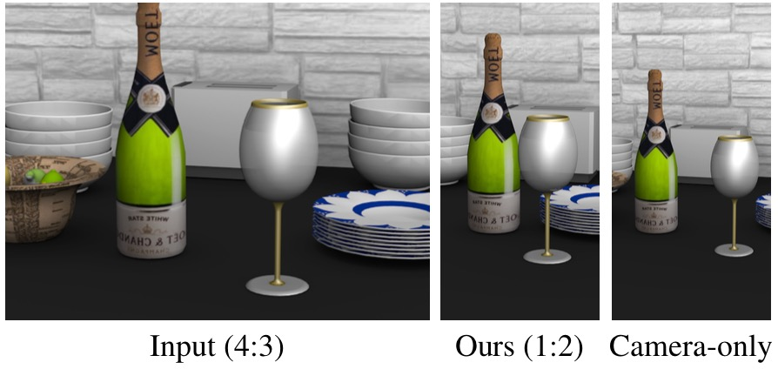
Application 2: Retargeting for different aspect ratios
Notes:
Simple cropping or zoom-in view is usually not sufficient because the relative arrangement of objects in image space remains fixed.

Slide 55
Application 2: Retargeting for different aspect ratios
Notes:
Our optimization has the ability to adjust object placement as well as camera parameters to produce good compositions for different aspect ratios.

Slide 56
App 3: Retargeting for different cultural preferences
Notes:
Our method can also perform retargeting for object replacement. Multinational furniture companies like IKEA usually customize their catalog images for different countries to match cultural preferences. This customization often involves choosing different materials or replacing objects within a scene

Slide 57
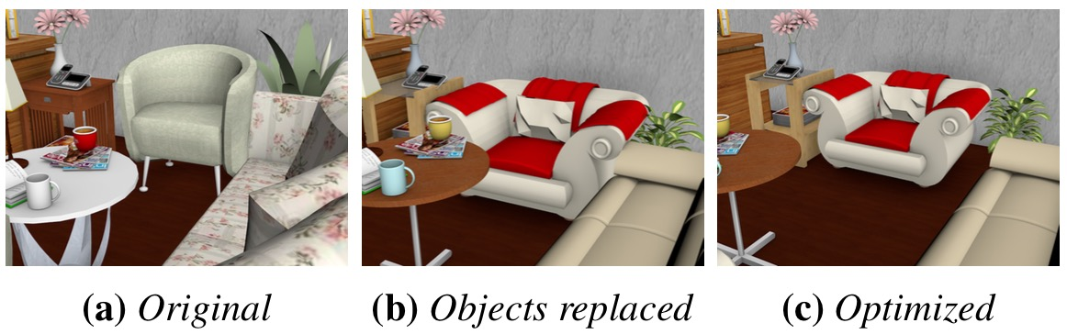
App 3: Retargeting for different cultural preferences
Notes:
In many cases, the size and shape of new objects can be significantly different form the original, which means the artist will have to spend additional effort adjusting the camera parameters and object placement to achieve a good composition for each customization. In this example, we replace the chair, side table, coffee table, plant, and couch. When we swap in the new objects, there is a collision between the chair and plant, and the composition feels cramped in general

Slide 58
App 3: Retargeting for different cultural preferences
Notes:
Our optimization framework can automatically make these adjustments to reduce the amount of human effort required to perform these cultural customizations. In this example, after we optimize the composition, the collision is resolved and the camera pulls back to keep all the relevant objects in the frame.

Slide 59
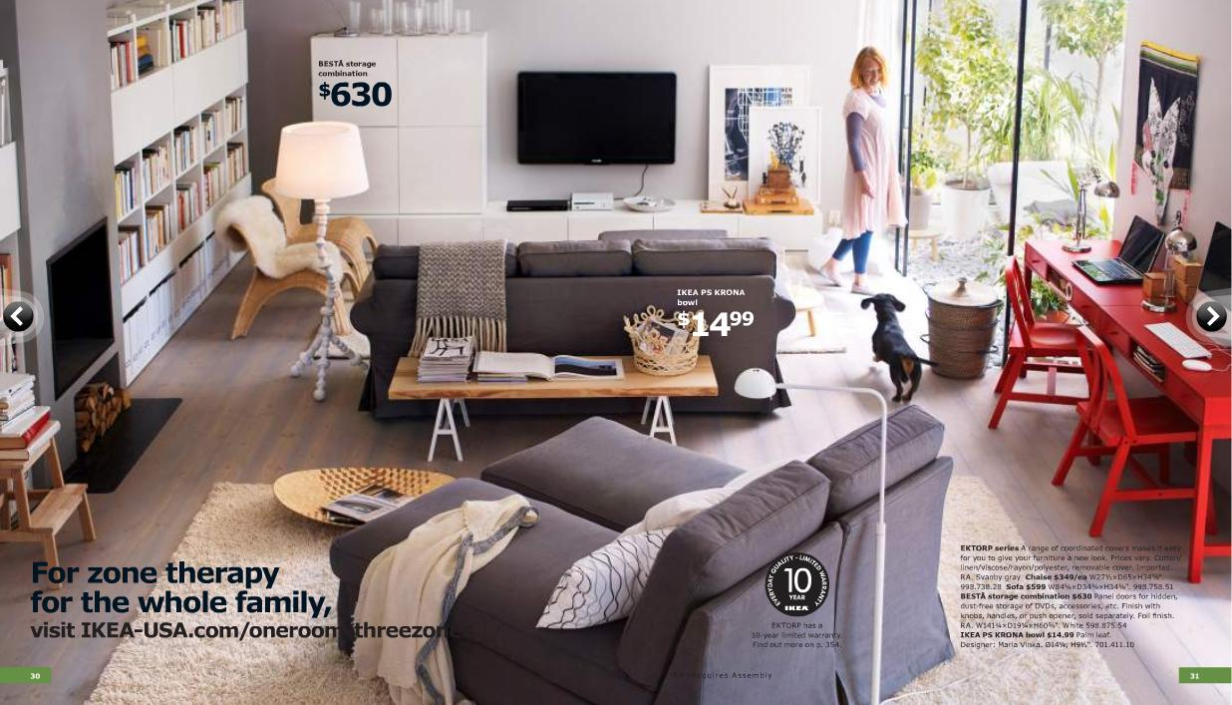
Application 4: Text-incorporated composition
Notes:
Most catalog images have text overlays that describe the depicted scene.
(click to show red boxes)
Such text is typically positioned over regions with nearly constant color so that it is easy to read and often appears in roughly the same location on every page so that the viewer knows where to look for textual information. Our optimization framework can automatically position text based on all of these criteria.

Slide 60
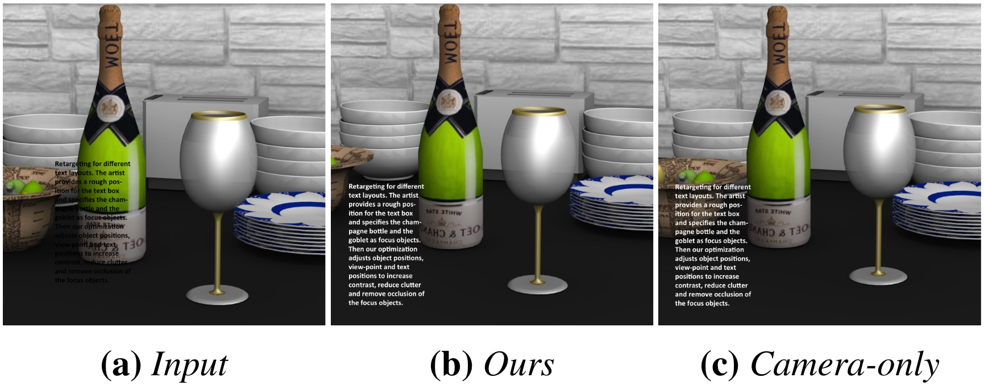
Application 4: Text-incorporated composition
Input
Notes:
In addition to a set of focus objects and an initial composition, the artist also specifies a set of rectangles where she would like overlay text to appear in the frame. Our system treats each rectangle as just another object in the scene, but one that only has a 2D position and can only move within the viewport.

Slide 61
Application 4: Text-incorporated composition
Extra terms for overlaid text
Contrast term
Input
Notes:
We introduce two extra terms to make the text with constant color stand out. First, a contrast term to keep the background light or dark, so that the text can be made a contrasting color.

Slide 62
Application 4: Text-incorporated composition
Extra terms for overlaid text
Contrast term
Variance term
Input
Notes:
Second, a variance term to keep a low variance in luminance within each rectangle to reduce clutter behind overlaid text.

Slide 63
Application 4: Text-incorporated composition
Input
Camera only
Notes:
If we only optimize the viewpoint of camera and the position of the text in the image, however, the result is usually not good enough. For example, in this case, the fruit bowl decreases the readability of the text

Slide 64
Application 4: Text-incorporated composition
Input
Camera only
Our result
Notes:
and it can only be fixed by moving objects around.

Slide 65
Application 5: Generating detail images from an overview
Notes:
The last application is to generate detail images from an overview.

Slide 66
Application 5: Generating detail images from an overview
Notes:
In many cases, catalogs provide an overview image that shows how various objects can fit together in a room, and then one or more detail images that focus on individual products of interest.
Rather than simply cropping or zooming in, the stylists typically choose different viewpoints and move objects slightly in order to highlight the object and its context.

Slide 67
Application 5: Generating detail images from an overview
Notes:
and then one or more detail images that focus on individual products of interest.
Rather than simply cropping or zooming in, the stylists typically choose different viewpoints and move objects slightly in order to highlight the object and its context.

Slide 68
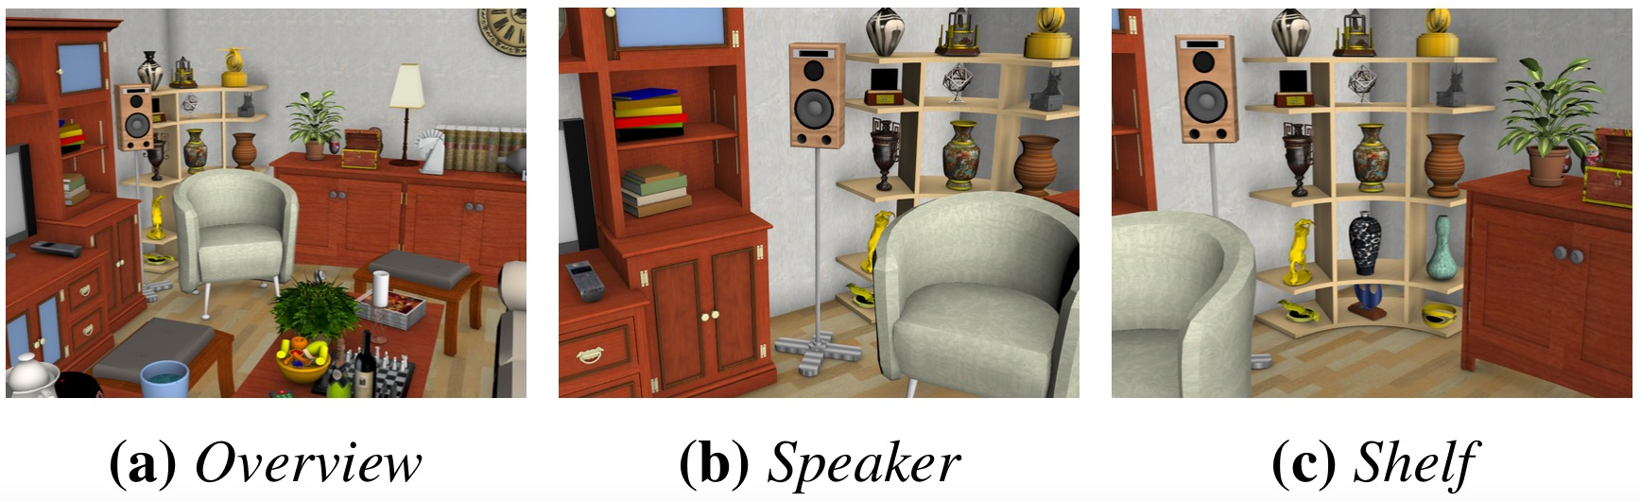
Application 5: Generating detail images from an overview
Notes:
Our system provides an automated solution to this application.
In this example, our system starts with the overview image on the left.

Slide 69
Application 5: Generating detail images from an overview
Notes:
In order to generate a detail image for the speaker, our system moves the chair to the right and also moves the speaker slightly in order to make it standout.

Slide 70
Application 5: Generating detail images from an overview
Notes:
In order to highlight the book shelf, the system moves the chair to the left to get a unobstructed view for the shelf.

Slide 71
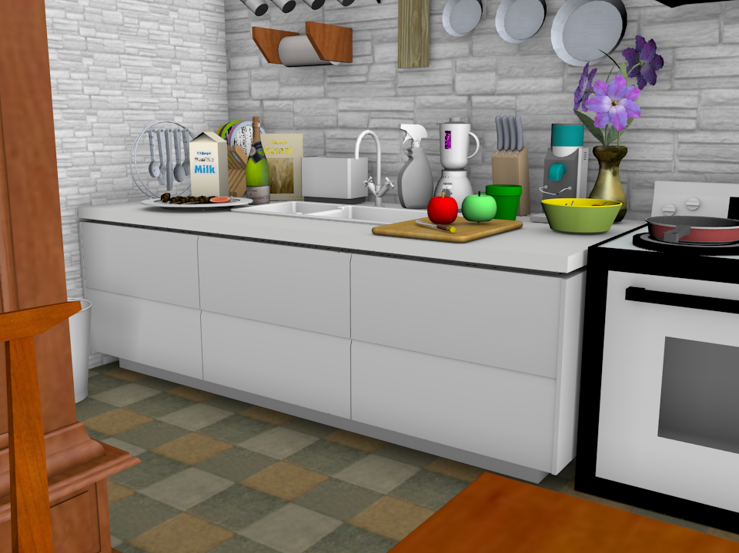
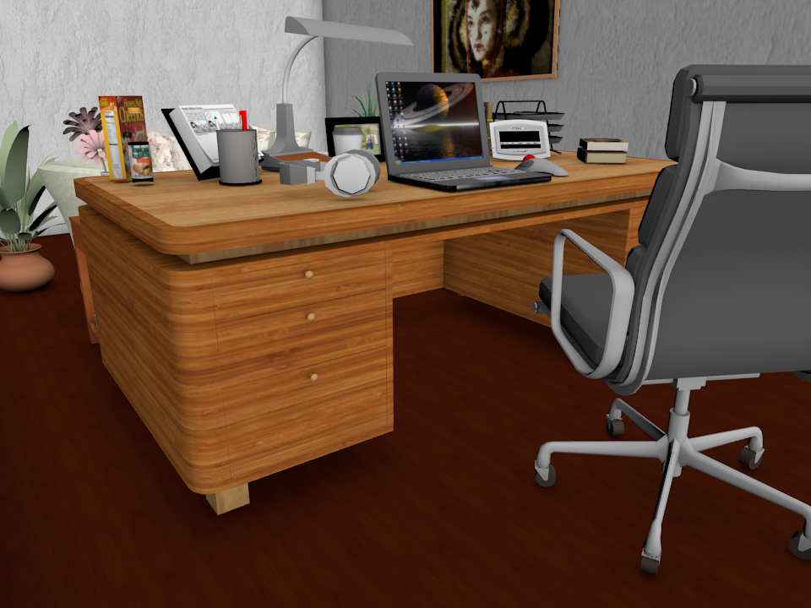
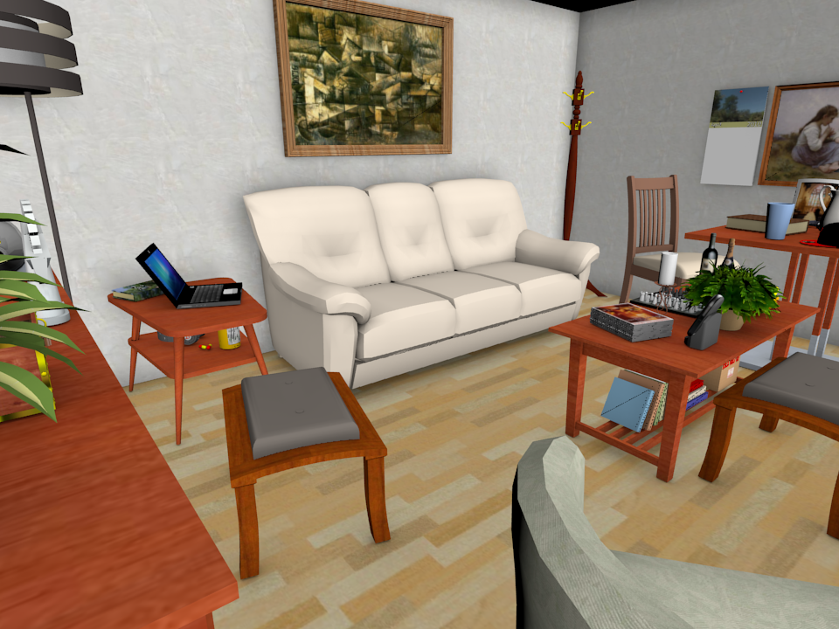
A Perceptual Study
Comparing the results of our method and optimizing camera only.
Kitchen
Study
Living room
Notes:
To better study how object movement helps create better composition, we ask people to compare 36 pairs of compositions created using our optimization procedure with object movement enabled or disabled. The 36 compositions are generated by focusing different objects in three rooms, kitchen, study and living room.

Slide 72
Expert Study Results
ID | Ours | Camera Only | No preference
Expert 1 | 22 | 12 | 2
Expert 2 | 17 | 14 | 3
Expert 3 | 22 | 11 | 3
Expert 4 | 21 | 12 | 3
Notes:
We first asked people who work professionally on scene layout for catalog images. Their response indicate that object movement does have a positive impact on the resulting composition.

Slide 73
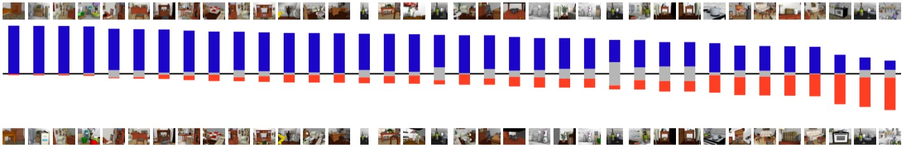
Amazon Mechanical Turk Study
Notes:
We also asked the same questions on AMT. Each column shows a result of comparison for a single case. Blue bars are the votes for our results, and the red bars are the votes for camera-only optimization, where objects are not able to move. Grey bars mean the participants don’t have preference.

Slide 74
Amazon Mechanical Turk Study
If null hypothesis is there is no preference,
Our method is preferred in 26/36 cases.
Notes:
The results show that object movement has a significant positive impact in 26/36 cases,

Slide 75
Amazon Mechanical Turk Study
If null hypothesis is there is no preference,
Our method is preferred in 26/36 cases.
No statistical significance in 8 cases.
Notes:
there is no significant difference in 8 cases,

Slide 76
Amazon Mechanical Turk Study
If null hypothesis is there is no preference,
Our method is preferred in 26/36 cases.
No statistical significance in 8 cases.
Camera only is preferred in 2 cases.
Notes:
and camera-only is preferred in 2 cases.

Slide 77
Summary
Moving objects and changing materials significantly improves the quality of compositions.
Our optimization framework benefits a variety of applications.
Notes:
To summarize our work, we found that …

Slide 78
Limitation and future work
Interactive scene optimization
Global illumination
Additional composition rules
Notes:
Our work suffers from several limitations, which indicate directions for future work.

Slide 79
Limitation and future work
Interactive scene optimization
Global illumination
Additional composition rules
Notes:
First, our current implementation does not run at interactive rates, which is largely because speed has been sacrificed for flexibility in our prototype. We believe a production-oriented implementation could likely run orders of magnitude faster. In particular, the computation of partial derivatives, which is the bottleneck of the speed of our optimization, is highly parallelizable.

Slide 80
Limitation and future work
Interactive scene optimization
Global illumination
Additional composition rules
Notes:
Second, we use OpenGL rendering during our optimization, which does not account for global illumination, which can impact the composition of the final image.

Slide 81

Limitation and future work
Interactive scene optimization
Global illumination
Additional composition rules
Symmetry
Vanishing points
Notes:
Third, additional composition rules could improve the quality of results.
(click)
For example, symmetry can improve the quality of compositions in some cases,
(click)
and vanishing points also help to emphasize the focus objects in the scene.

Slide 82
Acknowledgement
Interviews
Martin Enthed and Helen Crowther
Catalogue images
IKEA
Funding
NSF, Intel, Adobe

Slide 83
Thank you!
Take-away message
Moving objects and changing materials significantly improves the quality of compositions.
Our optimization framework benefits a variety of applications.

