Slide 1
Printing Spatially Varying Reflectance
Wojciech Matusik
Boris Ajdin
Jinwei Gu
Jason Lawrence
Hendrik P. A. Lensch
Fabio Pellacini
Szymon Rusinkiewicz
Adobe Systems, Inc. (now Disney Research)
MPI Informatik and Adobe Systems, Inc.
Columbia University and Adobe Systems, Inc.
University of Virginia
Ulm University
Dartmouth College and Adobe Systems, Inc.
Princeton University and Adobe Systems, Inc.

Slide 2
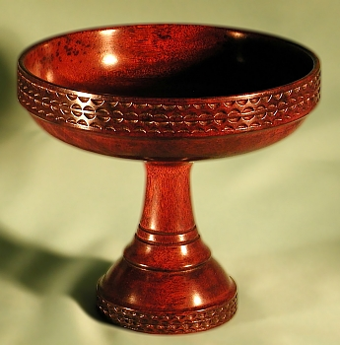
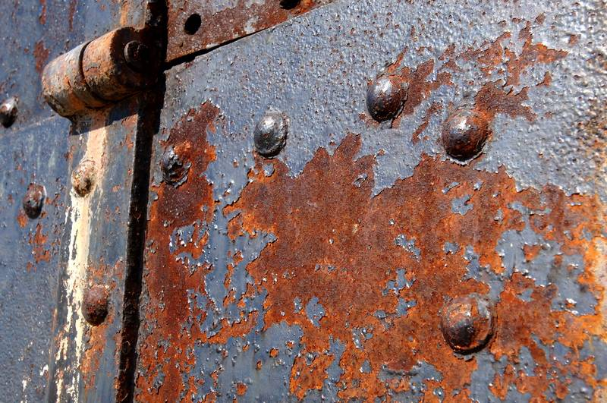
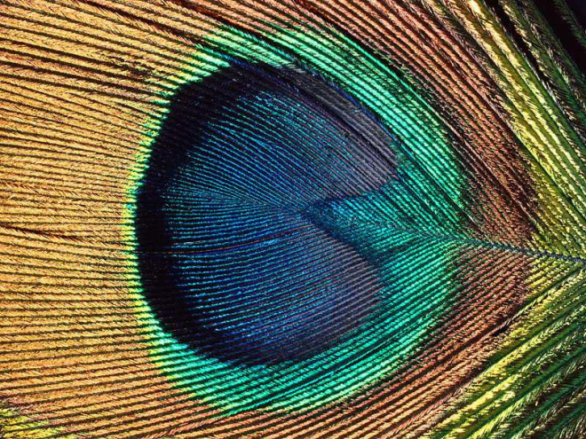
Motivation
Rich variety of materials: characterized by complex surface reflectance

Slide 3
Motivation
Ability to measure various materials
But limited ability to manipulate / edit / output
Inexpensive and flexible printers
But software only supports CMYK + spot colors

Slide 4
Goal
Document representation that supports rich variety of materials
Complete pipeline to output these materials using commodity devices

Slide 5
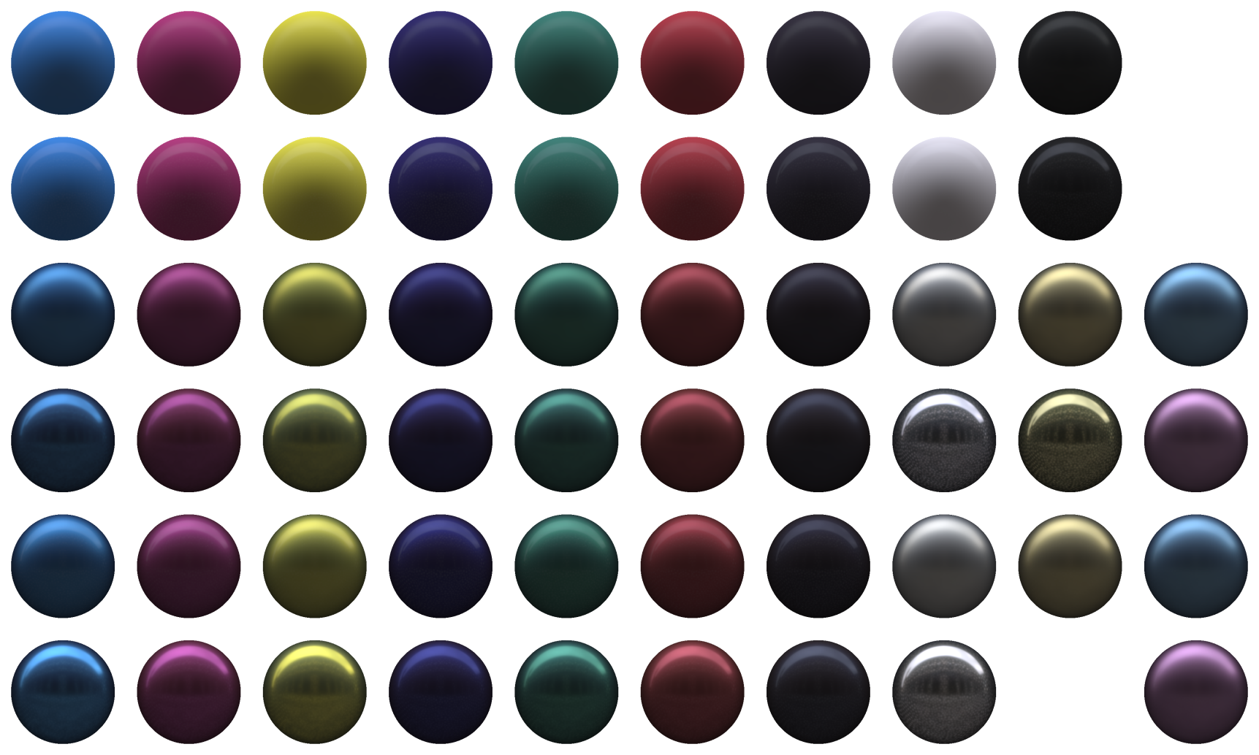
Approach
Characterize “basis inks” of printer

Slide 6
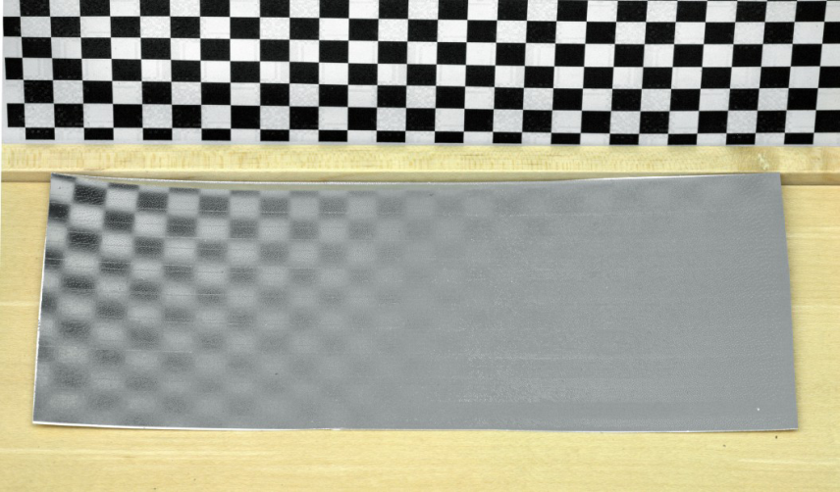
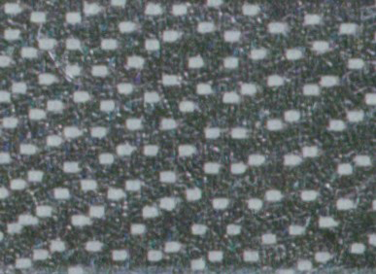
Approach
Spatial dithering for intermediate materials
Printed Ramp in Glossiness
Closeups of Halftoning Patterns

Slide 7
Pipeline
Representation
Gamut- Mapping
Halftoning
Printing

Slide 8
Representation: svBRDF
for each position:
for each direction of incident light:
for each reflected direction:
how much light is reflected?
(Formally: ratio of reflected radiance to irradiance, at each position)

Slide 9
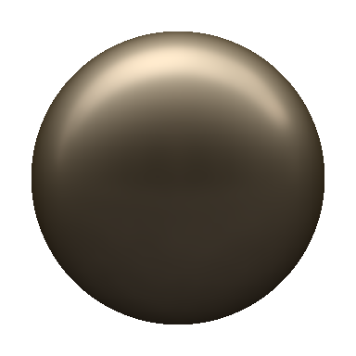
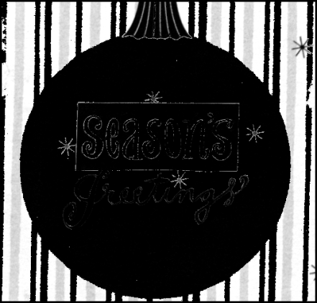
Factored Representation
Full svBRDF too big (6D function)
Decompose into basis materials and mixing maps [Cook84, Lawrence06]

Slide 10
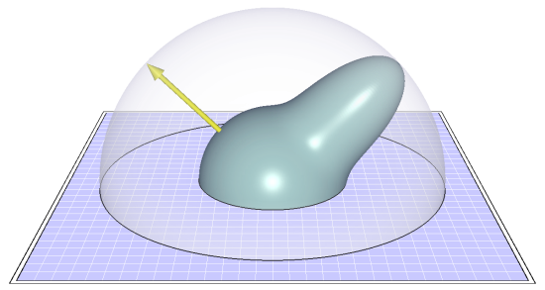
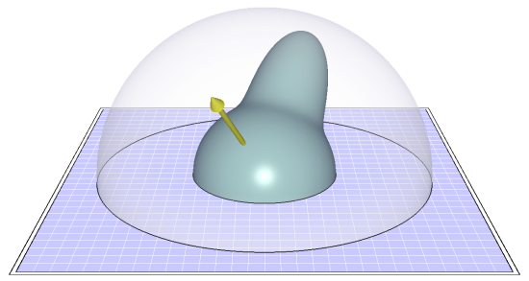
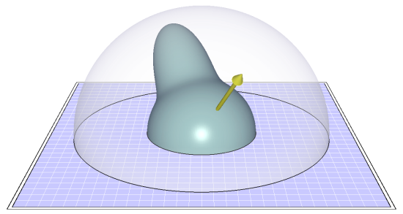
Curve-Based BRDF Representation
f_{r}(θ_{i},φ_{i},θ_{o},φ_{o} )
f_{r}(θ_{h} )

Slide 11
Pipeline
Representation
Gamut- Mapping
Halftoning
Printing

Slide 12
BRDF Gamut Mapping: Device Capabilities
Basis inks
Notes:
There is one more caveat:
Typically, you are not going to output a single appearance.
You are going to output a collection of brdfs, for example different locations on the object or document can have different appearance.

Slide 13
BRDF Gamut Mapping: Input
Desired materials

Slide 14
BRDF Gamut Mapping: Clamping (≈ Relative Colorimetric Intent)

Slide 15
BRDF Gamut Mapping: Warping (≈ Perceptual Intent)

Slide 16
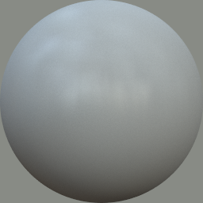
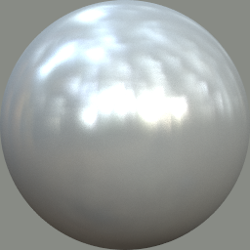
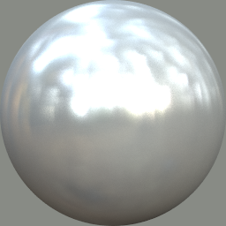
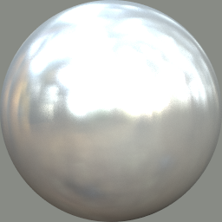
BRDF Gamut Mapping: 1D Example
Input
Device
Limitations
Clamping
Notes:
Map original BRDFs into the gamut of ink BRDFs, while trying to preserve the relative BRDF difference.

Slide 17
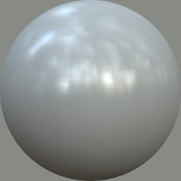
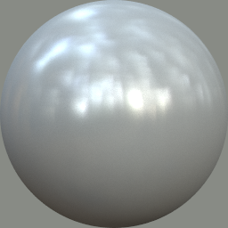
BRDF Gamut Mapping: 1D Example
Input
Device
Limitations
Clamping
Warping
Notes:
Map original BRDFs into the gamut of ink BRDFs, while trying to preserve the relative BRDF difference.

Slide 18
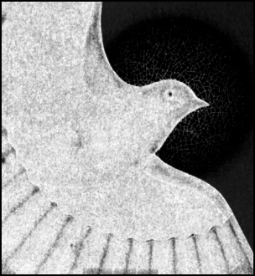
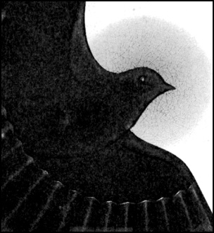
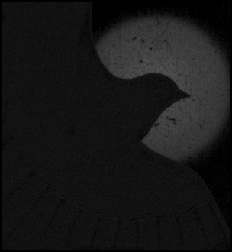
Approach
Remap basis materials, keep mixing weights
Spatial Weight Maps
Original Basis BRDFs
Mapped to Printer

Slide 19
Projection: Constrained Optimization
Desired BRDF
Basis inks
Use nonlinearly-mapped lit-sphere error metric [Ngan06]

Slide 20
Pipeline
Representation
Gamut- Mapping
Halftoning
Printing

Slide 21
Halftoning
Clustered Hilbert-curve error diffusion
Based on Velho and Gomes [1991]
Extend to multiple channels
Extend to enforce minimum “cluster” size
Result is halftoned map for each physical printer ink

Slide 22
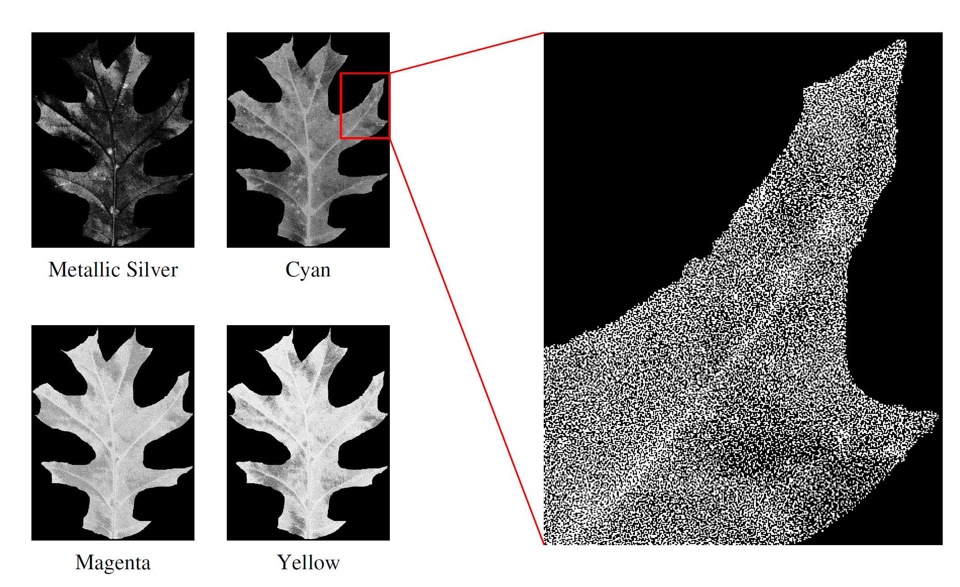
Halftoning Results

Slide 23
Pipeline
Representation
Gamut- Mapping
Halftoning
Printing

Slide 24
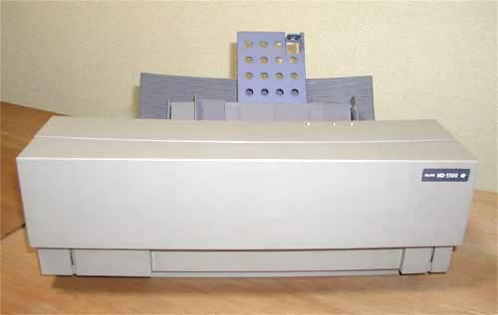
Printer
Alps MD-5500
Thermal transfer
Variety of inks:
Standard (diffuse)
Metallic
Foil
Glossy overcoat
Most can be overlaid

Slide 25
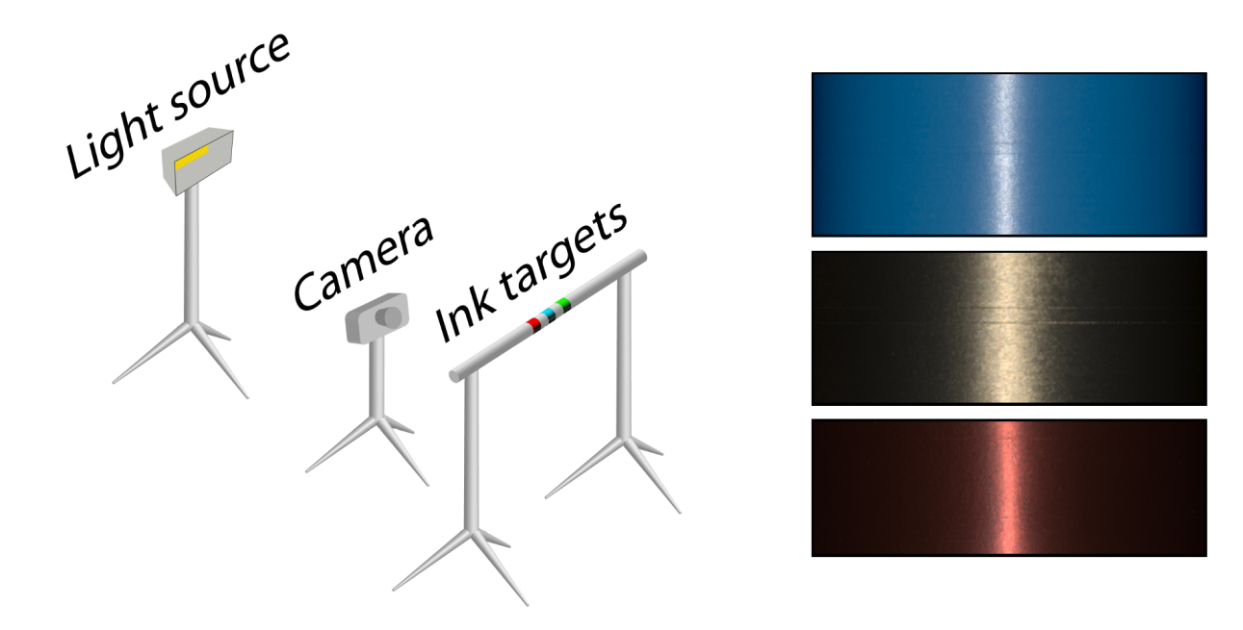
Measuring Inks
Image-based setup
One camera/light position
Samples wrapped around cylinder
Extract BRDF curves

Slide 26
Ink Measurements
57 layered combinations, ~ 10-15 used per dataset (~ 6-8 cartridges)

Slide 27
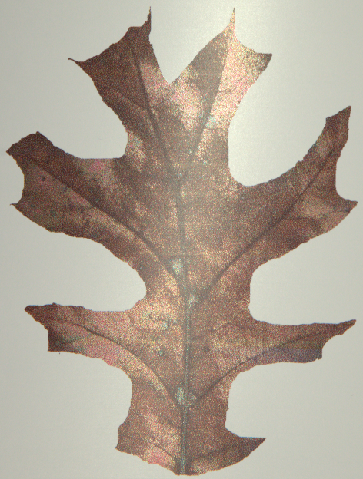
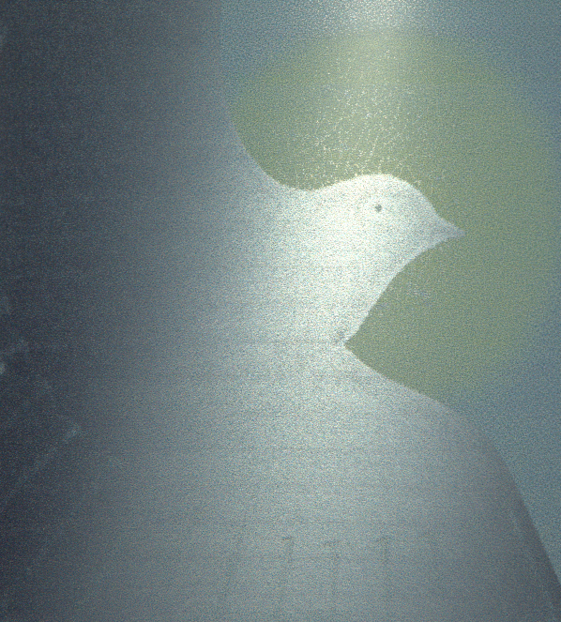
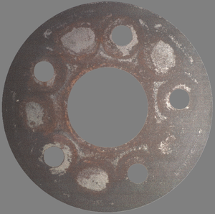
Printed Results

Slide 28
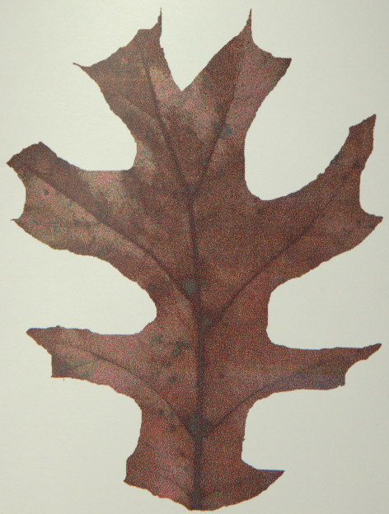
Printed Results
Preview for multiple light directions
Photos of printout

Slide 29
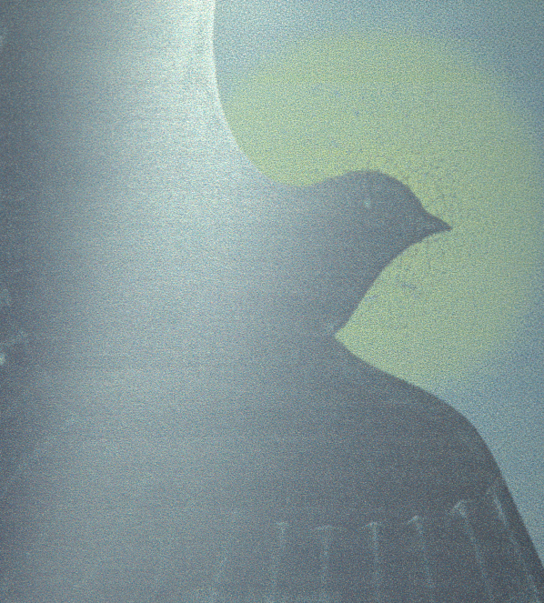
Printed Results
Preview for multiple light directions
Photos of printout

Slide 30
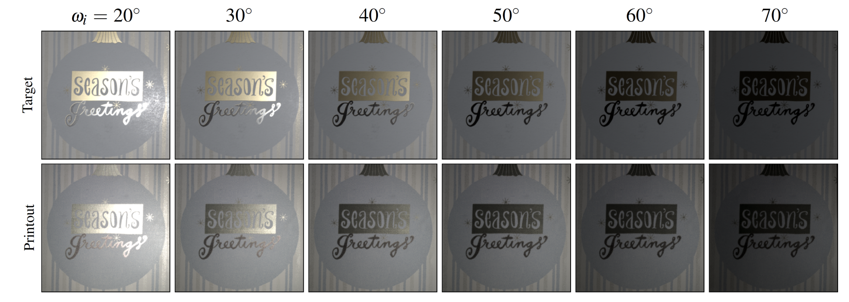
Comparisons

Slide 31
Comparisons

Slide 32
Limitations and Future Work
Materials:
Planar
Isotropic
Opaque
Methods:
Global (vs. local) gamut-mapping
Appropriate similarity metric for materials
Device-specific (vs. general-purpose) halftoning, gamut-mapping

Slide 33
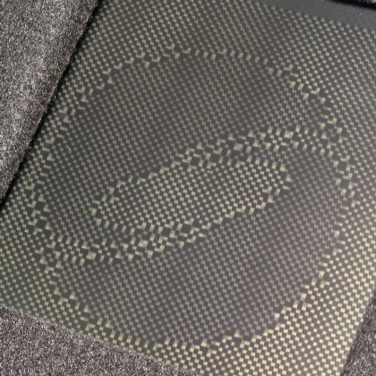
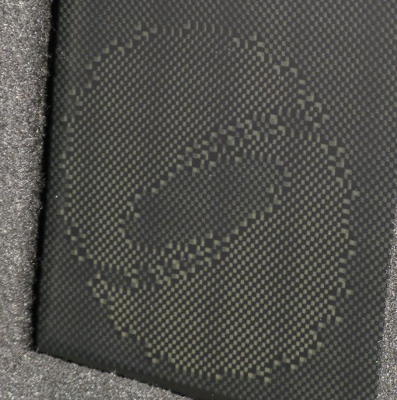
More Future Work
Dynamic “BRDF display”

Slide 34
Thanks to…
Colleagues at Adobe CTL and elsewhere
Anonymous reviewers
J. C. Bradfield for ppmtomd
Paul Debevec for environment maps
U.S. National Science Foundation grants CCF-0347427, CCF-0702580, CNS-070820, CCF-0746117 and CCF-0747220

