Slide 1
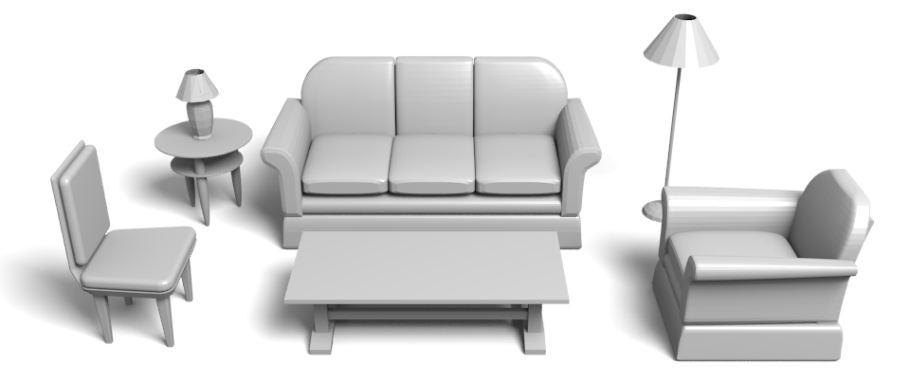
Style Compatibility For 3D Furniture Models
Tianqiang Liu¹
Aaron Hertzmann²
Wilmot Li²
Thomas Funkhouser¹
¹Princeton University
²Adobe Research

Slide 2
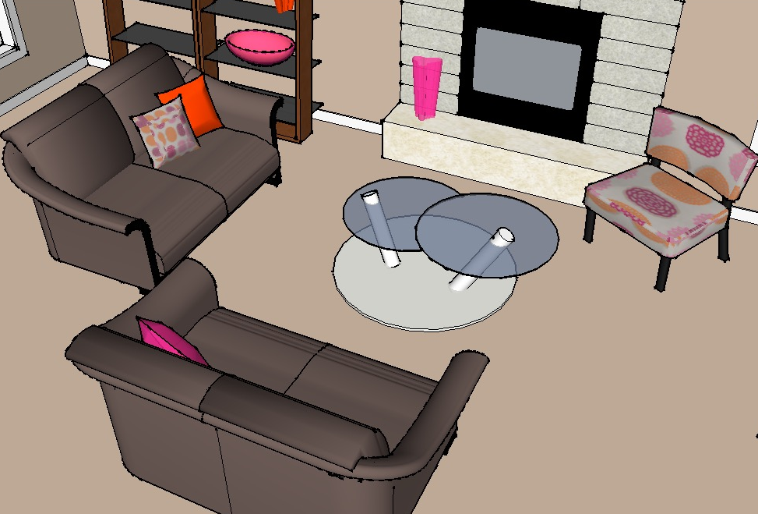
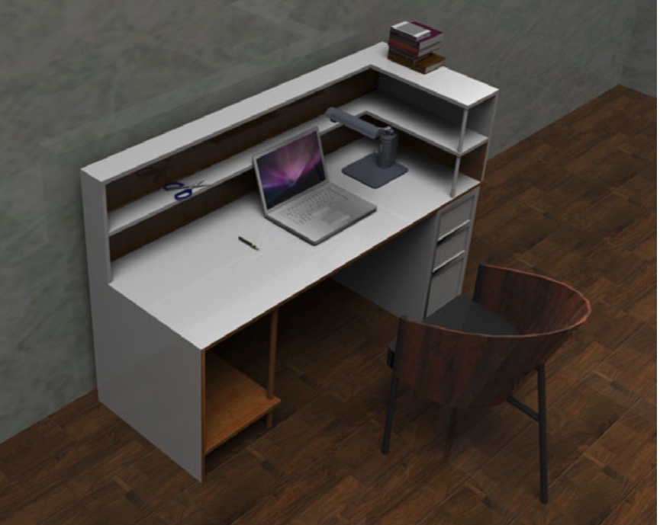
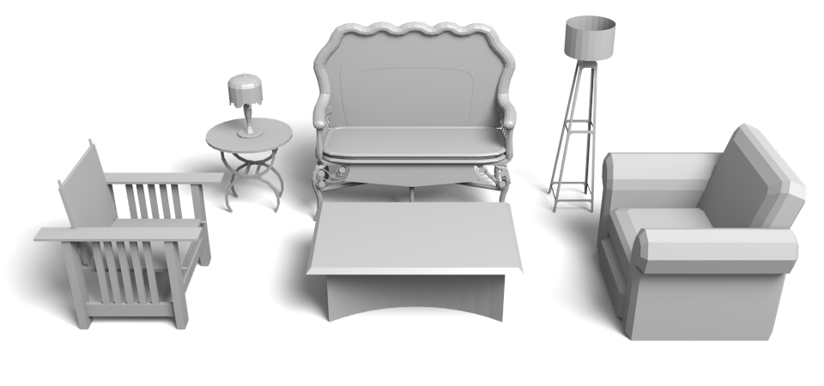
Motivation
Notes:
3D scenes are widely used in many applications, and modeling 3D scenes is one of the most common creative tasks in computer graphics.

Slide 3
Motivation
Notes:
There are many tools that allow people to create scenes with furniture in online repositories.
However, current tools don’t understand anything about style

Slide 4
Motivation
Stylistically incompatible
Notes:
As a result, users may create scenes combining mismatched styles.
For example, this scene pairs a very modern coffee table with an antique couch.

Slide 5
Motivation
Stylistically compatible
Notes:
What we need is a tool that can help people create scenes with stylistically compatible objects.
For example, in this scene, all chairs have similarly rounded cushions, which makes them go well together.
Our paper introduces a way for computers to reason about style compatibility between furniture models.
We focus on furniture, because it has a strong notion of style and is the most important component of indoor scenes.

Slide 6
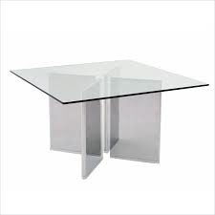
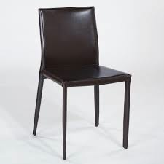
Goal
Modeling pairwise style compatibility
How likely is it that a person would put these two
furniture pieces together, when furnishing an apartment?
Notes:
Specifically, we want to model the style compatibility between a pair of 3D furniture models,
and the question we ask is (click) how likely is it that a person would put these two furniture pieces together when furnishing an apartment.

Slide 7
Goal
Extract feature vectors
d( , ) = Scalar
Notes:
To model this, we take a straightforward approach,
(click) We first extract a feature vector for each shape
(click) And then, we look for a function d, that takes as input the two feature vectors and returns a scalar that represents the style compatibility between the two shapes.

Slide 8
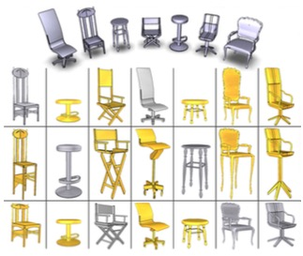
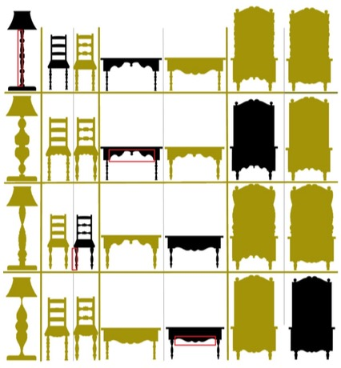
Previous work – shape style
[Xu et al. 2010]
[Li et al. 2013]
Notes:
Previously, researchers have developed methods to model styles of 2D and 3D shapes.
(click) For instance, researchers investigated style variations that are caused by anisotropic part scaling
(click) or curvature features.
In our work, rather than focusing on a specific source of shape style variation, we develop a method to quantify style compatibility, which is usually related to multiple sources of shape style variations.

Slide 9
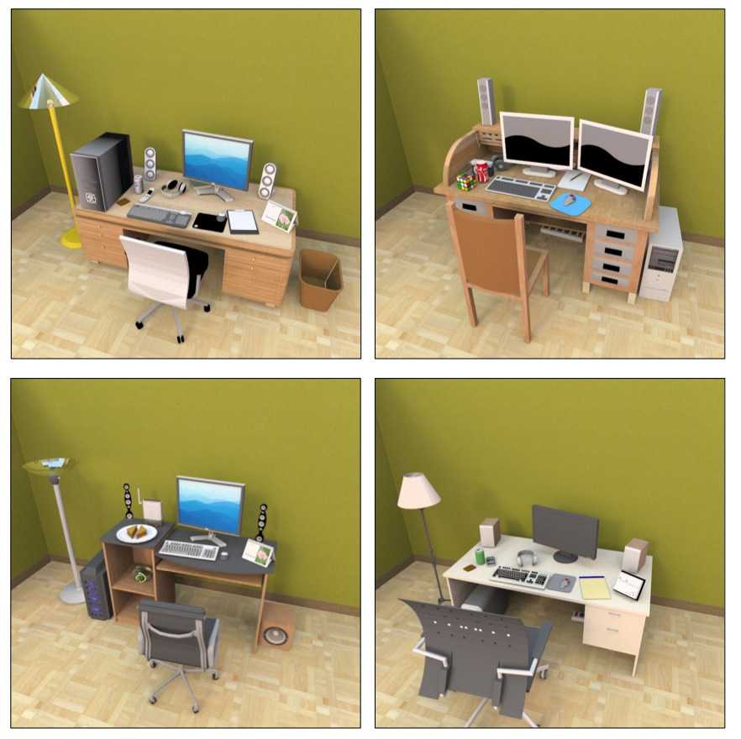
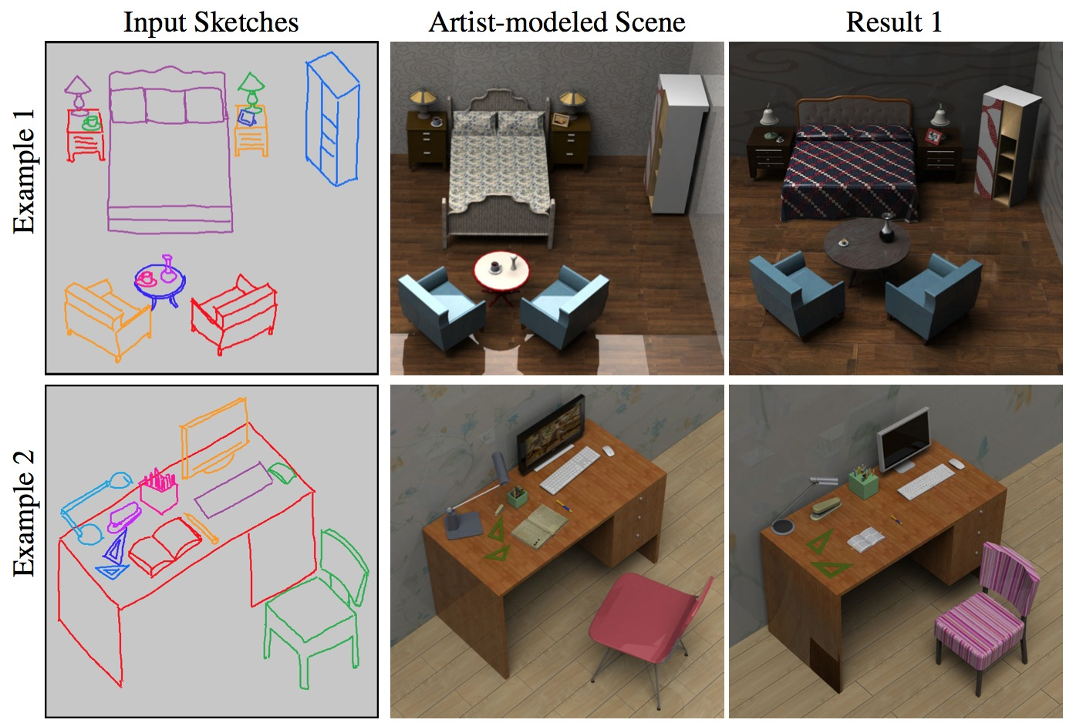
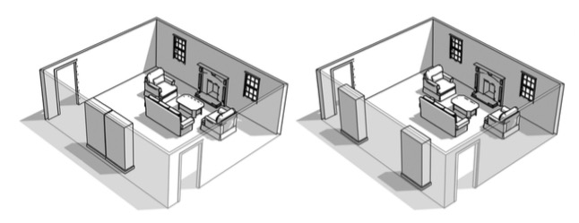
Previous work – virtual world synthesis
…
[Merrell et al. 2011]
[Fisher et al. 2012]
[Xu et al. 2013]
Notes:
Although several systems have been developed to assist scene modeling, no prior work explicitly consider style compatibility between objects.

Slide 10
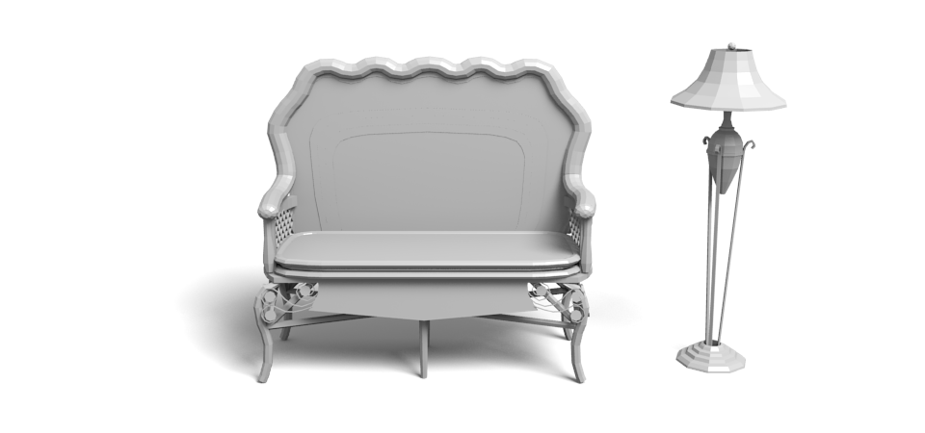
Concurrent work – style similarity
[Lun et al. 2015]
(previous talk in this session)
Notes:
In concurrent work, as presented in the previous talk in this session, Lun et al. [2015] measure style similarity based on geometric similarity of object elements.
Their method, unlike ours, may generalize to object classes unseen in the training data.
(click) However, their method may be unable to handle objects without corresponding elements, for example, a sofa and a lamp.
(3 minutes)

Slide 11
Challenges
Hard to design a hand-tuned function
Coupled with functionality
Requiring comparisons across object classes
Notes:
In our work, we identify three major challenges in developing a style compatibility metric for furniture models.

Slide 12
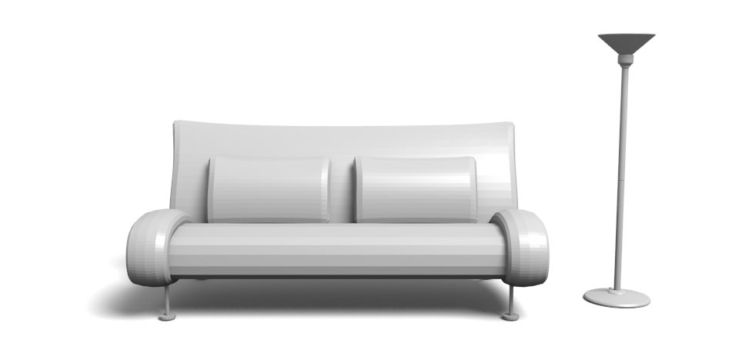
Challenges
Hard to design a hand-tuned function
Coupled with functionality
Requiring comparisons across object classes
Notes:
First, a person’s notion of furniture style usually combines many subtle factors, and it would be hard to design a hand-tuned mathematical function to compute it.

Slide 13
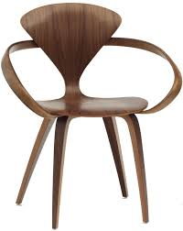
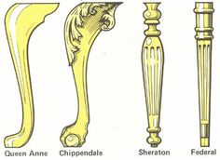
Challenges
Hard to design a hand-tuned function
Coupled with functionality
Requiring comparisons across object classes
Notes:
Second, geometry of furniture models is influenced by both function and style.
(click) For example, different parts of a chair have different geometries because they serve different functions.
On the other hand, although chair legs serve similar functions in different chairs, they can be geometrically different if they belong to different styles.
(click) Since we focus on style compatibility, it is important to capture geometric variation that is caused by style variation.

Slide 14
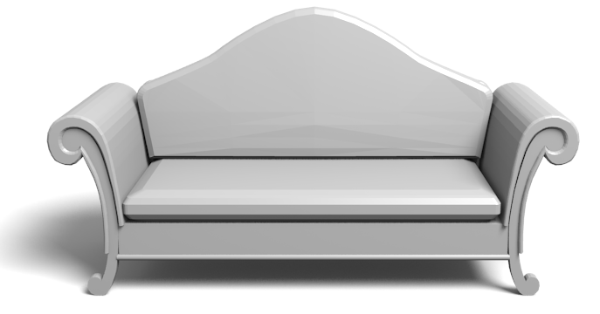
Challenges
Hard to design a hand-tuned function
Coupled with functionality
Requiring comparisons across object classes
Notes:
Third, solving our problem requires comparisons between models from different object classes, which may have feature vectors with different dimensionalities and distributions.
This requires novel ways to model relations between models.
(4min30s)

Slide 15
Key ideas
Crowdsourcing compatibility preferences
Part-based geometric features
Learning object-class specific embeddings
Notes:
According to these challenges, we base our work on three key ideas.

Slide 16
Key ideas
Crowdsourcing compatibility preferences
Part-based geometric features
Learning object-class specific embeddings
>
Notes:
First, since it is hard to design a hand-tuned mathematical function to model style compatibility, we learn a function from examples.
Specifically, we learn from crowdsourced data, in order to understand which furniture models are considered to be more compatible by people

Slide 17
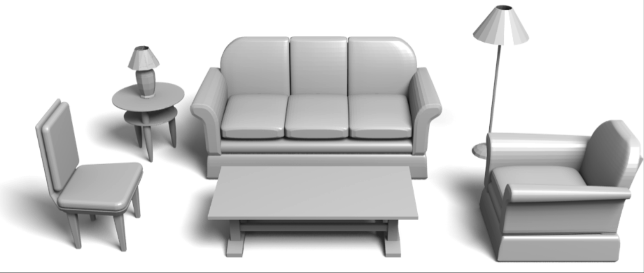
Crowdsourcing compatibility preferences
Living room
Couch
Table lamp
(28)
(39)
End table
Floor lamp
(23)
(42)
Chair
(37)
Coffee table
(49)
Armchair
(36)
Notes:
In our work, we consider two types of scenes: dining room and living room.
In this slide, I show the object classes that are included in living room, and the numbers in the parentheses are the numbers of models in each object class.
(click) When crowdsourcing people’s preferences, we only consider the pairs of object classes with close proximity and functional interaction. For living room, we only consider the pairs that are connected by arrows.

Slide 18
Crowdsourcing compatibility preferences
Design of user study [Wilber et al. 2014]
Please select the two most compatible pairs.
Notes:
For each pair of object classes, we randomly generate 50 tasks.
In each task, we use the grid technique proposed by Wilber et al. [2014] to make our study more cost-effective.
Specifically, we fix one model as reference (click), and pair it with six different models of the other object class (click).
Then, we ask human raters to select the two pairs in which the two models are most stylistically compatible.

Slide 19
Crowdsourcing compatibility preferences
Rater’s selection
Notes:
In this example, most raters select the two pairs at bottom-right corner as the most compatible ones.

Slide 20
Converted into 8 triplets
>
>
>
>
and 4 more triplets …
Notes:
We then convert the rater’s selection to 8 triplets.
(click 5 times)
(click) Each triplet consists of one dining chair that is selected,
(click) one dining chair that is not selected,
(click) and the reference dining table.
(click) In each triplet, the left pair is more compatible than the right pair.

Slide 21
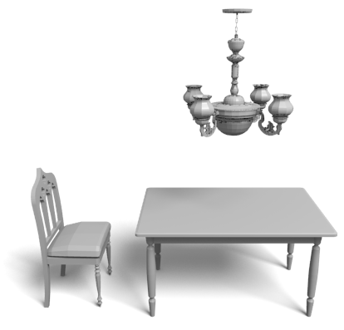
Crowdsourcing compatibility preferences
Living room
Dining room
Collected 63,800 triplets for living room
and 20,200 for dining room
Notes:
We finally collected 63,800 triplets for living room, and 20,200 triplets for dining room.
And we use them for both learning and evaluation.
(7 min)

Slide 22
Key ideas
Crowdsourcing compatibility preferences
Part-aware geometric features
Learning object-class specific embeddings
Notes:
Our second key idea is to use part-aware geometric features, in order to better capture the style characteristics of furniture models.

Slide 23
Part-aware geometric features
Contemporary
Antique
Notes:
Our key observation is that furniture styles are often strongly related to characteristic features of individual parts.
For example, (click) this contemporary couch has a bumpy seat, while this antique couch has a flat seat
(click) This contemporary floor lamp has a post with little ornamentation, (click) while this antique floor lamp has a post with richer ornamentation

Slide 24
Part-aware geometric features
Consistent segmentation
Computing geometry features for each part
Concatenating features of all parts
Notes:
This observation motivates us to compute part-aware geometric features, and we propose a method that proceeds in three steps.

Slide 25
Part-aware geometric features
Step 1: Consistent segmentation [Kim et al. 2013]
Armrest
Back
Legs
Seat
Notes:
First, we perform a consistent segmentation for all models within each object class by learning a part-based template.

Slide 26
Part-aware geometric features
Step 2: Computing geometry features for each part
Back
Curvature histogram
Bounding box dimensions
Shape diameter histogram
Normalized surface area
Notes:
For each furniture model, we then compute geometric features for each part and the entire shape.

Slide 27
Part-aware geometric features
Step 3: Concatenating features of all parts
…
…
…
…
…
Notes:
Finally, we concatenate feature vectors for all of its parts and its entire shape to form a single feature vector for the furniture model.
This approach has the advantage that distinctive features of one part are not blended with features of another.
We also think this is the first time that consistent segmentation has been used for this type of application.

Slide 28
Key ideas
Crowdsourcing compatibility preferences
Part-aware geometric features
Learning object-class specific embeddings
Notes:
Our third key idea is to learn embeddings that are specific to object classes in order to handle heterogeneous furniture types.

Slide 29
Learning object-class specific embeddings
Symmetric embedding
Previous approach [Kulis 2012]:
is the compatibility distance
are feature vectors of two shapes
Notes:
In previous work, distance learning was formulated as solving for a distance metric, parameterized by a matrix W.
With a low-rank matrix W, this can be viewed as embedding the original feature vectors in a style feature space.
Style incompatibility is then measured as the distance in this space.
(click) Since all object classes use the same matrix W, we call this method symmetric embedding

Slide 30
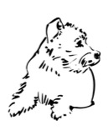
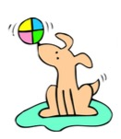
Learning object-class specific embeddings
Previous approach [Kulis 2012]:
Fonts
[O’Donovan et al. 2014]
Illustration styles
[Garces et al. 2014]
Notes:
This method has succeeded in modeling similarity between fonts and illustration styles.

Slide 31
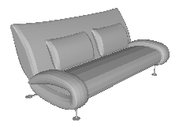
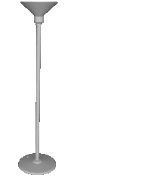
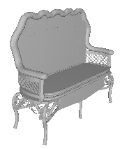
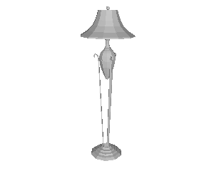
Learning object-class specific embeddings
Assumptions of the previous approach
Feature vectors have same dimensionality.
Corresponding dimensions are comparable.
Notes:
However, this method relies on two assumptions.
First, this method assumes that the feature vectors have the same dimensionality.
Second, the method assumes the two feature vectors under comparison are somewhat comparable.
These assumptions stem from the fact that previous work measure style similarity between objects in the same class, rather than objects from different classes.

Slide 32
Learning object-class specific embeddings
Our approach:
Asymmetric embedding
is the object class of
is the object class of
Notes:
Therefore, we propose the following approach. We solve for an individual embedding for each object class.
For example, to compare a sofa and a chair, we would solve for two matrices at the same time, w_sofa and w_chair
We show the general case in this equation. We use c(i) and c(j) to represent the object classes of xj and xj.
Xi and Xj are projected to the embedding space using Wc(i) and Wc(j), which are different matrices.
Similar to symmetric embedding, the style incompatibility between the two shapes is also measured by the distance in the embedding space.
And we call the new approach asymmetric embedding.

Slide 33
Learning object-class specific embeddings
Notes:
I would like to use the following example to better illustrate our idea.
(click) There are three tables on the left,
(right) and three chairs on the right.
(click) Their feature vectors are shown next to each model.
And we can see that since chair and table have different numbers of parts, their feature vectors have different dimensionalities.
(click) Our approach is to learn individual embedding matrices for each object class
(click) The embedding matrices map the original feature vectors into a shared feature space, and we call it style feature space.
In this space, the models from different object classes are close to each other if they are stylistically compatible.

Slide 34
Learning object-class specific embeddings
Learning procedure [O’Donovan et al. 2014]
Using a logistic function to model rater’s preferences
Learning by maximizing the likelihood of the training triplets with regularization
Notes:
Given a distance function, learning proceeds similar to previous work.
A rater’s preference is modeled as a logistic function.
And then, learning is performed by maximizing the likelihood of the training triplets with regularization. Please refer to our paper for details regarding the optimization and the regularization term.
(13min)

Slide 35
Outline
Key ideas
Results of triplet prediction
Applications
Notes:
Now I would like to talk about experimental results.

Slide 36
Results of triplet prediction
Test set: triplets that human agree upon
264 triplets from dining room
229 triplets from living room
Notes:
We test the accuracy of our metric on the prediction of relative style compatibility by using the triplets that human agree on.

Slide 37
Results of triplet prediction
Method | Dining room | Living room
Chance | 50% | 50%
No part-aware, Symmetric | 63% | 55%
Part-aware, Symmetric | 63% | 65%
No part-aware, Asymmetric | 68% | 65%
Part-aware, Asymmetric (Ours) | 73% | 72%
People | 93% | 99%
Notes:
We consider our basic algorithm, as well as variants with the novel aspects disabled to investigate their impact on the results.
The accuracy of our method is 73% in dining room, which means that our algorithm’s prediction is same as the majority of human’s preference in 73% of all testing triplets.
Note that the accuracy of chance is 50%, and the accuracy of people is almost 100%.

Slide 38
Results of triplet prediction
Method | Dining room | Living room
Chance | 50% | 50%
No part-aware, Symmetric | 63% | 55%
Part-aware, Symmetric | 63% | 65%
No part-aware, Asymmetric | 68% | 65%
Part-aware, Asymmetric (Ours) | 73% | 72%
People | 93% | 99%
Notes:
We find that using asymmetric embedding outperforms symmetric embedding.

Slide 39
Results of triplet prediction
Method | Dining room | Living room
Chance | 50% | 50%
No part-aware, Symmetric | 63% | 55%
Part-aware, Symmetric | 63% | 65%
No part-aware, Asymmetric | 68% | 65%
Part-aware, Asymmetric (Ours) | 73% | 72%
People | 93% | 99%
Notes:
We also find that using part-aware features outperforms using the same feature vector for the entire shapes

Slide 40
Outline
Key ideas
Results of triplet prediction
Applications

Slide 41
Applications
Style-aware shape retrieval
Style-aware furniture suggestion
Style-aware scene building
Notes:
We further investigate the utility of the proposed approach in three applications,

Slide 42
Applications
Style-aware shape retrieval
Style-aware furniture suggestion
Style-aware scene building
Notes:
and I will cover two of them in my talk

Slide 43
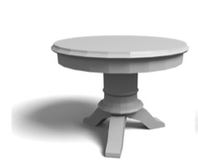
Style-aware shape retrieval
Query model
Dining chair
?
Notes:
In many cases, people want to retrieve models that are stylistically compatible to a query model of a different object class.
For example, in an online furniture shopping system, a potential customer may look for dining chairs that are compatible to the dining table in her apartment.

Slide 44
Style-aware shape retrieval
Query model
Dining chair
Notes:
Our system can retrieve chairs in the database that are most compatible to the query

Slide 45
Style-aware shape retrieval
Query model
Dining chair
(Most incompatible chairs)
Notes:
We also show the five chairs that are least compatible for comparison.
The numbers are incompatibility distances. A smaller value means more compatible.

Slide 46
Style-aware scene modeling
Notes:
Our second application is style-aware scene modeling

Slide 47
Notes:
The metric learned by our method can also provide suggestions to help people create stylistically compatible scenes in interactive design tools. This feature could help designers of interior spaces, virtual worlds, and immersive games create more plausible scenes.
To investigate this application domain, we have implemented an interactive scene builder augmented with the compatibility metric learned by our algorithm.
The input to the system is a set of prescribed object classes, an initial scene with a prescribed spatial layout, and a database of 3D models labeled by object classes.
(in video) During an interactive session, the user iteratively replaces models by other models from the same object class in an effort to make the furniture model compatible.
(in video) At any time, the user is allowed to fix/free any number of objects in the scene,
(in video) and our system suggests combinations of models from the database that are not currently fixed.
(in video) Then the user is able to choose one of the suggestions to perform the replacement. This procedure repeats until the user is satisfied with all models in the scene

Slide 48
Style-aware scene building
User study
12 participants, each works on 14 tasks.
Half of the tasks are assisted by our metric, and the other half are not.
Results from both conditions are compared on Amazon Mechanical Turk
Notes:
To evaluate how the learned metric helps in this application, we conduct a user study to compare the results generated using our system to an alternative where the suggestions are generated randomly.
In our user study, we recruited 12 participants, each participant works on 14 tasks. Half of the tasks are assisted by our learned metric, the other half are not.
We compare results from both conditions on Amazon Mechanical Turk.

Slide 49
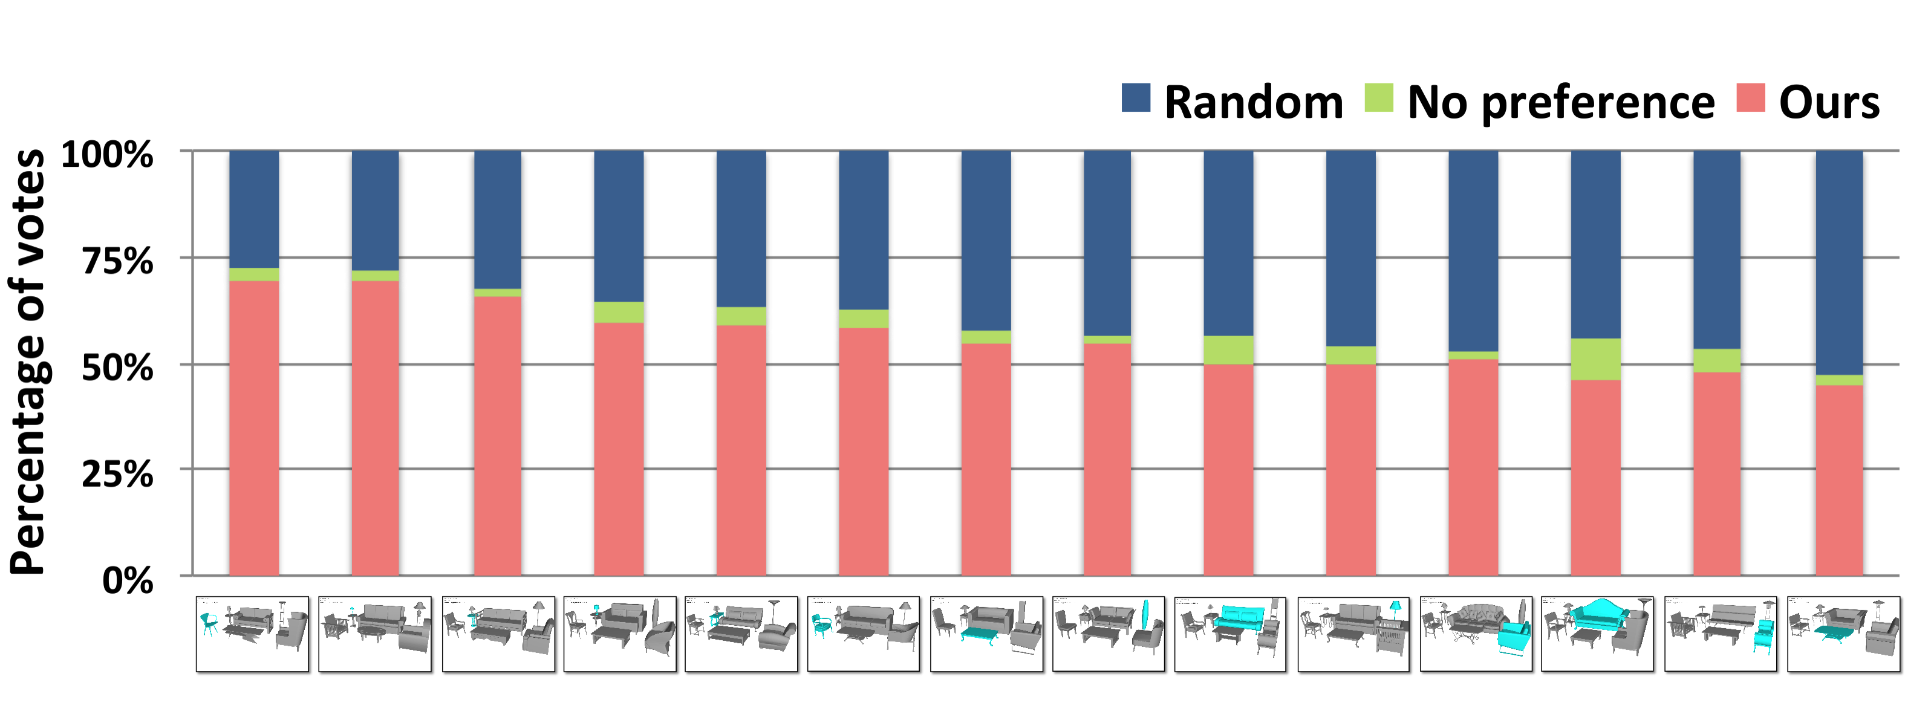
Style-aware scene building
Test scenes
Notes:
In this figure, red bars are the votes for the results generated by using assistance of our learned metric, and blue bars are the votes for random suggestions. Green bars mean the rater doesn’t have preference.

Slide 50
Style-aware scene building
Test scenes
Notes:
Our experiments show that the results generated with assistance of our learned metric are preferred in all but one tasks,

Slide 51
Style-aware scene building
Test scenes
Notes:
with statistical significance in 8 tasks

Slide 52
Take-away messages
It is possible to learn a compatibility metric for furniture of different classes.
Part-aware geometric features
Asymmetric embedding of individual object classes
The learned compatibility metric is effective in style-aware scene modeling.
Shape retrieval
Interactive scene building
Notes:
Here are two take-away messages of my talk.

Slide 53
Take-away messages
It is possible to learn a compatibility metric for furniture of different classes.
Part-aware geometric features
Asymmetric embedding of individual object classes
The learned compatibility metric is effective in style-aware scene modeling.
Shape retrieval
Interactive scene building
Notes:
First, our quantitative results show that it is possible to learn a compatibility metric for furniture of different classes, with greater accuracy using part-aware geometric features and with asymmetric embedding of individual object classes.

Slide 54
Take-away messages
It is possible to learn a compatibility metric for furniture of different classes.
Part-aware geometric features
Asymmetric embedding of individual object classes
The learned compatibility metric is effective in style-aware scene modeling.
Shape retrieval
Interactive scene building
Notes:
Second, our user studies show that the learned metric can be used effectively to achieve higher style compatibility in applications ranging from shape retrieval to scene building.
(18min15s)

Slide 55
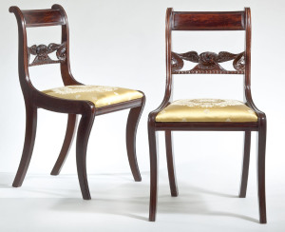
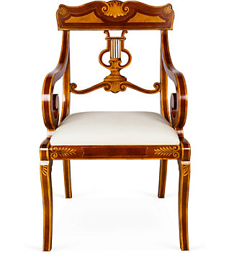
Limitations and future work
Modeling fine-grained style variations
Duncan Phyfe style with eagle motif
(Courtesy: Carswell Rush Berlin)
Sheraton style with lyre motif
Notes:
Our method has several limitations, which suggest topics for future work.
First, our method considers only a simple set of geometric features and thus cannot detect fine-grained style variations.

Slide 56
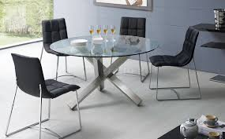
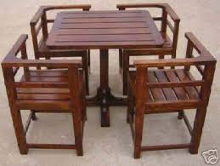
Limitations and future work
Modeling fine-grained style variations
Investigating how other properties determine style
Notes:
Second, our work only considers geometric properties.
In future work, it would be interesting to consider other properties of 3D models, such as materials and colors, which are clearly important for style compatibility.

Slide 57
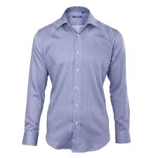
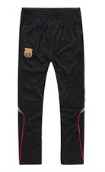
Limitations and future work
Modeling fine-grained style variations
Investigating how other properties determine style
Investigating style compatibility in other domains
OR
Notes:
Third, our work is targeted only at furniture within interior environment.
it would be interesting to investigate other domains where style compatibility is important.

Slide 58
Acknowledgements
Data and code
Trimble and Digimation
Vladimir Kim and Evangelos Kalogerakis
Discussion
Adam Finkelstein and Peter O’Donovan
Funding
Adobe, Google, Intel, NSF
Notes:
To conclude my talk, I would like to thank those who provided data set, code, suggestions, or funding for this project.

Slide 59
Project webpage
http://gfx.cs.princeton.edu/pubs/Liu_2015_SCF
Notes:
This is the url of our project. Thank you for your attention.

