Slide 1

Analyzing, Optimizing and Synthesizing Scenes by Reasoning About Relationships Between Objects
Tianqiang Liu
Adviser: Thomas A. Funkhouser
July 23rd, 2015

Slide 2
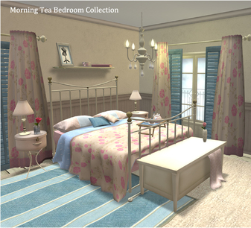
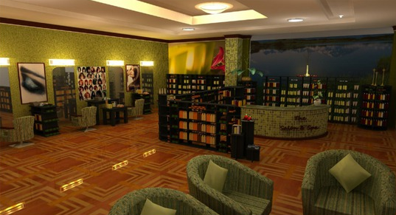

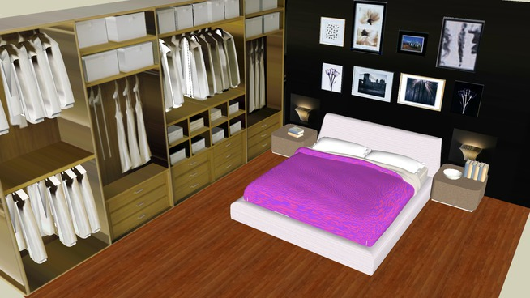
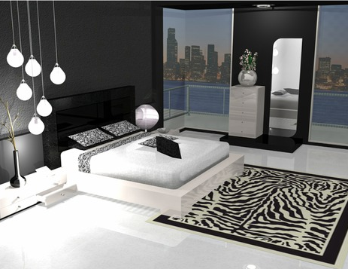
3D virtual scenes
Image courtesy: Winter Thorn, IKEA, Studio Bottini, Surya M.
Notes:
3D virtual scenes have been widely used in many applications, such as massively multiplayer online games and producing catalog images for furniture companies.
Therefore, modeling 3D scenes has become one of the most common creative tasks in computer graphics.
Large online 3D repositories, such as Trimble 3D Warehouse make it possible for novice users to create 3D scenes by assembling 3D models that can be found online.

Slide 3
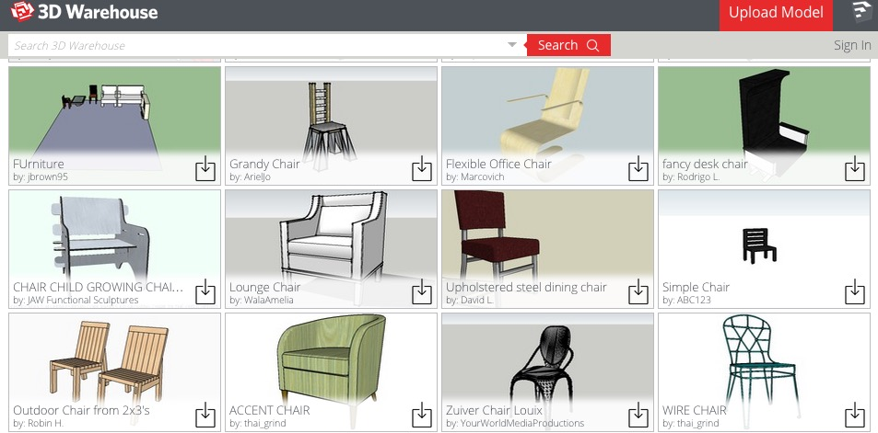
Manually scene modeling is tedious
Traversing large 3D databases
Choosing materials for each object
Positioning objects in the scene
Image courtesy: Trimble 3D Warehouse
Notes:
However, manually modeling 3D scenes is notoriously tedious and challenging, even by assembling existing 3D models.
Human modelers usually have to spend days or even weeks going through huge databases of 3D shapes, selecting appropriate objects for the scene,

Slide 4
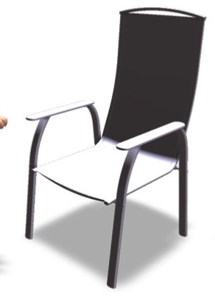
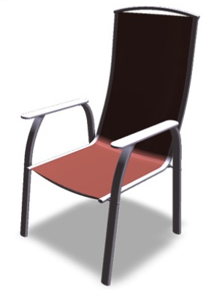
Manually scene modeling is tedious
Traversing large 3D databases
Choosing materials for each object
Positioning objects in the scene
Image courtesy: Jain et al.
Notes:
Choosing materials for each object

Slide 5
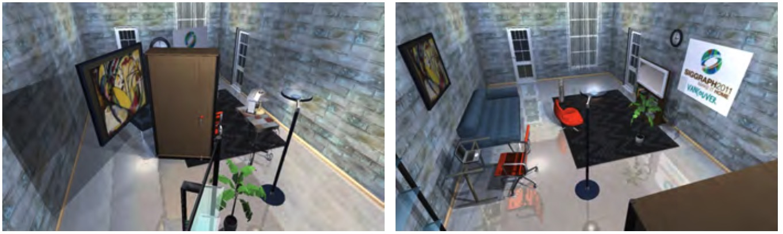
Manually scene modeling is tedious
Traversing large 3D databases
Choosing materials for each object
Positioning objects in the scene
Image courtesy: Yu et al.
Notes:
And positioning them in the scene.

Slide 6
Introduction
3D Scene Modeling
Notes:
So automated methods for scene modeling are needed.

Slide 7
Introduction
3D Scene Analysis
Data-driven methods
3D Scene Modeling
Notes:
Researchers have proposed many methods for scene modeling, And a particularly promising direction is data-driven approach, which is to first learn what makes a scene realistic from existing 3D virtual scenes, and then use the knowledge to create new scenes.

Slide 8
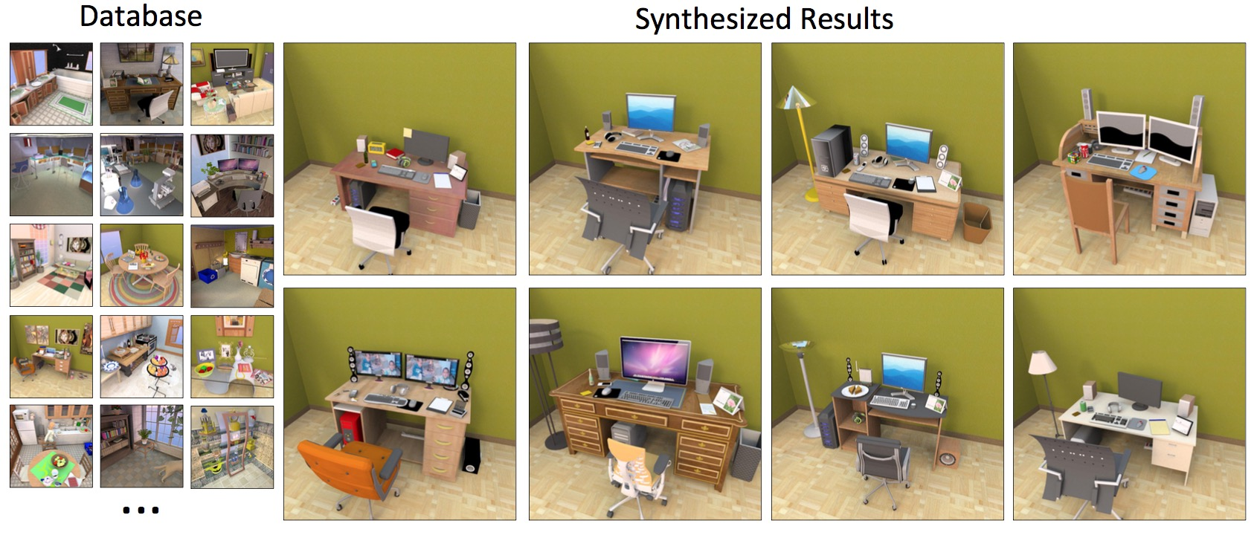
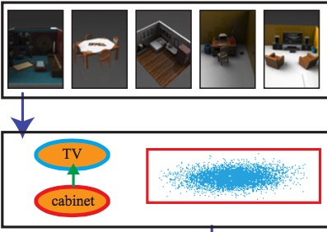
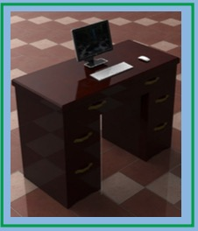
Related work: Data-driven scene modeling
Previous work requires
Perfect segmentation
Perfect annotation
Database
Output scene
[Fisher et al. 2012]
Database
Output scene
[Xu et al. 2013]
Notes:
The existing data-driven scene modeling tools usually require the exemplar scenes to have perfect segmentation and annotation.
Although online repositories offer a great number of 3D scenes that could be used as exemplars for data-driven scene modeling tools, the scenes are usually not semantically segmented and annotated, and the algorithms thus, unfortunately, require a lot of manual work to perform segmentation and annotation in advance. So, automated methods for analyzing 3D virtual scenes are needed.

Slide 9
Key idea
3D Scene Analysis
Reasoning about relationships between objects
3D Scene Modeling
Notes:
In my thesis, I deeply investigated the role of relationships between objects play in tasks of scene analysis and scene modeling.

Slide 10
Outline
Analyzing 3D scenes by modeling hierarchical structure
Composition-aware scene optimization for product images
Style compatibility for 3D furniture models
3D Scene Analysis
Reasoning about relationships between objects
3D Scene Modeling
Notes:
And I will talk about three projects to show you how reasoning about the relationships between objects can facilitate the two tasks.

Slide 11
Outline
Analyzing 3D scenes by modeling hierarchical structure
Composition-aware scene optimization for product images
Style compatibility for 3D furniture models
3D Scene Analysis
Reasoning about relationships between objects
3D Scene Modeling
Notes:
First, I will focus on the problem of scene analysis, and I will describe an algorithm that infers the segmentation and annotation of 3D scenes by reasoning about relationships between objects in a hierarchical scene representation.

Slide 12
Outline
Analyzing 3D scenes by modeling hierarchical structure
Composition-aware scene optimization for product images
Style compatibility for 3D furniture models
3D Scene Analysis
Reasoning about relationships between objects
3D Scene Modeling
Notes:
Second, I will focus on the problem of scene modeling, and I will describe a tool that optimizes a 3D virtual scene to produce good compositions by considering relationships between objects in the image space and the scene space

Slide 13
Outline
Analyzing 3D scenes by modeling hierarchical structure
Composition-aware scene optimization for product images
Style compatibility for 3D furniture models
3D Scene Analysis
Reasoning about relationships between objects
3D Scene Modeling
Notes:
Finally, I will focus on a relationship between objects that has never been considered in existing scene modeling tools, which is style compatibility. I will present a method for learning to predict the stylistic compatibility between 3D furniture models, and show you how modeling style compatibility facilitates scene modeling.

Slide 14
Outline
Analyzing 3D scenes by modeling hierarchical structure
Composition-aware scene optimization for product images
Style compatibility for 3D furniture models
Notes:
Now let me start by presenting my work on analyzing 3D scenes by modeling hierarchical structure.

Slide 15
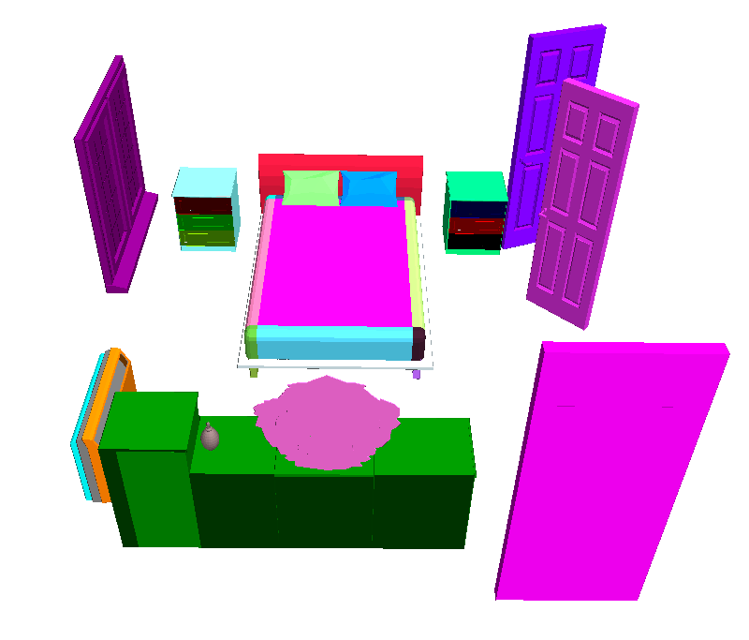
Goal
Input: A scene from Trimble 3D Warehouse
Notes:
As I just mentioned, scenes from public repositories are usually over-segmented and badly annotated, which prevent them from being directly used for many data-driven applications.
Starting with these scenes, our goal is to generate 3D scenes that are

Slide 16
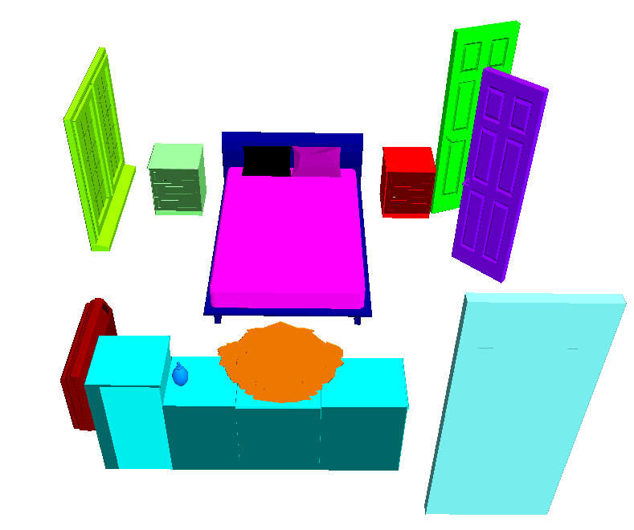
Goal
Output 1: Semantic segmentations
Notes:
semantically segmented

Slide 17
Goal
Output 2: Category labels.
Nightstand
Window
Door
Pillow
Bed frame
Heater
Mattress
Artifact
Mirror
Dresser
Notes:
and annotated.

Slide 18
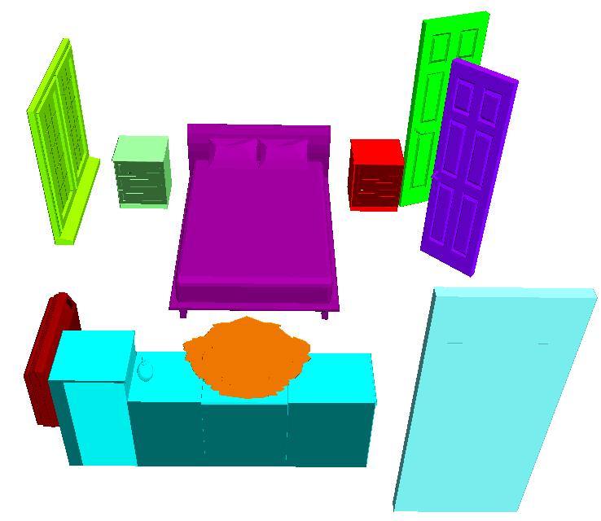
Goal
Output 2: Category labels at different levels.
Bed & supported
Dresser & supported
Notes:
, preferably at different levels

Slide 19
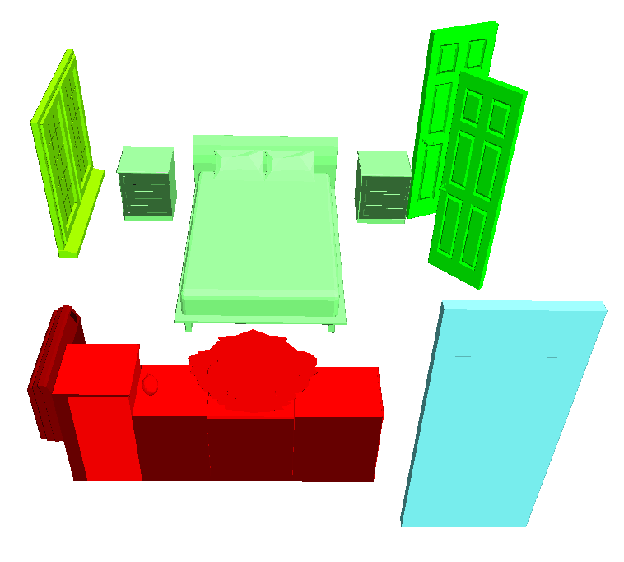
Goal
Output 2: Category labels at different levels.
Sleeping area
Door set
Vanity area

Slide 20
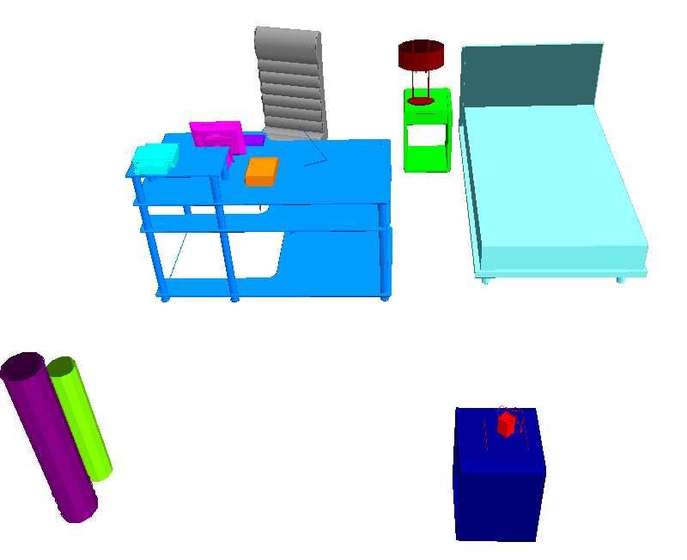
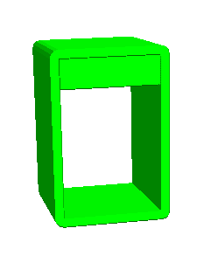
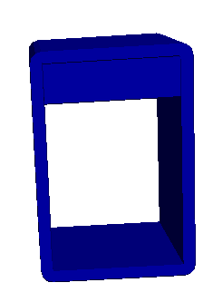
Challenges
Shape is not distinctive.
Night table
Console table
Notes:
Achieving this is challenging.
First, shape is not always distinctive.
For example, in this bedroom scene, the night table and the console table have similar geometries.
Therefore we have to rely on contextual information to distinguish them.

Slide 21
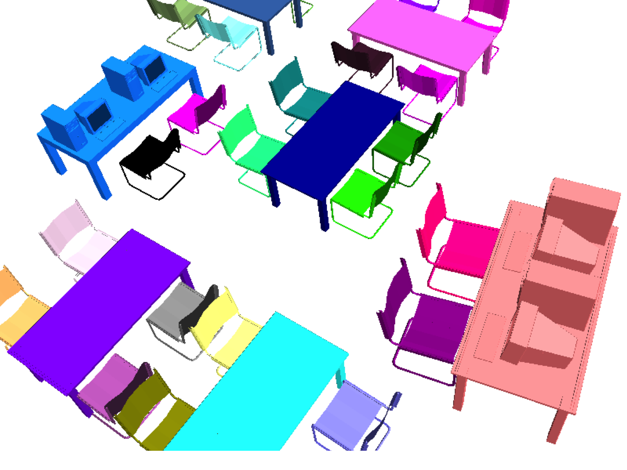
Challenges
Contextual information
Study desk
Study chair
Meeting table
Meeting chair
Notes:
However, for complex scenes, directly considering contextual information for the entire scene is not distinctive either.
Let’s look at this library, which contains two types of chairs and two types of tables.
(Click) Meeting chairs and meeting tables are arranged so that people could face one another,
(Click) while study chair and study desks are arranged so that people have more personal space.
We would like to classify the objects in this scene into these 4 object classes.

Slide 22
Challenges
All-pair contextual information is not distinctive.
#pairs
feet
#pairs
feet
Notes:
We first consider using spatial relations between each pair of objects in the scene.
Here, I plot the histograms of pairwise distances between objects of two object classes.
From the plots, we can see that contextual information is not discriminative in this case, because both curves are quite flat.

Slide 23
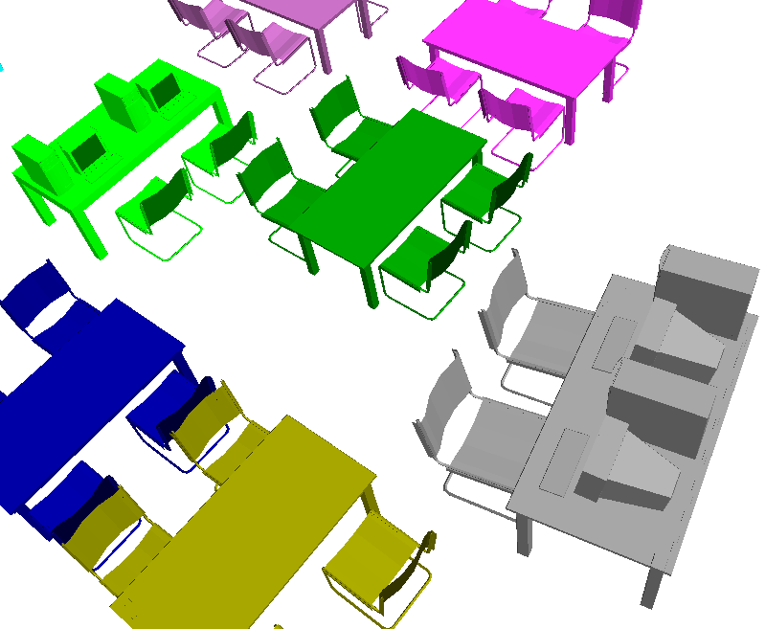
Challenges
Notes:
The reason why this happens is that a scene, particularly a complex scene, usually consists of multiple semantic groups,

Slide 24
Challenges
Notes:
and the contextual information exists both across groups

Slide 25
Challenges
Notes:
and within individual groups.

Slide 26
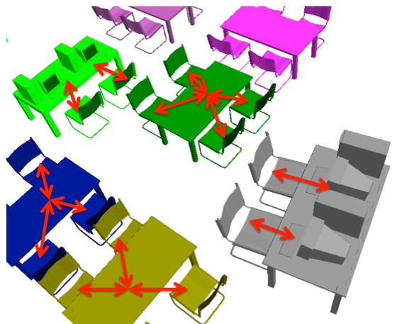
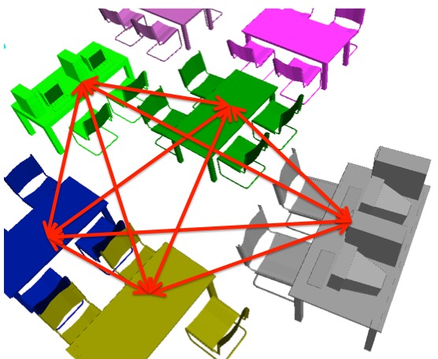
Challenges
All-pair contextual information is not distinctive.
#pairs
feet
#pairs
feet
Notes:
By considering all-pair contextual information, we unfortunately mix the two types of contextual information.

Slide 27
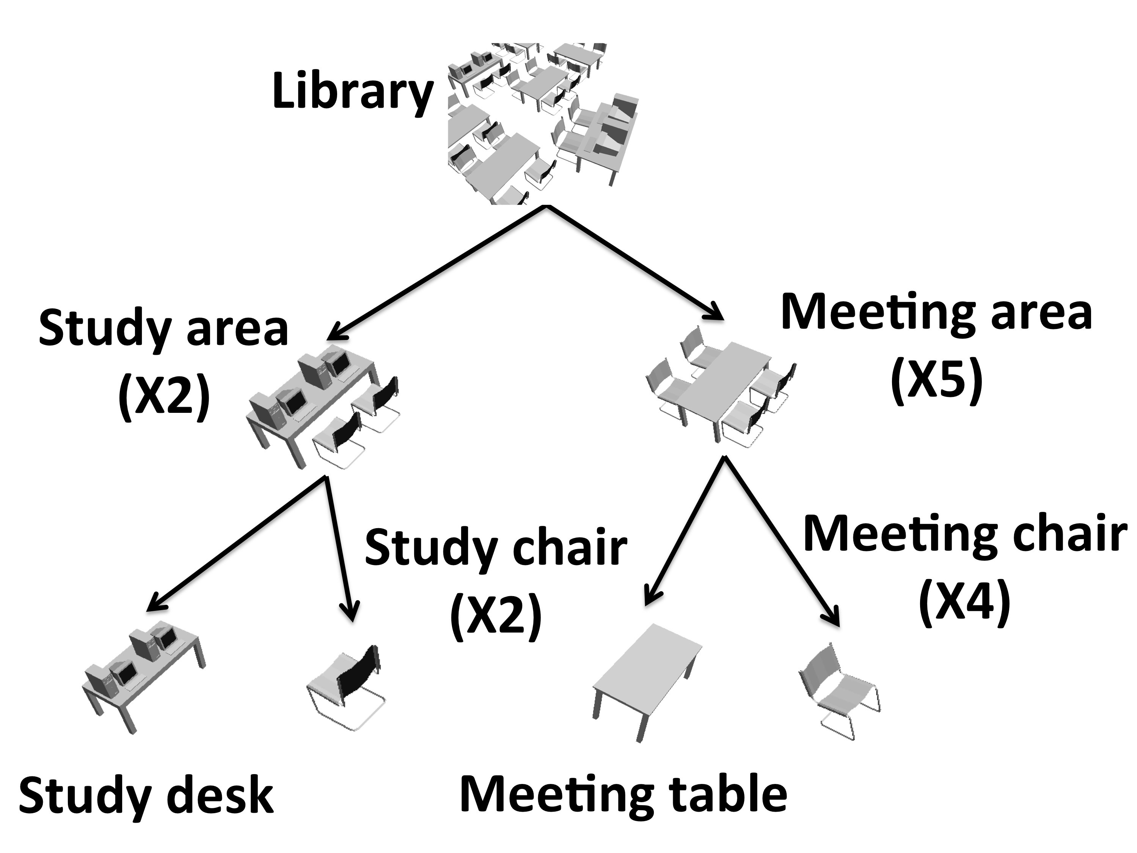
Key Idea
Semantic groups
Semantic hierarchy
Notes:
Our key idea in this work is that, if we can find semantic groups or a semantic hierarchy, which consists of semantic groups at multiple levels, we are able to separate different types of contextual information.

Slide 28
Key idea
#pairs
feet
#pairs
feet
Notes:
and considering one type of contextual information individually is usually distinctive for performing semantic segmentation and annotation.

Slide 29
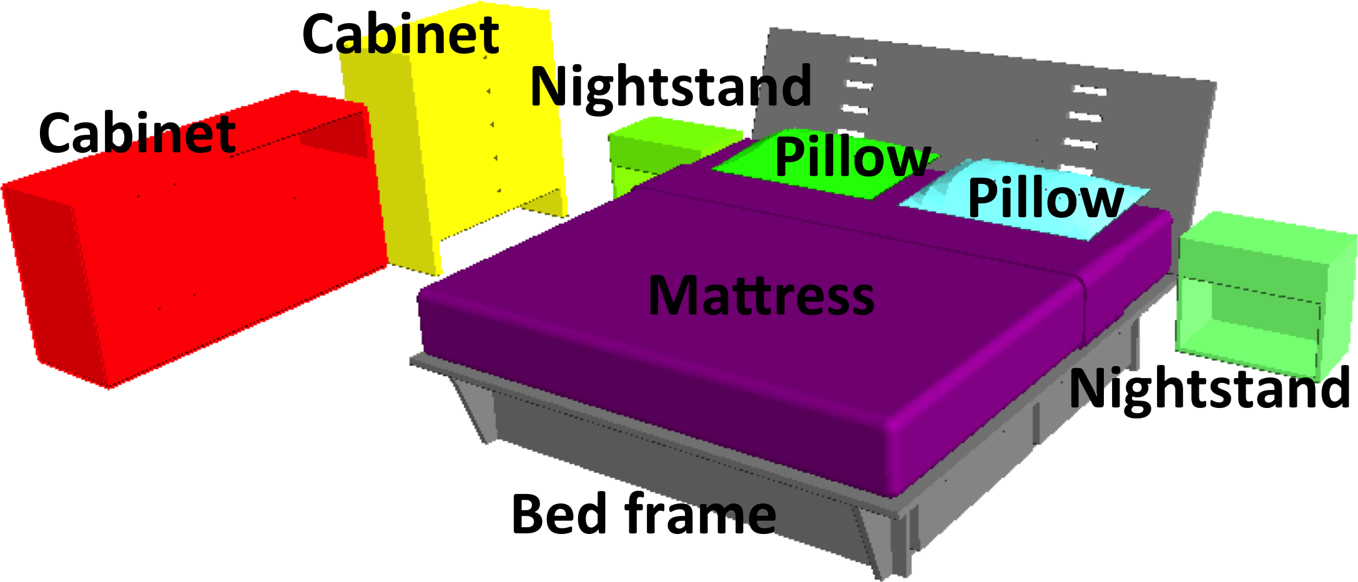
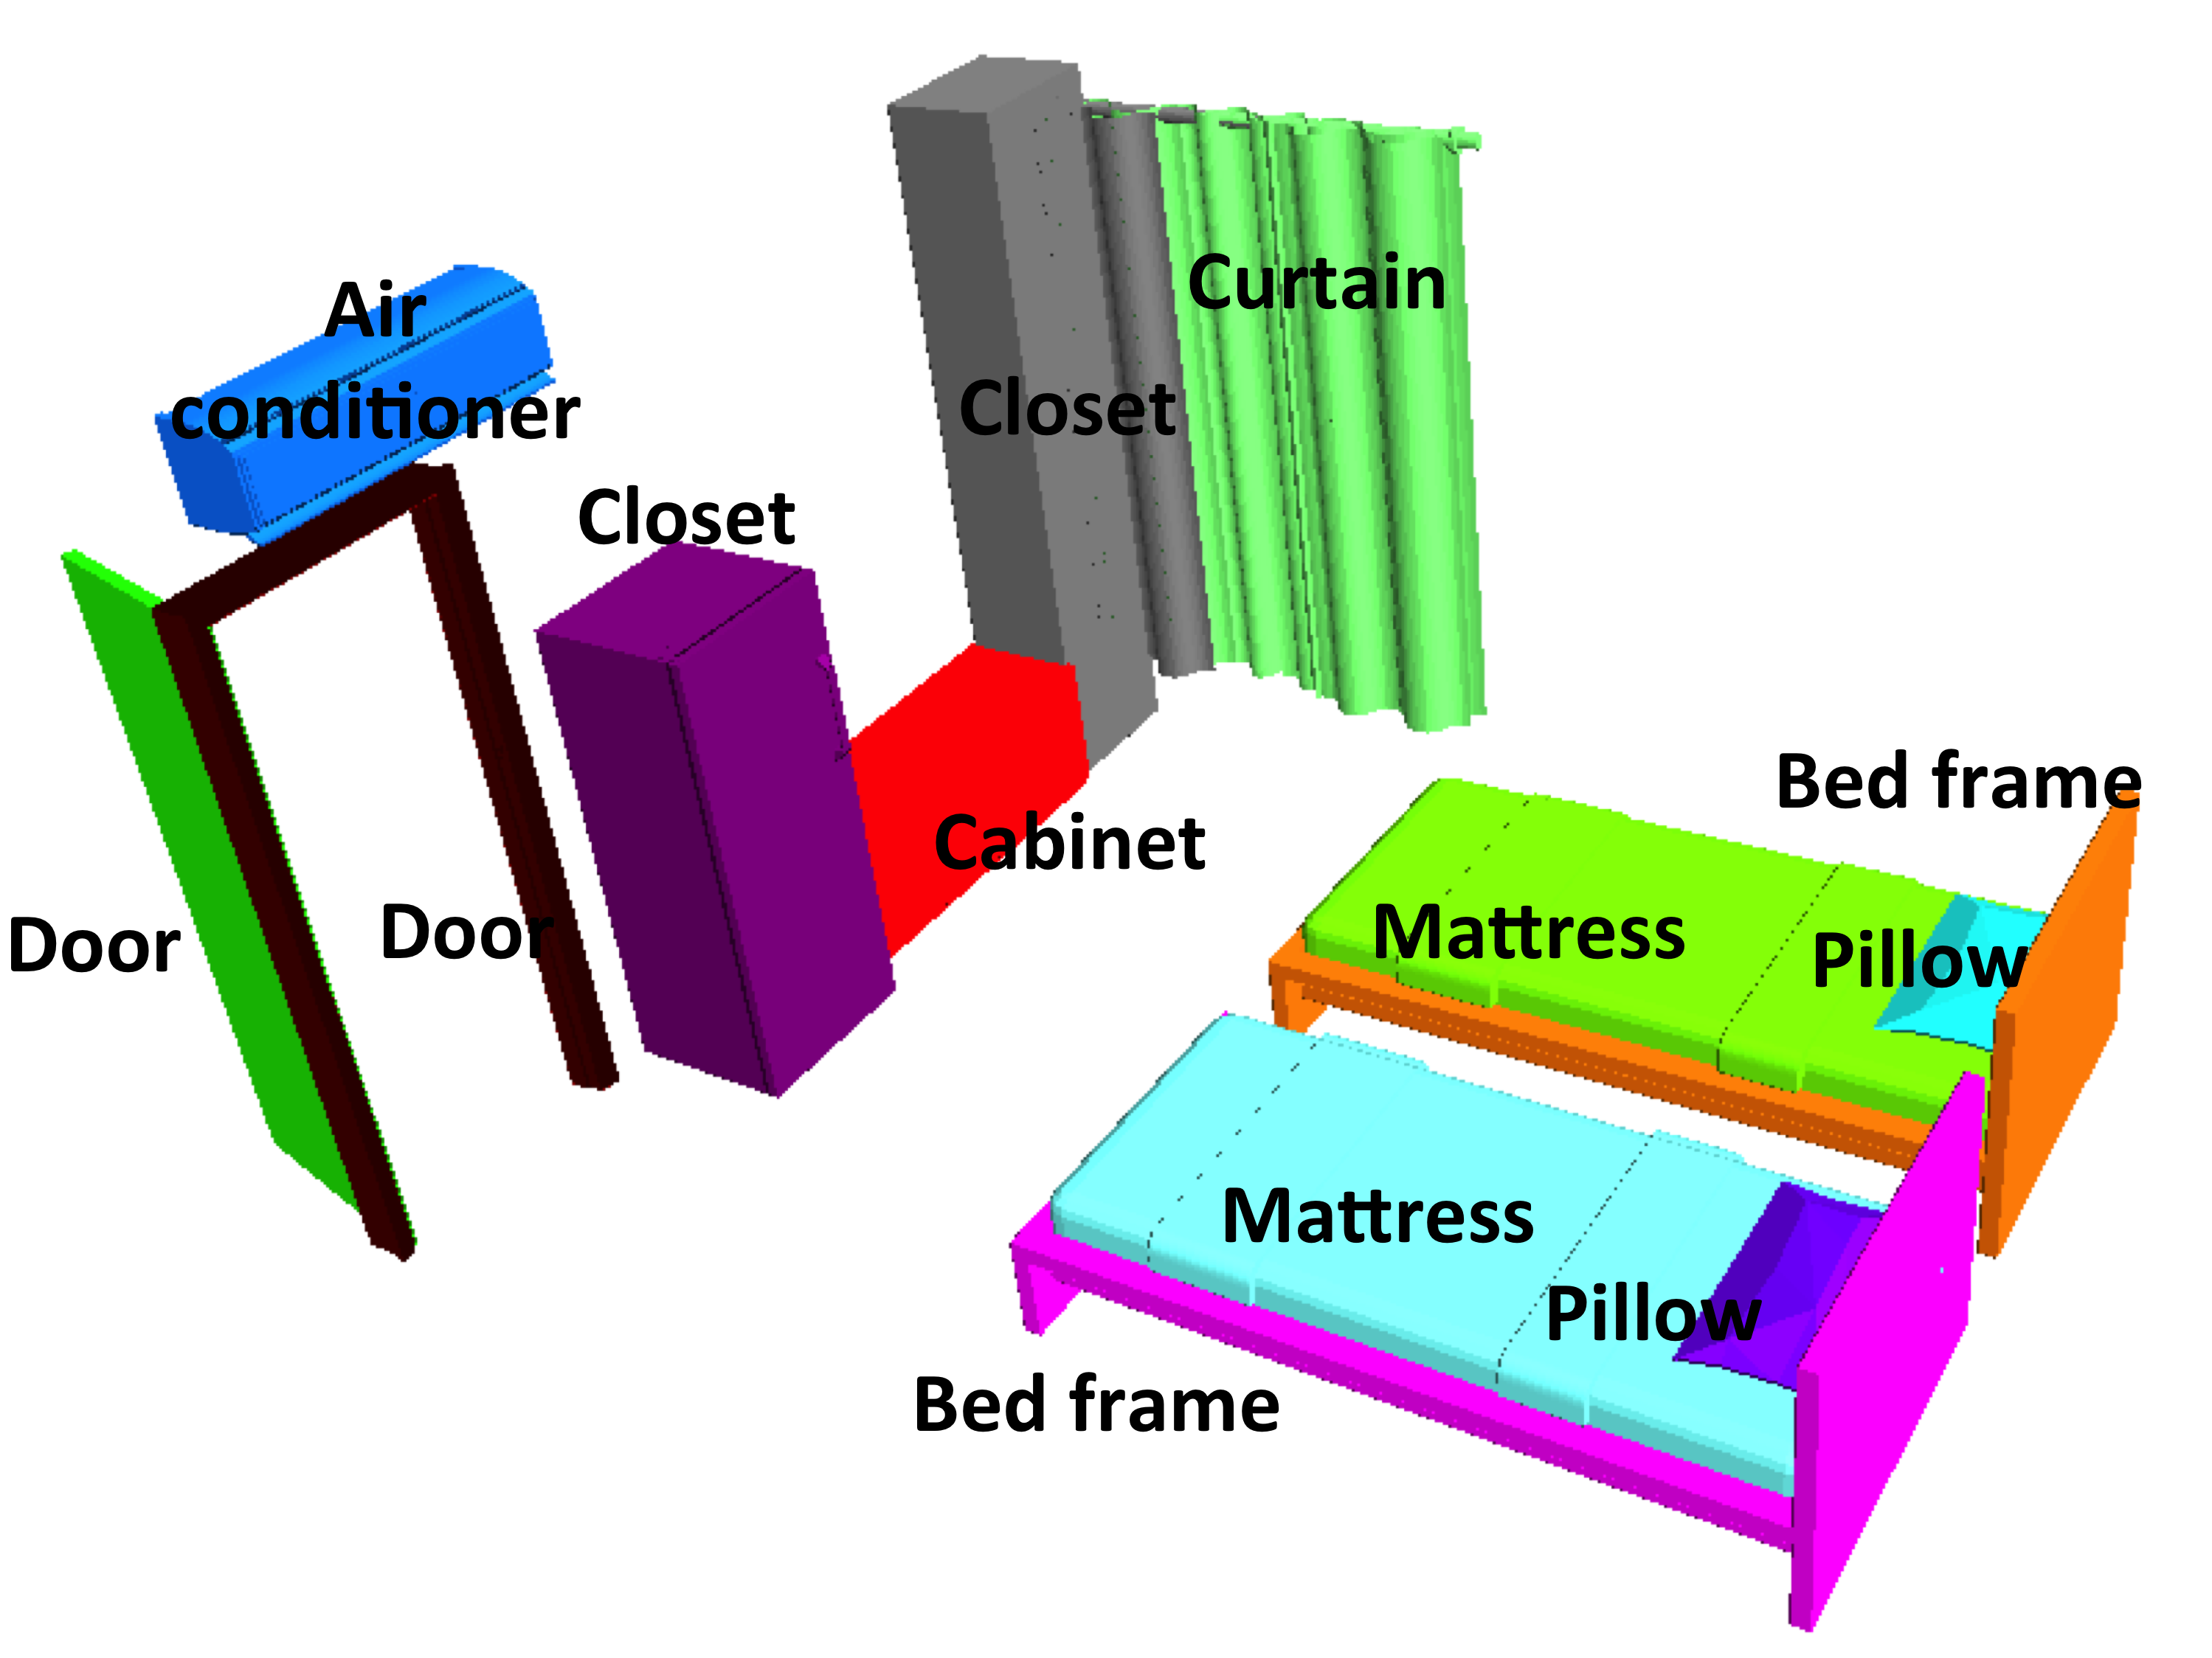
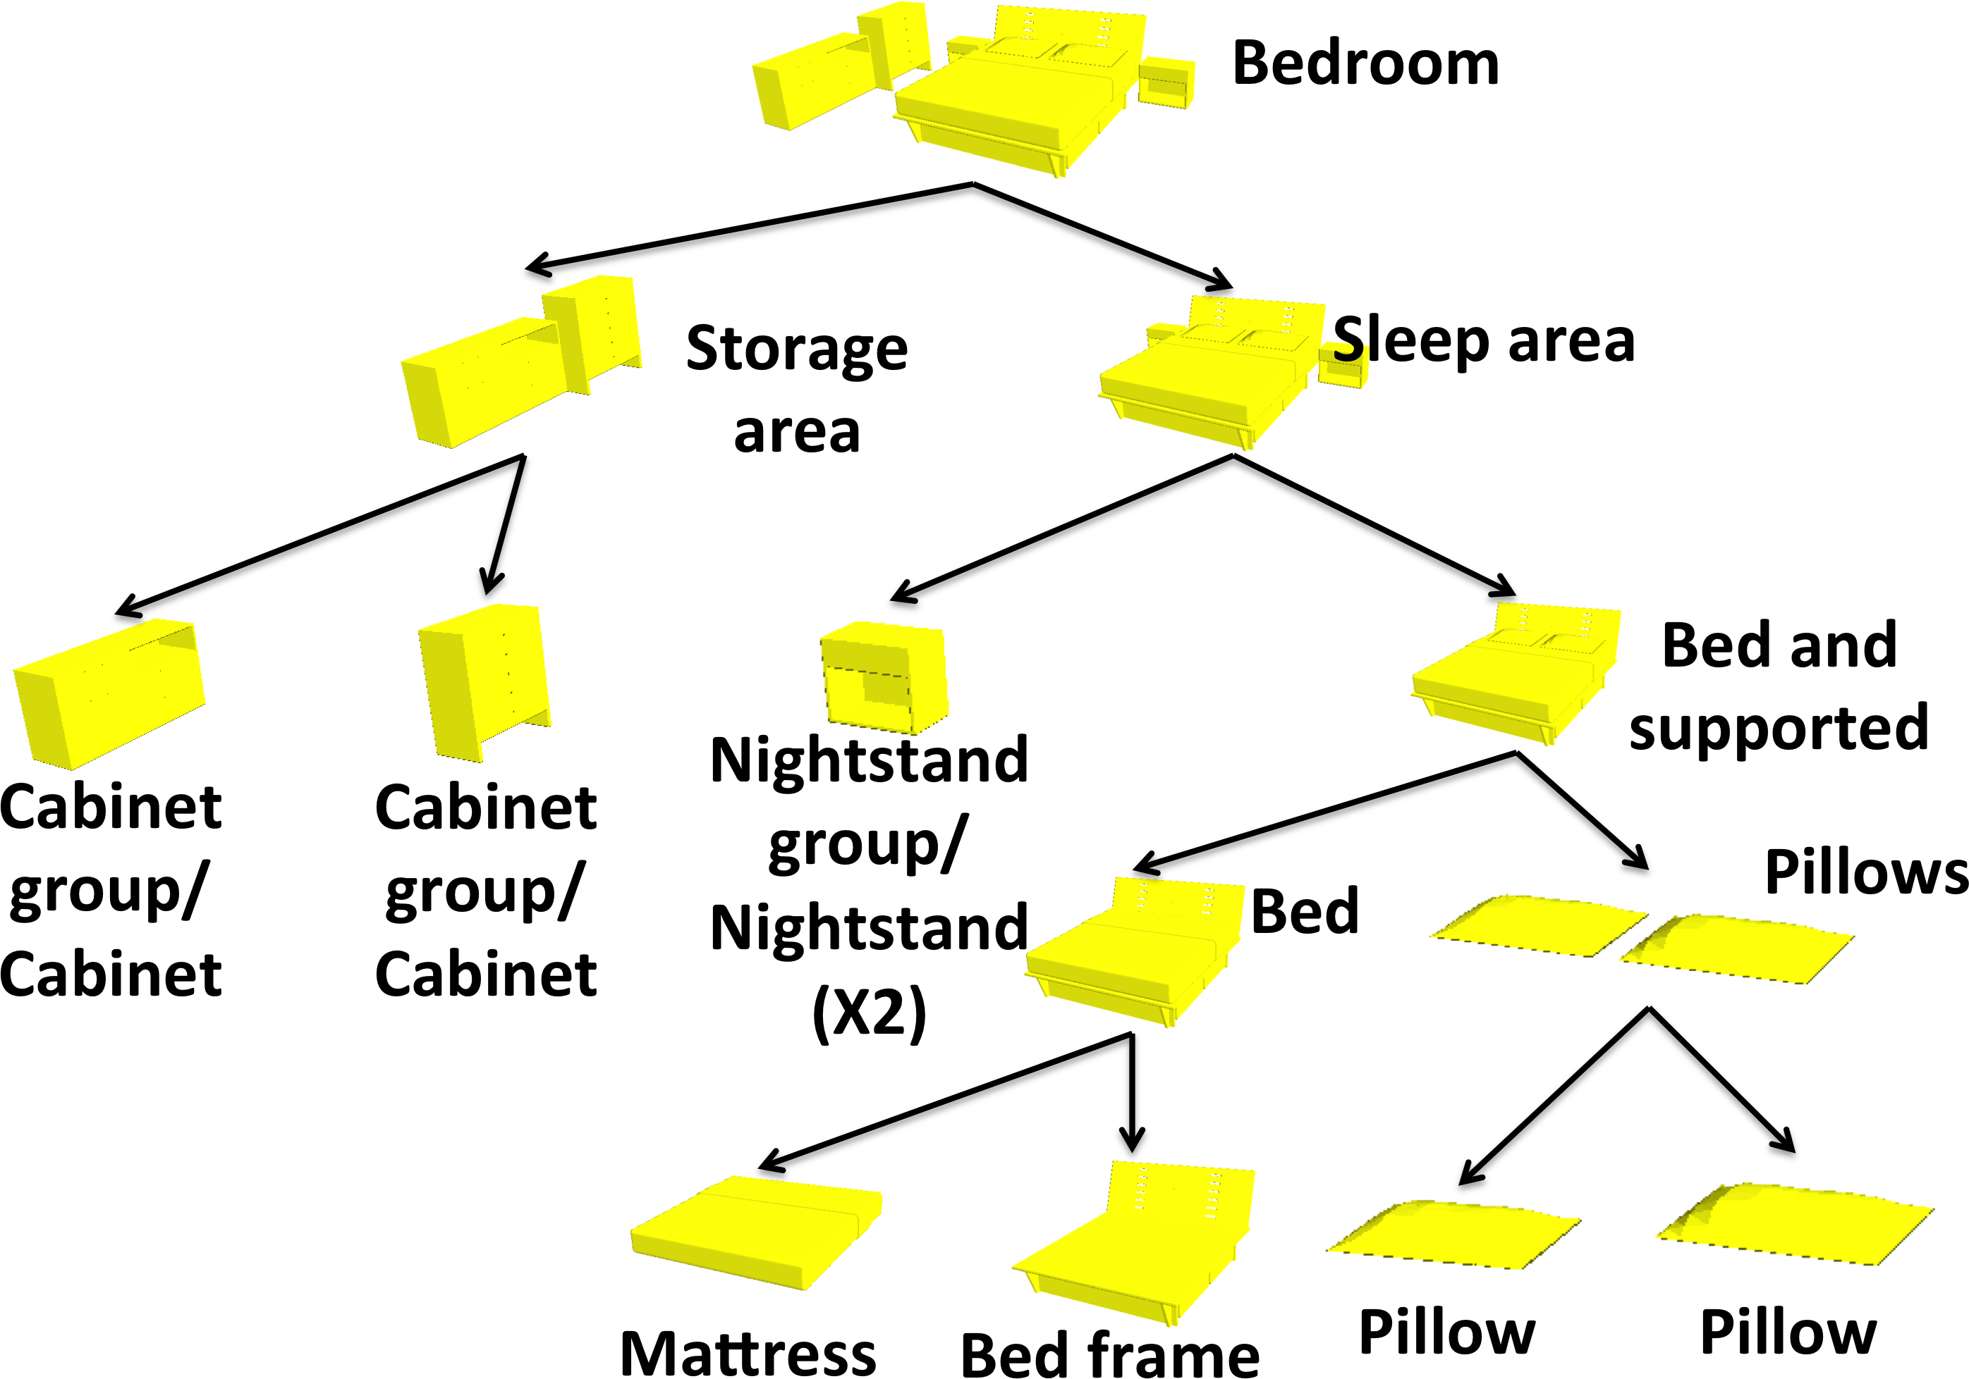
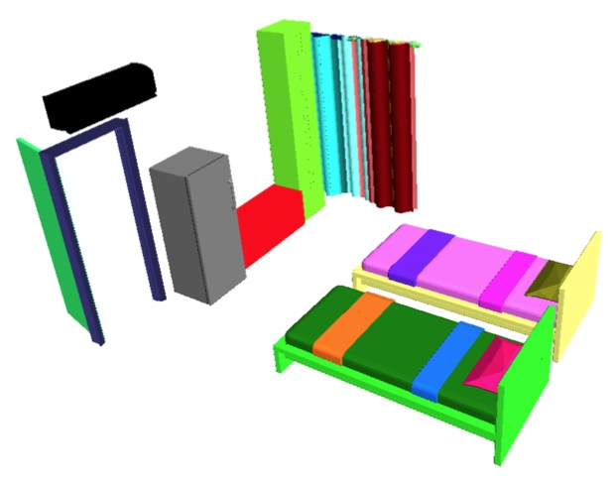
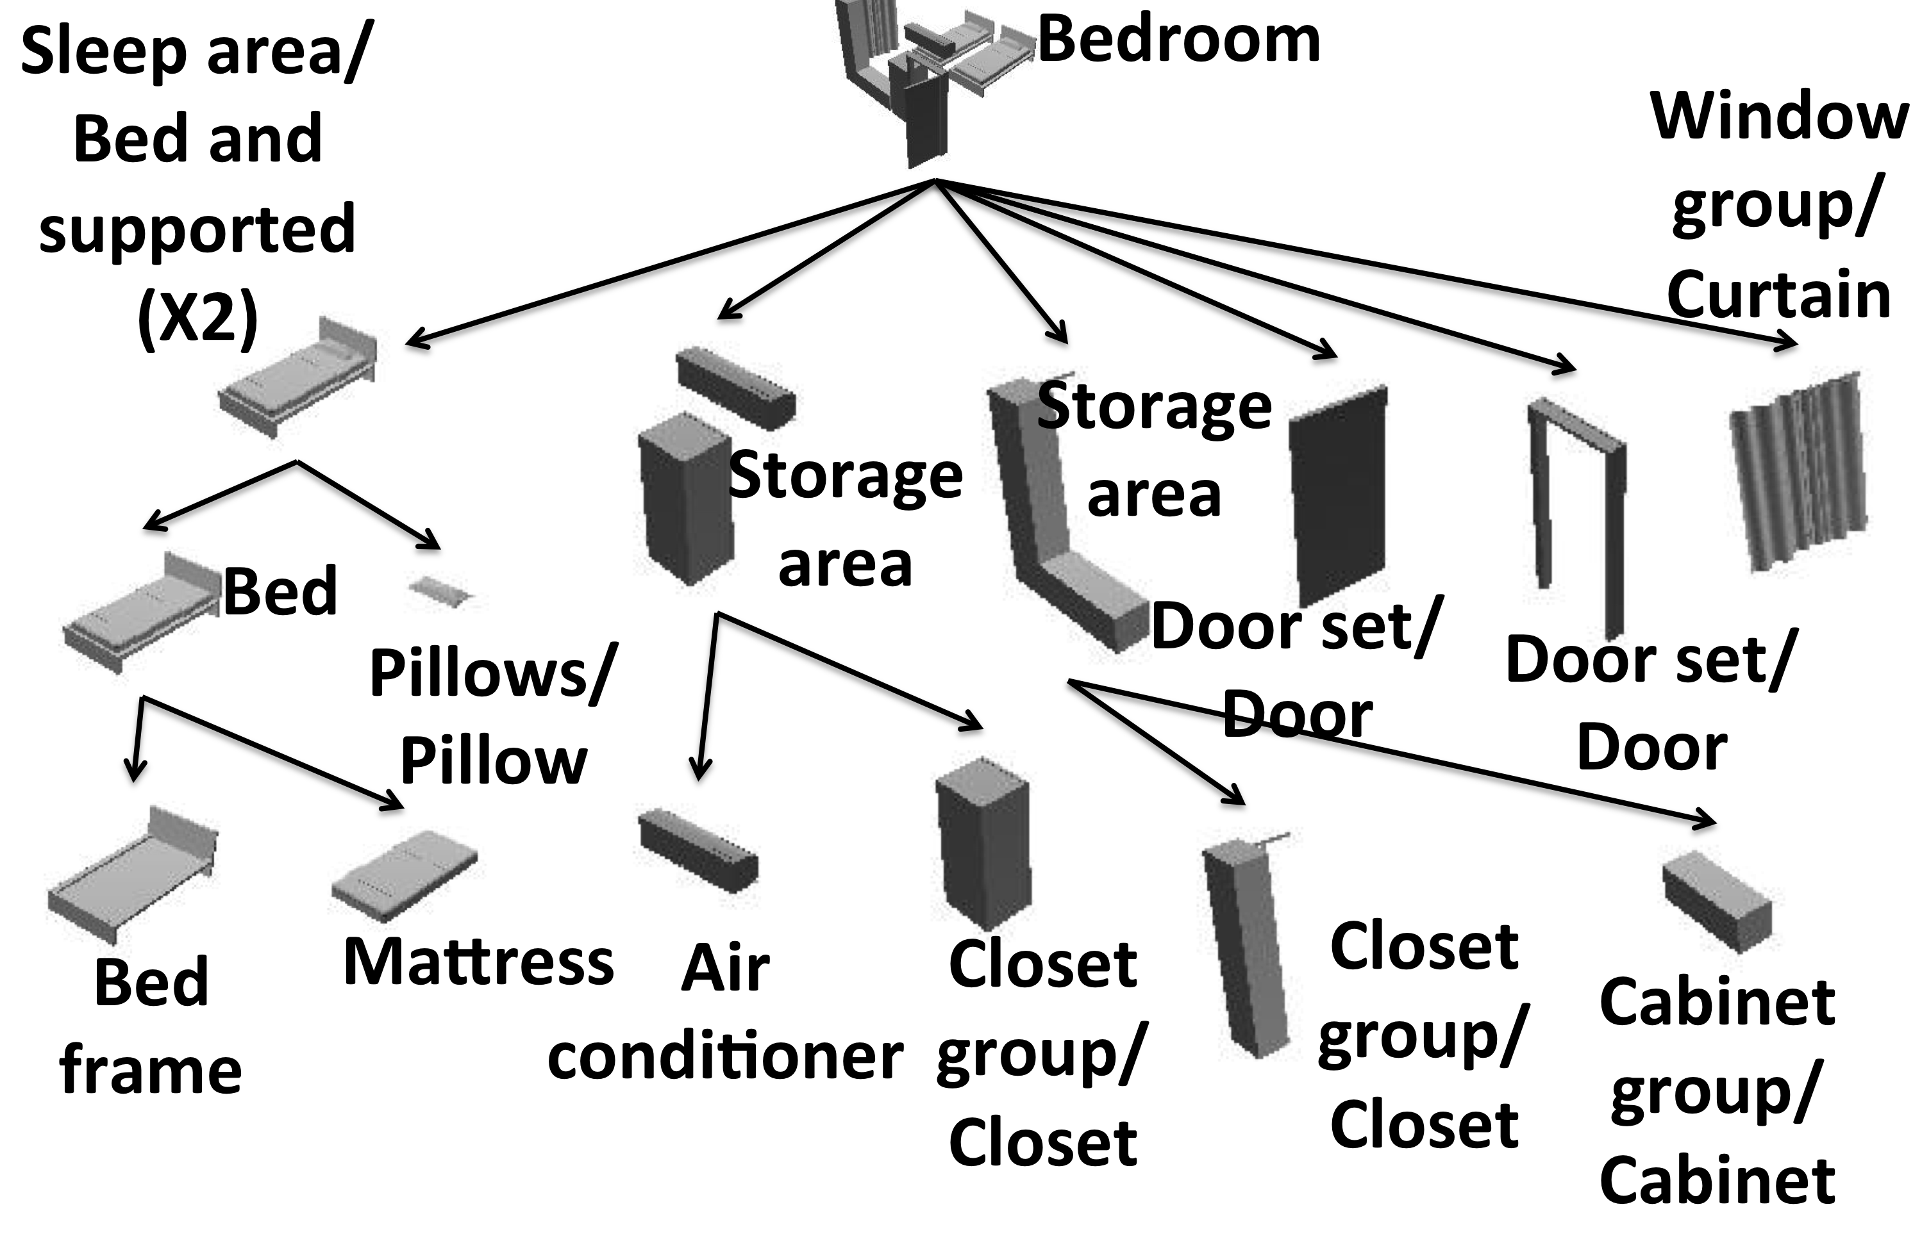
Pipeline
Probabilistic grammar
Notes:
Given this insight, we solve the segmentation and annotation problem by inferring a semantic hierarchy from the input scene.
In our work, we use a probabilistic grammar to represent the semantic hierarchy, and we find it is suitable to capture the large variability that is present in 3D scenes.

Slide 30
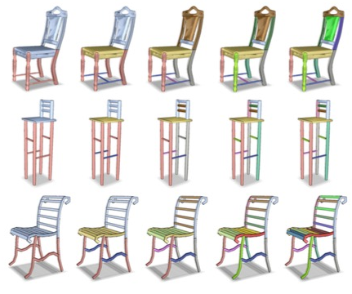
Related work
Van Kaick et al. 2013
Notes:
Previously, hierarchy has been used for analyzing single objects. However, these methods do not handle variability in 3D scenes.

Slide 31
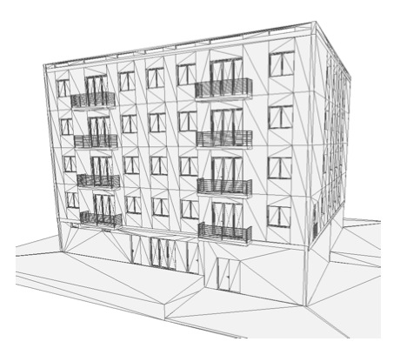
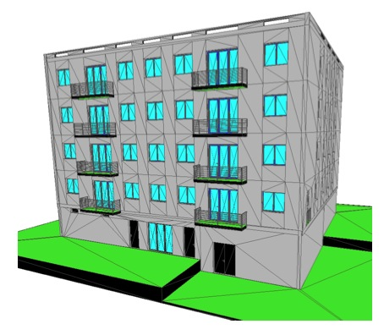
Related work
Van Kaick et al. 2013
Boulch et al. 2013
Notes:
There have also been works on extracting semantic hierarchies from buildings, which, however, require hand-crafted grammar that is domain-specific.
While in our work, we learn a probabilistic grammar from annotated scene graphs.

Slide 32
Overview
Grammar Structure
Learning a Probabilistic Grammar
Scene Parsing
Results
Notes:
Let me first describe how we define the probabilistic grammar.

Slide 33
Probabilistic grammar
Labels
Rules
Probabilities
Notes:
Our probabilistic grammar includes three components, labels, rules, probabilities.

Slide 34

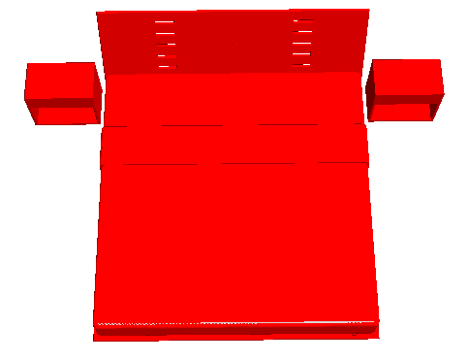
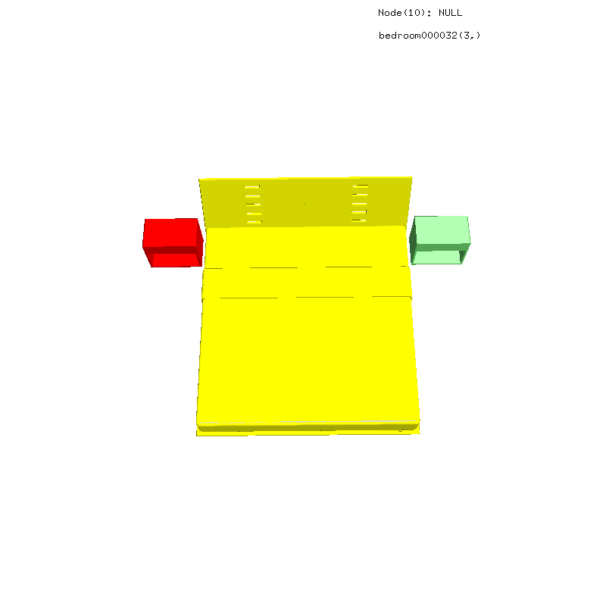
Labels
Examples:
bed, night table, sleeping area
Notes:
Each label represents an object class, a semantic object group or a non-semantic object part.

Slide 35
Rules
Example:
sleeping area
bed, night table
Notes:
Each rule represents an expansion from one label to a set of child labels.

Slide 36
Probabilities
Derivation probabilities
Cardinality probabilities
Geometry probabilities
Spatial probabilities
Notes:
We consider four types of probabilities in our grammar.

Slide 37
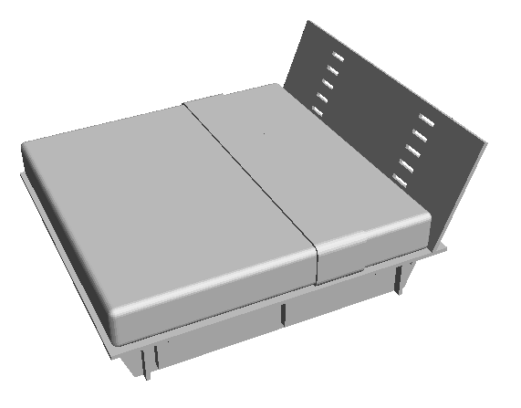
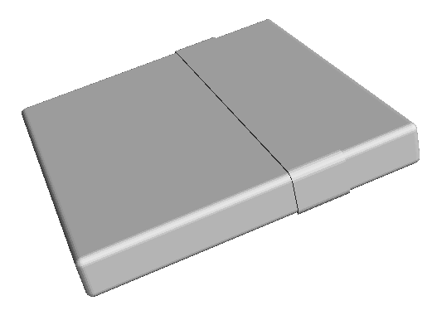
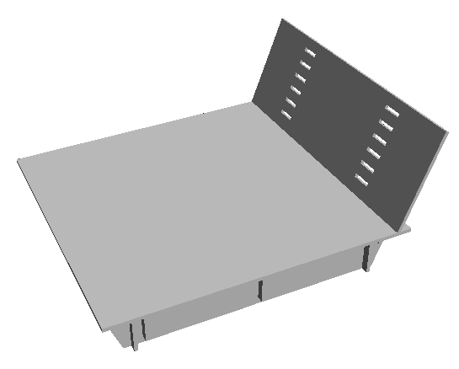
Derivation probability
bed
bed frame, mattress
Notes:
The first part is derivation probability, which represents how likely a label can be further expanded.

Slide 38
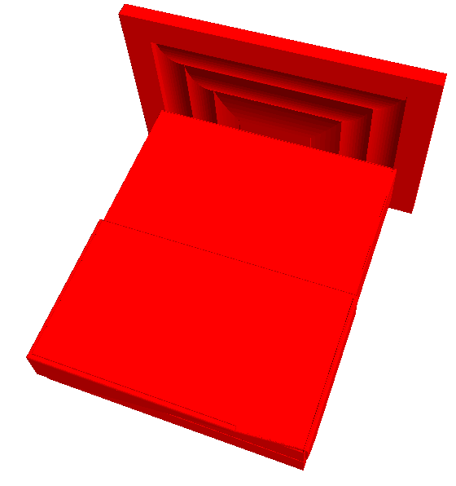
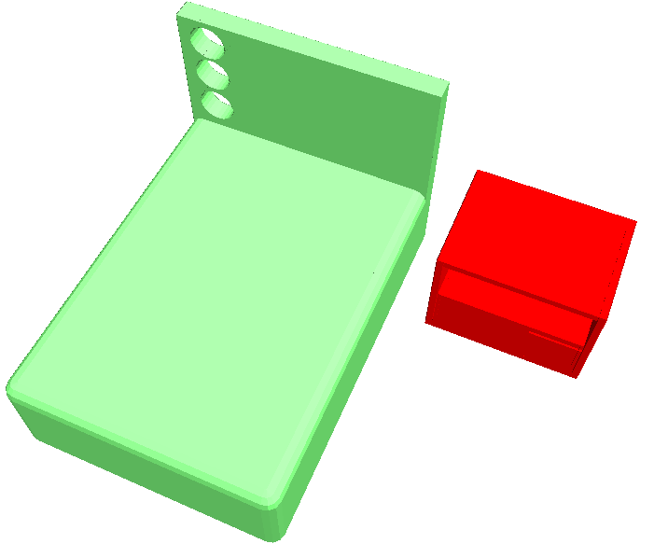
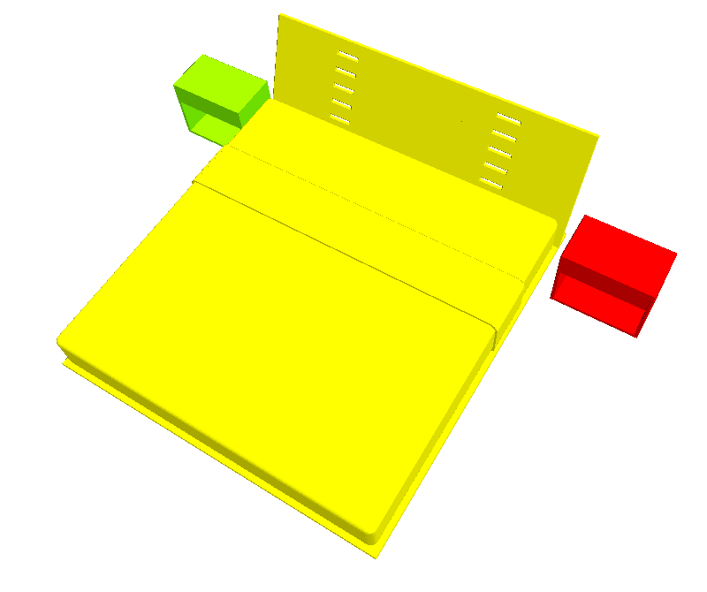
Cardinality probability
sleeping area
bed, night table
Notes:
The second part is cardinality probability, which represents the probability that a node with the parent label has a specific number of children with a certain label.
For instance, sleeping area may include 0,1,2 night tables, and we use cardinality distribution to capture the probability of each case.

Slide 39
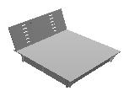
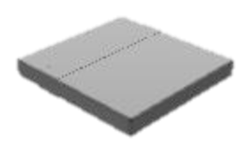
Geometry probability
Notes:
The third part is geometry probability, which measures the likelihood of a piece of geometry given a label.

Slide 40
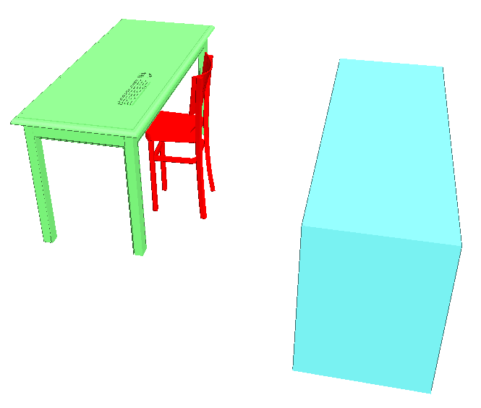
Spatial probability
Notes:
The last part is spatial probability, which measures the likelihood of a pairwise spatial relation given their labels and their parent’s label.
In this example, the spatial relation between the red and green piece is more likely to be the chair-and-desk relation in a study area.

Slide 41
Overview
Grammar Structure
Learning a Probabilistic Grammar
Scene Parsing
Results
Notes:
Now let me describe how we learn a probabilistic grammar.

Slide 42
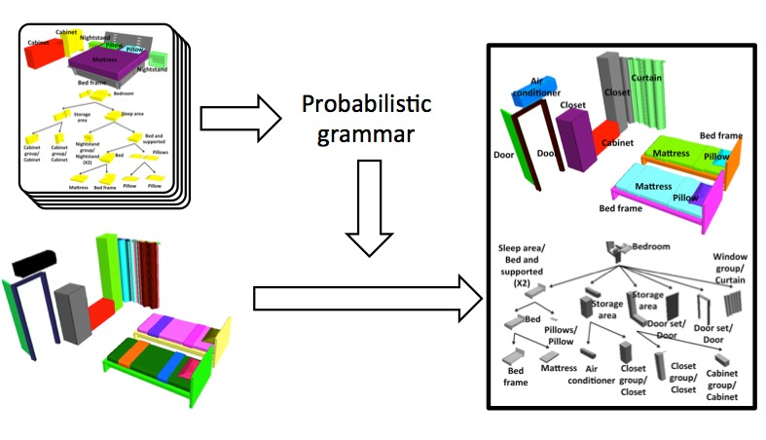
Pipeline
Probabilistic grammar
Notes:
The probabilistic grammar is learned from a set of consistent hierarchies that are created manually.

Slide 43
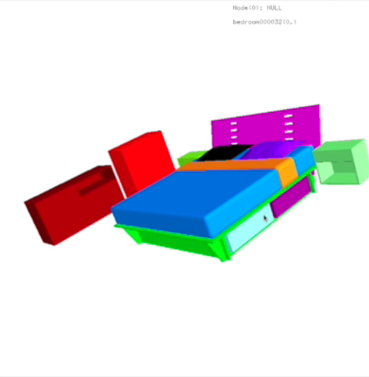
Learning a probabilistic grammar
Identify objects
Speed X 5
Notes:
Given an oversegmented scene, the annotator first identifies objects by merging non-semantic parts,

Slide 44
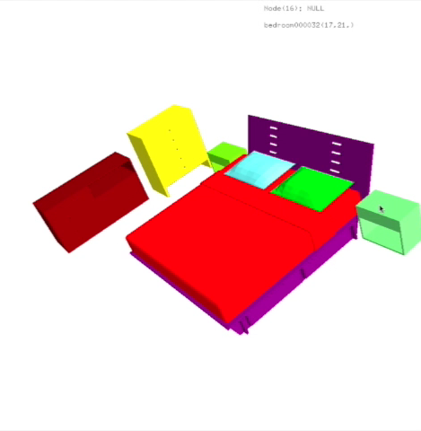
Learning a probabilistic grammar
Label objects
Speed X 5
Notes:
and then provides a label for each object.

Slide 45
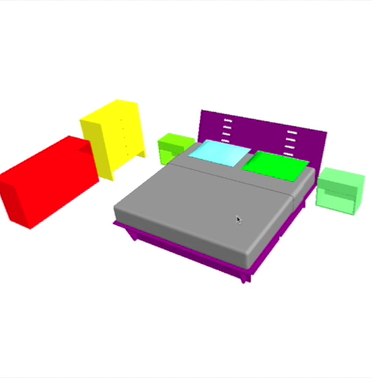
Learning a probabilistic grammar
Group objects
Speed X 5
Notes:
He further groups objects recursively to form semantic object groups, and the output of the annotation process is an annotated hierarchy.

Slide 46
Learning a probabilistic grammar
Grammar generation
Labels all unique labels
Rules
Probabilities
Notes:
Given a set of annotated hierarchies for training, we first extract all unique labels from the examples to form the label set.
(7 min?)

Slide 47
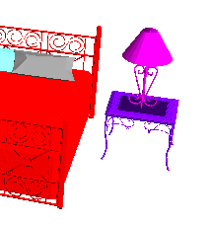
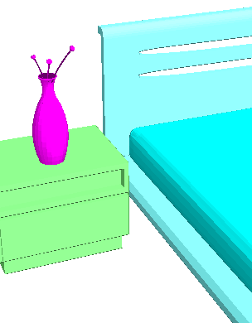
Learning a probabilistic grammar
Grammar generation
Labels
Rules concatenating all children for each label
Probabilities
Training example 1:
Training example 2:
Nightstand & supported
Nightstand & supported
Nightstand
Table lamp
Nightstand
Plant
Nightstand & supported
Plant
Nightstand
Table lamp
Notes:
Then we form a production rule for each label, and the right-hand-side of the production rule is a concatenation of all child labels in the annotated hierarchies.
Let’s assume we have two exemplar scenes in the training set. (Click) In the the first training example, a group annotated as nightstandsupported consists of nightstand and table lamp,
(Click) And in the second example, the group with the same annotation consists of nightstand and plant.
We combine them to form a production rule for the semantic group ‘nightstand & supported’

Slide 48
Learning a probabilistic grammar
Grammar generation
Labels
Rules
Probabilities
: learning from occurrence statistics
: estimating Gaussian kernels
: kernel density estimation
Notes:
We finally learn probabilities from training examples.
(Click) Specifically, we learn derivation probabilities and cardinality distribution from occurrence statistics.
(Click) We estimate Gaussian kernels to represent geometry distribution for each label.
(Click) We use kernel density estimation to model spatial probabilities

Slide 49
Overview
Grammar Structure
Learning a Probabilistic Grammar
Scene Parsing
Results
Notes:
Given a learned probabilistic grammar, we are able to parse a new scene

Slide 50
Pipeline
Probabilistic grammar
Notes:
Starting with an over-segmented scene,

Slide 51
Pipeline
Probabilistic grammar
Notes:
we generate a parse tree of the learned probabilistic grammar for it.

Slide 52
Scene parsing
Objective function
is the unknown hierarchy
is the input scene
is the probabilistic grammar
Notes:
our goal is to find the hierarchy H* that maximizes the posterior probability, given the probabilistic grammar G and the observed scene S.

Slide 53
Scene parsing
After applying Bayes’ rule
Notes:
We rewrite the objective function by applying Bayes’ rule.

Slide 54
Scene parsing
After applying Bayes’ rule
Prior of hierarchy
Notes:
The first term represents the prior probability of hierarchy given the grammar.

Slide 55
Scene parsing
After applying Bayes’ rule
Prior of hierarchy
: probability of a single derivation
formulated using
Notes:
Which is a product of probabilities of single derivations,
and the probability of each derivation can be represented by derivation probability and cardinality probability, which are available in the learned grammar.

Slide 56
Scene parsing
After applying Bayes’ rule
Prior of hierarchy
compensates for decreasing probability as has more internal nodes.
Notes:
We use T(x) to compensate for decreasing probability as H has more internal nodes.

Slide 57
Scene parsing
After applying Bayes’ rule
Likelihood of scene
Notes:
The second term in the objective function is the likelihood of scene, which represents how likely we can observe the scene given the grammar and the underlying hierarchy

Slide 58
Scene parsing
After applying Bayes’ rule
Likelihood of scene
: geometry probability
Notes:
The likelihood of scene can be represented using geometry probabilities

Slide 59
Scene parsing
After applying Bayes’ rule
Likelihood of scene
: sum of all pairwise spatial probabilities
Notes:
And spatial probabilities, which are also available in the probabilistic grammar.

Slide 60
Scene parsing
We work in the negative logarithm space
Notes:
We then rewrite the objective function in the negative logarithm space, which then becomes a summation of energies at each node.

Slide 61
Scene parsing
Rewrite the objective function recursively
where is the root of , is the energy of a sub-tree.
X
X
Notes:
Since the energy at each node only depends on its label and the labels of its children, we can further rewrite the objective function in a recursive form

Slide 62
Scene parsing
The search space is prohibitively large …
Problem 1: #possible groups is exponential.
Problem 2: #label assignments is exponential.
Notes:
Unfortunately, optimizing this objective function directly is challenging, because the search space is prohibitively large.
(9 min)

Slide 63
Scene parsing
Problem 1: #possible groups is exponential.
…
…
…
…
…
…
Notes:
First, the number of possible groups is exponential to the number of segments in the input scene. Specifically, if there are N segments, then there are 2^N-1 possible groups, and it is impractical to consider all the groups in the optimization.

Slide 64
Scene parsing
Problem 1: #possible groups is exponential.
Solution: proposing candidate groups.
…
…
…
…
…
…
Notes:
Our solution is to narrow down the search space by proposing a set of candidate groups, from which we build the hierarchy.
Our heuristic is that only shapes that are close to one another produce semantically meaningful groups.

Slide 65
Scene parsing
Problem 2: #label assignments is exponential.
Rule:
a
b
c
d
a
c
d
b
b
c
d
a
c
b
a
d
…
Notes:
However, even after we reduce the number of candidate groups, the search space is still large because the number of possible label assignments is exponential to the size of the input scene.
If there are N nodes in a group and there are m right-hand-side labels in current production rule, then there are m to N possible assignments for this group.
The major source of the complexity is the unbounded branching factor in the grammar.

Slide 66
Scene parsing
Problem 2: #label assignments is exponential.
Solution: bounding #RHS by grammar binarization
…
…
where
is partial label of
Notes:
Inspired by techniques in natural language processing, we bound the branching factor by producing a grammar that is similar to the input grammar, but each production rule has only one or two right-hand-side labels. The new grammar is called binarized grammar.
Specifically, we introduce a partial label for each label in the original grammar, which enables us to break down each original production rule into a set of production rules with 1 or 2 right-hand-side labels.
----------------------------------------------------------------
For the probabilities part, we still use the ones defined in the original grammar.
Which means when we evaluate the energy of a node, we expand it until all children have labels from the original grammar.

Slide 67
Scene parsing
Problem 2: #label assignments is exponential.
Solution: bounding #RHS by grammar binarization
…
…
where
is partial label of
Now #rules and #assignments are both polynomial.
The problem can be solved by dynamic programming.
Notes:
Now because the branching factor is bounded, the number of assignments Is polynomial, and dynamic programming provides an efficient solution to this problem.
---------------------------------------------------
However, I would like to point out that since we evaluate the energy of the tree using the probabilities from the original grammar, the binarized grammar is no longer context-free. So, there is no guarantee that our solution is optimal. In practice, we found our approximation always gave reasonable results,

Slide 68
Scene parsing
Problem 2: #label assignments is exponential.
Solution: bounding #RHS by grammar binarization
Convert the result to a parse tree of the original grammar
Notes:
we finally convert a parse tree of the binarized grammar, to a parse tree of the original grammar, by simply removing nodes with partial labels.

Slide 69
Overview
Grammar Structure
Learning a Probabilistic Grammar
Scene Parsing
Results
Notes:
Now I would like to talk about results of our algorithm.

Slide 70
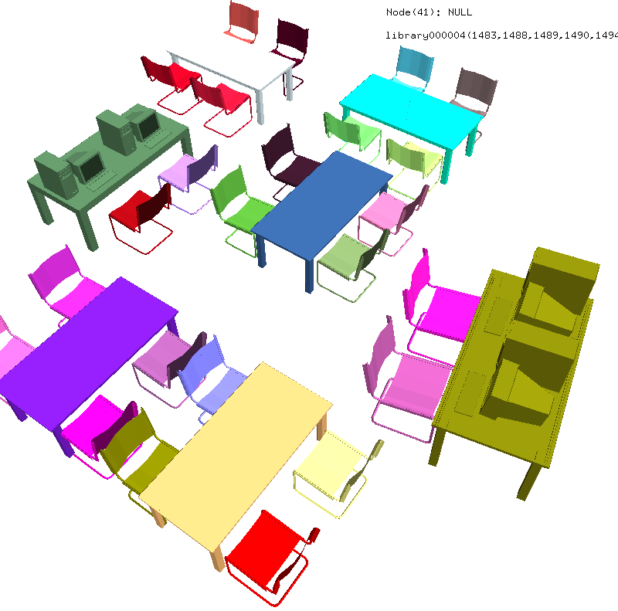
Benefit of hierarchy
Meeting table
Study chair
Shape only
Notes:
First, I would like to use one example to explain why modeling hierarchy helps scene understanding. I compare the result of using our method to two alternative methods.
First is shape-only, which means we don’t parse with any grammar, and we just use geometric features to do classification.
In this library scene, if we just leverage geometry information, we are unable to distinguish meeting tables from study desks because of their geometric similarity.
Note that we use red text and red arrows to represent incorrect prediction, and black text and black arrows to represent correct prediction.
(this is library000004)

Slide 71
Benefit of hierarchy
Meeting table
Meeting table
Study chair
Meeting chair
Shape only
Flat grammar
Notes:
Second alternative is flat-grammar, which means we execute our algorithm using a flattened grammar that has only one production rule that connects all terminals directly to the axiom.
In this method, we only capture contextual information among all objects without leveraging semantic groups.
In this library scene, using flat grammar further mislabels the study chairs, which indicates the contextual information is misleading in this case.

Slide 72
Benefit of hierarchy
Meeting table
Meeting table
Study desk
Study chair
Meeting chair
Study chair
Shape only
Flat grammar
Ours
Notes:
By contrast, our algorithm labels all objects correctly by detecting study areas and meeting areas.

Slide 73
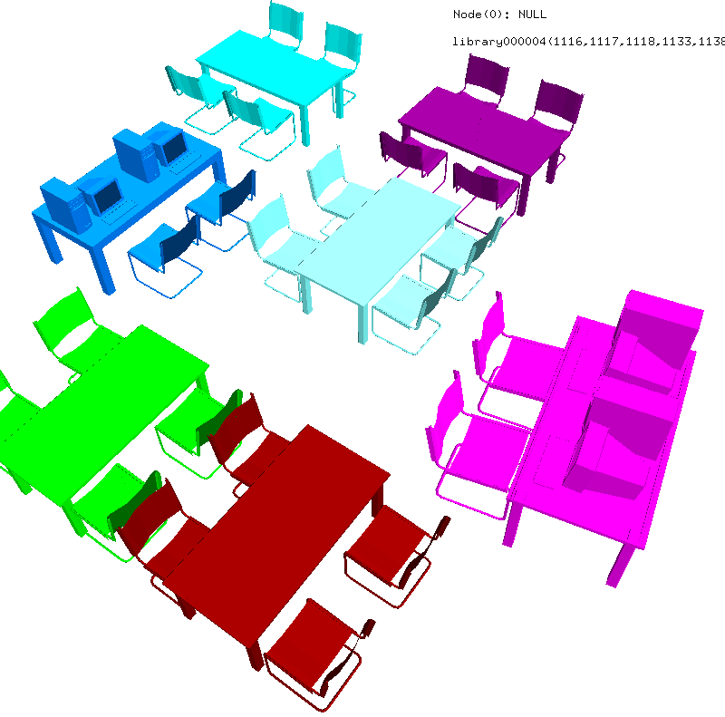
Benefit of hierarchy
Meeting table
Meeting table
Study area
Study chair
Meeting chair
Meeting area
Shape only
Flat grammar
Ours
Notes:
By contrast, our algorithm labels all objects correctly by detecting study areas and meeting areas.

Slide 74





Datasets
77 bedrooms
30 classrooms
8 libraries
17 small bedrooms
8 small libraries
Notes:
We further evaluate our method extensively on 5 datasets, covering 3 types of indoor scenes, which include bedroom, classroom and library.

Slide 75

Benefit of hierarchy
Object classification
Notes:
In this slide, we compare our results to alternative methods on all 5 datasets.
Blue bars are our results. Y axis is F1 score, which is the harmonic mean of precision and recall.
It shows that our algorithm outperforms alternatives in all 5 datasets..

Slide 76
Summary
Modeling hierarchy improves scene understanding.
Notes:
To summarize, in this work, we find modeling hierarchy and relationships between objects within semantic groups improves scene understanding,.

Slide 77


Limitations and future work
Modeling correlation in probabilistic grammar
Grammar learning from noisy data
Applications in other fields
Notes:
our method has several limitations, which suggest topics for future work.
First, our current grammar does not capture the correlations between co-occurrences of sibling labels.
It would be interesting to augment the grammar with higher-order relationships
------------------------
For instance, couch and chair are interchangeable in a rest area, so the occurrences of them are highly related.

Slide 78



Limitations and future work
Modeling correlation in probabilistic grammar
Grammar learning from noisy data
Applications in other fields
Input scene graphs
Grammar
Sleep area
Nightstand & supported
bed
Nightstand
Table lamp
Notes:
Second, our algorithm learns the probabilistic grammar from labeled examples, which may not be always available.
It would be nice to develop methods to detect repeated shapes and patterns in existing scene graphs and use them to derive grammars automatically.

Slide 79

Limitations and future work
Modeling correlation in probabilistic grammar
Grammar learning from noisy data
Applications in other fields
Modeling from RGB-D data [Chen et al. 2014]
Notes:
Finally, it would be nice to explore applications in computer vision, robotics and other fields.
For instance, our method could be working together with the methods on modeling 3D scenes from RGB-D data.

Slide 80
Outline
Analyzing 3D scenes by modeling hierarchical structure
Composition-aware scene optimization for product images
Style compatibility for 3D furniture models
Notes:
Now, I conclude the first part of my talk. Next, I will show you how reasoning about relationships between objects facilitates scene modeling using two projects. First, I will focus on a recent application of scene modeling, which is creating compositions from virtual scenes.

Slide 81



Motivation
Notes:
Here, I show you 4 images from IKEA catalog. These images are from catalogs of different years, and they are describing different rooms. However, one thing that these images have in common is that they are all rendered from 3D virtual scenes. Since 2010, IKEA started to create and render 3D virtual scenes to produce catalog images, instead of photographing physical objects and scenes.

Slide 82
Motivation
35% of scenes in IKEA catalogue are CGI.
Notes:
In 2014, 35% of the scenes in IKEA catalog are created from virtual scenes, and we expect more catalog images will be created in this way in the future.

Slide 83
Advantages
Much less expensive
Much easier for customization
Notes:
Compared to photographing physical scenes and objects, rendering 3D virtual scenes has many advantages.

Slide 84



Advantages
Much less expensive
Much easier for customization
Notes:
First, rendering virtual 3D scenes is much less expensive than photographing real scenes, as it does not require building physical sets in large photo studios..

Slide 85


Advantages
Much less expensive
Much easier for customization
Notes:
Or storing physical objects in large warehouses.

Slide 86




Advantages
Much less expensive
Much easier for customization
Notes:
Second, digital assets make it easier to customize catalog images in a variety of ways. In 2014, IKEA made 62 variants for its catalogue for 43 countries, and the artists usually customize scene layouts to match cultural preferences.
(click)
For example, in this kitchen, the cabinet in the Japanese version is replaced by shelves in the British version, while the range hood is replaced by cabinets. Performing object replacement in a virtual scene is much easier than doing it in a physical scene.

Slide 87

Artist’s goal
Notes:
In this task, the artist’s goal is to create an appealing product image like this.

Slide 88

Artist’s goal
Input: a rough scene, objects to highlight, and an initial camera view
Rough layout
Notes:
The artist first creates an approximate scene layout with the appropriate objects in roughly the desired configuration. In this example, the artist creates an approximate layout for a dining room, including dining chairs, dining table, ceiling lamps, and arrange them in a plausible manner.

Slide 89
Artist’s goal
Input: a rough scene, objects to highlight, and an initial camera view
Highlight
this chair
and this table
Notes:
The artist also specifies two highlighted items, which are the dining table and the dining chair pointed by the red arrows.

Slide 90
Artist’s goal
Input: a rough scene, objects to highlight, and an initial camera view
Camera view
Notes:
The artist may also specify an initial camera view.

Slide 91

Artist goal
Output: a scene with optimized object placement, materials and camera view that produce an appealing 2D composition.
Notes:
Then, based on the input, the artist’s goal is to compose an image of the scene that highlights the prescribed objects of interest by carefully refining the positions, orientations and materials of objects as well as the camera viewpoint.

Slide 92

Challenges
Huge search space to explore
Many principles/constraints to balance
Requiring repeating work for customization
Notes:
So far, this refinement step is performed purely manually, which is challenging and tedious due to the following reasons,

Slide 93

Challenges
Huge search space to explore
Many principles/constraints to balance
Requiring repeating work for customization
4*N + 6 parameters
3 DOF per object
1 material per object
6 DOF for camera
Notes:
First, the search space is large. If there are N objects in the scene and we assume each object stays upon its supporting surface, each object has 3 degree of freedom, which means two for translation and one for rotation, and the camera has 6 degree of freedom, then there are 4*N+6 parameters in total, which is too many for an artist to optimize efficiently.

Slide 94




Challenges
Huge search space to explore
Many principles/constraints to balance
Requiring repeating work for customization
…
…
Notes:
Second, to generate aesthetically appealing compositions, the artist usually has to balance many principles and constraints
(click)
For instance, visual balance needs to be maintained,
(click)
highlighted objects must not be severely occluded
(click)
the arrangement of objects has to be plausible in 3D and
(click)
color contrast must also be considered.

Slide 95



Challenges
Huge search space to explore
Many principles/constraints to balance
Requiring repeating work for customization
Notes:
1. Third, although the artist is working on 3D virtual scenes now, it is still tedious to perform customization.
2. For example,
(Click)
the artist sometimes customizes the scene layout for different countries to match cultural preferences.
(Click)
The artist may also produces multiple compositions from a single 3D scene to highlight different objects each time.
(Click)
He may also want to produce compositions in different aspect ratios for different displays.
As a result, artists often spend multiple days refining the initial rough scene layouts to produce all necessary compositions.

Slide 96





Related work
Image optimization
[Liu et al. 2010]
Camera optimization
[Gooch et al. 2001]
Scene optimization
[Yu et al. 2011]
Notes:
Previously, researchers proposed methods to optimize the quality of composition automatically by cropping images or optimizing camera viewpoint. However, this is not sufficient if the image includes many items, which is common for 3D virtual scenes.
(click to show)
Methods have also been proposed to automatically arrange objects in 3D. However, they do not aim to produce an appealing 2D composition.

Slide 97
Key idea
: position of object i on its supporting surface
Notes:
Our idea is to optimize
Object positions

Slide 98
Key idea
: position of object i on its supporting surface
: orientation of object i
Notes:
Object orientations

Slide 99
Key idea
: position of object i on its supporting surface
: orientation of object i
: material of object i
Notes:
Object materials

Slide 100
Key idea
: position of object i on its supporting surface
: orientation of object i
: material of object i
: camera parameters
Notes:
And camera parameters

Slide 101
Key idea
: position of object i on its supporting surface
: orientation of object i
: material of object i
: camera parameters
: terms for composition rules
Notes:
in order to minimize an objective function that accounts for aesthetic principles and object focus, while maintaining 3D spatial constraints and 2D image space layout constraints.

Slide 102
Key idea
Never been considered before
: position of object i on its supporting surface
: orientation of object i
: material of object i
: camera parameters
: terms for composition rules
Notes:
Note that no previous work has considered to optimize the positions, orientations, and materials of objects in order to improve 2D composition. Later, I will show you these newly added degrees of freedom are critical to producing good compositions.

Slide 103
Overview
Composition rules and constraints
Optimization
Applications
Notes:
First, I will go through the composition rules and constraints that we consider in our work. I will just give a brief explanation of why each is important. Mathematical details of how each one is encoded can be found in my thesis.

Slide 104
Composition rules
Object placement within 2D frame
Object saliency within 2D frame
Image composition
Camera placement
Object constraints within 3D scene
Regularization
Notes:
We interviewed professionals responsible for creating scenes for popular product catalogs, and worked with them to identify a set of principles important for product image compositions. The professionals identified 13 different factors, and we group them to form 6 terms in our energy function.

Slide 105

Term 1: Object placement within 2D frame
Rule of thirds
Centeredness
Clearance
Notes:
How objects are positioned in the 2D composition is important for image quality.
In general, focus objects should align with vertical or horizontal lines that divide the viewport into thirds.

Slide 106

Term 1: Object placement within 2D frame
Rule of thirds
Centeredness
Clearance
Notes:
For some product images, particularly, the ones with zoomed views of single objects, focus objects should appear near the center of the image.

Slide 107

Term 1: Object placement within 2D frame
Rule of thirds
Centeredness
Clearance
Notes:
Since other objects should not compete with the focus objects in the composition, we introduce a term to penalize objects that are close to focus objects.

Slide 108
Term 2: Object saliency within 2D frame
Visibility
Object size
Notes:
The visibility and the size of objects in the image space also contribute to their perceived importance. Specifically, an object is perceived as less important if it is partially occluded by another objects or partially clipped by the frame. Therefore, focus objects should be more visible than others.

Slide 109

Term 2: Object saliency within 2D frame
Visibility
Object size
Notes:
Similarly, because larger objects are perceived as more important, focus objects should take up more image space than others.

Slide 110
Term 3: Image composition
Visual balance
Color contrast
Notes:
We also include two well-established composition guidelines for creating aesthetically pleasing images. First is visual balance, which means people in general prefer the center of mass of the image to be close to the center of the image frame.

Slide 111
Term 3: Image composition
Visual balance
Color contrast
Notes:
Second is color contrast. Greater color contrast at object contours can help people understand boundaries between shapes in a scene.

Slide 112

Term 4: Camera placement
Canonical views
Typical views
Notes:
We also impose constraints on camera placement in order to generate images that depict scenes from viewpoints that are natural for people. We consider two typical scenarios. If there is only one highlighted object, artists favor canonical views of the object class.

Slide 113

Term 4: Camera placement
Canonical views
Typical views
Notes:
If the image depicts a large scene with multiple focus objects, artists often use camera viewpoints that match how a human would typically see the scene.

Slide 114

Term 5: Object constraints within 3D scene
Collision relationships
Support relationships
Semantic constraints
Notes:
Object relations in 3D are also critical to ensuring the scene plausibility. Avoiding collision and respecting support relationships are important for physical plausibility.

Slide 115

Term 5: Object constraints within 3D scene
Collision relationships
Support relationships
Semantic constraints
Notes:
In this slide, note how the plausibility of the composition is harmed if we don’t consider support relationship between the cabinet and the books in the energy term.

Slide 116
Term 5: Object constraints within 3D scene
Collision relationships
Support relationships
Semantic constraints
Notes:
Other semantic spatial constraints should also be satisfied during the optimization. For example, note how the plausibility of the spatial relation between the dining chair in the front and the dining table is important for the quality of the composition.

Slide 117

Term 6: Regularization
Notes:
We finally apply a regularization term that encourages small changes to the scene with respect to the initial configuration provided by the artist.

Slide 118
Overview
Composition rules and constraints
Optimization
Applications
Notes:
Now, let me describe how we optimize the energy function.

Slide 119
Energy function
Continuous variables
Discrete variables
Notes:
In our optimization problem, we have continuous variables, including camera parameters, object positions and orientations.
(click)
We also have discrete variables, which are the selected material of each object.

Slide 120
Optimization
Continuous optimization – camera view and object placement
Discrete optimization – materials
Notes:
We therefore alternate between a continuous optimization and a discrete optimization
The continuous optimization accounts for optimizing camera view and object placement, while the discrete optimization accounts for materials.
In the continuous optimization, we use stochastic gradient descent and line search.
The discrete optimization only affects color contrast term, and we iteratively optimize for each object.

Slide 121

Example
Notes:
I would like to use an example to show your how the optimization works.
As input, the artist specifies the desired aspect ratio, a rough scene layout, the focus objects and an initial camera view.
I use blue bars on the right to show the value of each term in the energy function, and the red bar for the total energy at each frame.
In the optimization, the object positions, orientations, camera viewpoints, and materials are updated in order to minimize the energy of the scene.

Slide 122
Overview
Composition rules and constraints
Optimization
Applications

Slide 123
Applications
Refining rough compositions
Retargeting for different aspect ratios
Retargeting for different cultural preferences
Text-incorporated composition
Generating detail images from an overview
Notes:
Now, I would like to talk about 5 applications that are enabled by our scene optimization technique.

Slide 124


Application 1: Refining rough compositions
Rough composition
Optimized composition
Notes:
The primary application of our system is to facilitate the refinement stage of catalog image creation. Given a rough scene configuration and a set of highlighted objects, we achieve a nice 2D composition by automatically adjusting viewpoint, object placement and materials.

Slide 125


Application 1: Refining rough compositions
User study
Notes:
To evaluate whether our system can assist this application, we ran an informal experiment.
We asked a user to go through the full process of creating and refining a scene for a product image using an interactive modeling tool.
We instructed the user to create a 3D scene motivated by an image highlighting a dining table and chair in the IKEA catalog.

Slide 126
Application 1: Refining rough compositions
User study
Reference
Notes:
which she could refer to as she modeled.

Slide 127

Application 1: Refining rough compositions
Notes:
During the interactive session, we logged ‘snapshot’ scene files to represent the user’s progress. We show several examples in the top row.
After the session was finished, we used the snapshot scenes to do two things. (1) to analyze whether our energy function explains changes made interactively by the user. (2) to study at which point in the modeling process our optimization could have been used to assist the user by refining the scene automatically.

Slide 128

Application 1: Refining rough compositions
Notes:
We use the blue curve to represent the value of our energy function for each snapshot of the user’s interactive session.

Slide 129
Application 1: Refining rough compositions
Notes:
To study how our optimization could have helped, we run our optimization on each of the snapshot scenes shown in the top row. The optimized scenes are in the second row, and we plot the energy function values of the optimized scene in red dots.
The curves clearly reveal two phases.

Slide 130
Application 1: Refining rough compositions
Large-scale layout
Refinement
Notes:
A period of ‘large-scale layout’ when the scene energy goes up and down, on the left
(click)
Followed by a period of ‘fine-scale refinements’, where the energy decreases almost steadily.
First, it indicates that the energy function correctly captures images quality differences of improvements made by the user.

Slide 131
Application 1: Refining rough compositions
(Could have been off-loaded to the computer)
Large-scale layout
Refinement
Notes:
Second, note how the optimized scenes after A47 are qualitatively similar to the final scene created by the user,
(click)
which suggests that the time the user spent on scene refinement could have been off-loaded to the computer.

Slide 132
App 2: Retargeting for different aspect ratios
?
Notes:
Our system can also automatically retarget catalog images to aspect ratios that are appropriate for different display formats.

Slide 133

App 2: Retargeting for different aspect ratios
Notes:
Simple cropping or zoom-in view is usually not sufficient because the relative arrangement of objects in image space remains fixed.

Slide 134
App 2: Retargeting for different aspect ratios
Notes:
Our optimization has the ability to adjust object placement as well as camera parameters to produce good compositions for different aspect ratios.

Slide 135
App 3: Retargeting for different cultural preferences
Notes:
Our method can also perform retargeting for different cultural preferences.
Multinational furniture companies like IKEA usually customize their catalog images for different countries to match cultural preferences.
This customization often involves choosing different materials or replacing objects within a scene

Slide 136

App 3: Retargeting for different cultural preferences
Notes:
In many cases, the size and shape of new objects can be significantly different from the original,
which means the artist will have to spend additional effort adjusting the camera parameters and object placement to achieve a good composition for each customization.
In this example, we replace the chair, side table, coffee table, plant, and couch. When we swap in the new objects, there is a collision between the chair and plant, and the composition feels cramped in general

Slide 137
App 3: Retargeting for different cultural preferences
Notes:
Our optimization framework can automatically make these adjustments to reduce the amount of human effort required to perform these cultural customizations.
In this example, after we optimize the composition, the collision is resolved and the camera pulls back to keep all the relevant objects in the frame.

Slide 138

App 4: Text-incorporated composition
Notes:
Most catalog images have text overlays that describe the depicted scene.
(click to show red boxes) Such text is typically positioned over regions with nearly constant color so that it is easy to read and often appears in roughly the same location on every page so that the viewer knows where to look for textual information.
Our optimization framework can automatically position text based on all of these criteria.

Slide 139

App 4: Text-incorporated composition
Input
Notes:
In addition to a set of focus objects and an initial composition, the artist also specifies a set of rectangles where she would like overlay text to appear in the frame (click).
Our system treats each rectangle as just another object in the scene, but one that only has a 2D position and can only move within the viewport.

Slide 140
App 4: Text-incorporated composition
Extra terms for overlaid text
Contrast term
Input
Notes:
We introduce two extra terms to make the text with constant color stand out. First, a contrast term to keep the background light or dark, so that the text can be made a contrasting color.

Slide 141
App 4: Text-incorporated composition
Extra terms for overlaid text
Contrast term
Variance term
Input
Notes:
Second, a variance term to keep a low variance in luminance within each rectangle to reduce clutter behind overlaid text.

Slide 142
App 4: Text-incorporated composition
Input
Camera only
Notes:
If we only optimize the viewpoint of camera and the position of the text in the image, however, the result is usually not good enough. For example, in this case, the fruit bowl decreases the readability of the text

Slide 143
App 4: Text-incorporated composition
Input
Camera only
Our result
Notes:
and it can only be fixed by moving objects around.

Slide 144
App 5: Generating detail images from an overview
Notes:
The last application I would like to talk about is to generate detail images from an overview.

Slide 145
App 5: Generating detail images from an overview
Notes:
In many cases, catalogs provide an overview image that shows how various objects can fit together in a room,

Slide 146
App 5: Generating detail images from an overview
Notes:
and then one or more detail images that focus on individual products of interest.
Rather than simply cropping or zooming in, the stylists typically choose different viewpoints and move objects slightly in order to highlight the object and its context.

Slide 147

App 5: Generating detail images from an overview
Notes:
Our system provides an automated solution to this application.
In this example, our system starts with the overview image on the left.

Slide 148
App 5: Generating detail images from an overview
Notes:
In order to generate a detail image for the speaker, our system moves the chair to the right and also moves the speaker slightly in order to make it standout.

Slide 149
App 5: Generating detail images from an overview
Notes:
In order to highlight the book shelf, the system moves the chair to the left to get a unobstructed view for the shelf.

Slide 150



A perceptual study
Comparing the results of our method and optimizing camera only.
Kitchen
Study
Living room
Notes:
To better study how object movement helps create better composition, we ask people to compare 36 pairs of compositions created using our optimization procedure with object movement enabled or disabled.
The 36 compositions are generated by focusing different objects in three rooms, kitchen, study and living room.

Slide 151
Expert study results
ID | Ours | Camera Only | No preference
Expert 1 | 22 | 12 | 2
Expert 2 | 17 | 14 | 3
Expert 3 | 22 | 11 | 3
Expert 4 | 21 | 12 | 3
Notes:
We first asked people who work professionally on scene layout for catalog images. Their response indicate that object movement does have a positive impact on the resulting composition.

Slide 152

Amazon Mechanical Turk study
Notes:
We also asked the same questions on Amazon Mechanical Turk.
Each column shows a result of comparison for a single case. Blue bars are the votes for our results, and the red bars are the votes for camera-only optimization, where objects are not able to move. Grey bars mean the participants don’t have preference.

Slide 153
Amazon Mechanical Turk study
If null hypothesis is there is no preference,
Our method is preferred in 26/36 cases.
Notes:
The results show that object movement has a significant positive impact in 26/36 cases,

Slide 154
Amazon Mechanical Turk study
If null hypothesis is there is no preference,
Our method is preferred in 26/36 cases.
No statistical significance in 8 cases.
Notes:
there is no significant difference in 8 cases,

Slide 155
Amazon Mechanical Turk study
If null hypothesis is there is no preference,
Our method is preferred in 26/36 cases.
No statistical significance in 8 cases.
Camera only is preferred in 2 cases.
Notes:
and camera-only is preferred in 2 cases.

Slide 156
Summary
Reasoning about relationships between objects in the image space and the scene space helps create good compositions.
Moving objects and changing materials significantly improves the quality of compositions.
Our optimization framework benefits a variety of applications.
Notes:
To summarize this work, we found that

Slide 157
Limitations and future work
Interactive scene optimization
Global illumination
Additional composition rules
Notes:
Our work suffers from several limitations, which suggest directions for future work.

Slide 158
Limitations and future work
Interactive scene optimization
Global illumination
Additional composition rules
Notes:
First, our current implementation does not run at interactive rates, which is largely because speed has been sacrificed for flexibility in our prototype. We believe a production-oriented implementation could probably run orders of magnitude faster. In particular, the computation of partial derivatives, which is the bottleneck of the speed of our optimization, is highly parallelizable.

Slide 159
Limitations and future work
Interactive scene optimization
Global illumination
Additional composition rules
Notes:
Second, we use OpenGL rendering during our optimization, which does not account for global illumination, which can impact the composition of the final image.

Slide 160

Limitations and future work
Interactive scene optimization
Global illumination
Additional composition rules
Symmetry
Vanishing points
Notes:
Third, additional composition rules could improve the quality of results.
(click)
For example, symmetry can improve the quality of compositions in some cases,
(click)
and vanishing points also help highlight the focus objects in the scene, (click) which is the cooking area in this example

Slide 161
Outline
Analyzing 3D scenes by modeling hierarchical structure
Composition-aware scene optimization for product images
Style compatibility for 3D furniture models
Notes:
Now I conclude the second part of my talk. You have probably noticed that in my second work, I assume the objects in the scene are provided by the user in advance. However, as I said, manually selecting objects to compose a scene is usually tedious, particularly when the database of 3D models is large. In the next part of my talk, I will describe an algorithm that helps user select 3D models to assemble a scene. In particular, I will focus on a new relationship between objects, which is style compatibility.

Slide 162




Motivation
Image courtesy: smartnick100, Designer_Tina, Xu et al.
Notes:
Although many tools can help users select appropriate object categories and placements of objects in scene modeling, they generally ignore style compatibility between objects.
(click) Consequently, many scenes ended up with incompatible set of 3D shapes, which badly diminishes the scene plausibility

Slide 163

Motivation
Style compatibility
Notes:
In this work, our goal is to introduce a way for computers to reason about style compatibility that can be used to guide 3D scene modeling tools.
We focus on compatibility of furniture in indoor scenes, because furniture exhibits a diverse range of distinct styles, and indoor scenes account for a large fraction of scene modeling tasks.

Slide 164


Goal
Modeling pairwise style compatibility
How likely would a person put the two furniture pieces together in the same room if he was furnishing an apartment?
Notes:
Specifically, we want to model style compatibility between a pair of 3D shapes.
(click) We define the pairwise compatibility as how likely a person would put the two furniture pieces together in the same room if he was furnishing an apartment.

Slide 165
Goal
Modeling pairwise style compatibility
Extract feature vectors
F( , ) = Scalar
Notes:
We take a straightforward approach to modeling this.
(click) We first to extract a feature vector for each shape
(click) And then, we look for a function f, that returns a compatibility distance given the two feature vectors

Slide 166


Previous work – shape style
[Xu et al. 2010]
[Li et al. 2013]
Notes:
Previously, researchers have developed methods to model styles of 2D and 3D shapes.
(click )For instance, people investigated style variations that are caused by anisotropic part scaling
(click) and curvature features.
In our work, rather than focusing on a specific source of shape style variation, we develop a method to quantify style compatibility, which is usually determined by multiple sources of shape style variations.

Slide 167




Previous work – virtual world synthesis
…
[Merrell et al. 2011]
[Fisher et al. 2012]
[Xu et al. 2013]
Notes:
Although several systems have been developed to help users select the appropriate categories and placements when modeling a 3D scene, no prior work explicitly consider stylistic compatibility between objects.

Slide 168
Challenges
Hard to design a hand-tuned function
Coupled with functionality
Requiring comparisons across object classes
Notes:
In our work, we identify three major challenges in developing a style compatibility metric for furniture models.

Slide 169


Challenges
Hard to design a hand-tuned function
Coupled with functionality
Requiring comparisons across object classes
Notes:
First, a person’s notion of furniture style usually combines many subtle factors, and it would be hard to design a hand-tuned mathematical function to compute it.

Slide 170


Challenges
Hard to design a hand-tuned function
Coupled with functionality
Requiring comparisons across object classes
Notes:
Second, furniture shapes are influenced by both function and style.
(click) For example, although chair legs serve similar functions in different chairs, they can be geometrically different if they belong to different styles.
(click) On the other hand, different parts of a chair have different geometries because they serve different functions.
4. So, we need to compute geometric features that can reflect geometric details of parts rather than gross shapes.

Slide 171



Challenges
Hard to design a hand-tuned function
Coupled with functionality
Requiring comparisons across object classes
Notes:
Third, solving our problem requires comparisons between models from different object classes, which may have different dimensionalities and distributions of features.
This requires novel ways to model relations between models.

Slide 172
Key Ideas
Crowdsourcing compatibility preferences
Part-aware geometric features
Learning object-class specific mappings
Notes:
According to these challenges, we base our work on three key ideas.

Slide 173

Key Ideas
Crowdsourcing compatibility preferences
Part-based geometric features
Learning object-class specific mappings
>
Notes:
First, since it is hard to encode a hand-tuned mathematical function, we learn a function from examples. Specifically, we learn from crowdsourced data, in order to understand which furniture models are considered to be more compatible by people

Slide 174

Crowdsourcing compatibility preferences
Living room
Table lamp
(28)
Couch
(39)
End table
Floor lamp
(23)
(42)
Chair
(37)
Coffee table
(49)
Armchair
(36)
Notes:
In our work, we consider two types of scenes: dining room and living room.
(click) I show the number of models for each object class in living room in the parentheses next to the class names.
(click) When crowdsourcing people’s preferences, we only consider the pairs of object classes with close proximity and functional interaction, which are the pairs connected by arrows.

Slide 175

Crowdsourcing compatibility preferences
Design of user study [Wilber et al. 2014]
Please select the two most compatible pairs.
Notes:
For each pair of object classes, we randomly sample 50 tasks.
And in each task, we use the grid technique proposed by Wilber et al. [2014] to make our study more cost-effective.
We fix one model as reference, and pair it with six different models of another object class.
In this example, we fix the dining table (click) and pair it with six different dining chairs (click).
Then, we ask human raters on Amazon Mechanical Turk to select the two pairs in which the two models are most stylistically compatible.

Slide 176
Crowdsourcing compatibility preferences
Rater’s selection
Notes:
In this example, most raters select the two pairs at bottom-right corner as the most compatible ones.

Slide 177
Crowdsourcing compatibility preferences
Converted into 8 triplets
>
>
>
>
and 4 more triplets …
Notes:
We then convert the rater’s selection to 8 triplets.
(click 5 times)
(click) Each triplet consists of one dining chair that is selected,
(click) one dining chair that is not selected,
(click) and the reference dining table.
(click) In each triplet, the left pair is more compatible than the right pair.

Slide 178

Crowdsourcing compatibility preferences
Living room
Dining room
Collected 63,800 triplets for living room
and 20,200 for dining room
Notes:
We finally collected 63,800 triplets for living room, and 20,200 triplets for dining room.
And use them for both learning and evaluation.

Slide 179
Key Ideas
Crowdsourcing compatibility preferences
Part-aware geometric features
Learning object-class specific mappings
Notes:
Our second key idea is to use part-based geometric features, in order to better capture the style characteristics of furniture models.

Slide 180
Part-aware geometric features
Contemporary
Antique
Notes:
Our key observation is that furniture styles are often strongly related to characteristic features of individual parts.
For example, modern-style couch features straight legs, bumpy seats and short backs, while antique couch features curved legs, flat seats and tall backs.
(click) In the meantime, modern-style floor lamp features small shades, straight and thin post, while antique floor lamp usually has relatively larger shades, and posts with richer ornamentation.
----
Use arrows to point to individual parts when describing.

Slide 181
Part-aware geometric features
Consistent segmentation
Computing geometry features for each part
Concatenating features of all parts
Notes:
This observation motivates us to compute part-aware geometric features, and we propose a method that proceeds in three steps.

Slide 182





Part-aware geometric features
Step 1: Consistent segmentation [Kim et al. 2013]
Armrest
Back
Legs
Seat
Notes:
First, we perform a consistent segmentation for all models within each object class by learning a part-based template.

Slide 183

Part-aware geometric features
Step 2: Computing geometric features for each part
Curvature histogram
Back
Shape diameter histogram
Bounding box dimensions
Normalized surface area
Notes:
We then compute geometric features for each part and the entire shape.

Slide 184
Part-aware geometric features
Step 3: Concatenating features of all parts
…
Back
Legs
…
Entire model
Notes:
Finally, we concatenate feature vectors for all of its parts and its entire shape.
This approach has the advantage that distinctive features of one part are not blended with features of another.
We think this is the first time that consistent segmentation has been used for this type of application.

Slide 185
Key Ideas
Crowdsourcing compatibility preferences
Part-aware geometric features
Learning object-class specific mappings
Notes:
Our third key idea is to learn compatibility metric by learning a mapping from the geometry features to style features for each individual object class.

Slide 186
Learning object-class specific mappings
Previous approach [Kulis 2012]:
is the compatibility distance
are feature vectors of two shapes
Notes:
In previous work, distance learning is formulated as solving a common embedding.
If we assume xi and xj are feature vectors of two shapes, then the goal is to learn an embedding matrix W so that the distance in the embedding space represents the distance or similarity between the two shapes.
Since all object classes use the same embedding matrix, we call this method symmetric mapping.

Slide 187



Learning object-class specific mappings
Previous approach [Kulis 2012]:
Fonts
[O’Donovan et al. 2014]
Illustration styles
[Garces et al. 2014]
Notes:
This method has succeeded in modeling similarity between fonts and illustration styles.

Slide 188




Learning object-class specific mappings
Assumptions of the previous approach
Feature vectors have the same dimensionality
Corresponding dimensions are comparable
4 parts
3 parts
Notes:
However, this method relies on two key assumptions.
First, this method assumes that the feature vectors are in the same size.
Second, the method assumes the two feature vectors under comparison are somewhat comparable.
For fonts and illustration styles, it is relatively easy to extract feature vectors that are independent of content, and therefore the feature vectors can easily satisfy these assumptions.
For example, (click) stroke width has been used to model font styles, and (click) color features have been used to model illustration styles. All these features are fairly comparable even if they are computed for different contents.
(click) By contrast, geometric features of 3D furniture models are determined by both content and style, and it is hard to separate them.
(click) Moreover, since we use part-aware geometric features, the feature vectors from different object classes even don’t have the same dimensionality.

Slide 189
Learning object-class specific mappings
Our approach:
is the object class of
is the object class of
Notes:
Therefore, we propose the following approach. We solve for an individual mapping for each object class.
In this equation, c(i) stands for the object class of xi, and c(j) stands for the object class of xj.
Xi and Xj are projected to the embedding space using Wc(i) and Wc(j), which are different matrices.
Similar to symmetric mapping, the final style incompatibility is measured by the distance in the embedding space.
And we call the new approach asymmetric mapping.

Slide 190

Learning object-class specific mappings
Notes:
I would like to use this slide to (hopefully) better illustrate our idea.
(click) There are three tables on the left,
(right) and three chairs on the right.
(click) Their feature vectors are illustrated next to each model.
And we can see that since chair and table have different numbers of parts, their feature vectors have different dimensionalities.
(click) We therefore learn separate embedding matrices for each object class
(click) that map shapes into a shared feature space, where objects that are stylistically compatible are close to each other.

Slide 191
Learning object-class specific mappings
Learning procedure [O’Donovan et al. 2014]
Using a logistic function to model rater’s preferences
Learning by maximizing the likelihood of the training triplets with regularization
Notes:
Given a distance function, learning proceeds similar to previous work.
A rater’s preference is modeled as a logistic function.
And then, learning is performed by maximizing the likelihood of the training triplets with regularization. Please refer to my thesis for details regarding the optimization and the regularization term.

Slide 192
Results of triplet prediction
Test set: triplets that human agree upon
264 triplets from dining room
229 triplets from living room
Method | Dining room | Living room
Chance | 50% | 50%
No part-aware, Symmetric | 63% | 55%
Part-aware, Symmetric | 63% | 65%
No part-aware, Asymmetric | 68% | 65%
Part-aware, Asymmetric (Ours) | 73% | 72%
People | 93% | 99%
Notes:
Now I would like to talk about experimental results.
We test our algorithm upon the triplets that human agree on using hold-out triplet data. We include 264 triplets from dining room and 229 triplets from living room for testing.
(click) We consider our basic algorithm, as well as variants with the novel aspects disabled to investigate their impact on the results.
The accuracy of our method is 73% in dining room means that our algorithm’s prediction is same as the majority of human’s preference in 73% of all triplets.
Note that the accuracy of chance is 50%, and the accuracy of people is almost 100%.
Our algorithm performs clearly better than alternative methods, although it is not comparable to human’s performance.

Slide 193
Applications
Style-aware shape retrieval
Style-aware furniture suggestion
Style-aware scene building
Notes:
We further investigate the utility of the proposed style compatibility metric in several applications

Slide 194
Applications
Style-aware shape retrieval
Style-aware furniture suggestion
Style-aware scene building
Notes:
Due to the time constraint, I will talk about two of them today.

Slide 195

Style-aware shape retrieval
Query model
Dining chair
?
Notes:
First is style-aware shape retrieval.
In many cases, people want to retrieve models that are stylistically compatible to a query model of a different object class.
For example, in an online furniture shopping system, a potential customer may look for dining chairs that are compatible to the dining table in her apartment.

Slide 196

Style-aware shape retrieval
Query model
Dining chair
Notes:
Our system can retrieve chairs in the database that are most compatible to the query

Slide 197

Style-aware shape retrieval
Query model
Dining chair
(Most incompatible chairs)
Notes:
We also show the five chairs that are least compatible for comparison.
The numbers are compatibility distances. Smaller value means more compatible.

Slide 198

Style-aware scene building
Notes:
The metric learned by our method can also provide suggestions to help people create stylistically compatible scenes in interactive design tools. This feature could help designers of interior spaces, virtual worlds, and immersive games create more plausible scenes.
To investigate this application domain, we have implemented an interactive scene builder augmented with the compatibility metric learned by our algorithm.
The input to the system is a set of prescribed object classes, an initial scene with a prescribed spatial layout, and a database of 3D models labeled by object classes.
(in video, no fixed, go through some candidate scenes) During an interactive session, the user iteratively replaces models by other models from the same object class in an effort to make the furniture model compatible.
(in video, fix an object, go to the next best) At any time, the user is allowed to fix/free any number of objects in the scene,
(in video, ) and our system suggests combinations of models from the database that are not currently fixed.
(in video, make another a few moves) Then the user is able to choose one of the suggestions to perform the replacement. This procedure repeats until the user is satisfied with all models in the scene
-----
Record or live

Slide 199
Style-aware scene building
User study
12 participants, each works on 14 tasks.
Half of the tasks are assisted by our metric, and the other half are not.
Results from the two settings are compared on Amazon Mechanical Turk.
Notes:
We compare our system to an alternative where the suggestions are generated randomly.
In our user study, we recruited 12 participants, each participant works on 14 tasks. Half of the tasks are assisted by our learned metric, the other half are not.
We compare results from the two settings on Amazon Mechanical Turk.

Slide 200

Style-aware scene building
Notes:
In this figure, red bars are the votes for the results generated by using assistance of our learned metric, and blue bars are the votes for random suggestions. Green bars mean no preference. Our experiments show that the results generated with assistance of our learned metric are preferred in all but one tasks, with statistical significance in 8 tasks.

Slide 201
Summary
It is possible to learn a compatibility metric for furniture of different classes.
The learned compatibility metric is effective in style-aware scene modeling.
Notes:
To summarize ,
First, our quantitative results show that it is possible to learn a compatibility metric for furniture of different classes, with greater accuracy using part-aware geometric features and with joint embeddings of individual object classes.
Second, our user studies show that the learned metric can be used effectively to achieve higher style compatibility in applications ranging from shape retrieval to scene building.

Slide 202
Limitations and future work
Modeling fine-grained style variations
Investigating style compatibility in other domains
Notes:
Again, this work suffers from several limitations, which suggest directions for future work.

Slide 203


Limitations and future work
Modeling fine-grained style variations
Investigating style compatibility in other domains
Duncan Phyfe style with eagle motif
(Courtesy: Carswell Rush Berlin)
Sheraton style with lyre motif
Notes:
First, our method considers only a simple set of geometric features and thus cannot detect fine-grained style variations.
For example, our method is unable to detect different motifs (click), which are usually indicative for furniture styles.

Slide 204



Limitations and future work
Modeling fine-grained style variations
Investigating style compatibility in other domains
OR
Notes:
Second, our work is targeted only at furniture within interior environment. Investigating how the proposed techniques could be used in systems for modeling garments, architecture or other domains where style is important could provide a fruitful line of research for future study.

Slide 205
Outline
Analyzing 3D scenes by modeling hierarchical structure
Composition-aware scene optimization for product images
Style compatibility for 3D furniture models
Notes:
Now I have finished all three projects that I want to talk about today.

Slide 206
Summary of my thesis
Relationships between objects are
a strong cue for scene understanding
a strong factor for scene plausibility and aesthetics
3D Scene Analysis
Reasoning about relationships between objects
3D Scene Modeling
Notes:
To summarize my thesis, first, we found that relationships between objects, particularly the ones between objects within a semantic group, provide a strong cue for scene analysis.

Slide 207
Summary of my thesis
Relationships between objects are
a strong cue for scene understanding
a strong factor for scene plausibility and aesthetics
3D Scene Analysis
Reasoning about relationships between objects
3D Scene Modeling
Notes:
Second, they are also strongly related to scene plausibility and aesthetics.
We particularly focus on style compatibility between objects and aesthetics of compositions created from virtual scenes,
and we show that reasoning about relationships between objects greatly improves the plausibility and aesthetics of synthesized scenes.

Slide 208
Future work
Other sources for data-driven scene modeling
Other factors related to scene plausibility
Notes:
Our work suggests directions for future work.

Slide 209

Future work
Other sources for data-driven scene modeling
Other factors related to scene plausibility
Image courtesy: IKEA
Notes:
First, it would be interesting to explore other sources of scene examples that the knowledge of scene realism can be learned from.
For example, there are millions of high-quality product images of indoor scenes on the Internet, which are great examples for learning design constraints and image composition rules.

Slide 210

Future work
Other sources for data-driven scene modeling
Other factors related to scene plausibility
Image courtesy: Xiao et al.
Notes:
Furthermore, as RGB-D cameras become more popular and cheaper, it will become easier to acquire a large number of scans of real scenes, which would provide even more opportunities for data-driven scene modeling.
However, similar to the scenario of virtual scenes, data-driven applications would probably require good segmentation and annotation on the exemplar images or RGB-D scans in order to maximize the usefulness of the data, which would require more sophisticated scene analysis tools.

Slide 211


Future work
Other sources for data-driven scene modeling
Other factors related to scene plausibility
Materials are strongly related to style compatibility
Notes:
Second, it would also be interesting to investigate other factors that are related to scene plausibility and scene semantics.
For example, one factor that has not been fully investigated in my thesis is materials.
And we believe materials may play a large role in ensuring the style compatibility of a scene.
Besides materials, many other properties of 3D models, such as construction methods and affordances, could also be strongly related to scene plausibility, and we leave them for future work.

Slide 212




Acknowledgements
Adviser: Thomas Funkhouser
Mentors:
Wilmot Li, Jim McCann, Aaron Hertzmann
Notes:
At the end of my talk, I would like to thank people who have supported me in my thesis and throughout my PhD studies.
(click) Foremost, I would like to thank my adviser, Thomas Funkhouser for his continuous support and guidance in the past 5 years.
(click) I am also grateful to my internship mentors, Wilmot Li, Jim McCann and Aaron Hertzmann, for sharing knowledge, insights and expertise with me during and after my internships at Adobe Research.

Slide 213




Acknowledgements
Collaborators
Niloy Mitra
Vladimir Kim
Sid Chaudhuri
Qi-Xing Huang
Notes:
I was fortunate to collaborate with Niloy Mitra, Vladimir Kim, Siddhartha Chaudhuri, and Qi-Xing Huang. This work would not have been possible without their insightful suggestions and invaluable advice throughout my projects.

Slide 214





Acknowledgements
Princeton Graphics Group
Notes:
I am also grateful to everyone in this group.
(click) I’d like to thank David, Adam, Szymon and Jianxiong for their help and discussions in almost every project that I have been working on.
I am also thankful to my friends. My PhD life would not have been so amazing without them.

Slide 215


Acknowledgements
Family
Notes:
Finally, I am grateful to my family, as they always give me the strongest support and encouragement.

Slide 216
Acknowledgements
Funding agencies
Adobe
NSF, ERC Starting Grant, Intel, Google
Notes:
My work was also supported by a number of funding agencies. I would like to thank them for their generosity.

Slide 217

Thank you!
Notes:
Thank you for your attention.

